Slide 1
Summarize results on:
Classification of sst anomaly fields (ENSO)
Layer-wise relevance propagation (LRP)
ESN_exp08_LRP.ipynb .. ESN_exp08_LRP_part5.ipynb
ESN_exp09_Classification_LRP .. ESN_exp09_Classification_LRP_part4.ipynb

Slide 2
Base ESN – methodology and reservoir transition
(Hyper)parameters:
n_res: number of res. units
sparsity of reservoir connections
spectral radius: max EV of W_{res}
leak rate ⍺ in reservoir transition
activation for reservoir transition
Reservoir states X
(samples, timesteps, n_res)
W_{res}
Dimensions:
W_{in} (input features, n_res)
W_{res} (n_res, n_res)
W_{out} (n_res, output features)
Biases:
b_{in} , b_{res} , b_{out}
W_{in}
W_{out}
Output Y
(samples, output features)
Input U
(samples, timesteps, input features)
current timestep‘s input
keep fraction of previous timestep‘s reservoir state
recurrence inside reservoir

Slide 3
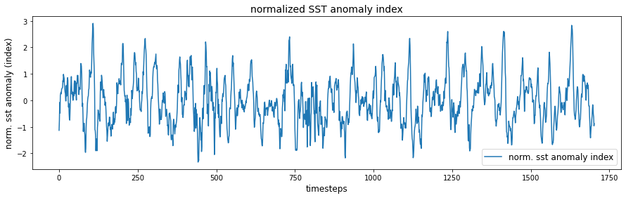
El Niño Southern Oscillation (ENSO)
Use Nino3.4 box (5°N–5°S, 120–170°W) in the tropical Pacific to diagnose ENSO from sea-surface temperature (SST) anomalies.
SST data: https://downloads.psl.noaa.gov/Datasets/noaa.ersst.v5/sst.mnmean.nc
Provides monthly mean SST from 1854 to now in 2° by 2° lat/lon grid
Start from 1880
Calaculate ENSO index:
Compute area averaged total SST from Niño 3.4 region
Compute monthly climatology (e.g., 1980-2009) for area averaged total SST from Niño 3.4 region, and subtract climatology from area averaged total SST time series to obtain anomalies
Normalize, no rolling mean!

Slide 4
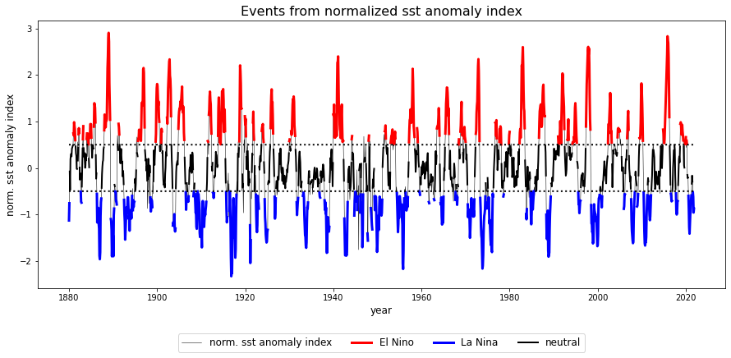
El Niño Southern Oscillation (ENSO)

Slide 5
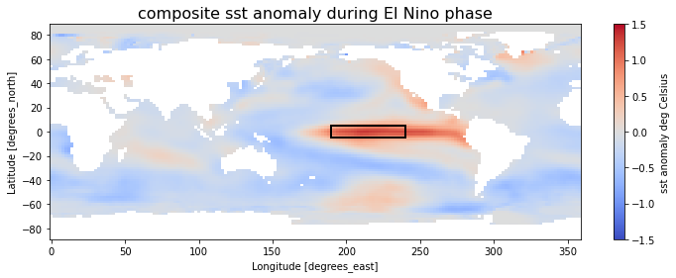
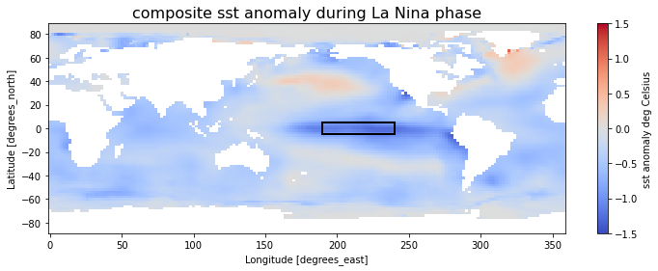
El Niño Southern Oscillation (ENSO)

Slide 6
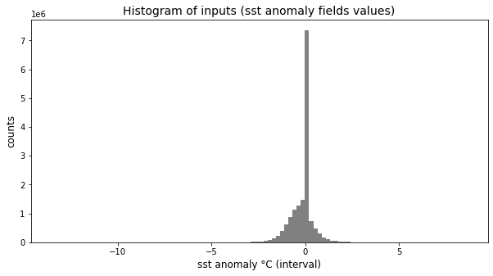
Data pre-processing: Scale inputs
raw input values
NaN to zero

Slide 7
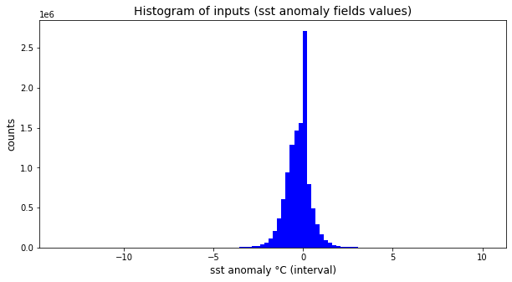
Data pre-processing: Scale inputs
raw input values
NaN to zero
remove NaN
→ Even with removed (former) NaN values find peek from sst anomalies over Arctic region, seasonally covered with ice.

Slide 8
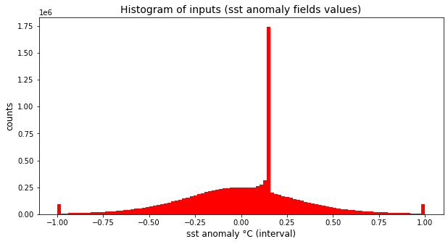
Data pre-processing: Scale inputs
raw input values
NaN to zero
remove NaN
→ Even with removed (former) NaN values find peek from sst anomalies over Arctic region, seasonally covered with ice.
→ All models can handle un-capped input data. But for getting „nice“ relevance maps, prefere working on capped inputs, essential for ESN models (see later results…)
capped (0.005% quantile)
scaled to [-1,1]

Slide 9
Agenda
Classification of sst anomaly fields and LRP
Linear Regression
Multilayer perceptron
„coupled“ baseESN
base ESN: feed inputs column by column or row by row

Slide 10
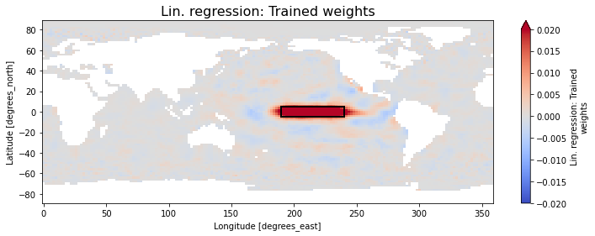
1. Linear Regression: Classification and „LRP“
Best performance is found for the following setup:
Feed whole world's sst anomaly fields as input
Only consider „valid“ gridpoints (remove NaN values), flattened (vectorized)
capped with “hard“ limits [-5°C, 5°C]
scaled to [-1,1]
unscaled continuous normalized sst anomaly index as target.
train accuracy 100%
validation accuracy of 100% / 100% for El Nino / La Nina samples
(Fidelity is close to perfect!)

Slide 11
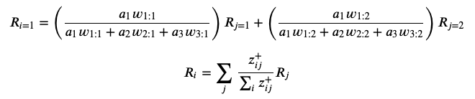
Layer-wise relevance propagation in a nutshell
R_{i=1}
layer i
i = 1
a₁
layer j
w_{1:1}
j = 1
R_{j=1}
a₂
i = 2
w_{1:2}
j = 2
R_{j=2}
a₃
i = 3

Slide 12
Layer-wise relevance propagation in a nutshell
R_{i=1}
layer i
i = 1
a₁
layer j
w_{1:1}
j = 1
R_{j=1}
a₂
i = 2
w_{1:2}
j = 2
R_{j=2}
a₃
i = 3

Slide 13
Layer-wise relevance propagation in a nutshell
R_{i=1}
layer i
i = 1
a₁
layer j
w_{1:1}
j = 1
R_{j=1}
a₂
i = 2
w_{1:2}
j = 2
R_{j=2}
a₃
i = 3

Slide 14
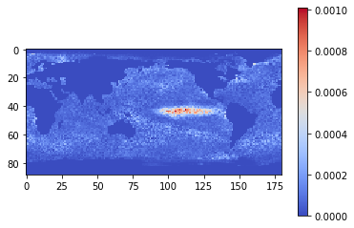
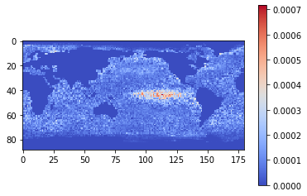
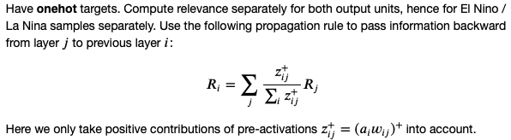
2. Multilayer Perceptron (MLP): Classification and LRP
mean relevance map: EL NINO
Best performance is found for the following setup:
Feed whole world's sst anomaly fields as input
Only consider „valid“ gridpoints (remove NaN values)
flattened (vectorized)
capped with “hard“ limits [-5°C, 5°C]
scaled to [-1,1]
one-hot targets (needed for LRP).
train accuracy 100%
validation accuracy of 100% / 98% for El Nino / La Nina samples
mean relevance map: LA NINA

Slide 15

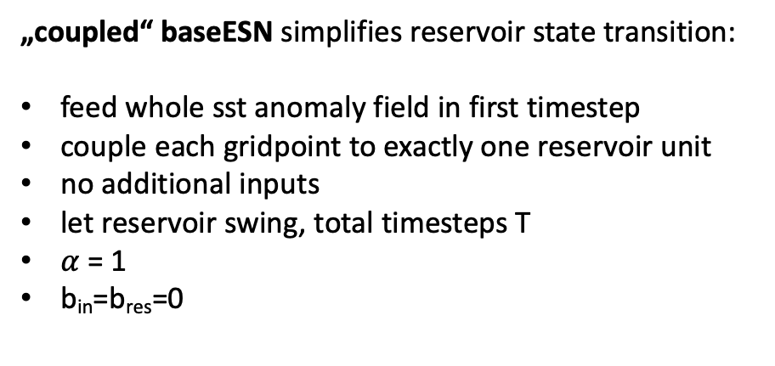
Layer-wise relevance propagation for „coupled“ baseESN
current timestep‘s input
keep fraction of previous timestep‘s reservoir state
recurrence inside reservoir
„coupled“ baseESN simplifies reservoir state transition:
feed whole sst anomaly field in first timestep
couple each gridpoint to exactly one reservoir unit
no additional inputs
let reservoir swing, total timesteps T
$α$ = 1
b_{in}=b_{res}=0

Slide 16




„coupled“ baseESN: Unfold recurrence
input
u(1)
act(1)
act(T-1)
act(T)
output (one-hot)
$α$=1
$α$=1
$α$=1
W_{out} b_{out}
W_{res}
W_{res}
(…)
x(1)
x(T-2)
x(T-1)

Slide 17
„coupled“ baseESN: Unfold recurrence
input
u(1)
act(1)
act(T-1)
act(T)
output (one-hot)
$α$=1
$α$=1
$α$=1
W_{out} b_{out}
W_{res}
W_{res}
(…)
x(1)
x(T-2)
x(T-1)

Slide 18
„coupled“ baseESN: Unfold recurrence
input
u(1)
act(1)
act(T-1)
act(T)
output (one-hot)
$α$=1
$α$=1
$α$=1
W_{out} b_{out}
W_{res}
W_{res}
(…)
x(1)
x(T-2)
x(T-1)

Slide 19
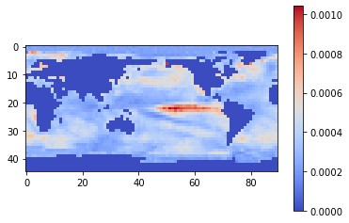
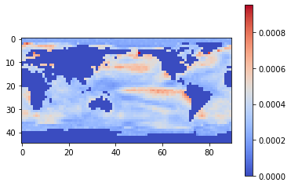
„coupled“ baseESN
mean relevance map: EL NINO
Best performance is found for the following setup:
Feed whole world's sst anomaly fields as input
Only consider „valid“ gridpoints (remove NaN values)
reduced in size by factor of 4, flattened (vectorized)
capped with quantile limits 0.005% and 0.995%
scaled to [-1,1]
one-hot targets
tanh activation
n_{res} = lat x lon gridpoints
spectral radius = 0.8
sparsity = 0.3
total timesteps T = 3
train accuracy 100%
validation accuracy of 98% / 98% for El Nino / La Nina
mean relevance map: LA NINA

Slide 20
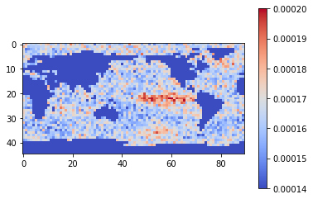
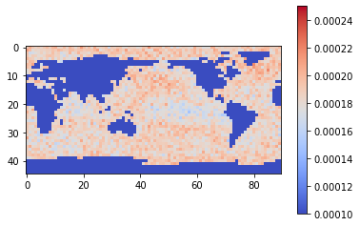
„coupled“ baseESN
mean relevance map: EL NINO
Mixed performance is found for the following setup:
Feed whole world's sst anomaly fields as input
reduced in size by factor of 4, flattened (vectorized)
un-capped inputs
scaled to [0,1]
continuous sst anomaly index as single target
sigmoid activation
n_{res} = lat x lon gridpoints
spectral radius = 0.8
sparsity = 0.3
total timesteps T = 3
train accuracy 100%
validation accuracy of 98% / 100% for El Nino / La Nina
mean relevance map: LA NINA

Slide 21
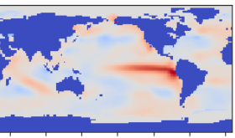
baseESN: Feed inputs column-wise or row-wise
t=1
t=5
t=2
t=4
t=3

Slide 22




baseESN: Feed inputs column-wise or row-wise
input
u(1)
act(1)
input
u(T-1)
act(T-1)
input
u(T)
act(T)
W_{in} b_{in}
W_{in} b_{in}
W_{in} b_{in}
$$α$$
W_{out} b_{out}
output (one-hot)
W_{res}b_{res}
$$α$$
W_{res}b_{res}
W_{out} b_{out}
$$(1−α)$$
(…)
$$(1−α)$$
x(1)
x(T-2)
x(T-1)

Slide 23
baseESN: Feed inputs column-wise or row-wise
input
u(1)
act(1)
input
u(T-1)
act(T-1)
input
u(T)
act(T)
W_{in} b_{in}
W_{in} b_{in}
W_{in} b_{in}
$$α$$
W_{out} b_{out}
output (one-hot)
W_{res}b_{res}
$$α$$
W_{res}b_{res}
W_{out} b_{out}
$$(1−α)$$
(…)
$$(1−α)$$
x(1)
x(T-2)
x(T-1)

Slide 24
baseESN: Feed inputs column-wise or row-wise
input
u(1)
act(1)
input
u(T-1)
act(T-1)
input
u(T)
act(T)
W_{in} b_{in}
W_{in} b_{in}
W_{in} b_{in}
$$α$$
W_{out} b_{out}
output (one-hot)
W_{res}b_{res}
$$α$$
W_{res}b_{res}
W_{out} b_{out}
$$(1−α)$$
(…)
$$(1−α)$$
x(1)
x(T-2)
x(T-1)

Slide 25
baseESN: Feed inputs column-wise or row-wise
input
u(1)
act(1)
input
u(T-1)
act(T-1)
input
u(T)
act(T)
W_{in} b_{in}
W_{in} b_{in}
W_{in} b_{in}
$$α$$
W_{out} b_{out}
output (one-hot)
W_{res}b_{res}
$$α$$
W_{res}b_{res}
W_{out} b_{out}
$$(1−α)$$
(…)
$$(1−α)$$
x(1)
x(T-2)
x(T-1)

Slide 26
baseESN: Feed inputs column-wise or row-wise
input
u(1)
act(1)
input
u(T-1)
act(T-1)
input
u(T)
act(T)
W_{in} b_{in}
W_{in} b_{in}
W_{in} b_{in}
$$α$$
W_{out} b_{out}
output (one-hot)
W_{res}b_{res}
$$α$$
W_{res}b_{res}
W_{out} b_{out}
$$(1−α)$$
(…)
$$(1−α)$$
x(1)
x(T-2)
x(T-1)

Slide 27
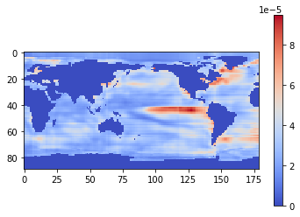
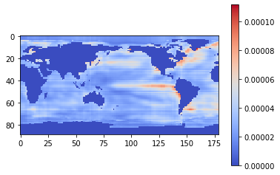
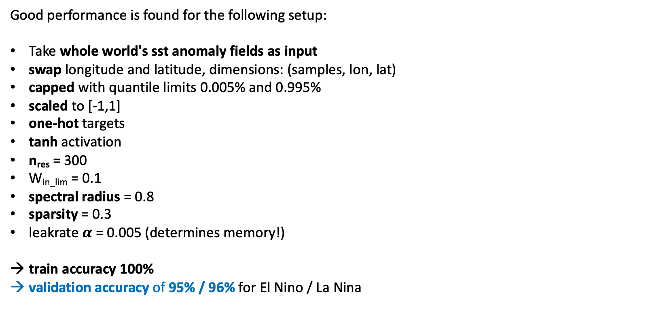
baseESN: Feed inputs column by column
mean relevance map: EL NINO
Good performance is found for the following setup:
Take whole world's sst anomaly fields as input
swap longitude and latitude, dimensions: (samples, lon, lat)
capped with quantile limits 0.005% and 0.995%
scaled to [-1,1]
one-hot targets
tanh activation
n_{res} = 300
W_{in_lim} = 0.1
spectral radius = 0.8
sparsity = 0.3
leakrate $α$ = 0.005 (determines memory!)
train accuracy 100%
validation accuracy of 95% / 96% for El Nino / La Nina
timesteps features
mean relevance map: LA NINA

Slide 28
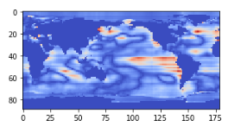
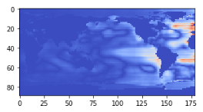
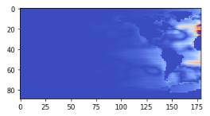



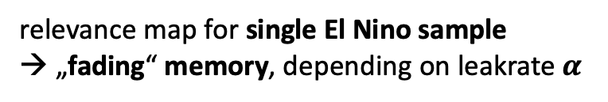
baseESN: Feed inputs column by column
relevance map for single El Nino sample
→ „fading“ memory, depending on leakrate $α$
$α$ = 0.005
$α$ = 0.05
$α$ = 0.1

Slide 29
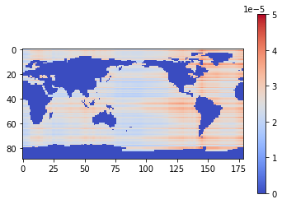
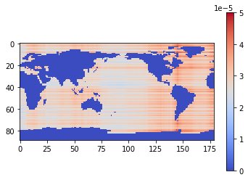

baseESN: Feed inputs column by column
mean relevance map: EL NINO
Mixed performance is found for the following setup:
Take whole world's sst anomaly fields as input
swap longitude and latitude, dimensions: (samples, lon, lat)
un-capped inputs
scaled to [0,1]
continuous sst anomaly index as single target
sigmoid activation
n_{res} = 300
W_{in_lim} = 0.1
spectral radius = 0.8
sparsity = 0.3
leakrate $α$ = 0.005 (determines memory!)
train accuracy 96% / 100% for El Nino / La Nina
validation accuracy of 97% / 99% for El Nino / La Nina
timesteps features
mean relevance map: LA NINA

Slide 30
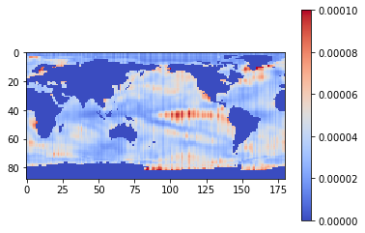
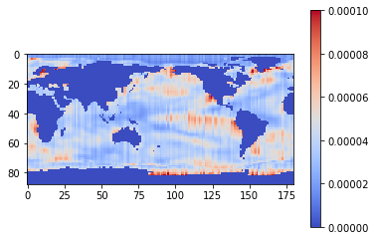
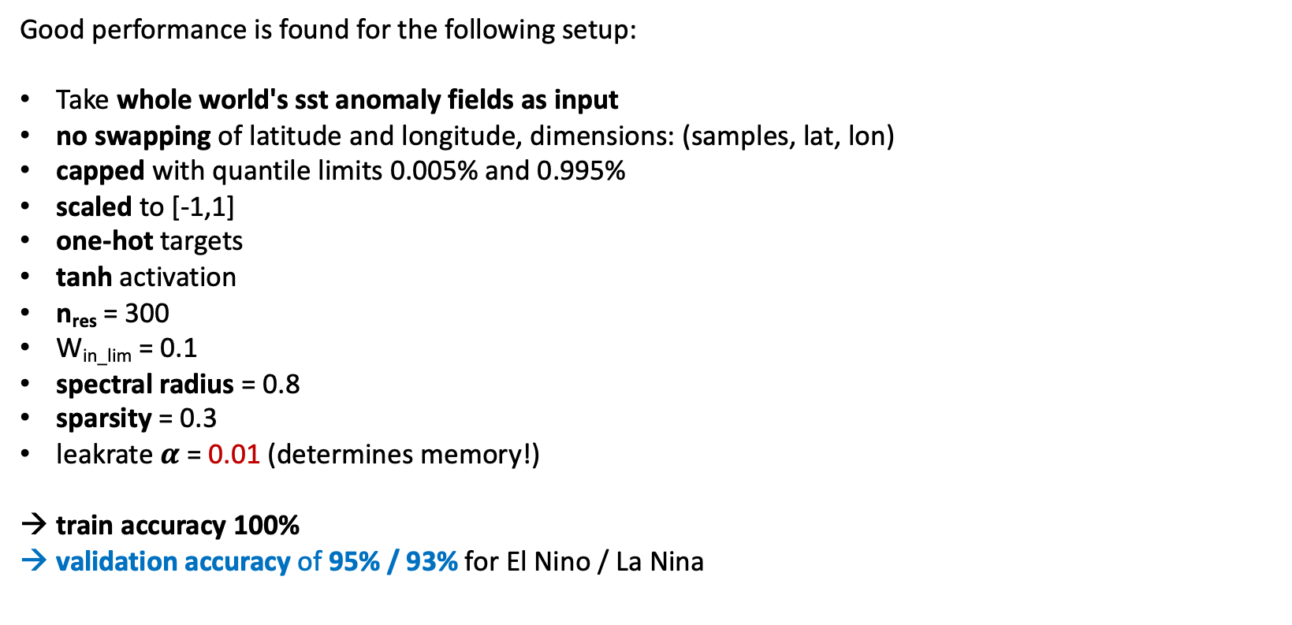
baseESN: Feed inputs row by row
mean relevance map: EL NINO
Good performance is found for the following setup:
Take whole world's sst anomaly fields as input
no swapping of latitude and longitude, dimensions: (samples, lat, lon)
capped with quantile limits 0.005% and 0.995%
scaled to [-1,1]
one-hot targets
tanh activation
n_{res} = 300
W_{in_lim} = 0.1
spectral radius = 0.8
sparsity = 0.3
leakrate $α$ = 0.01 (determines memory!)
train accuracy 100%
validation accuracy of 95% / 93% for El Nino / La Nina
timesteps features
mean relevance map: LA NINA

Slide 31
Discussion
ESN models also work on un-capped inputs, in some case with even better classification accuracy.
But then don‘t find nice relevance maps highlighting Nino region.
Feeding inputs col by col slightly outperforms row by row approach in terms of accuracy.
Plus observe less artefacts in terms of stripes for col by col method. Prefer col by col approach!
Coupled ESN requires very large reservoirs (lat x lon gridpoints = n_{res}). That leads to runtime explosion, since we need largest eigenvalue of reservoir weights. Reduced input size by factor of 4 to overcome this problem. Look for fast algorithms to at least estimate largest eigenvalue.
Comparing number of trainable parameters, ESN models clearly win:
Linear Regression has 10.988 weights.
MLP (2 hidden layers with 8 units each) has some 88.000 parameters.
couples ESN has 2.772 x 2 output weights to train but note: With one-targets and output weights trained in closed-form manner, find inverse weights.
base ESN with column by column and row by row approach only work with n_{res}=300 output weights to be trained.
ESN models in this experiment are very sensitive to preparation of input data (e.g. scaling) and have some problems with noise and outliers in sst anomaly fields.

Slide 32
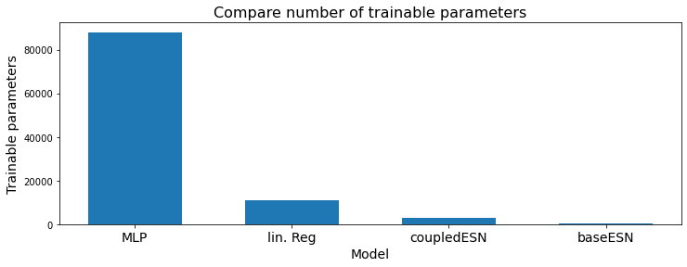
Discussion
ESN models also work on un-capped inputs, in some case with even better classification accuracy.
But then don‘t find nice relevance maps highlighting Nino region.
Feeding inputs col by col slightly outperforms row by row approach in terms of accuracy.
Plus observe less artefacts in terms of stripes for col by col method. Prefer col by col approach!
Coupled ESN requires very large reservoirs (lat x lon gridpoints = n_{res}). That leads to runtime explosion, since we need largest eigenvalue of reservoir weights. Reduced input size by factor of 4 to overcome this problem. Look for fast algorithms to at least estimate largest eigenvalue.
Comparing number of trainable parameters, ESN models clearly win:
Linear Regression has 10.988 weights.
MLP (2 hidden layers with 8 units each) has some 88.000 parameters.
couples ESN has 2.772 x 2 output weights to train but note: With one-targets and output weights trained in closed-form manner, find inverse weights.
base ESN with column by column and row by row approach only work with n_{res}=300 output weights to be trained.
ESN models in this experiment are very sensitive to preparation of input data (e.g. scaling) and have some problems with noise and outliers in sst anomaly fields.

Slide 33
Next steps
Need to think about area-averaging for relevance maps!?
ENSO has some strong zonal structure. Question is, what happens if we apply some (invertible) transformation on sst field – like e.g. rotate coordinate system by 45%. Still have the same information, but does that “destroy“ ESN model performance? Expect problems with col- / row-wise approach. Whereas coupled ESN should be robust agains transformations, since we feed whole sst anomaly field (valid gridpoints) vectorized into the model.
But have to deal with sensitivity of coupled ESN models. Try:
alpha < 1 (leaky reservoir)
include non-zero b_{in} and b_{res}
Alternatively scale inputs to [0,1]
In combination with sigmoid activation
De-trend target index to have better balance in El Nino / La Nina events
…
Apply to ENSO (sst) and SAM (slp) obtained from FOCI model data.
Agglomerative relevance: Have redundant information in whole sst anomaly fields. Try bottom-up approach, how many gridpoints from sst field do we need to reach optimal accuracy?
Try transfer on some real problem.

Slide 34
Sources
[Kim & King, 2020] „Time series prediction using deep echo state networks“
[Toms et al., 2020] „Physically Interpretable Neural Networks for the Geosciences: Applications to Earth System Variability“
[Schaetti et al., 2017] „Echo State Networks-based Reservoir Computing for MNIST Handwritten Digits Recognition“
[Woodward et al., 2011] "A Reservoir Computing approach to Image Classification using Coupled Echo State and Back-Propagation Neural Networks“
Free online book „Mining massive data sets“ (http://www.mmds.org), shows two approaches to get largest eigenvalue and related eigenvector in ch. 11: „Power iteration“ and „CUR decomposition“

