Slide 1



“Using Echo State Networks for detecting ENSO“
Marco Landt-Hayen Prof. Dr. Peer Kröger (CAU Kiel)
June 2nd, 2022 Prof. Dr. Martin Claus (GEOMAR)
Dr. Willi Rath (GEOMAR)

Slide 2
Let‘s start with a quiz!
1. Who of you has ever trained some artificial neural network?

Slide 3
Let‘s start with a quiz!
2. Who of you has at least a rough idea, what „explainable AI“ refers to?

Slide 4
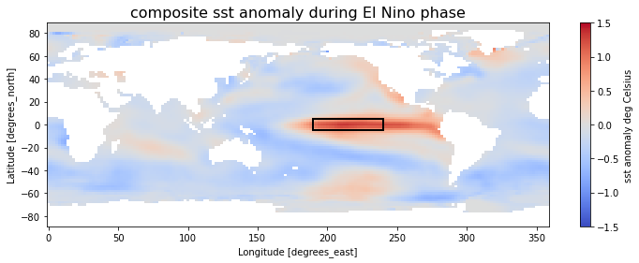
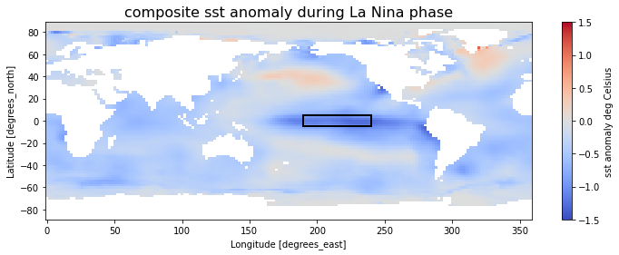
El Niño Southern Oscillation (ENSO)

Slide 5
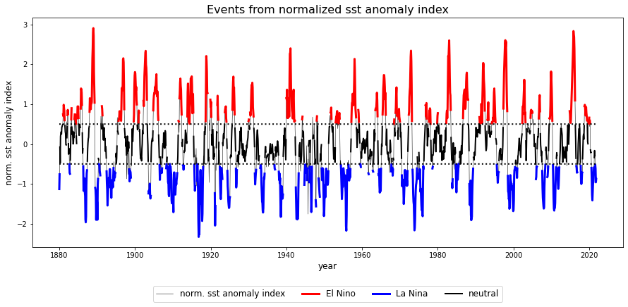
El Niño Southern Oscillation (ENSO)

Slide 6
Base ESN – methodology and reservoir transition
T timesteps
D input features
u(3)
u(1)
u(2)
u(4)

Slide 7
Base ESN – methodology and reservoir transition
T timesteps
Reservoir states X
(samples, timesteps, n_res)
D input features
W_{res}
W_{in}
u(3)
u(1)
u(2)
u(4)
Input U
here 5 input features with T=10 timesteps

Slide 8
Base ESN – methodology and reservoir transition
(Hyper)parameters:
n_res: number of res. units
sparsity of reservoir connections
spectral radius: max EV of W_{res}
leak rate ⍺ in reservoir transition
activation for reservoir transition
T timesteps
Reservoir states X
(samples, timesteps, n_res)
D input features
Dimensions:
W_{in} (input features, n_res)
W_{res} (n_res, n_res)
W_{out} (n_res, output features)
Biases:
b_{in} , b_{res} , b_{out}
W_{res}
W_{in}
W_{out}
Output Y
(here a single output feature)
u(3)
u(1)
u(2)
u(4)
Input U
here 5 input features with T=10 timesteps
current timestep‘s input
keep fraction of previous timestep‘s reservoir state
recurrence inside reservoir

Slide 9
Layer-wise relevance propagation in a nutshell
layer (l)
R_{i=1}
i = 1
a₁
layer (l+1)
w_{1:1}
j = 1
R_{j=1}
a₂
i = 2
w_{1:2}
j = 2
R_{j=2}
a₃
i = 3

Slide 10
Layer-wise relevance propagation in a nutshell
layer (l)
R_{i=1}
i = 1
a₁
layer (l+1)
w_{1:1}
j = 1
R_{j=1}
a₂
i = 2
w_{1:2}
j = 2
R_{j=2}
a₃
i = 3

Slide 11





baseESN: Feed inputs column-wise or row-wise
input
u(1)
input
u(2)
input
u(T-1)
input
u(T)
act(1)
act(2)
act(T-1)
act(T)
W_{in} b_{in}
W_{in} b_{in}
W_{in} b_{in}
W_{in} b_{in}
(…)
$$α$$
$$α$$
$$α$$
W_{res}b_{res}
W_{res}b_{res}
W_{res}b_{res}
output y(T)
W_{out} b_{out}
(…)
$$(1−α)$$
$$(1−α)$$
x(1)
x(T-2)
x(T-1)
x(T)

Slide 12
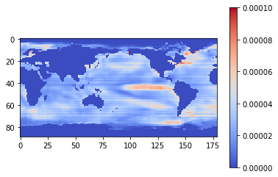
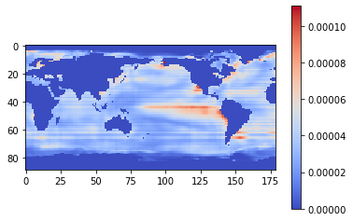
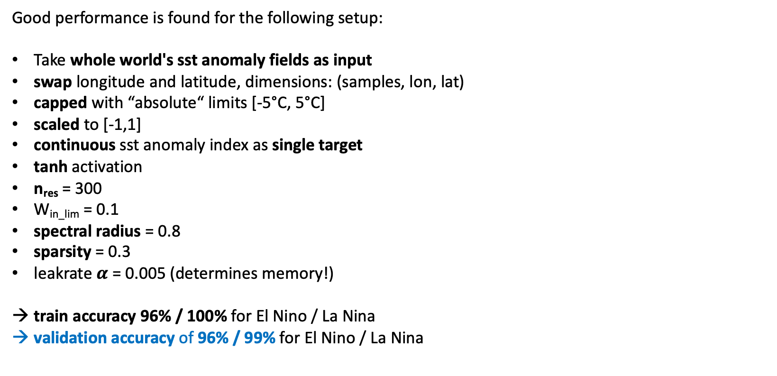
baseESN: Feed inputs column by column
mean relevance map: EL NINO
Good performance is found for the following setup:
Take whole world's sst anomaly fields as input
swap longitude and latitude, dimensions: (samples, lon, lat)
capped with “absolute“ limits [-5°C, 5°C]
scaled to [-1,1]
continuous sst anomaly index as single target
tanh activation
n_{res} = 300
W_{in_lim} = 0.1
spectral radius = 0.8
sparsity = 0.3
leakrate $α$ = 0.005 (determines memory!)
train accuracy 96% / 100% for El Nino / La Nina
validation accuracy of 96% / 99% for El Nino / La Nina
timesteps features
mean relevance map: LA NINA

Slide 13
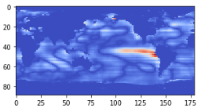
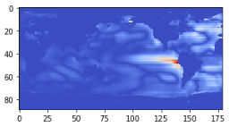
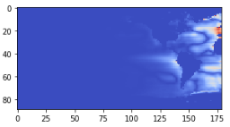
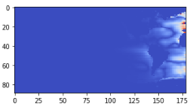
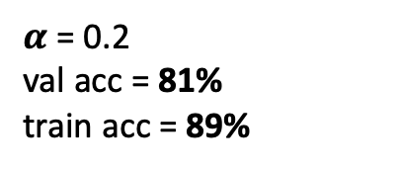
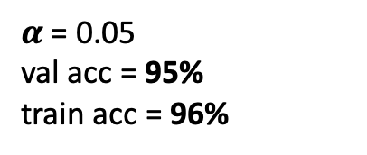
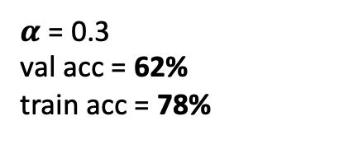
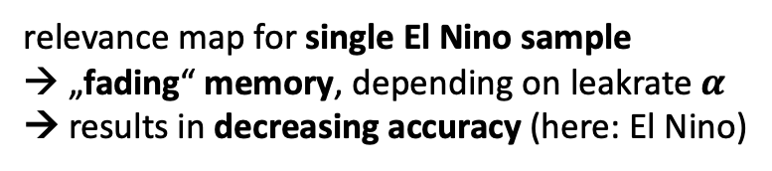
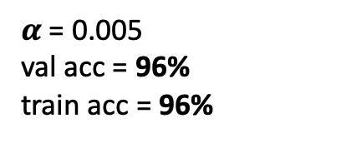
baseESN: Feed inputs column by column
relevance map for single El Nino sample
→ „fading“ memory, depending on leakrate $α$
→ results in decreasing accuracy (here: El Nino)
$α$ = 0.005
val acc = 96%
train acc = 96%
$α$ = 0.05
val acc = 95%
train acc = 96%
$α$ = 0.2
val acc = 81%
train acc = 89%
$α$ = 0.3
val acc = 62%
train acc = 78%

Slide 14
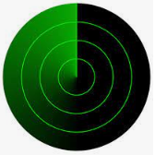
baseESN: Feed inputs column by column
relevance map for single El Nino sample
→ „fading“ memory, depending on leakrate $α$
→ results in decreasing accuracy (here: El Nino)
$α$ = 0.005
val acc = 96%
train acc = 96%
$α$ = 0.05
val acc = 95%
train acc = 96%
$α$ = 0.2
val acc = 81%
train acc = 89%
$α$ = 0.3
val acc = 62%
train acc = 78%
„radar sweep“

Slide 15
Discussion
ESN models also work on un-capped inputs, in some case with even better classification accuracy.
But then don‘t find nice relevance maps highlighting Nino region (overfitting on invalid noise?!).
Feeding inputs col by col slightly outperforms row by row approach in terms of accuracy.
Plus observe less artefacts in terms of stripes for col by col method. Prefer col by col approach!
Coupled ESN requires very large reservoirs (lat x lon gridpoints = n_{res}). That leads to runtime explosion, since we need largest eigenvalue of reservoir weights. Reduced input size by factor of 4 to overcome this problem. Look for fast algorithms to at least estimate largest eigenvalue.
Comparing number of trainable parameters, ESN models clearly win:
Linear Regression has 10.988 weights.
MLP (2 hidden layers with 8 units each) has some 88.000 parameters.
couples ESN has 2.772 x 2 output weights to train but note: With one-targets and output weights trained in closed-form manner, find inverse weights.
base ESN with column by column and row by row approach only work with n_{res}=300 output weights to be trained.
ESN models in this experiment are very sensitive to preparation of input data (e.g. scaling) and have some problems with noise and outliers in sst anomaly fields.

Slide 16
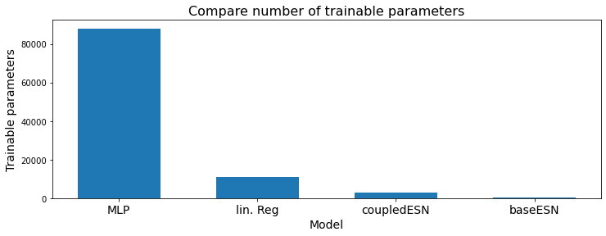
Discussion
ESN models also work on un-capped inputs, in some case with even better classification accuracy.
But then don‘t find nice relevance maps highlighting Nino region.
Feeding inputs col by col slightly outperforms row by row approach in terms of accuracy.
Plus observe less artefacts in terms of stripes for col by col method. Prefer col by col approach!
Coupled ESN requires very large reservoirs (lat x lon gridpoints = n_{res}). That leads to runtime explosion, since we need largest eigenvalue of reservoir weights. Reduced input size by factor of 4 to overcome this problem. Look for fast algorithms to at least estimate largest eigenvalue.
Comparing number of trainable parameters, ESN models clearly win:
Linear Regression has 10.988 weights.
MLP (2 hidden layers with 8 units each) has some 88.000 parameters.
couples ESN has 2.772 x 2 output weights to train but note: With one-targets and output weights trained in closed-form manner, find inverse weights.
base ESN with column by column and row by row approach only work with n_{res}=300 output weights to be trained.
ESN models in this experiment are very sensitive to preparation of input data (e.g. scaling) and have some problems with noise and outliers in sst anomaly fields.

Slide 17
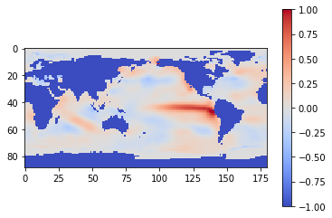
FollowUp experiment: Permutation
ENSO has some strong zonal structure. Question is, what happens if we apply some (reversible!) transformation on sst field?
Still have the same information, but does that “destroy“ ESN model performance?
Expect problems with col- / row-wise approach. Whereas coupled ESN should be robust agains transformations, since we feed whole sst anomaly field (valid gridpoints) vectorized into the model.

Slide 18
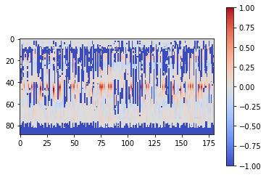
FollowUp experiment: Permutation
ENSO has some strong zonal structure. Question is, what happens if we apply some (reversible!) transformation on sst field?
Still have the same information, but does that “destroy“ ESN model performance?
Expect problems with col- / row-wise approach. Whereas coupled ESN should be robust agains transformations, since we feed whole sst anomaly field (valid gridpoints) vectorized into the model.
apply (same) random permutation on input sample for each row, to disturb zonal structure

Slide 19
FollowUp experiment: Permutation
ENSO has some strong zonal structure. Question is, what happens if we apply some (reversible!) transformation on sst field?
Still have the same information, but does that “destroy“ ESN model performance?
Expect problems with col- / row-wise approach. Whereas coupled ESN should be robust agains transformations, since we feed whole sst anomaly field (valid gridpoints) vectorized into the model.
val acc drops from 96% → 75%
apply (same) random permutation on input sample for each row, to disturb zonal structure

Slide 20
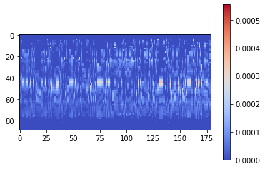
FollowUp experiment: Permutation
ENSO has some strong zonal structure. Question is, what happens if we apply some (reversible!) transformation on sst field?
Still have the same information, but does that “destroy“ ESN model performance?
Expect problems with col- / row-wise approach. Whereas coupled ESN should be robust agains transformations, since we feed whole sst anomaly field (valid gridpoints) vectorized into the model.

Slide 21
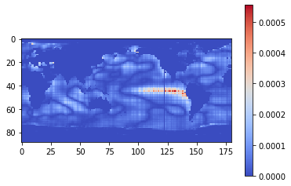
FollowUp experiment: Permutation
ENSO has some strong zonal structure. Question is, what happens if we apply some (reversible!) transformation on sst field?
Still have the same information, but does that “destroy“ ESN model performance?
Expect problems with col- / row-wise approach. Whereas coupled ESN should be robust agains transformations, since we feed whole sst anomaly field (valid gridpoints) vectorized into the model.
reverse permutation to restore relevance map

Slide 22
Sources
[Kim & King, 2020] „Time series prediction using deep echo state networks“
[Toms et al., 2020] „Physically Interpretable Neural Networks for the Geosciences: Applications to Earth System Variability“
[Schaetti et al., 2017] „Echo State Networks-based Reservoir Computing for MNIST Handwritten Digits Recognition“
[Woodward et al., 2011] "A Reservoir Computing approach to Image Classification using Coupled Echo State and Back-Propagation Neural Networks“
Free online book „Mining massive data sets“ (http://www.mmds.org), shows two approaches to get largest eigenvalue and related eigenvector in ch. 11: „Power iteration“ and „CUR decomposition“

Slide 23
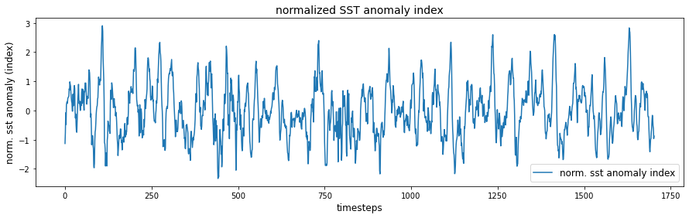
El Niño Southern Oscillation (ENSO)
Use Nino3.4 box (5°N–5°S, 120–170°W) in the tropical Pacific to diagnose ENSO from sea-surface temperature (SST) anomalies.
SST data: https://downloads.psl.noaa.gov/Datasets/noaa.ersst.v5/sst.mnmean.nc
Provides monthly mean SST from 1854 to now in 2° by 2° lat/lon grid
Start from 1880
Calaculate ENSO index:
Compute area averaged total SST from Niño 3.4 region
Compute monthly climatology (e.g., 1980-2009) for area averaged total SST from Niño 3.4 region, and subtract climatology from area averaged total SST time series to obtain anomalies
Normalize, no rolling mean!

Slide 24
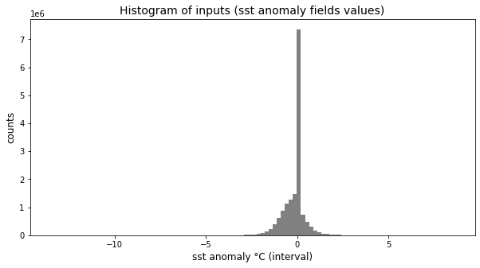
Data pre-processing: Scale inputs
raw input values
NaN to zero

Slide 25
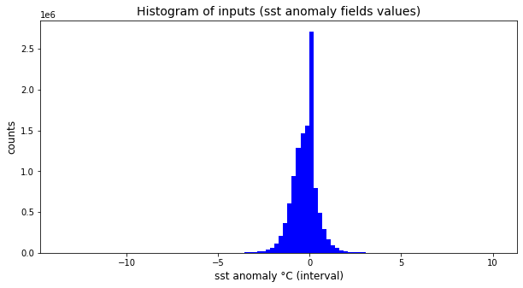
Data pre-processing: Scale inputs
raw input values
NaN to zero
remove NaN
→ Even with removed (former) NaN values find peek from sst anomalies over Arctic region, seasonally covered with ice.

Slide 26
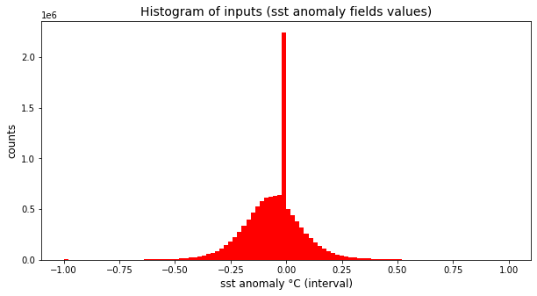
Data pre-processing: Scale inputs
raw input values
NaN to zero
remove NaN
→ Even with removed (former) NaN values find peek from sst anomalies over Arctic region, seasonally covered with ice.
→ All models can handle un-capped input data. But for getting „nice“ relevance maps, prefere working on capped inputs, essential for ESN models (see later results…)
capped values outside [-5,5]
scaled to [-1,1]

Slide 27
Agenda
Classification of sst anomaly fields and LRP
Linear Regression
Multilayer perceptron
„coupled“ baseESN
base ESN: feed inputs column by column (or row by row)

Slide 28
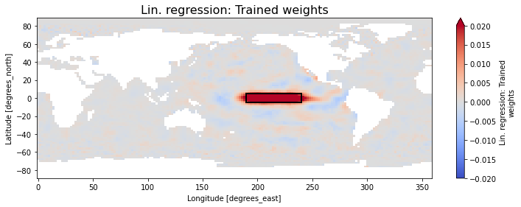
1. Linear Regression: Classification and „LRP“
Best performance is found for the following setup:
Feed whole world's sst anomaly fields as input
Only consider „valid“ gridpoints (remove NaN values), flattened (vectorized)
capped with “absolute“ limits [-5°C, 5°C]
scaled to [-1,1]
unscaled continuous normalized sst anomaly index as target.
train accuracy 100%
validation accuracy of 100% / 100% for El Nino / La Nina samples
(Fidelity is close to perfect!)

Slide 29
Layer-wise relevance propagation in a nutshell
R_{i=1}
layer i
i = 1
a₁
layer j
w_{1:1}
j = 1
R_{j=1}
a₂
i = 2
w_{1:2}
j = 2
R_{j=2}
a₃
i = 3

Slide 30
Layer-wise relevance propagation in a nutshell
R_{i=1}
layer i
i = 1
a₁
layer j
w_{1:1}
j = 1
R_{j=1}
a₂
i = 2
w_{1:2}
j = 2
R_{j=2}
a₃
i = 3

Slide 31
Layer-wise relevance propagation in a nutshell
R_{i=1}
layer i
i = 1
a₁
layer j
w_{1:1}
j = 1
R_{j=1}
a₂
i = 2
w_{1:2}
j = 2
R_{j=2}
a₃
i = 3

Slide 32
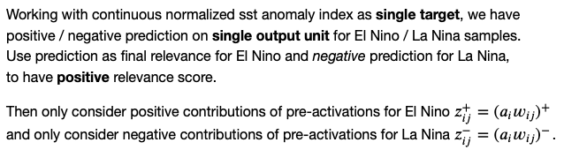


Layer-wise relevance propagation in a nutshell
R_{i=1}
layer i
i = 1
a₁
layer j
w_{1:1}
j = 1
R_{j=1}
a₂
i = 2
w_{1:2}
j = 2
R_{j=2}
a₃
i = 3

Slide 33
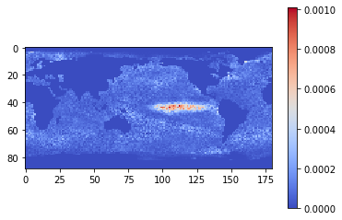
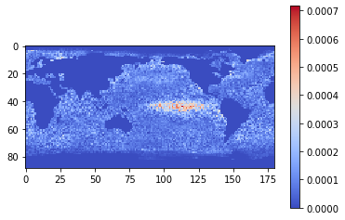
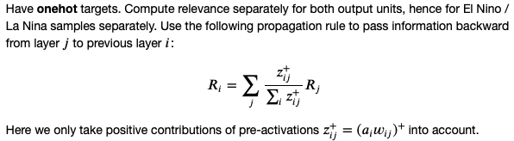
2. Multilayer Perceptron (MLP): Classification and LRP
mean relevance map: EL NINO
Best performance is found for the following setup:
Feed whole world's sst anomaly fields as input
Only consider „valid“ gridpoints (remove NaN values)
flattened (vectorized)
capped with “absolute“ limits [-5°C, 5°C]
scaled to [-1,1]
one-hot targets
train accuracy 100%
validation accuracy of 100% / 98% for El Nino / La Nina samples
mean relevance map: LA NINA

Slide 34

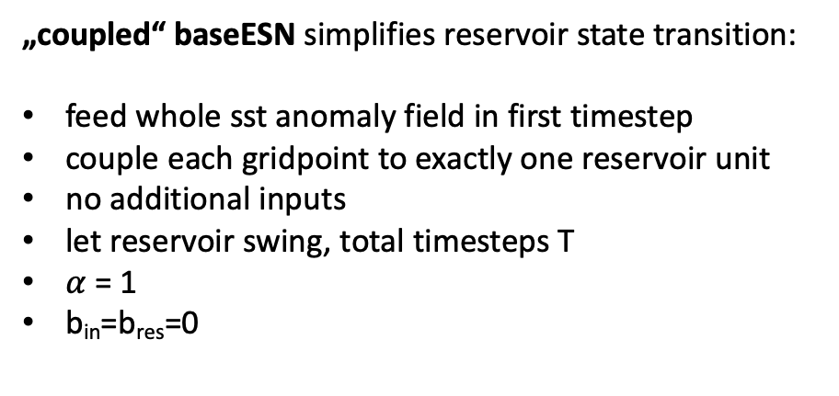
Layer-wise relevance propagation for „coupled“ baseESN
current timestep‘s input
keep fraction of previous timestep‘s reservoir state
recurrence inside reservoir
„coupled“ baseESN simplifies reservoir state transition:
feed whole sst anomaly field in first timestep
couple each gridpoint to exactly one reservoir unit
no additional inputs
let reservoir swing, total timesteps T
$α$ = 1
b_{in}=b_{res}=0

Slide 35




„coupled“ baseESN: Unfold recurrence
input
u(1)
act(1)
act(T-1)
act(T)
output (one-hot)
$α$=1
$$α$$
$α$=1
W_{out} b_{out}
W_{res}
W_{res}
(…)
x(1)
x(T-2)
x(T-1)

Slide 36

„coupled“ baseESN: Unfold recurrence
input
u(1)
act(1)
act(T-1)
act(T)
output (one-hot)
$α$=1
$α$=1
$α$=1
W_{out} b_{out}
W_{res}
W_{res}
(…)
x(1)
x(T-2)
x(T-1)

Slide 37
„coupled“ baseESN: Unfold recurrence
input
u(1)
act(1)
act(T-1)
act(T)
output (one-hot)
$α$=1
$α$=1
$α$=1
W_{out} b_{out}
W_{res}
W_{res}
(…)
x(1)
x(T-2)
x(T-1)

Slide 38
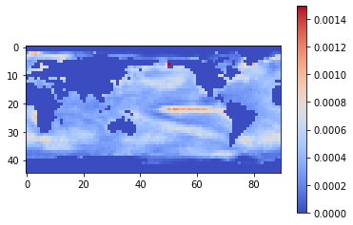
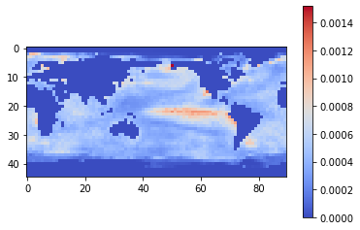
„coupled“ baseESN
mean relevance map: EL NINO
Best performance is found for the following setup:
Feed whole world's sst anomaly fields as input
Only consider „valid“ gridpoints (remove NaN values)
reduced in size by factor of 4, flattened (vectorized)
capped with “absolute“ limits [-5°C, 5°C]
scaled to [-1,1]
continuous sst anomaly index as single target
tanh activation
n_{res} = lat x lon gridpoints
spectral radius = 0.8
sparsity = 0.3
total timesteps T = 4
train accuracy 100%
validation accuracy of 97% / 100% for El Nino / La Nina
mean relevance map: LA NINA

Slide 39
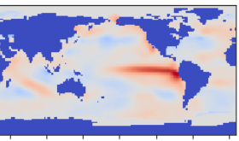
baseESN: Feed inputs column-wise or row-wise
t=1
t=5
t=2
t=4
t=3

Slide 40




baseESN: Feed inputs column-wise or row-wise
input
u(1)
act(1)
input
u(T-1)
act(T-1)
input
u(T)
act(T)
W_{in} b_{in}
W_{in} b_{in}
W_{in} b_{in}
$$α$$
W_{out} b_{out}
output (one-hot)
$$α$$
W_{res}b_{res}
$$α$$
W_{res}b_{res}
W_{out} b_{out}
$$(1−α)$$
(…)
$$(1−α)$$
x(1)
x(T-2)
x(T-1)

Slide 41
baseESN: Feed inputs column-wise or row-wise
input
u(1)
act(1)
input
u(T-1)
act(T-1)
input
u(T)
act(T)
W_{in} b_{in}
W_{in} b_{in}
W_{in} b_{in}
$$α$$
W_{out} b_{out}
output (one-hot)
$$α$$
W_{res}b_{res}
$$α$$
W_{res}b_{res}
W_{out} b_{out}
$$(1−α)$$
(…)
$$(1−α)$$
x(1)
x(T-2)
x(T-1)

Slide 42
baseESN: Feed inputs column-wise or row-wise
input
u(1)
act(1)
input
u(T-1)
act(T-1)
input
u(T)
act(T)
W_{in} b_{in}
W_{in} b_{in}
W_{in} b_{in}
$$α$$
W_{out} b_{out}
output (one-hot)
$$α$$
W_{res}b_{res}
$$α$$
W_{res}b_{res}
W_{out} b_{out}
$$(1−α)$$
(…)
$$(1−α)$$
x(1)
x(T-2)
x(T-1)

Slide 43
baseESN: Feed inputs column-wise or row-wise
input
u(1)
act(1)
input
u(T-1)
act(T-1)
input
u(T)
act(T)
W_{in} b_{in}
W_{in} b_{in}
W_{in} b_{in}
$$α$$
W_{out} b_{out}
output (one-hot)
$$α$$
W_{res}b_{res}
$$α$$
W_{res}b_{res}
W_{out} b_{out}
$$(1−α)$$
(…)
$$(1−α)$$
x(1)
x(T-2)
x(T-1)

Slide 44
baseESN: Feed inputs column-wise or row-wise
input
u(1)
act(1)
input
u(T-1)
act(T-1)
input
u(T)
act(T)
W_{in} b_{in}
W_{in} b_{in}
W_{in} b_{in}
$$α$$
W_{out} b_{out}
output (one-hot)
$$α$$
W_{res}b_{res}
$$α$$
W_{res}b_{res}
W_{out} b_{out}
$$(1−α)$$
(…)
$$(1−α)$$
x(1)
x(T-2)
x(T-1)

