Slide 1
Austausch mit Yannick u. Willi
25.01.2022
Startproject_extended: Patterns and EOFs

Slide 2
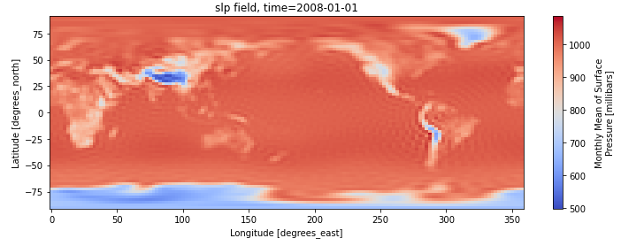
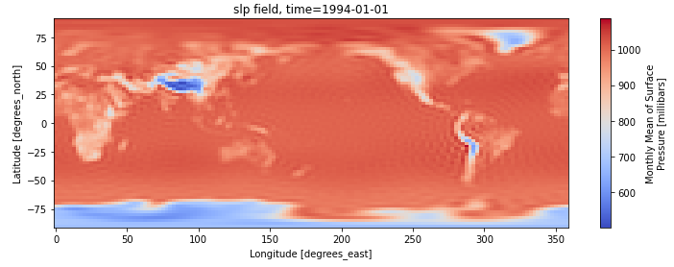
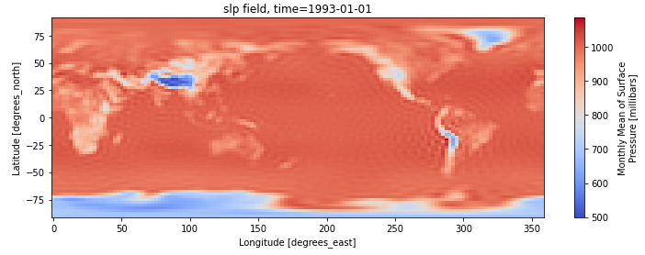
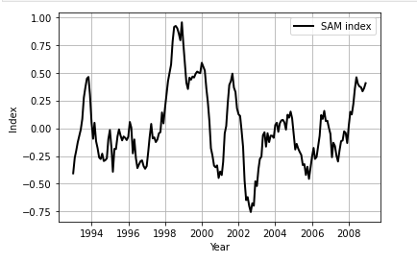
Remember: SAM index is calculated from the difference of zonal mean sea level pressure between 40°S and 65°S. (→ ACC region)

Slide 3
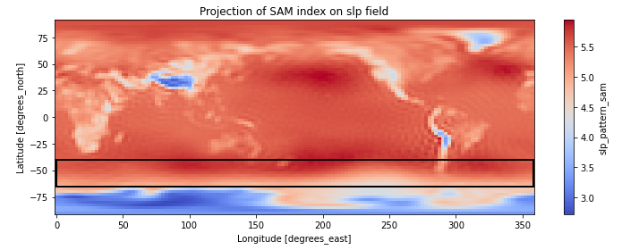
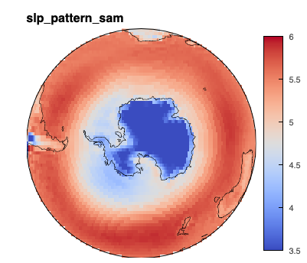
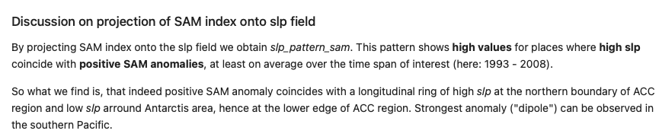

Slide 4
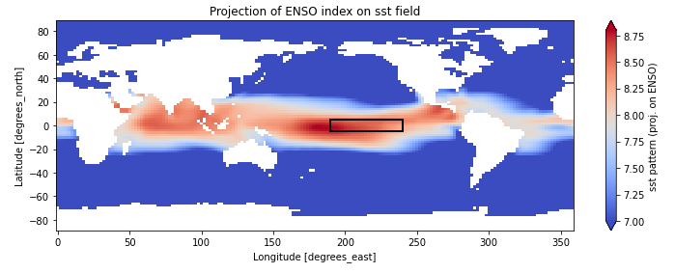
Remember ENSO Index computation:
Compute area averaged total SST from Niño 3.4 region
Compute monthly climatology (e.g., 1950-1979) for area averaged total SST from Niño 3.4 region, and subtract climatology from area averaged total SST time series to obtain anomalies;
Smooth and normalize

Slide 5
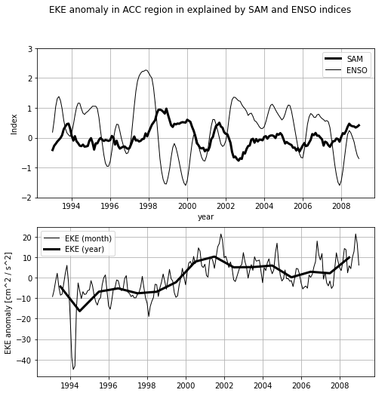

Slide 6
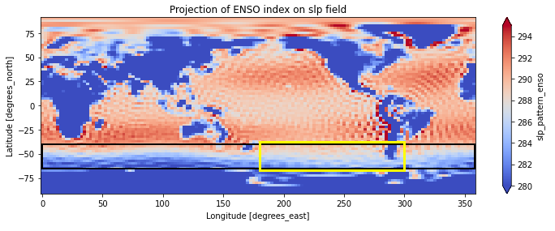
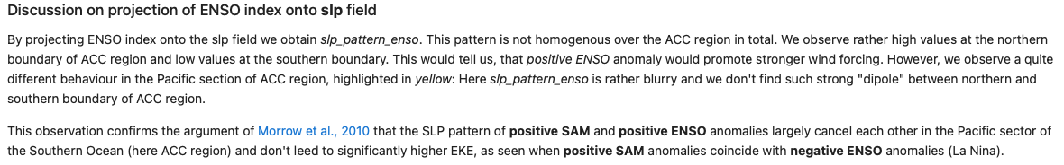

Slide 7
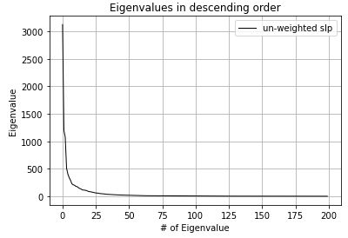
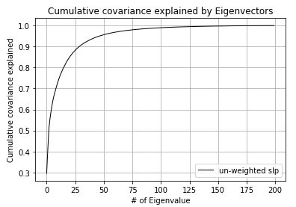
Empirical Orthogonal Functions (EOFs)
We now want to calculate the EOFs for the slp field:
slp field for the whole world, time 1993 – 2008: (time, lat, lon) (192, 73, 144)
Re-shape: (num samples, num pixels) (192, 10512)
Standardize (center and scale)
Covariance matrix (10512 x 10512)
Then get Eigenvalues and –vectors of ovariance matrix to obtain EOFs.
Makes almost no difference, if we work with un-weighted or area-weighted slp field as input.

Slide 8
