Slide 1
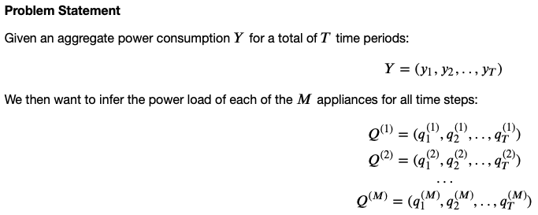
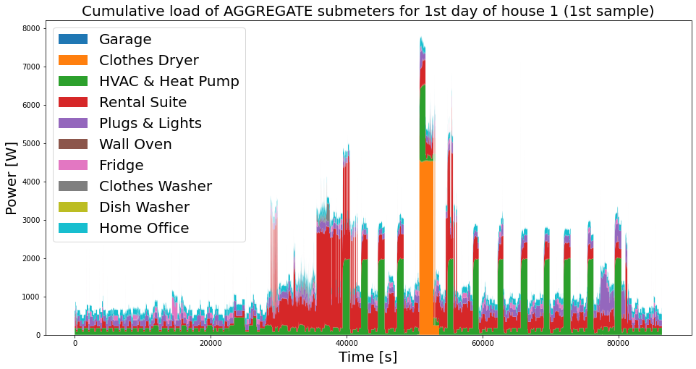

Slide 2

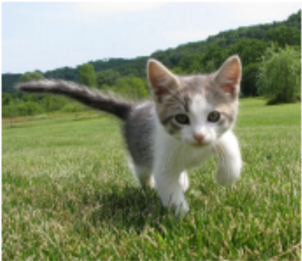
The problem resembles a classical problem in computer vision: Detect objects and draw a bounding box

Slide 3
The problem resembles a classical problem in computer vision: Detect objects and draw a bounding box

Slide 4
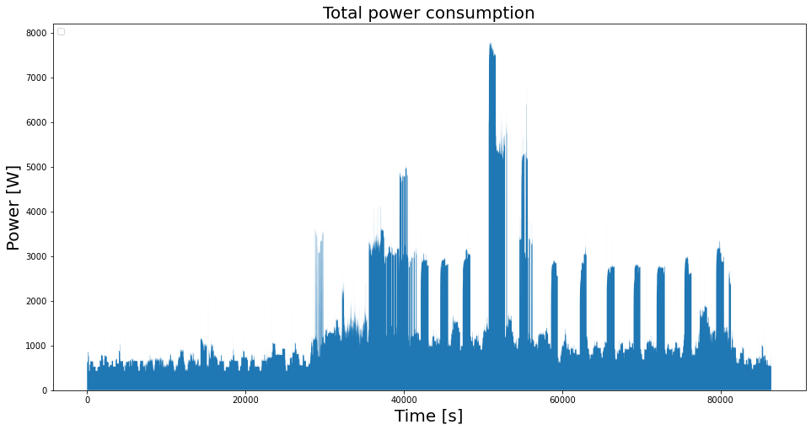
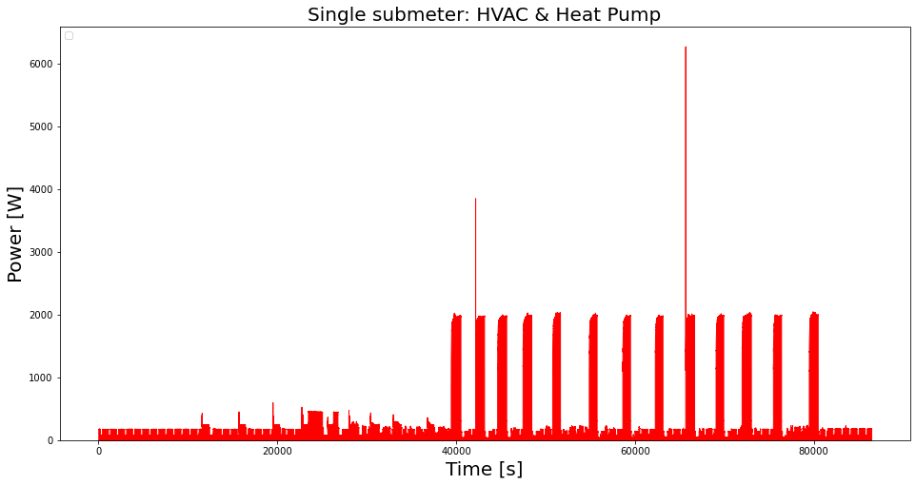
Try to use the similar CNN models:
Sliding window approach, 1D convolution
Input: Time series of total power consumption
Regression of three scalar values: start time, end time, and average power consumption for a given submeter.

Slide 5
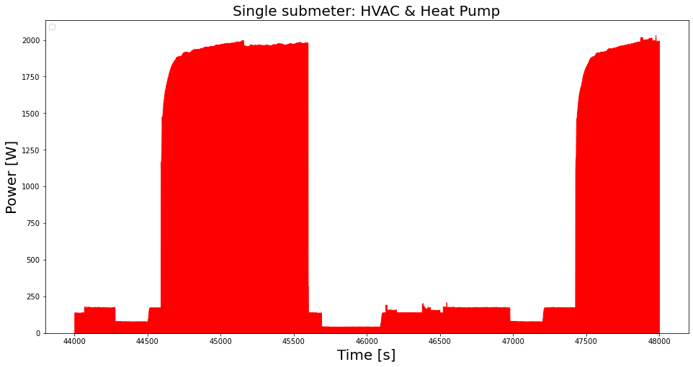
Zoom in: Sliding window approach
Look at single input sample (here: 4.000 sec)
Regression of three scalar values: start time, end time, and average power consumption
Only consider FIRST use of appliance, ignore further uses in sample
Manually define noise threshold!

