Slide 1
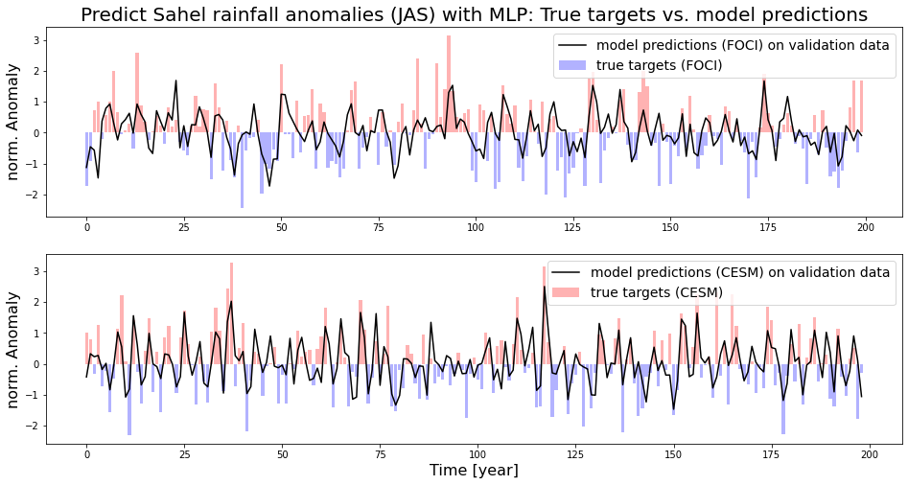

Slide 2

Targets
Correlation Coefficient
Input Features

Slide 3

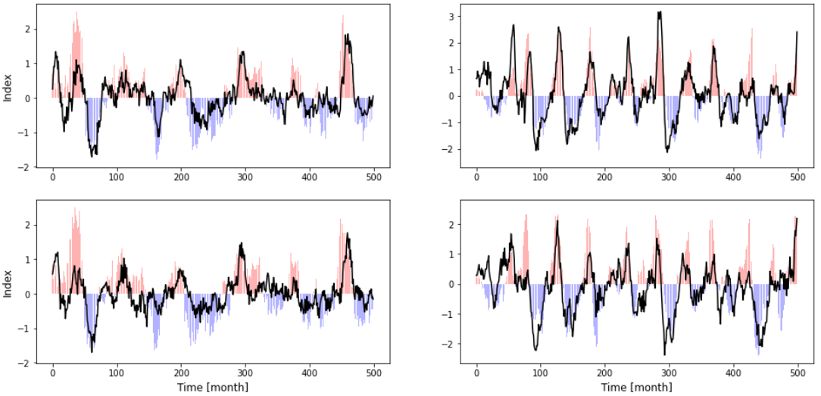
A
B
C
D
E
F

