Slide 1
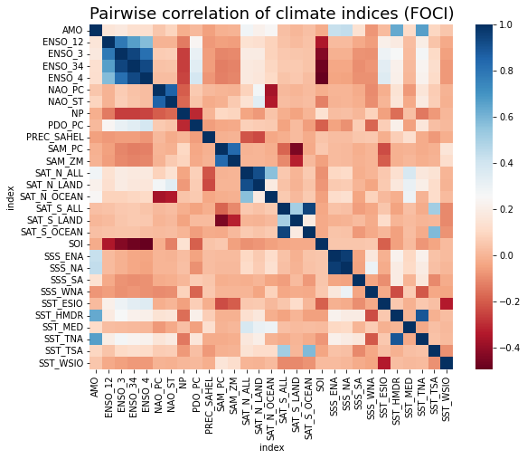

Correlation Coefficient

Slide 2
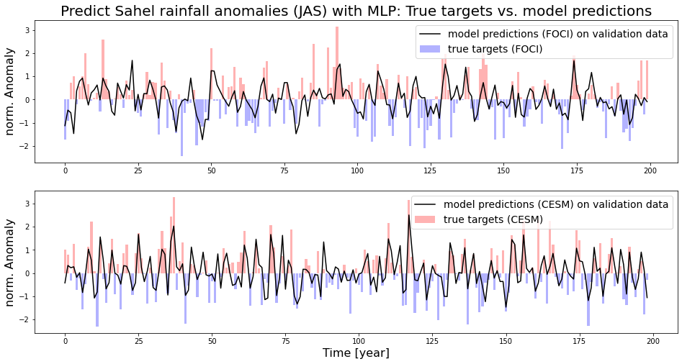

Slide 3

Correlation Coefficient
Targets
Input Features

Slide 4

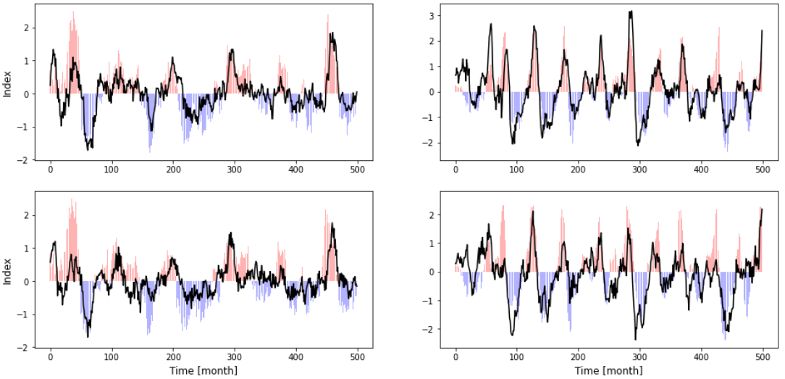
A
B
C
D
E
F

