Slide 1
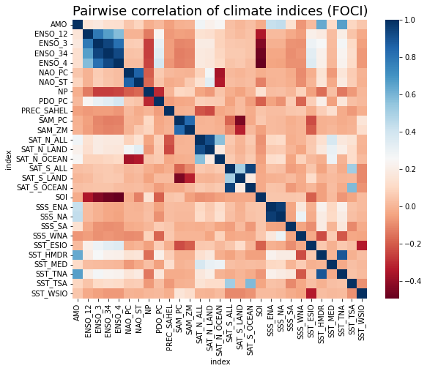

Correlation Coefficient

Slide 2
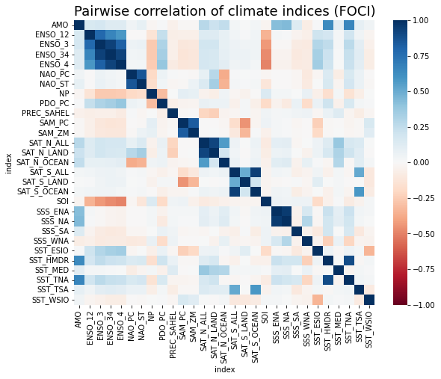

Correlation Coefficient

Slide 3
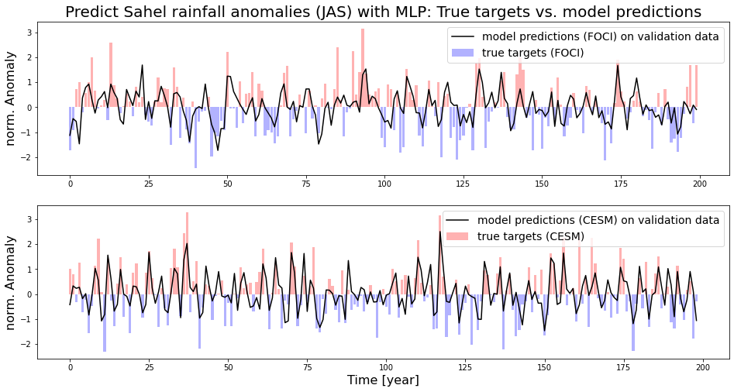

Slide 4
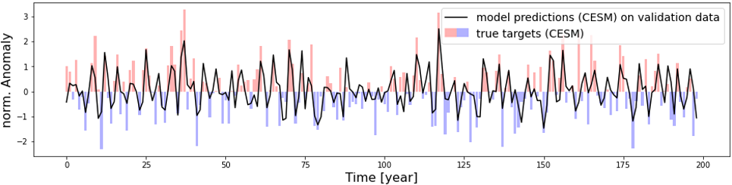

Slide 5
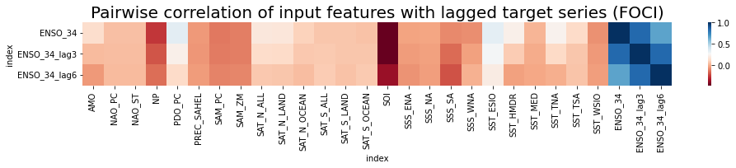
Correlation Coefficient
Targets
Input Features

Slide 6
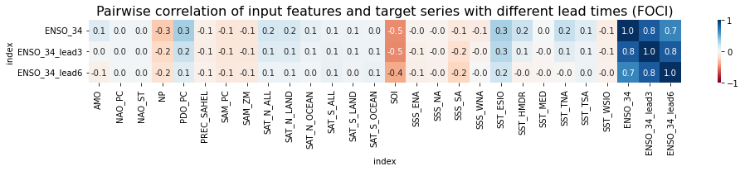
Correlation Coefficient
Targets
Input Features

Slide 7
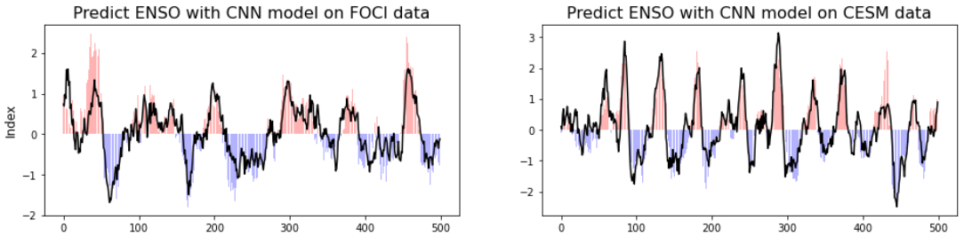
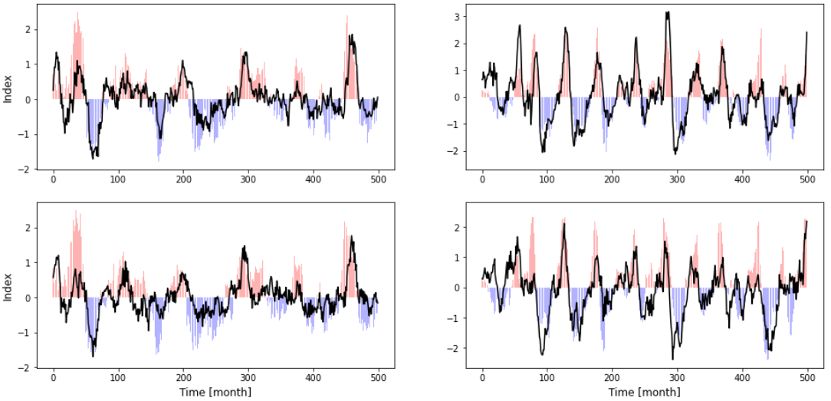
A
B
C
D
E
F

Slide 8
A
current phase
C
3 months into the future
E
6 months into the future

Slide 9
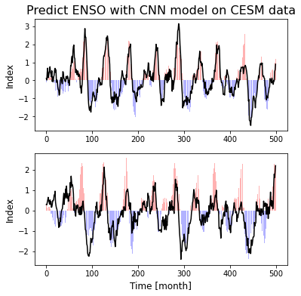
current phase
6 months into the future

