Slide 1
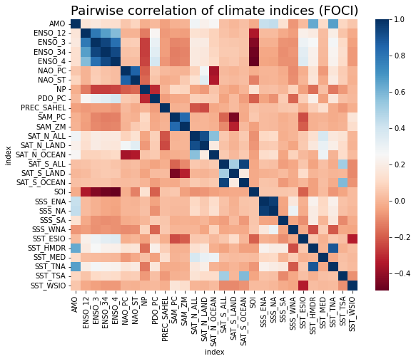

Correlation Coefficient

Slide 2
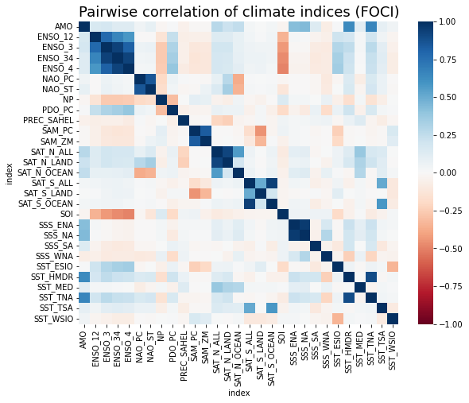

Correlation Coefficient

Slide 3
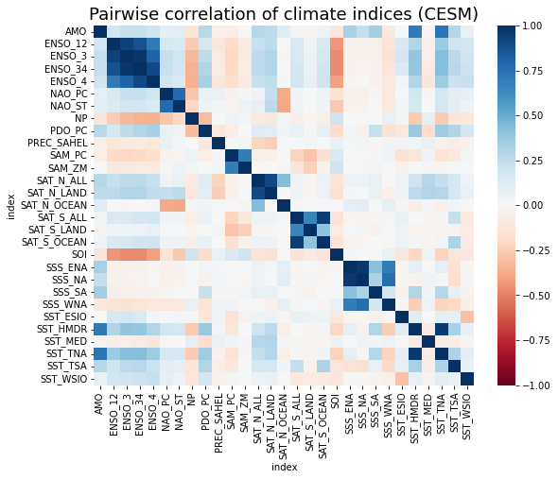
Correlation Coefficient

Slide 4
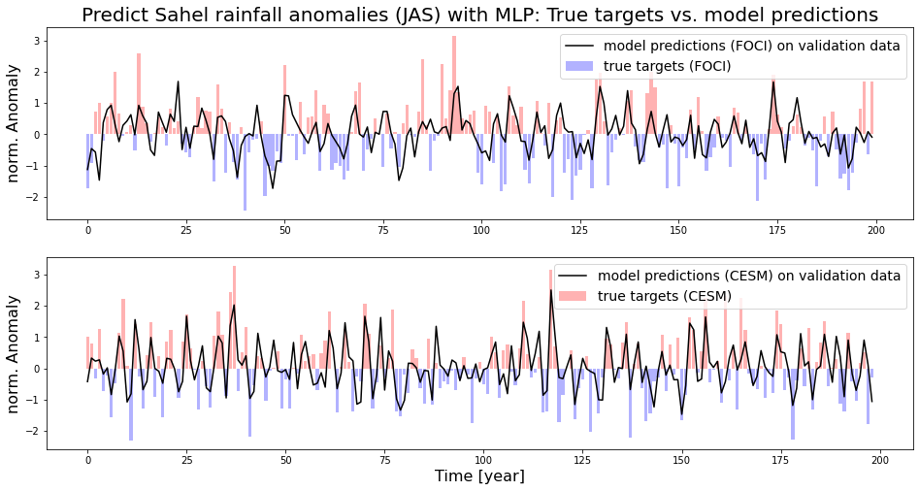

Slide 5
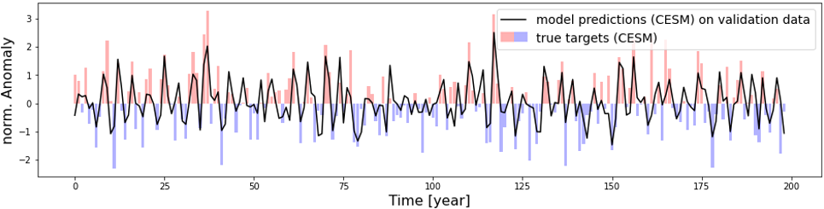

Slide 6
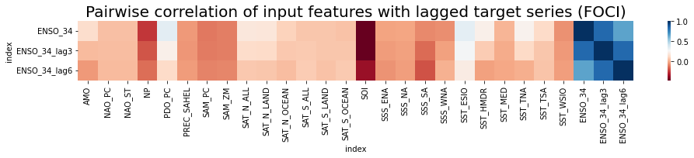
Correlation Coefficient
Targets
Input Features

Slide 7
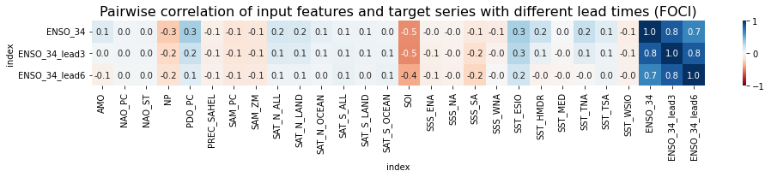
Correlation Coefficient
Targets
Input Features

Slide 8
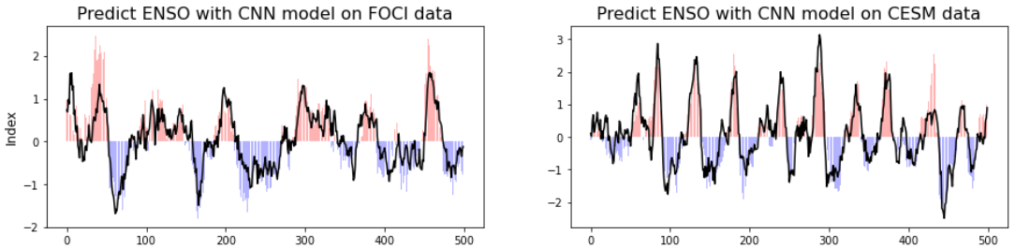
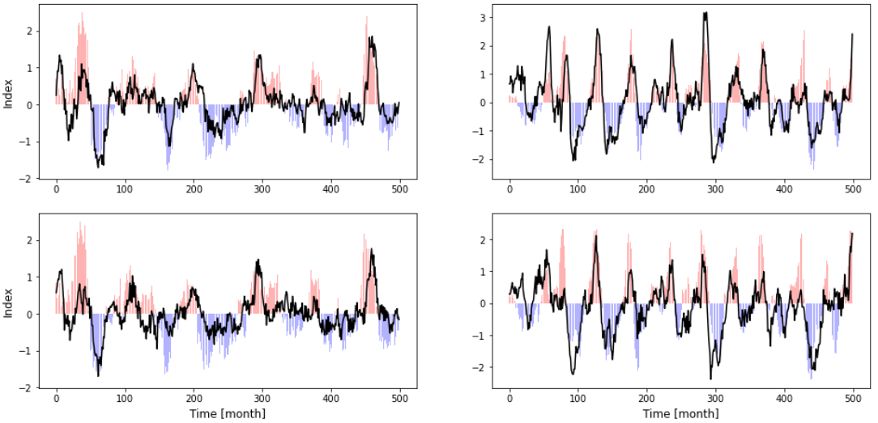
A
B
C
D
E
F

Slide 9
current phase
A
current phase
B
lead time 3 months
C
lead time 3 months
D
lead time 6 months
E
lead time 6 months
F

Slide 10
A
current phase
C
3 months into the future
E
6 months into the future

Slide 11
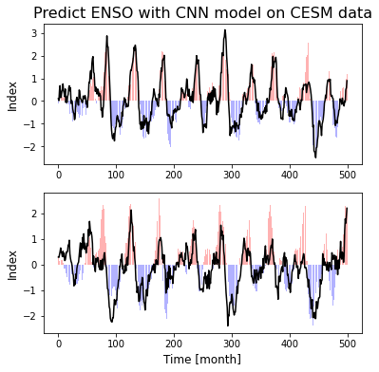
current phase
6 months into the future

