Slide 1
U-Net (4 convolutions) on slp real world data
Compare results with ‚fixed‘ and ‚variable‘ sparsity masks and data augmentation.
Jan, 20th 2023

Slide 2
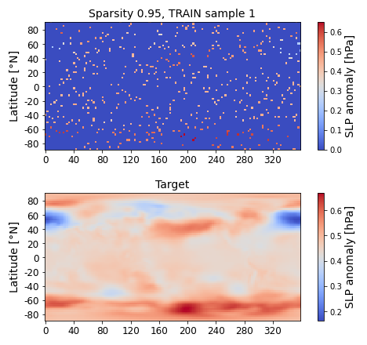
Get an impression of inputs and targets: What do we deal with?
Started with monthly 2D real world sea level pressure (slp) anomaly fields, as targets. Raw slp data from: https://downloads.psl.noaa.gov/Datasets/ncep.reanalysis.derived/surface/pres.sfc.mon.mean.nc (2.5° x 2.5° latitude-longitude grid, years 1948 – 2022, 887 samples)
Train U-Net models with 4 convolutions on sparse inputs with specified sparsity from [0.99, 0.95, 0.9, 0.75, 0.5], over 10 epochs.
Sparsity masks can be identical for ALL samples (‚fixed‘), or randomly and individually for each sample (‚variable‘).
For ‚variable‘ masks, allow to use each sample multiple times (data autmentation) according to some factor.
Inputs and targets are scaled to [0,1], since we work with ReLU activations in our CNN model.
Missing values are set to zero, AFTER scaling!
Longitude [°E]

Slide 3
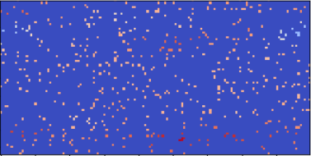
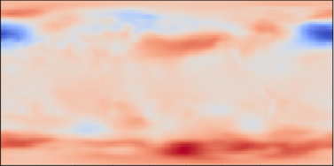
Adopt U-Net from [Xiantao et al., 2022]*
sparse input
2D conv. + ReLU
max Pooling 2x2
up-sampling 2x2
copy
concatenate
1x1 convolution
CNN filters = [64,128,256,512]
CNN kernel size = 5x5
21.6 Mio trainable parameters
*Source [Xiantao et al., 2022]: Nature article "Deep learning for irregularly and regularly missing data reconstruction“ (https://www.nature.com/articles/s41598-020-59801-x)
target / output

Slide 4
Define experiments
mask_type='fixed', augmentation_factor=1: Base experiment, according to szenario to have limited number of measurements from stations, that are fixed in their location. Fast to train, low ressources required. Expect good performance, since ANN always gets the same grid points as inputs.
mask_type='variable', augmentation_factor=1: Extends base experiment, can handle variable inputs with fixed sparsity in single model. Fits to observations from e.g. argo floats on their trajectory or well suited for e.g. sea surface temperature measurements, where varying cloud coverage limits infrared observations. In its simplest form, use each sample only once. Expect worse performance, compared to base experiment, but increased flexibility.
mask_type='variable', augmentation_factor=2: Improve performance by using each input sample multiple times, due to random sparsity. Try to reduce overfitting and increase generalization on unseen data. Comes at the expense of increased training time.

Slide 5
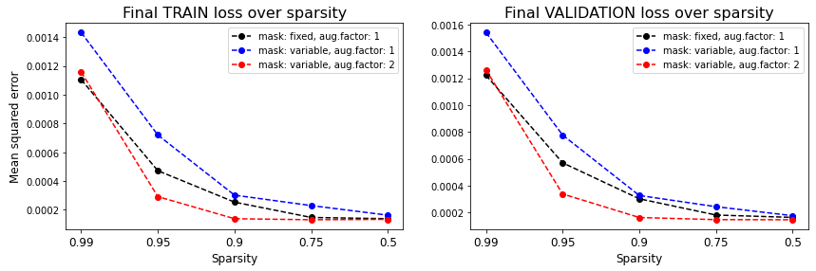
Find the U-Net to act in a reasonable way during training process.
→ With data augmentation (factor=2), we already beat the baseline. And are free to choose, which inputs to use, at least if we respect the specified sparsity, used to train the model.

Slide 6
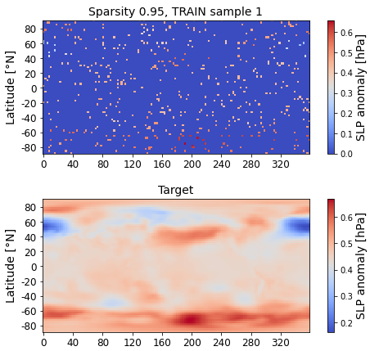
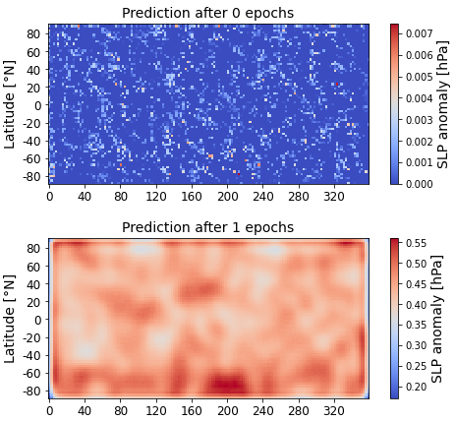
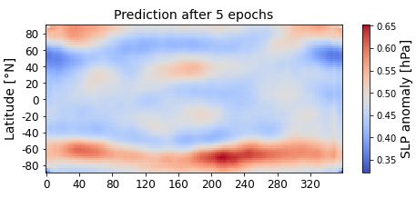
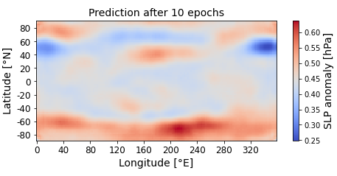
Translate loss curves to real predictions: Visualize training progress over epochs
Clearly see training progress in predictions from untrained model and after 1, 5, 10 epochs.
After 1 epoch, find artifacts at border of sample. No artifacts for later epochs.
Show examplary TRAIN input sample (sparse and scaled data) and corresponding target (complete and scaled data).

Slide 7
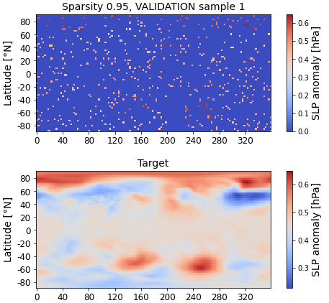
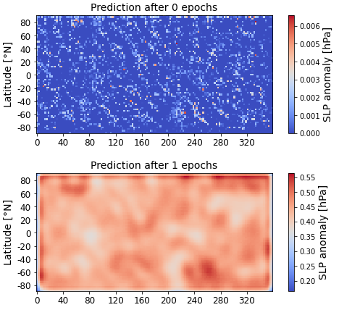
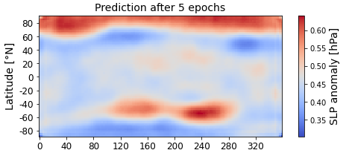
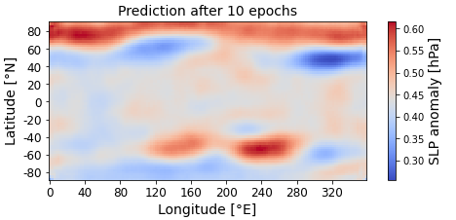
Translate loss curves to real predictions: Visualize training progress over epochs
Clearly see training progress in predictions from untrained model and after 1, 5, 10 epochs.
After 1 epoch, find artifacts at border of sample. No artifacts for later epochs.
Show examplary VALIDATION input sample (sparse and scaled data) and corresponding target (complete and scaled data).

Slide 8
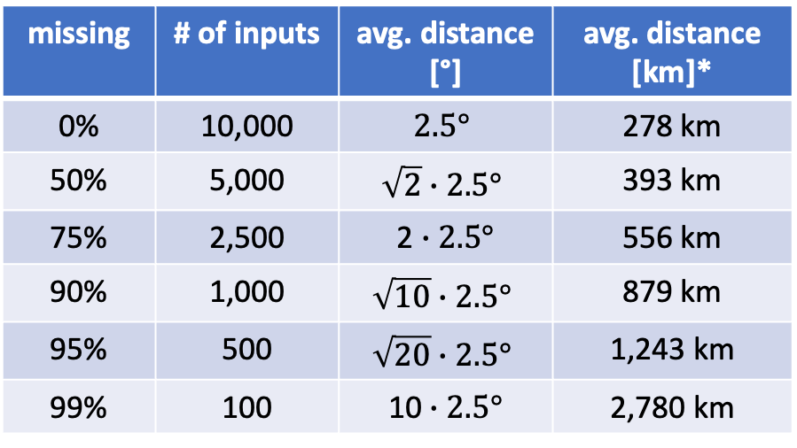
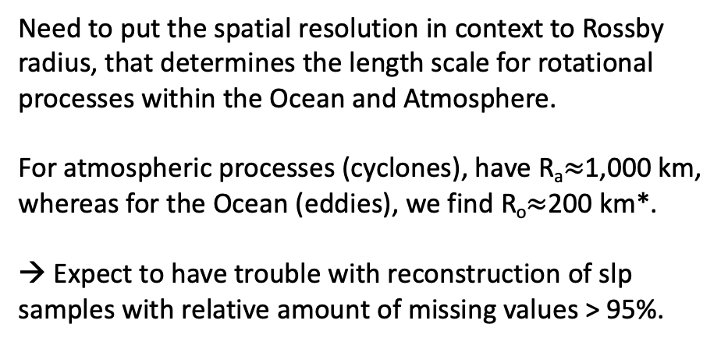
Some words on minimal resolution, related to amount of missing values
We have samples on a 2.5° x 2.5° latitude-longitude grid. That gives us 72 x 144 $≈$ 10,000 grid points.
The minimal spatial resolution depends on the relative amount of missing values, as follows:
missing | # of inputs | avg. distance [°] | avg. distance [km]*
0% | 10,000 | $$2.5°$$ | 278 km
50% | 5,000 | $$\sqrt{2}∙2.5°$$ | 393 km
75% | 2,500 | 2 $∙2.5°$ | 556 km
90% | 1,000 | $$\sqrt{10}∙2.5°$$ | 879 km
95% | 500 | $$\sqrt{20}∙2.5°$$ | 1,243 km
99% | 100 | 10 $∙2.5°$ | 2,780 km
Need to put the spatial resolution in context to Rossby radius, that determines the length scale for rotational processes within the Ocean and Atmosphere.
For atmospheric processes (cyclones), have R_{a}$≈$1,000 km, whereas for the Ocean (eddies), we find R_{o}$≈$200 km*.
→ Expect to have trouble with reconstruction of slp samples with relative amount of missing values > 95%.
*depending on latitude, here: close to equator

Slide 9
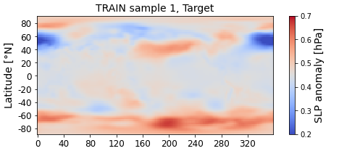
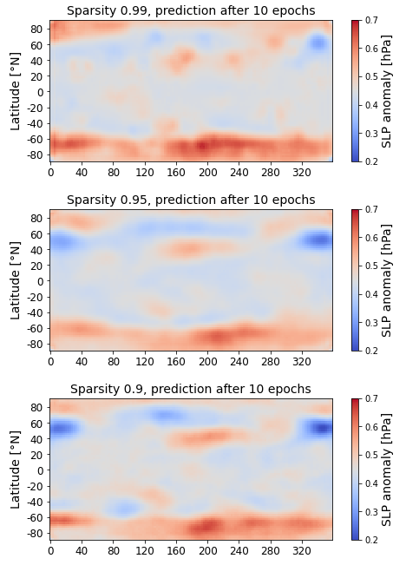
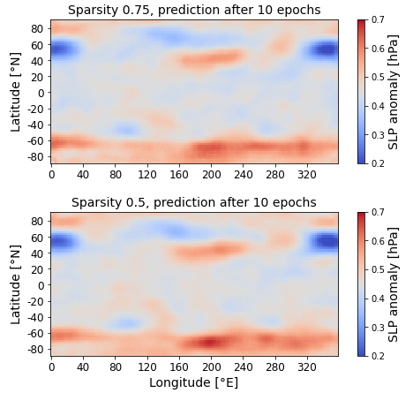
Show examplary TRAIN target (complete and scaled data) and model prediction after 10 epochs for different sparsity settings.
Main structure in slp anomalies is already captured for extreme sparsity (0.99).

Slide 10
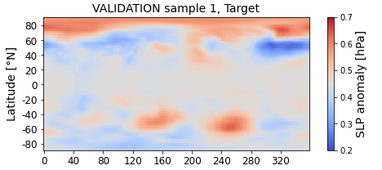
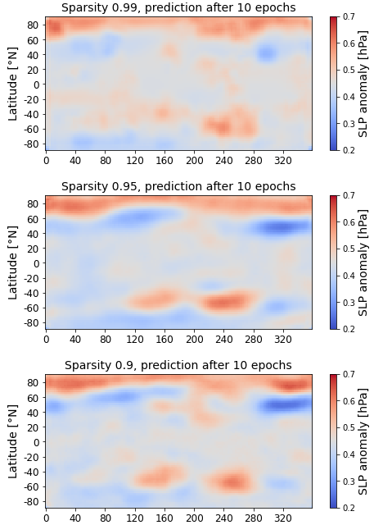
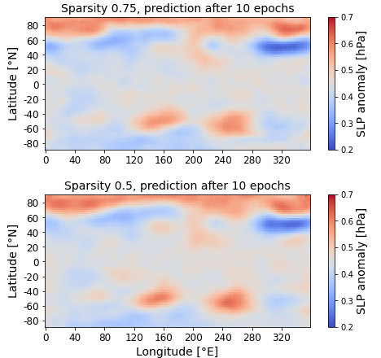
Show examplary VALIDATION target (complete and scaled data) and model prediction after 10 epochs for different sparsity settings.
Main structure in slp anomalies is only captured from sparsity >= 0.95.

Slide 11
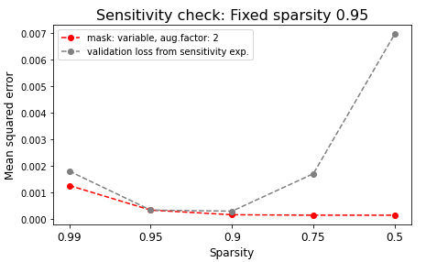
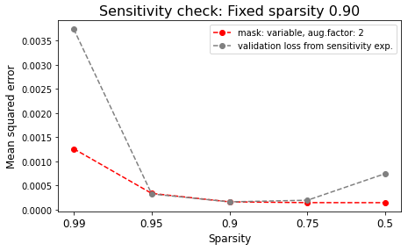
Sensitivity experiment
Now we have U-Net models that are trained to predict on samples with specified sparsity but allow to arbitrarily choose, which inputs we present.
The next question is: Can we use e.g. a model pretrained on sparsity=0.95 and feed samples with different sparsity? How does validation loss change?
That works quite nice: Especially for fixed sparsity=0.9, we find that model to almost perfectly perform in the sparsity range of [0.95, 0.75]. Our flexibility is hence further increased: Can not only freely choose, which inputs to use, but can also use a varying number of inputs, at least in a certain range!

Slide 12
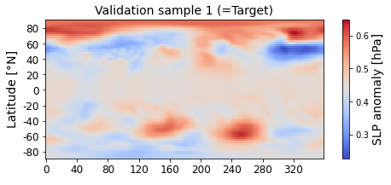
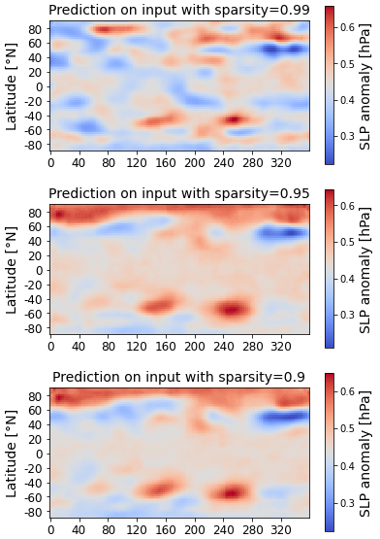
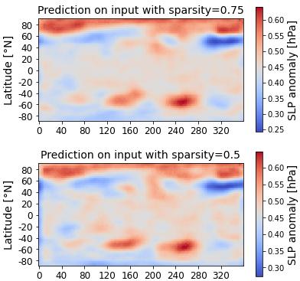
Sensitivity experiment
Use pre-trained model on sparsity=0.9

Slide 13
Game plan: Lots of ideas for further experiments
Switch from real world data to model data, use CICMoD source fields:
Constistent data from 2 ESMs 12 times more training samples, 6 fields: SST, SLP, Z500, SSS, SAT, PREC
Drive sparsity to its extreme: Add grid points in decreasing order of variance over time (choose only single input from each spot of high variance). How many inputs do we need?
Train models with varying sparsity in the underlying input samples, instead of keeping sparsity fixed.
Transfer learning: Train model on slp fields, infer on Z500 or SST.
Display feature maps from various convolutions to add xAI component: Do we find different spatial scales accorging to latitude? That could prove, that models learns cos(lat) dependency.
Include evaluation metrics related to physical processes and signal processing:
Expect to loose information, if avg. distance of sparse inputs >> Rossby radius. (For sst: Eddy radius, for slp/Z500: Atmospheric scales!)
Compute climate indices (SAM, ENSO,…) on complete and re-constructed fields: mse / fidelity / correlation?
Scatterplot: slp anomaly values for re-constructed fields (y-axis) over targets (x-axis), ideally have straight line with slope 1, expect some eliptical cloud. Look for anomalies, possibly revealing artifacts at sample borders.
Also check histograms of slp anomalies for targets vs. predictions, to check if model captures physics.
Add further evaluation metrics following [Xiantao et al, 2020}: Signal-to-noise ratio (SNR), peak SNR
Use cases:
„lossy“ compression: Compare to zfp compression algorithm (can specify target compression).
Use sparse inputs to re-construct complete fields before computing climate indices (CICMoD).
Further extensions / different approaches:
Aim to get rid of zero-inflated fixed 2D grid, rather feed inputs as (unstructured) quadrupels (time, lat, lon, value)
Graph Neural Networks, ESC-GAN: https://dl.acm.org/doi/abs/10.1145/3488560.3498461
Other ideas for imputation of missing values (from Yvonne Henniges): Mean, KNN,, MissTree, GAIN

Slide 14
Remarks from PI-Meeting (Jan 20th, 2023): Even more ideas…
Use realistic sampling for missing_mask, rather than random:
slp is measured from ships → favors variable missing_mask. Plus have fixed stations, preferably over land in the Northern hemisphere → Should reflect that in sampling of inputs, to have realistic sampling instead of random.
sst is hindered by cloud coverage, average coverage of 20% (see http://www-das.uwyo.edu/~geerts/cwx/notes/chap11/sst0026.gif --> Typical Satellite Sparsity). Realistic sampling would have missing regions or blobs, instead of randomly missing grid points. But clouds move fast, compared to changes in sst. Martin‘s advice: Check related work from satellite imagery community. They might have some imputation strategies or ways to eliminate clouds?!
Also try latitude-dependent missing_mask, to have equal weight on equal spatial scales.
Right now, have only single input channel. Could extend to have multi-channel inputs. Either by adding time dimension (feed resent XX months of slp to infer current slp) or by adding further features (e.g. infer sst from slp and Z500).
As Martin mentioned: Rossby radius determines some minimal spatial scale for geostrophy (?), some balance with coriolis force (?). Atmospheric processes mostly happen on much larger scales (multiples of Rossby radius). However, Rossby radius is good physical interpretation link!
Additionally, it is of interest, how many degrees of freedom we have in slp fields, related to spatial autocorrelation. In other words: If we miss 95% of the inputs, we probably don‘t lose 95% of the contained information, due to redundancy and (auto)correlation. But where is the limit? How many inputs do we need, to restore „full“ information? As estimate, look for the number of independent EOF modes.
That directly leads to another important xAI application: Which are the most relevant grid points for global reconstruction? In other words: Where do we need to measure, to significantly improve prediction quality – in a data-driven way? → “Sampling policy!“
Right now, we have some 2D rectangle projection of the World. That fits the needs of a CNN. But wouldn‘t it be better, to have some elliptical projection with less inputs, the higher the latitude? Fill the borders with zeros, to have 2D rectangle again. Or further extension: Have periodic border conditions, but that could be tricky and more an application for a Graph Neural Network.
Could also try U-Net on ssh data, e.g. from high-resolution NEMO run. Find many more eddies on smaller scales, compared to atmospheric cyclones. Could then work with only an extract, to neglect grid distortion with latitude. (https://academiccommons.columbia.edu/doi/10.7916/d8-bngk-r215 and https://github.com/rabernat/local_stencil_ml_examples/)

