Slide 1
U-Net (4 convolutions) on slp real world data
Results with variable random sparsity mask

Slide 2
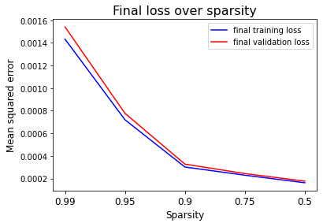
Models train well, close to saturation after 3 epochs. Nevertheless, trained over 10 epochs.

Slide 3
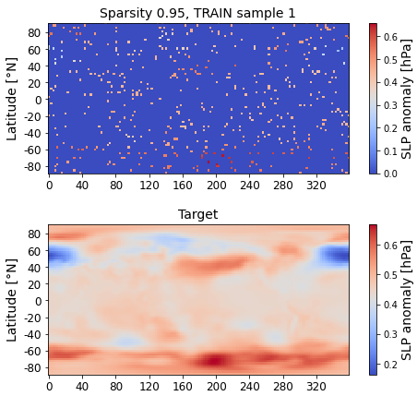
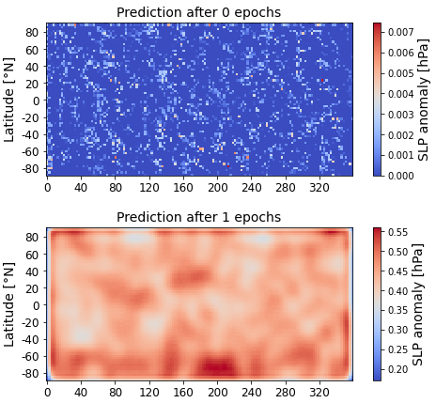
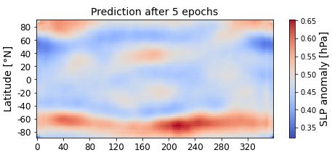
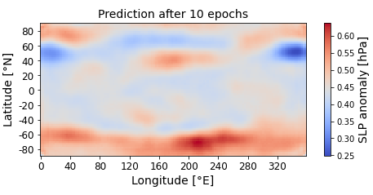
Clearly see training progress in predictions from untrained model and after 1, 5, 10 epochs.
Show examplary TRAIN input sample (sparse and scaled data) and corresponding target (complete and scaled data).

Slide 4
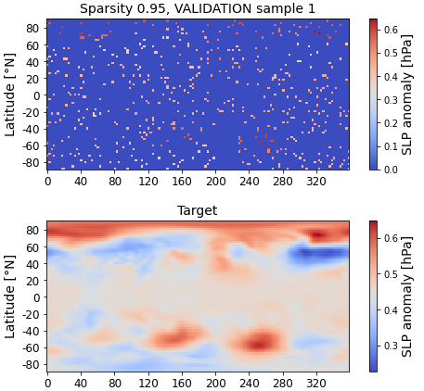
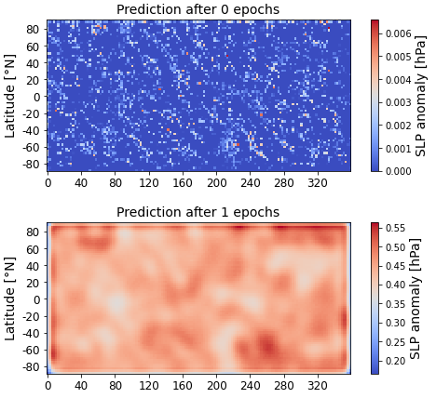
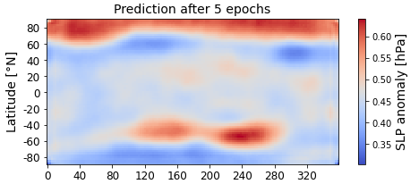
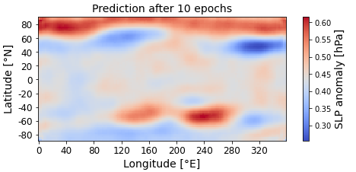
Clearly see training progress in predictions from untrained model and after 1, 5, 10 epochs.
Show examplary VALIDATION input sample (sparse and scaled data) and corresponding target (complete and scaled data).

Slide 5
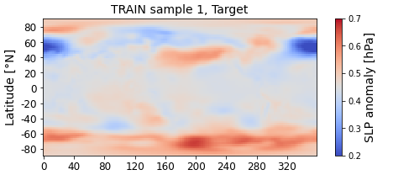
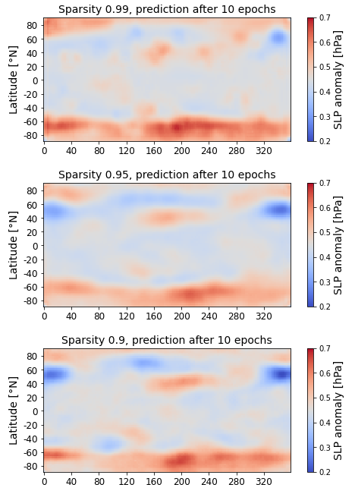
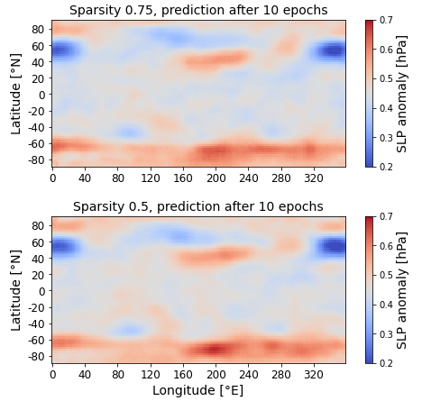
Show examplary TRAIN target (complete and scaled data) and model prediction after 10 epochs for different sparsity settings.
Main structure in slp anomalies is already captured for extreme sparsity (0.99).

Slide 6
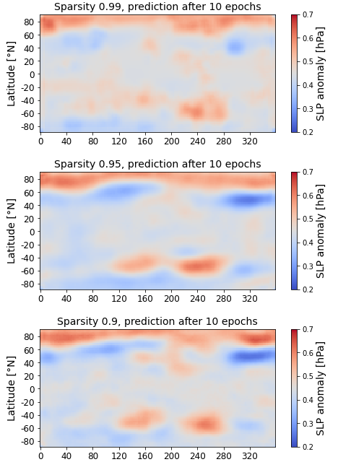
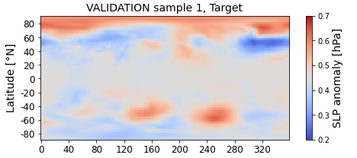
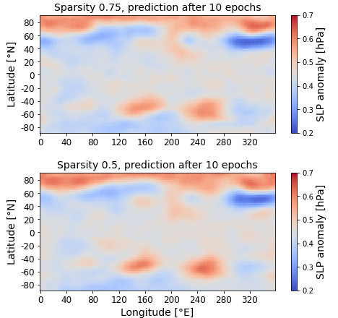
Show examplary VALIDATION target (complete and scaled data) and model prediction after 10 epochs for different sparsity settings.
Main structure in slp anomalies is only captured from sparsity >= 0.95.

