Slide 1
A bottom-up sampling strategy for reconstruction of geospatial data from ultra sparse inputs
Figures for manuscript

Slide 2
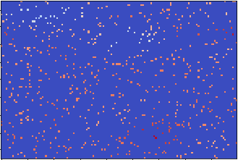
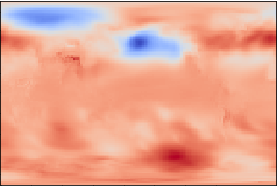
sparse input
2D conv. + ReLU
max Pooling 2x2
up-sampling 2x2
copy
concatenate
1x1 convolution
CNN filters = [64,128,256,512]
CNN kernel size = 5x5
21.6 Mio trainable parameters
target / output

