Slide 1
Reconstruct Geospatial Data from Ultra Sparse Inputs to Predict Climate Events
Figures for manuscript

Slide 2
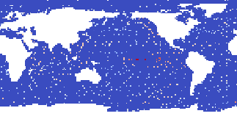
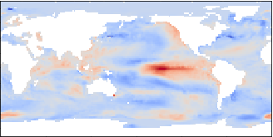
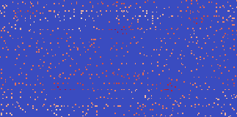

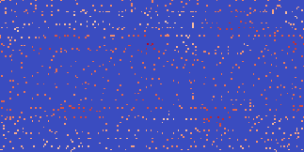
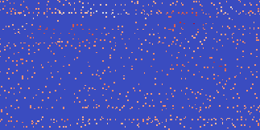
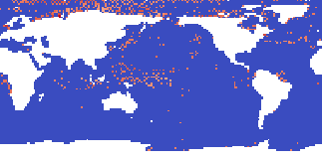
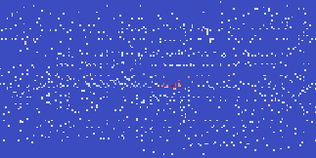
univariate input: SST
time-lagged inputs: SST with lag 0..6 months
multivariate inputs: SLP, SST, Z500, SAT, SSS, PREC
target / output

Slide 3


















sparse multivariate
inputs
2D conv. + ReLU
max pooling 2x2
upsampling 2x2
copy
concatenate
1x1 convolution
$$N_{lat}×N_{lon}$$
$$\frac{N_{lat}}{2^{1}}×\frac{N_{lon}}{2^{1}}$$
$$F_{1}$$
$$\frac{N_{lat}}{2^{2}}×\frac{N_{lon}}{2^{2}}$$
$$F_{2}$$
encoder
$$\frac{N_{lat}}{2^{3}}×\frac{N_{lon}}{2^{3}}$$
$$F_{3}$$
$$F_{4}$$
$$F_{3}+F_{4}$$
decoder
$$F_{2}+F_{3}$$
$$F_{3}$$
$$F_{1}+F_{2}$$
$$F_{2}$$
$$F_{1}$$
$$F_{2}$$
$$F_{3}$$
$$F_{4}$$
$$F_{1}$$
CNN filters = [64,128,256,512]
CNN kernel size = 5x5
target / output

Slide 4
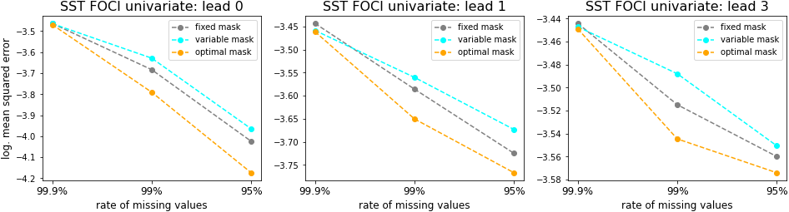
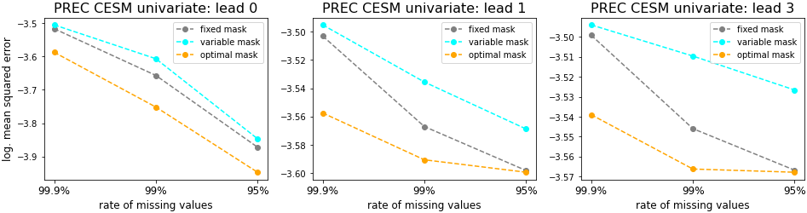
A
B
C
D
E
F

Slide 5
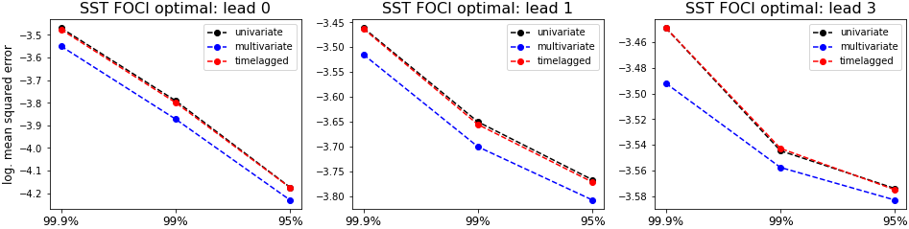
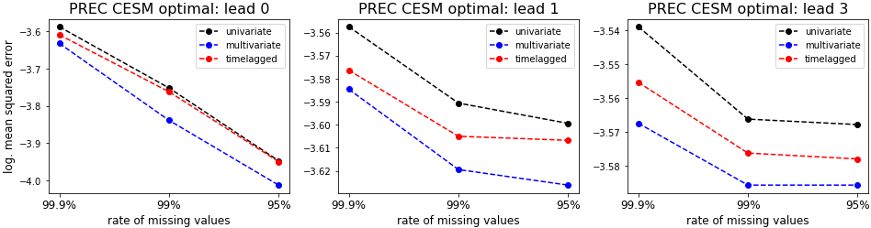
A
B
C
D
E
F

Slide 6
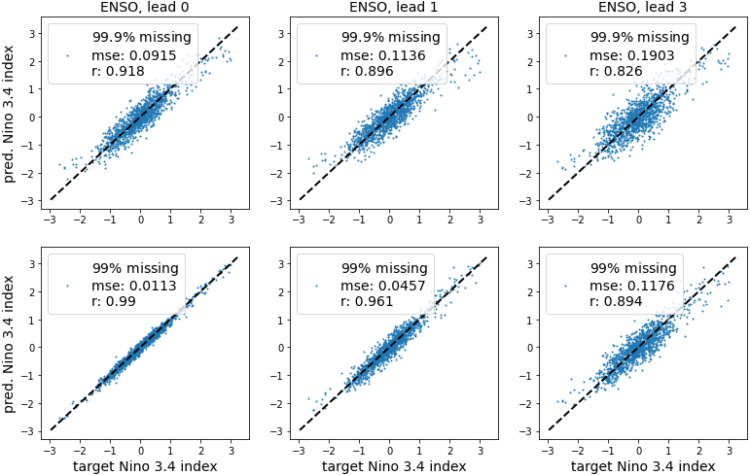
A
B
C
D
E
F

Slide 7
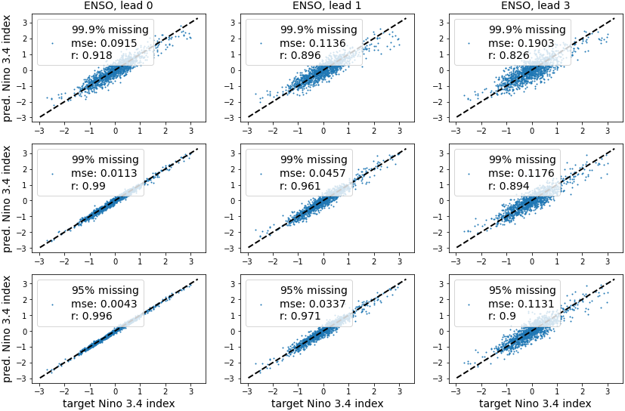
A
B
C
D
E
F
G
H
I

Slide 8
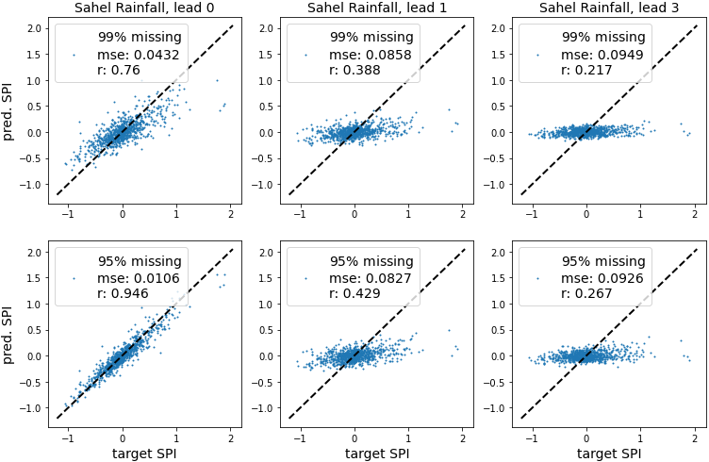
A
B
C
D
E
F

Slide 9
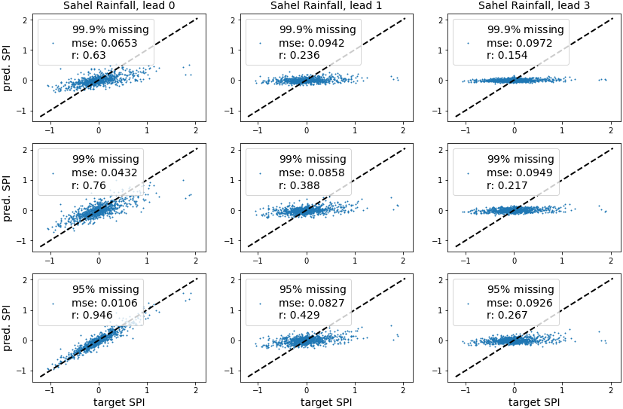
A
B
C
D
E
F
G
H
I

Slide 10
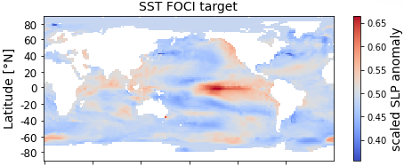
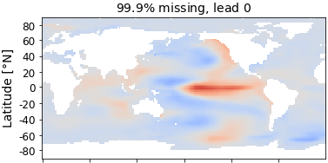
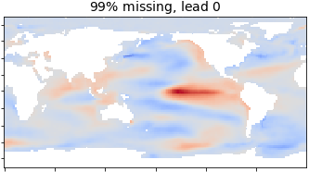
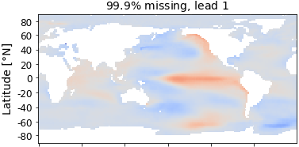
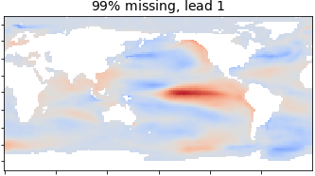
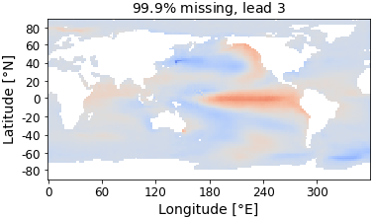
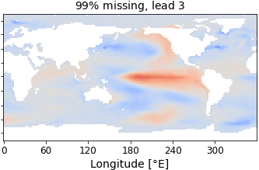
A
B
E
C
F
D
G

Slide 11

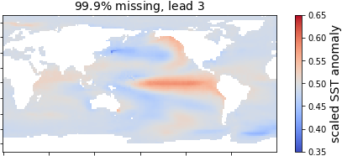
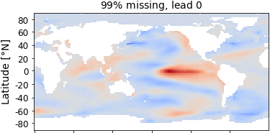
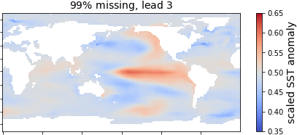
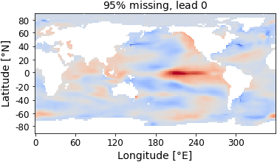
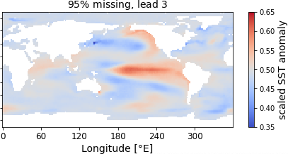
A
B
C
D
E
F
G

Slide 12
A
← correct caption
B
C
D
E
F
G

