Slide 1
Reconstruct Geospatial Data from Ultra Sparse Inputs to Predict Climate Events
Figures for manuscript

Slide 2
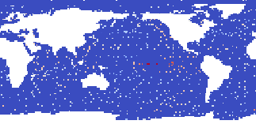
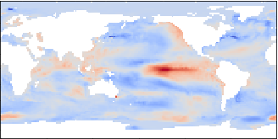




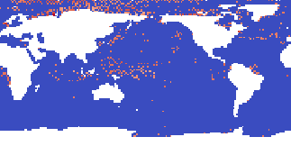
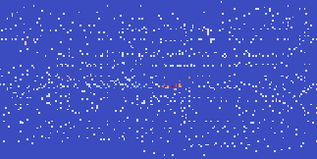
univariate input: SST
time-lagged inputs: SST with lag 0..6 months
multivariate inputs: SLP, SST, Z500, SAT, SSS, PREC
target / output

Slide 3


A
B
C
D
E
F

Slide 4


A
B
C
D
E
F

Slide 5
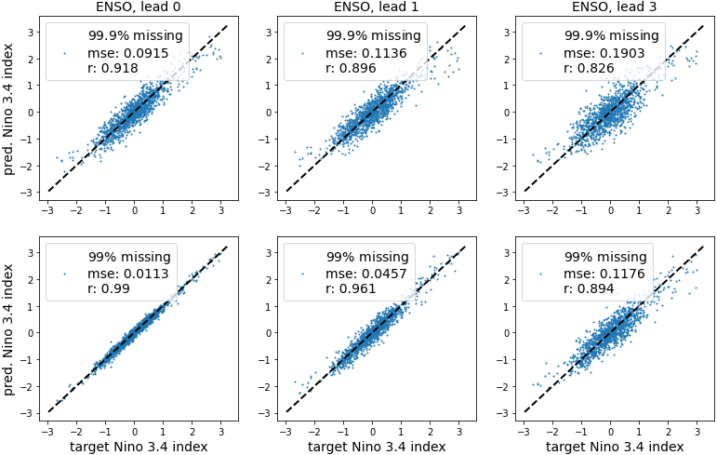
A
B
C
D
E
F

Slide 6
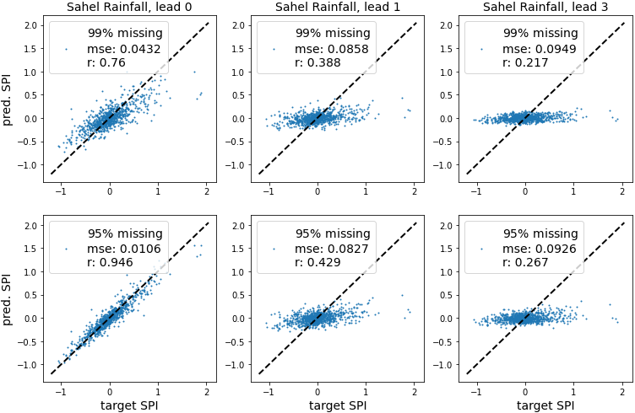
A
B
C
D
E
F

Slide 7
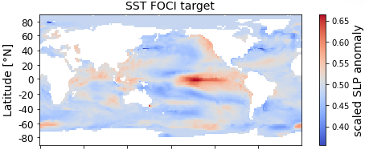
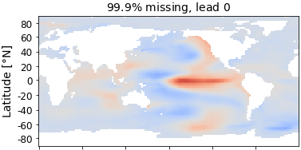
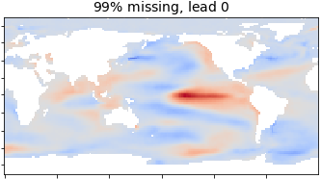
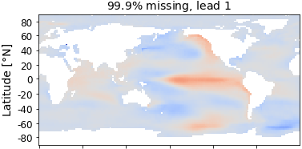
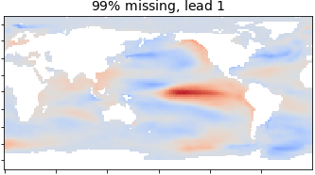
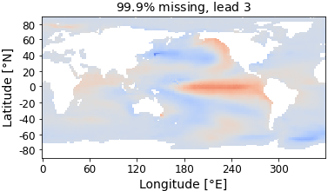
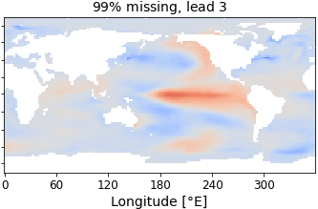
A
B
E
C
F
D
G

