Slide 1
A bottom-up sampling strategy for reconstruction of geospatial data from ultra sparse inputs
Interim results on SLP CESM data and storyline.
Feb, 2nd 2023

Slide 2
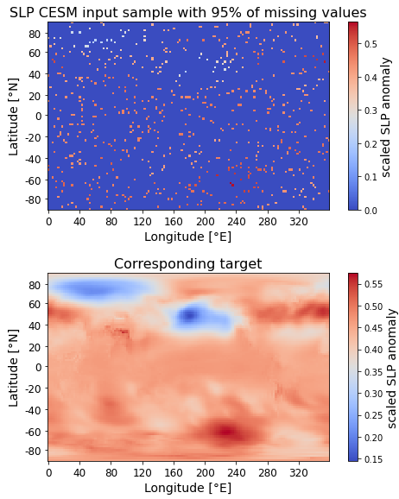
Get an impression of inputs and targets: What do we deal with?
Observational data in climate / ocean context often contains missing values, due to e.g., physical limitations (cloud coverage permits remote sensing) or economic reasons (sparse measurements, limited funding periods for research missions).
Require imputation techniques for post-processing.
Favor ESM data over real world data: Need consistent data over long time span with known ground truth.
Started with monthly 2D sea level pressure (SLP) anomaly fields, as targets. Raw SLP data comes on 96 x 144 latitude-longitude grid, 999 years, 11,988 samples.
Train U-Net models with 4 convolutions on various rates of missing data, from [0.999, 0.99, 0.95, 0.9, 0.75, 0.5], over 10 epochs.
Random masks for missing values can be identical for all samples (‚fixed‘), or individually for each sample (‚variable‘).
For ‚variable‘ masks, allow to use each sample multiple times (data autmentation) according to some factor.
Inputs and targets are scaled to [0,1], since we work with ReLU activations in our CNN model.
Missing values are set to zero, after scaling (zero-inflated).

Slide 3
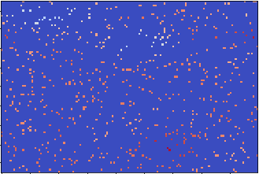
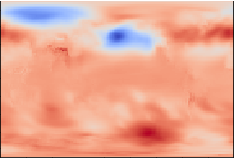
Adopt U-Net from [Xiantao et al., 2022]*
sparse input
2D conv. + ReLU
max Pooling 2x2
up-sampling 2x2
copy
concatenate
1x1 convolution
CNN filters = [64,128,256,512]
CNN kernel size = 5x5
21.6 Mio trainable parameters
*Source [Xiantao et al., 2022]: Nature article "Deep learning for irregularly and regularly missing data reconstruction“ (https://www.nature.com/articles/s41598-020-59801-x)
target / output

Slide 4
Define experiments
mask_type='fixed', augmentation_factor=1: Base experiment, according to szenario to have limited number of measurements from stations, that are fixed in their location. Fast to train, low ressources required. Expect good performance, since U-Net always gets the same grid points as inputs.
mask_type='variable', augmentation_factor=1: Extends base experiment, can handle arbitrary subsets of inputs with fixed rate of missing values in single model. Fits to observations from e.g. argo floats on their trajectory or well suited for e.g. sea surface temperature measurements, where varying cloud coverage limits infrared observations. In its simplest form, use each sample only once. Expect worse performance, compared to base experiment, but increased flexibility.
mask_type='variable', augmentation_factor=2 (exp. 3a) or 3 (exp. 3b): Improve performance by using each input sample multiple times, due to randomness in missing values. Try to reduce overfitting and increase generalization on unseen data. Comes at the expense of increased training time.

Slide 5
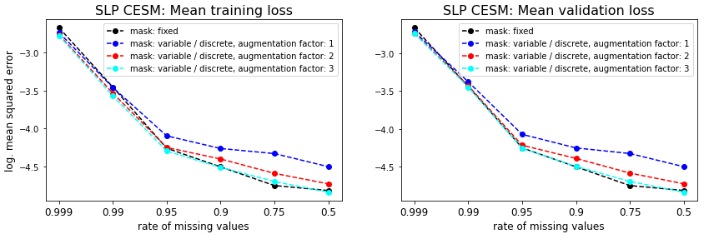
Find the U-Net to act in a reasonable way during training process.
Show mean squared error loss on a logarithmic scale, averaged over three runs with random seeds 1, 2 and 3, used for creating masks for missing values.
Models trained on variable masks can compete with baseline model trained on fixed mask, if we use data augmentation.
We gain the flexibility to freely choose any subset of inputs, at least if we respect the specified rate of missing values, used to train the model.

Slide 6
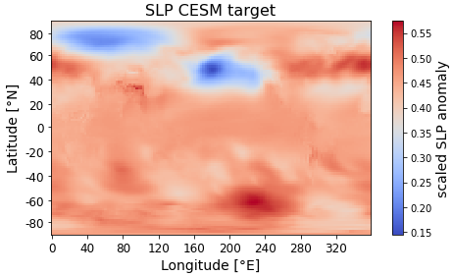
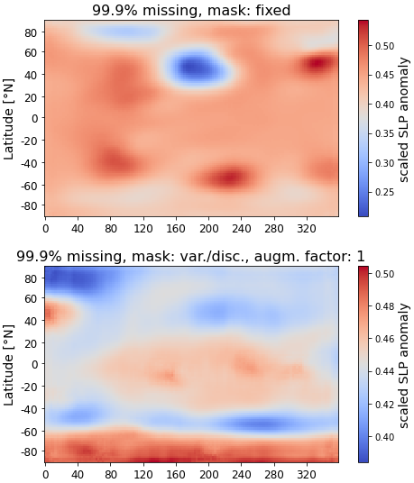
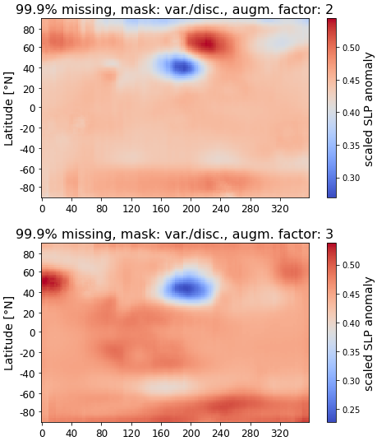
Look at the reconstructions from all models on ultra sparse inputs with 99.9% and 99% missing values:
Poor reconstruction on 99.9% missing values.

Slide 7
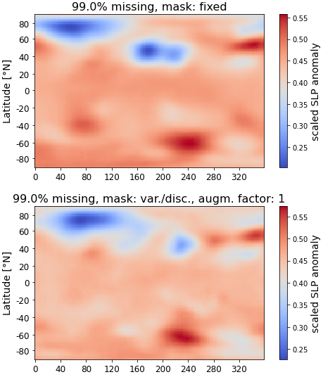
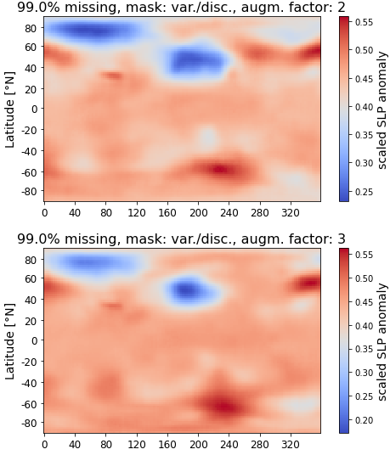
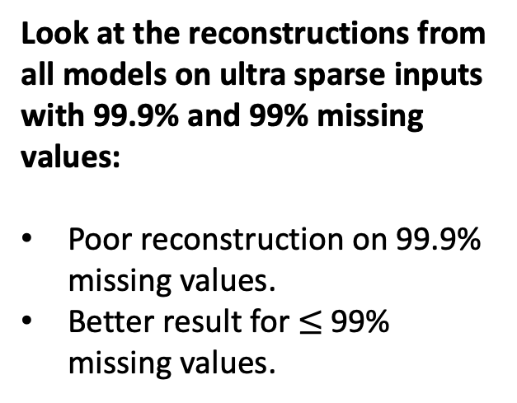
Look at the reconstructions from all models on ultra sparse inputs with 99.9% and 99% missing values:
Poor reconstruction on 99.9% missing values.
Better result for $≤$99% missing values.

Slide 8
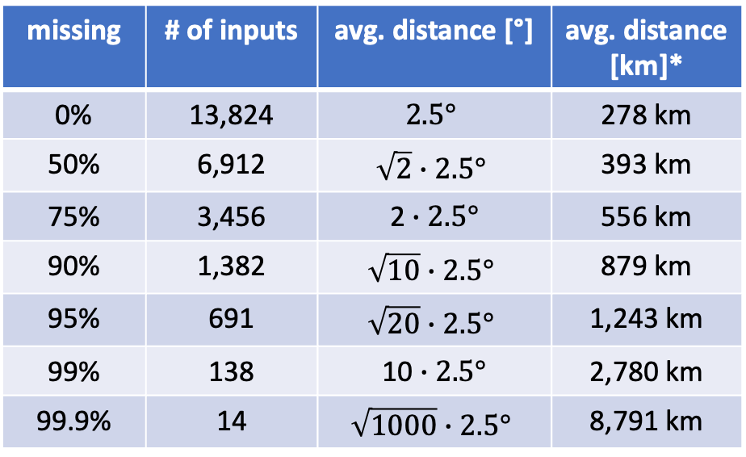
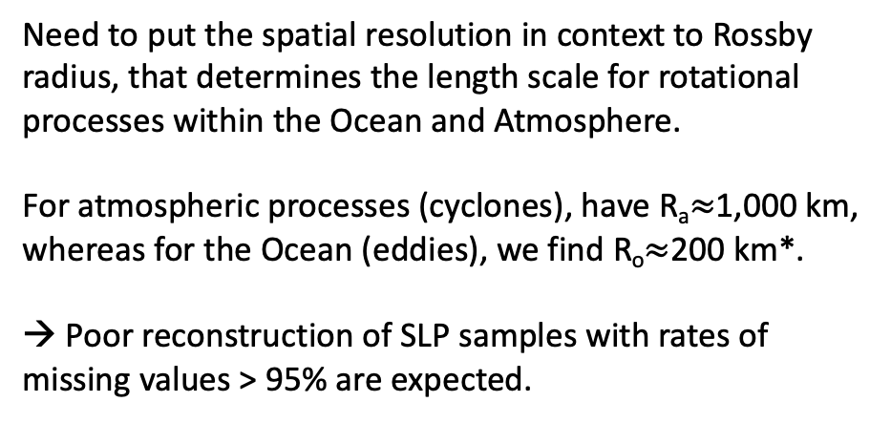
Some words on minimal resolution, related to rate of missing values
We have samples on a 1.875° x 2.5° latitude-longitude grid. That gives us 96 x 144 $=$ 13,824 grid points.
The minimal spatial resolution depends on the rate of missing values, as follows:
missing | # of inputs | avg. distance [°] | avg. distance [km]*
0% | 13,824 | $$2.5°$$ | 278 km
50% | 6,912 | $$\sqrt{2}∙2.5°$$ | 393 km
75% | 3,456 | 2 $∙2.5°$ | 556 km
90% | 1,382 | $$\sqrt{10}∙2.5°$$ | 879 km
95% | 691 | $$\sqrt{20}∙2.5°$$ | 1,243 km
99% | 138 | 10 $∙2.5°$ | 2,780 km
99.9% | 14 | $$\sqrt{1000}∙2.5°$$ | 8,791 km
Need to put the spatial resolution in context to Rossby radius, that determines the length scale for rotational processes within the Ocean and Atmosphere.
For atmospheric processes (cyclones), have R_{a}$≈$1,000 km, whereas for the Ocean (eddies), we find R_{o}$≈$200 km*.
→ Poor reconstruction of SLP samples with rates of missing values > 95% are expected.
*in longitude direction, depending on latitude, here: close to equator

Slide 9
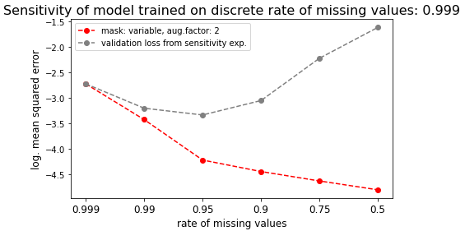
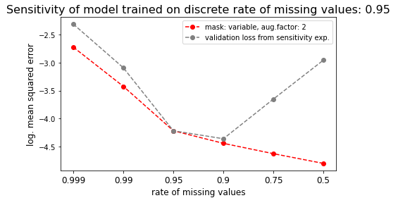
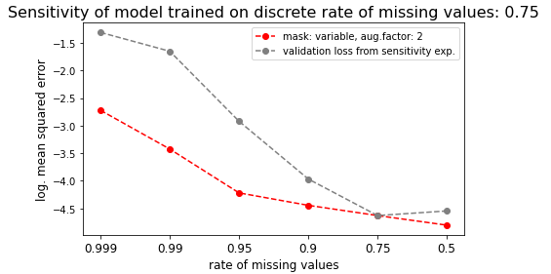
Investigate Sensitivity of models,
trained on discrete rate of missing values
In this experiment, we use models trained on variable masks with data augmentation (factor 2) on discrete rates of missing values.
Obtained minimum loss from previously mentioned three runs are shown in red.
These models allow arbitrary subsets of inputs.
But these models are sensitive if inputs violate the discrete rate of missing values, used to train the models.
Here, we feed validation samples with various discrete rates of missing values into model, that have been pre-trained on samples with a single rate of missing values. Resulting loss is shown in grey.
Expecially the model trained on ultra sparse inputs (99.9% missing) fails for inuts violating this rate.

Slide 10
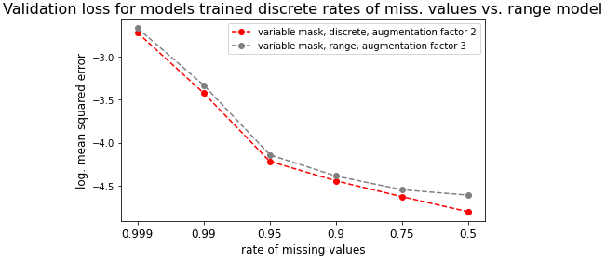
Train model on range of missing values to gain maximum flexibility
A straightforward idea to gain maximum flexibility is to train a model on the full range of rates of missing values [0.5, 0.999]. To increase performance in terms of generalization capabilities, we use data augmentation (factor 3).
This model can compete with our former model trained on variable discrete masks of missing values and data augmentation (factor 2).
It allows not only to choose any subset of inputs, but also allows for varying rates of missing values in the whole range of interest.

Slide 11
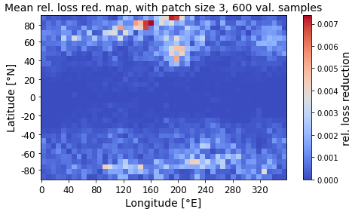
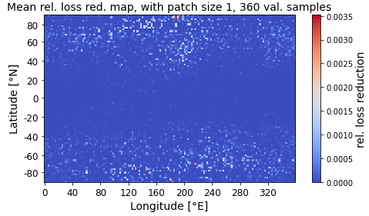
Aim to find the optimal sampling strategy for ultra sparse inputs
Our range model allows not only to choose any subset of inputs, but also allows for varying rates of missing values in the whole range of interest. → Make use of that maximum flexibility!
Try to identify grid points with highest relevance for successful reconstruction.
Successively add rectangular patches of given patch size or – for patch size = 1 – add grid points.
Track patches (or grid points) with maximum loss reduction, relative to the difference of mean state loss and minimum loss, where ‚mean state loss‘ is obtained from model prediction on empty sample, and ‚minimum loss‘ denotes the loss obtained from model prediction on complete sample.
Maps of rel. loss reduction can be shown as heat maps and give an intuitive visual understanding of which areas are most relevant for reconstructing complete information from sparse inputs.

Slide 12
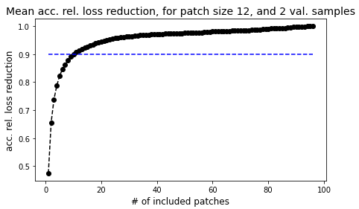
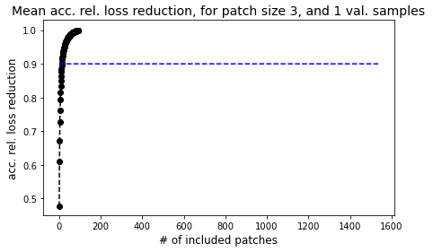
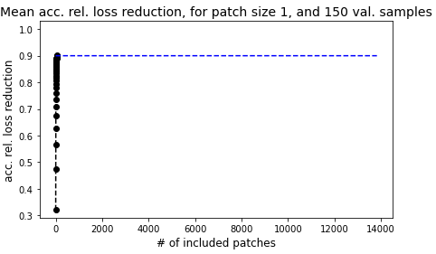
Aim to find the optimal bottom-up sampling strategy for ultra sparse inputs
Successively add patches, optionally stop, if accumulated rel. loss reduction exceeds threshold, here: 90%. (This is mandatory for patch size < 3, due to exploding run time!)
Show accumulated rel. loss reduction over number of included patches. (→ Reminds of accumulated expressed variance in EOF analysis, keep that in mind!)
Find substantial contribution of first patches.
In case of patch size = 1, need on average 23 patches (= grid points), to obtain 90% loss reduction. Reconstruction from only 23 grid points means 99.83% of missing values.

Slide 13
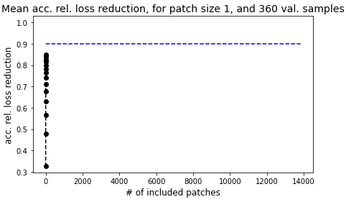
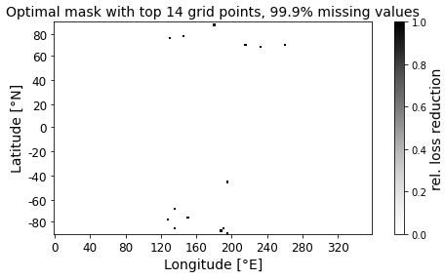
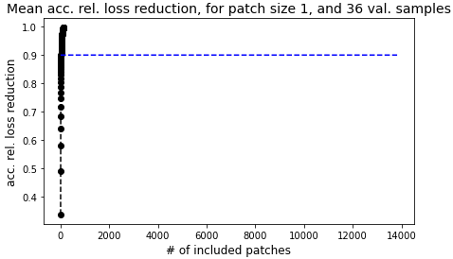
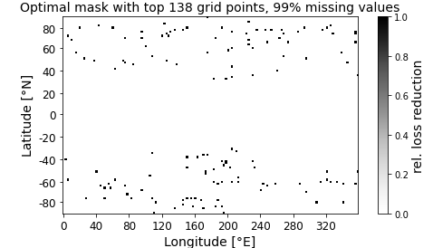
Aim to find the optimal bottom-up sampling strategy for ultra sparse inputs
Refine stopping criterion: Stop after fixed number of grid points, here: 14 or 138 (relates to 99.9% or 99% missing values.
Reach about 85% and almost 100% rel. loss reduction with first 14 and 138 out of 13,824 total grid points.

Slide 14
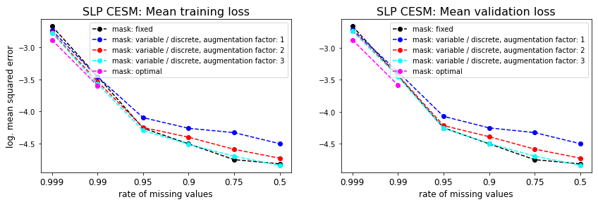
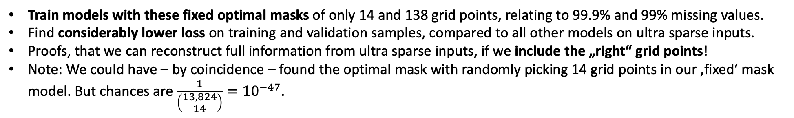
Aim to find the optimal bottom-up sampling strategy for ultra sparse inputs
Train models with these fixed optimal masks of only 14 and 138 grid points, relating to 99.9% and 99% missing values.
Find considerably lower loss on training and validation samples, compared to all other models on ultra sparse inputs.
Proofs, that we can reconstruct full information from ultra sparse inputs, if we include the „right“ grid points!
Note: We could have – by coincidence – found the optimal mask with randomly picking 14 grid points in our ‚fixed‘ mask model. But chances are $\frac{1}{\left(\begin{aligned}13,824 \\ 14\end{aligned}\right)}={10}^{−47}$.

Slide 15
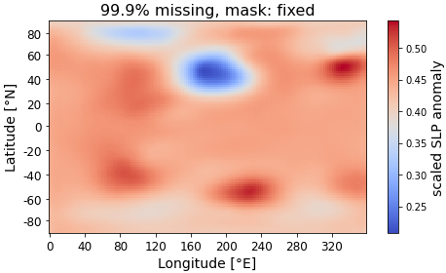
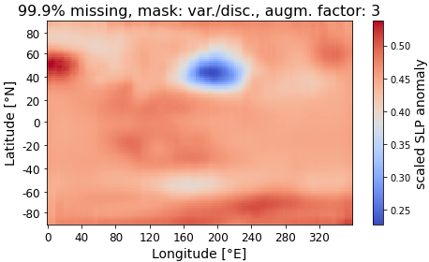
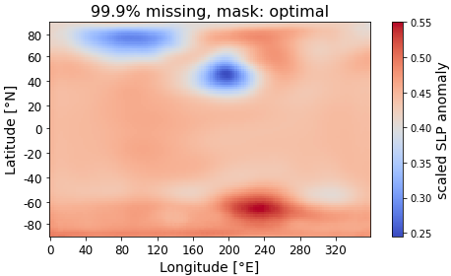
Aim to find the optimal bottom-up sampling strategy for ultra sparse inputs
Train models with these fixed optimal masks of only 14 and 138 grid points, relating to 99.9% and 99% missing values.
Find considerably lower loss on training and validation samples, compared to all other models on ultra sparse inputs.
Proofs, that we can reconstruct full information from ultra sparse inputs, if we include the „right“ grid points!

Slide 16
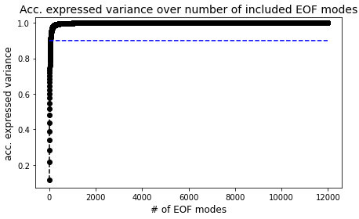
Degrees of freedom: Can we build a bridge to EOF modes?
Remember, that accumulated rel. loss reduction resembles accumulated expressed variance in EOF analyses.
That points to only a limited number of degrees of freedom in SLP fields or high correlation among various grid points.
Compute EOF modes for SLP anomaly fields.
Exceed 90% of expressed variance for 47 included EOF modes, compared to needing 23 grid points to surpass 90% of rel. loss reduction.

Slide 17
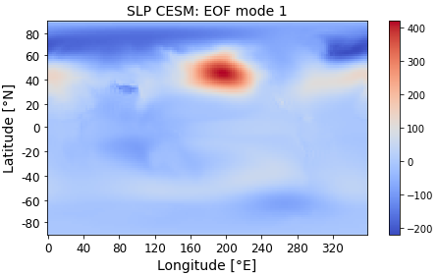
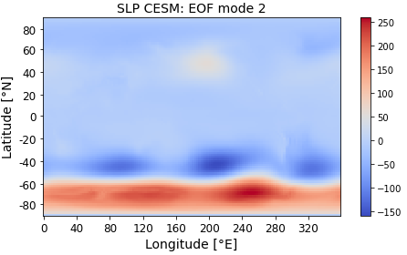
Degrees of freedom: Can we build a bridge to EOF modes?
Find eye-catching similarities of mean rel. loss reduction map (here: patch size = 3) and first two EOF modes.
Both share the same prominent structures.
Is that physically reasonable? Or just coincidence?

Slide 18
Degrees of freedom: Can we build a bridge to EOF modes?
Find eye-catching similarities of mean rel. loss reduction map (here: patch size = 3) and first two EOF modes.
Both share the same prominent structures.
Is that physically reasonable? Or just coincidence?

Slide 19
Missing experiments for SLP CESM samples:
As evaluation metric (or uncertainty measure), compare several climate indices, computed on reconstruction vs. complete samples. → mse, correlation?
And open the black bock: Pick single samples and visualize selected feature maps of U-Net in all stages. Investigate, how model reconstructs complete information. Also visualize patches, that lead to TOPn activations.

Slide 20
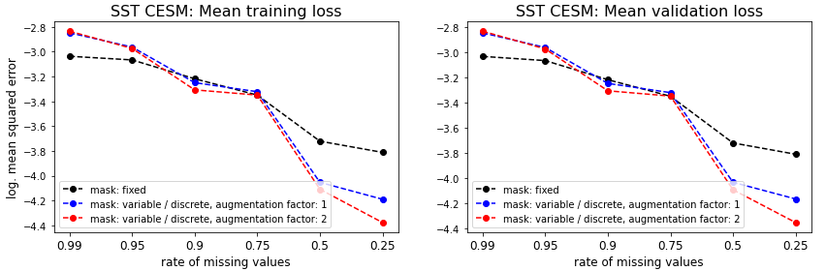
Next: Investigate sea surface temperature (SST) anomaly fields from CESM
On the first sight: For reconstruction of SST samples, we need more inputs!
This is expected, due to smaller spatial scales for processes in the Ocean, compared to the atmosphere.

