Slide 1
A bottom-up sampling strategy for reconstruction of geospatial data from ultra sparse inputs
Figures for manuscript

Slide 2
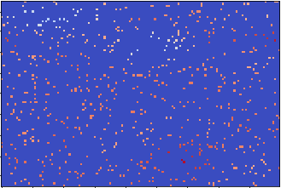
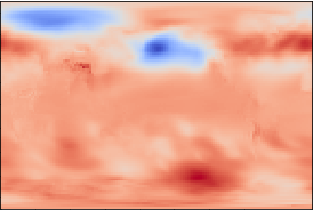


















sparse input
2D conv. + ReLU
max pooling 2x2
upsampling 2x2
copy
concatenate
1x1 convolution
$$N_{lat}×N_{lon}$$
$$\frac{N_{lat}}{2^{1}}×\frac{N_{lon}}{2^{1}}$$
$$F_{1}$$
$$\frac{N_{lat}}{2^{2}}×\frac{N_{lon}}{2^{2}}$$
$$F_{2}$$
encoder
$$\frac{N_{lat}}{2^{3}}×\frac{N_{lon}}{2^{3}}$$
$$F_{3}$$
$$F_{4}$$
$$F_{3}+F_{4}$$
decoder
$$F_{2}+F_{3}$$
$$F_{3}$$
$$F_{1}+F_{2}$$
$$F_{2}$$
$$F_{1}$$
$$F_{2}$$
$$F_{3}$$
$$F_{4}$$
$$F_{1}$$
CNN filters = [64,128,256,512]
CNN kernel size = 5x5
target / output

Slide 3
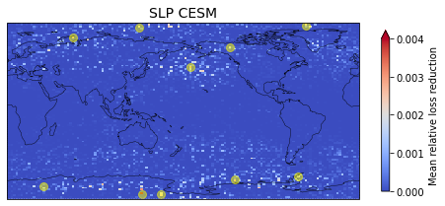
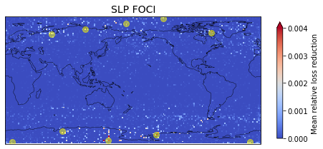
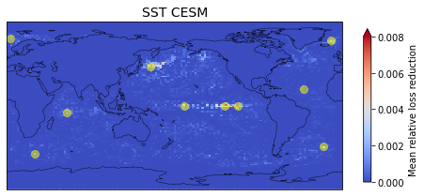
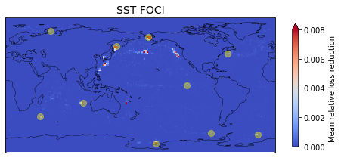
A
B
C
D

Slide 4
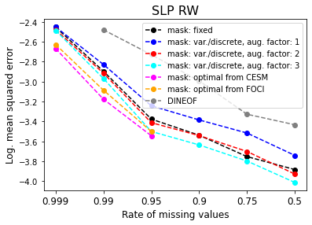
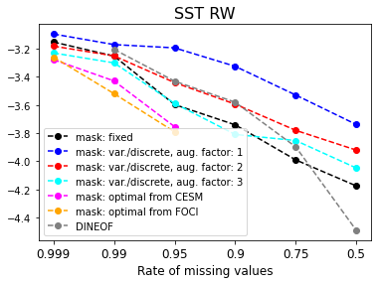

Slide 5
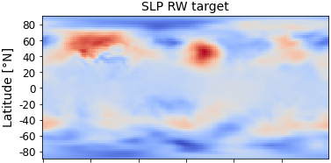
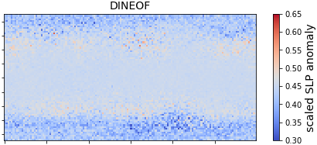
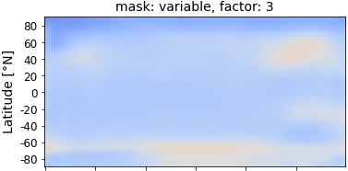
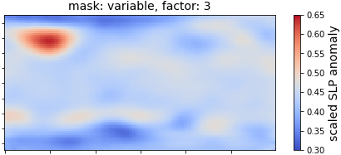
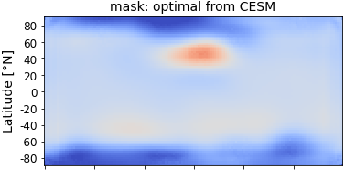
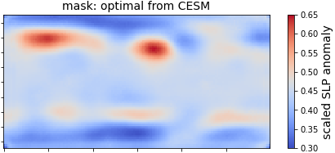
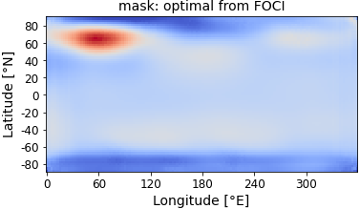
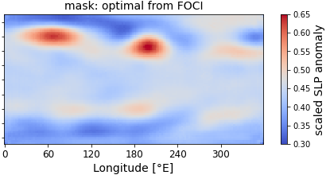
A
E
B
F
C
G
D
H

Slide 6
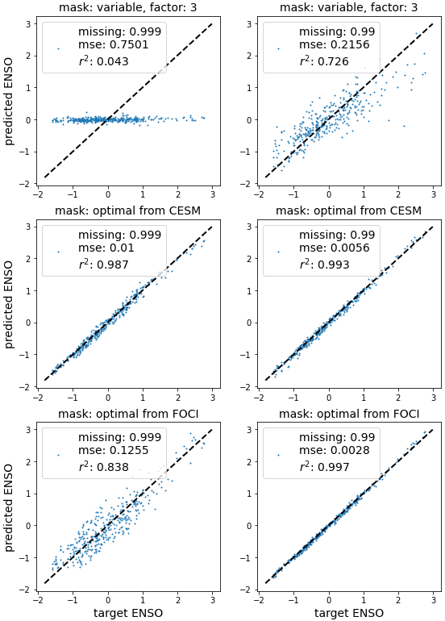
A
D
B
E
C
F

Slide 7
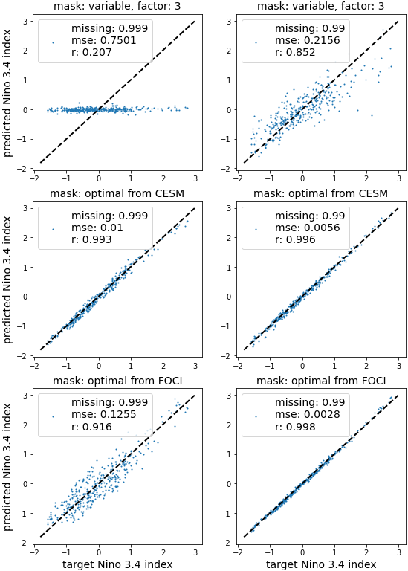
A
D
B
E
C
F

Slide 8
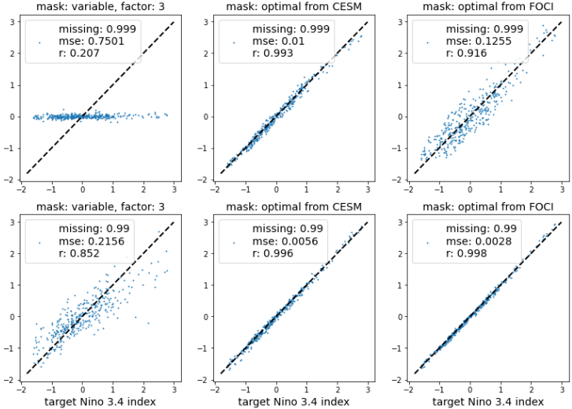
A
C
E
B
D
F

