Slide 1
Introduction to Machine Learning and Optimization
Marco Laudato – KTH Department of Engineering Mechanics
MOGE 2026, Napoli (IT), 26th March 2026

Slide 2

Overview of the lectures
We will cover the following curriculum:
(Github repo: https://github.com/MarcoLaud/VP2024/tree/main/VP2025):
Introduction and motivation to scientific machine learning
Neural Networks and architectures
Regression problems
Optimization
Learning goals:
Understand basics of neural networks and their application
Understand basics of optimization
Train your first code-free neural network in Grasshopper

Slide 3
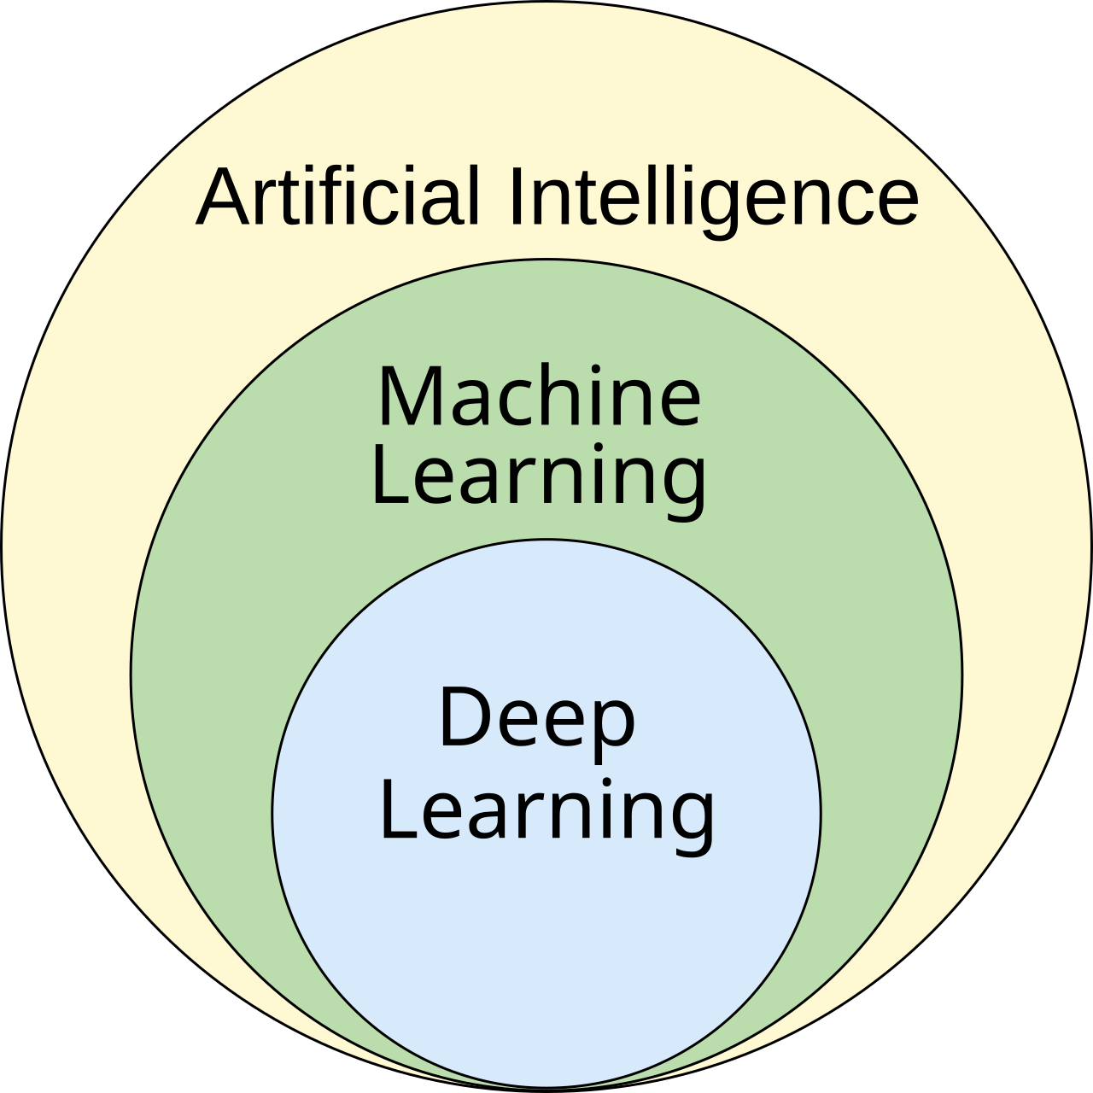
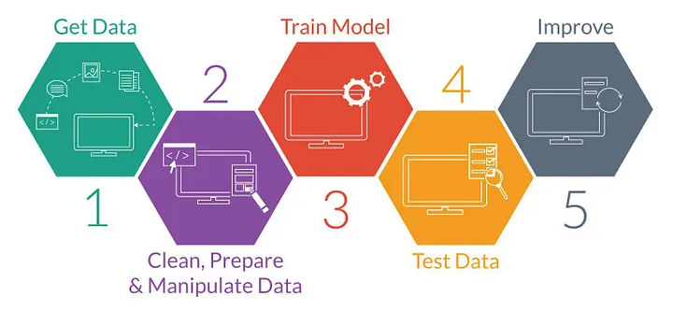
What is Machine Learning?
Machine Learning concerns training computers to learn from data and make predictions.
The term was coined in 1959 (!) by Arthur Samuel (IBM).
Applications: healthcare (e.g., diagnosis), finance (e.g., algorithmic trading), transportation (e.g., autonomous vehicles), daily life (e.g., LLMs).

Slide 4
MODULE 1 INTRODUCTION TO NEURAL NETWORKS

Slide 5
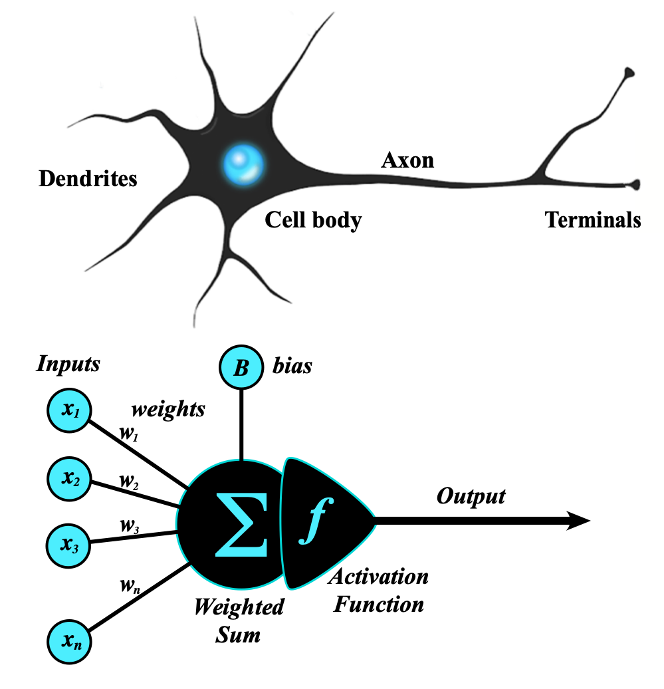
Neural Networks - Neurons
Neural networks (NNs) are computational models inspired by the human brain's network of neurons.
Neurons are the fundamental units of neural networks that process data.
Weights determine the strength of the connection between neurons. They are adjusted during the training.
Activation functions introduce non-linearity in the model.
Tutorial 1

Slide 6
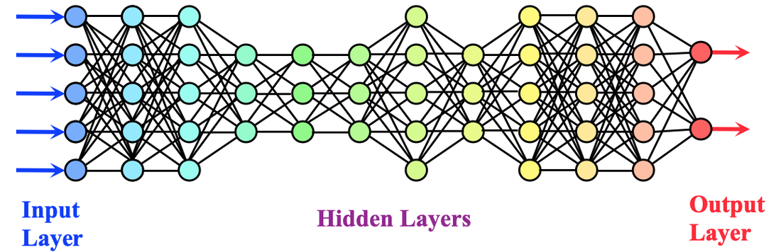
Fully connected neural network
Neural networks are composed of several layers of neurons.
Neural networks take an input and yield and output → they approximate functions!
PROBLEM: how do I find the optimal weights for so many neurons?

Slide 7
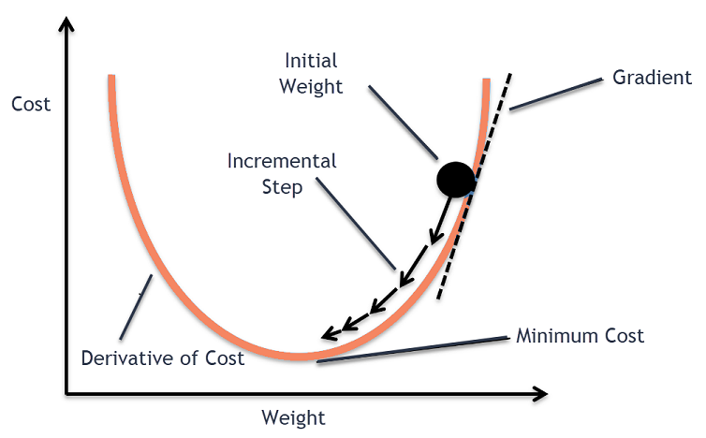
Gradient descent
Finding the optimal weights is an optimization problem!
We must define a cost function.
Optimal weights
Tutorial 1

Slide 8
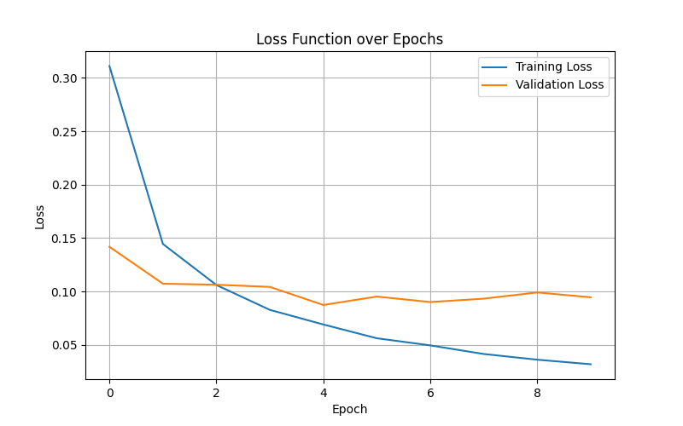
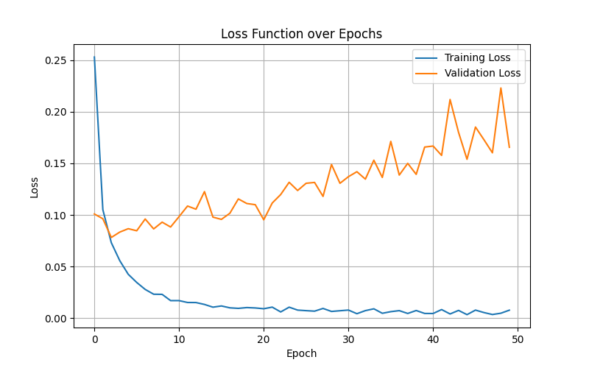
Be aware of overfitting
Overfitting occurs when a neural network learns the details and noise in the training data to such an extent that it performs poorly on new, unseen data.
Instead of generalizing to capture the underlying patterns in the data, the model becomes overly specialized to the training dataset, resulting in high accuracy on the training data but poor performance on validation or test datasets.
Overfitting can be caused by training for too long (too many epochs!)

Slide 9
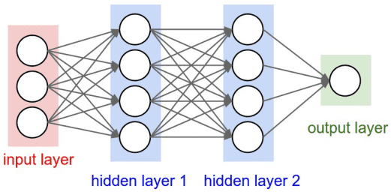
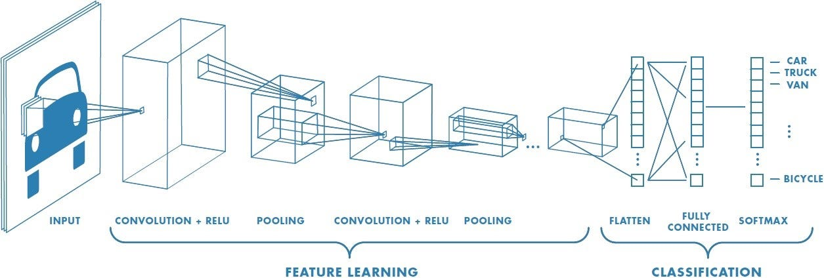
Neural Network Architectures (two examples)
Different arrangements of neurons are called architectures.
Different architectures are designed to be optimal for different tasks.
Feedforward Neural Network:
Fully-connected layers (“perceptron”)
Used for classification and regression tasks
Can approximate functions (!!!)
Convolutional Neural Network:
Convolutional layers (filters)
Used for processing visual data
Used in facial recognition and medical images

Slide 10

What are they good at?
Real-world applications:
Identification of objects, facial recognition, medical diagnostics, autonomous vehicles.
Natural Language Processing:
Understand human language, chatbots, language translation, sentiment analysis
Applications in architecture:
Generative design, structural analysis, building information modelling (BIM)
Applications in acoustics:
Acoustic feature recognition, shape optimization, and more on the second module…

Slide 11


What are they bad at?
Neural networks often require large amounts of high-quality data
NNs require significant computational power (bad for the environment and time-consuming)
Overfitting: the model cannot generalise and perform poorly on unseen data.
NNs are difficult to interpret and are usually seen as “black boxes”.

Slide 12
MODULE 2 INTRODUCTION TO REGRESSION PROBLEMS AND OPTIMIZATION

Slide 13
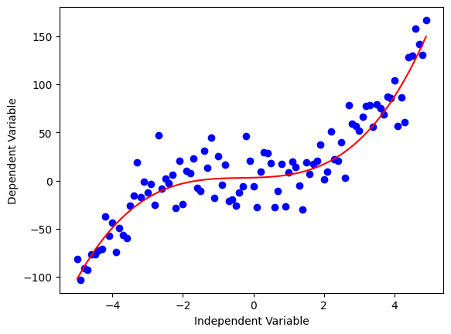
What is a regression problem?
Regression is a type of supervised learning task where the goal is to predict a continuous (real-valued) output from one or more input features.
Examples: House price prediction, Weather forecasting, Daylight in a room, Acoustic Reverberation Time.
Neural networks learn a continuous mapping from inputs to outputs by minimizing a suitable loss across a training set, then generalize to new data.
Example: the model learns (from past data) how to associate window size to daylight level in a room. The noise is due to windows orientation and weather. Then it generalizes to present and future data.

Slide 14
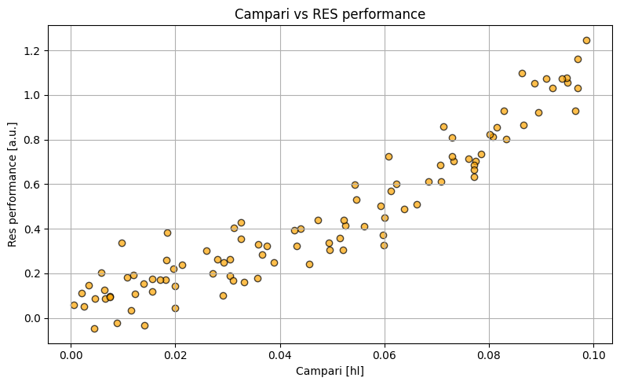
Linear regression
We must decide how to model the data:
Linear function:
Quadratic function:

Slide 15
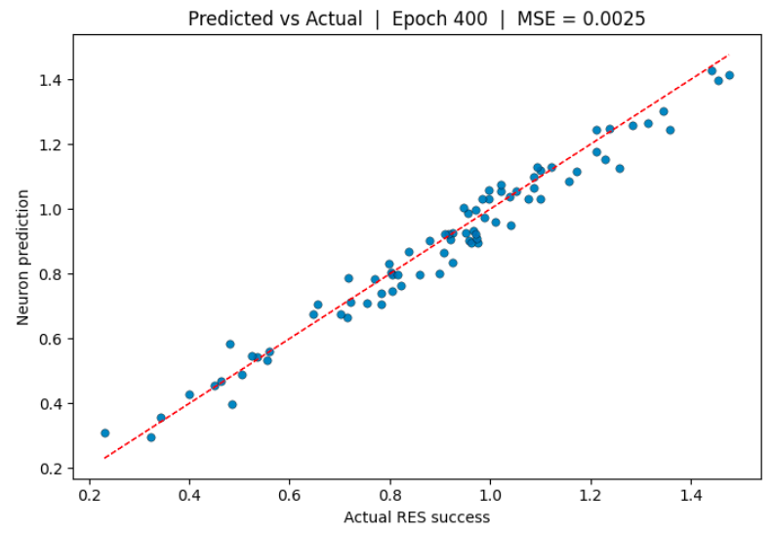
NOT TO BE CONFUSED !!
Parity plot
Regression

Slide 16
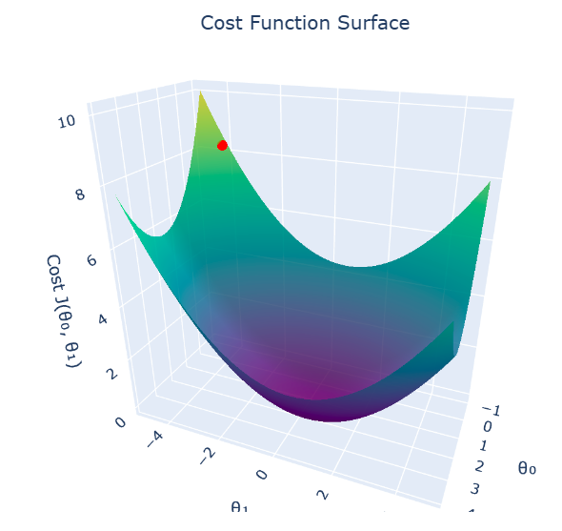
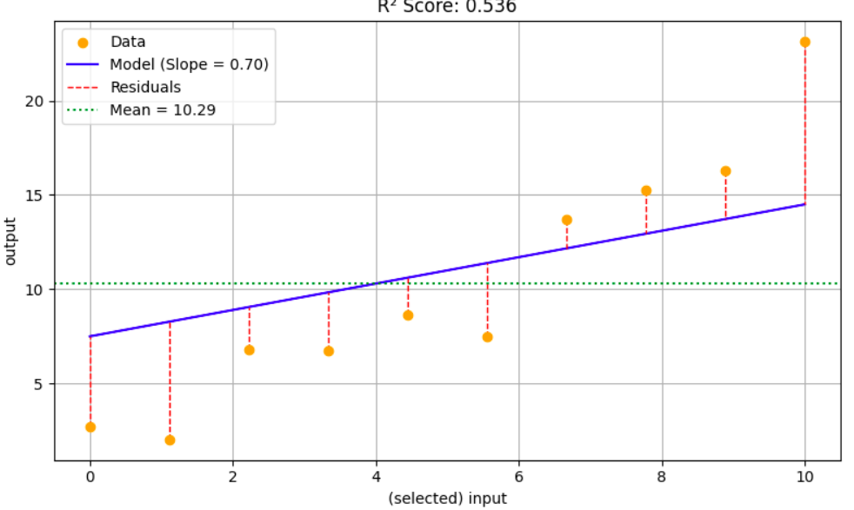

Linear regression: cost function
The goal is to identify the parameters (m,q) that best explain the data.
Minimizing the cost
Gradient descent
Optimal parameters (m,q)
Tutorial 2

Slide 17
MODULE 3 CASE STUDY: Neural network model of a reverberation time in a shoebox

Slide 18
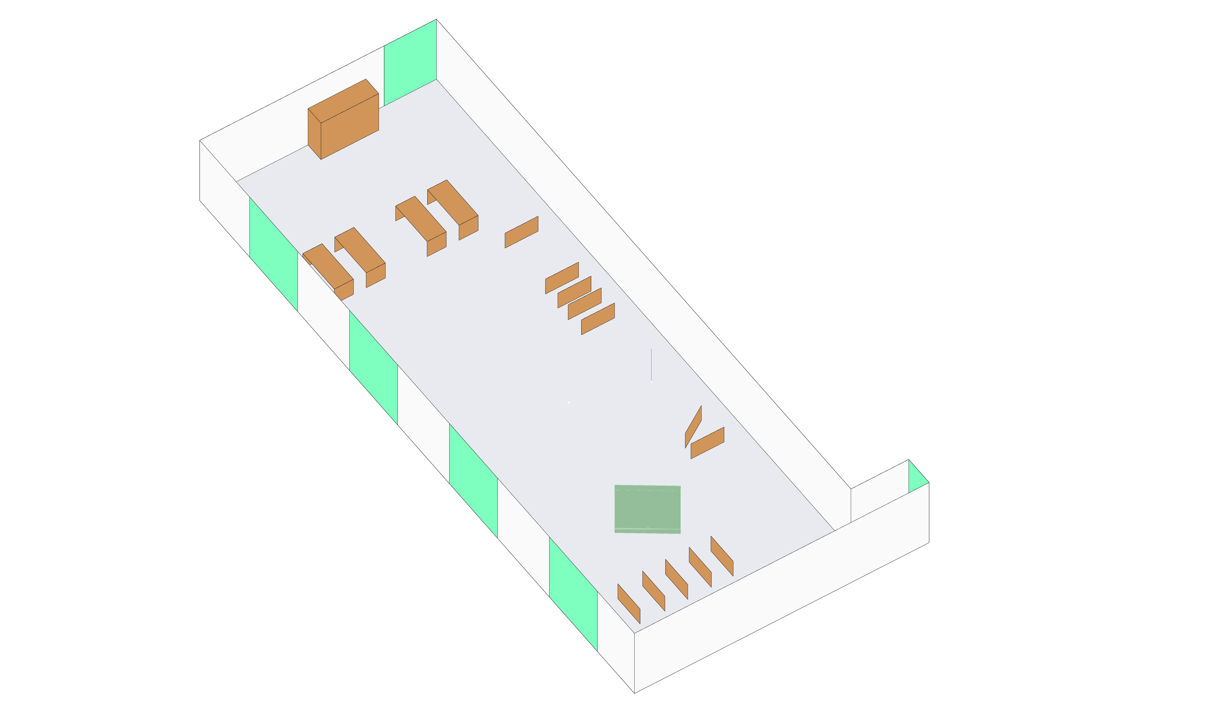
Case study: acoustic reverberation time
We will use a neural network to determine the reverberation time of a shoebox, given the position of an acoustic absorption panel.
Input: position (x,y) of the acoustic absorption panel; room geometry (implicit!).
Output: reverberation time at 500 Hz.
We will use a Neural Network to solve this problem!

Slide 19
Surrogate models
The main idea is to replace Pachyderm with a surrogate (the neural network):
Once trained the neural network can replicate Pachyderm’s results in a fraction of a second!
The neural network is solving a regression problem (yields reverberation time by moving the panel)
INPUT
Panel position (x,y)
Pachyderm
OUTPUT
e.g., reverberation time
NN

Slide 20
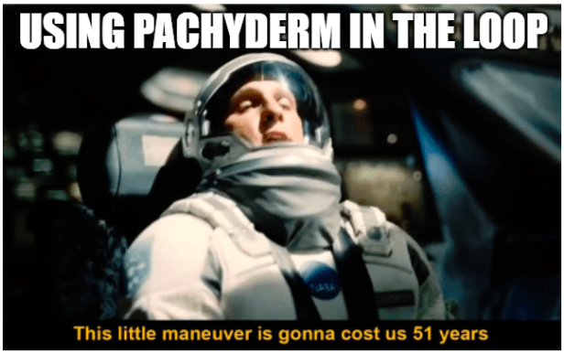
Fast optimization with neural networks
Since the neural network surrogate is orders of magnitude faster than Pachyderm, we can use it in an optimization loop.
Optimization problem: how to find the position of the panel that minimizes the reverberation time?
Optimization loop:
Place the panel;
Compute the reverberation time;
IF increases: move the panel in the OPPOSITE direction
IF decreases: move the panel in the SAME direction
Repeat
It can take thousands of iterations to find the optimal position! If we use Pachyderm each time the problem would become unpractical.
With a neural network surrogate the optimization becomes feasible: you know where to put the panel!

Slide 21
MODULE 4 Neural Network Implementation in PUG (GH)

Slide 22

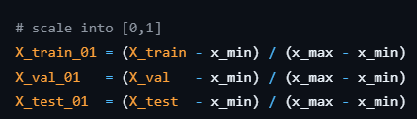
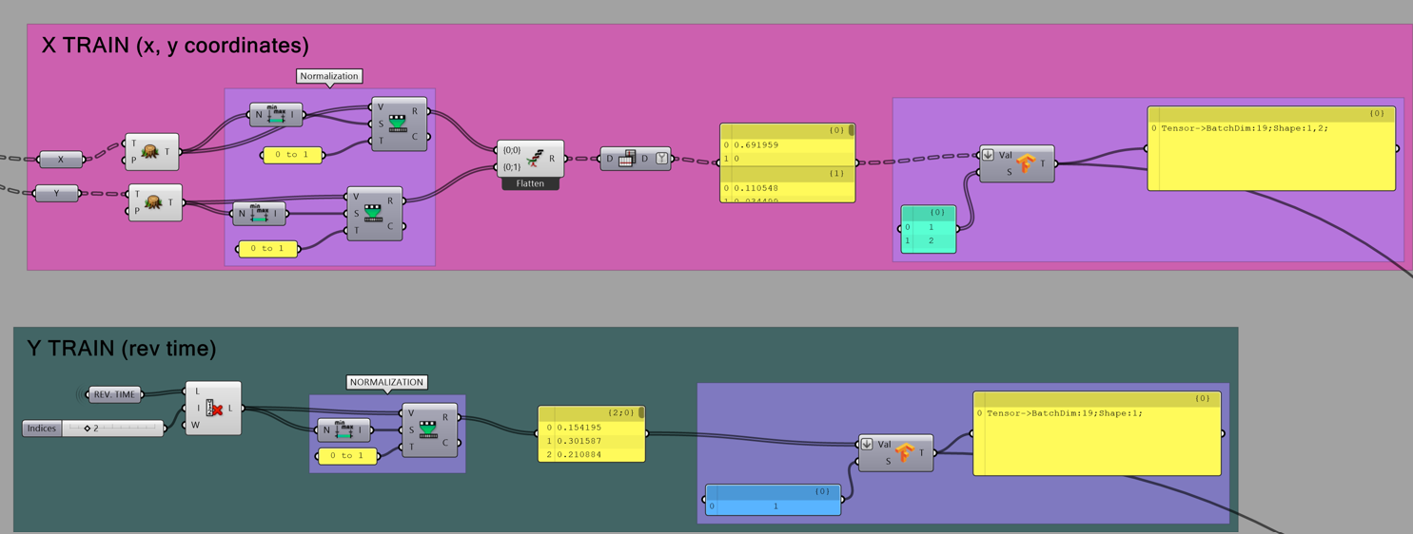
1. Data pre-processing
The first step is to load the dataset. Usually, this step come after the production of the dataset. In our case it is pre-made by us (see GitHub repo).
Third step is to Normalize the training dataset: all the values are in the range [0,1]
The second step is to pre-process the training dataset:
Split the dataset into input and output.

Slide 23
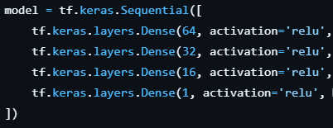
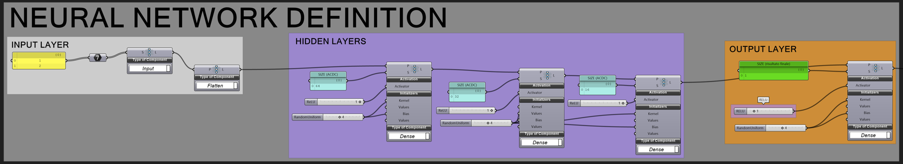
2. Define the neural network architecture
The next step is to build the architecture of the neural network.
The neural network has 5 layers:
Input layer: 2 neurons (to receive x and y of panel position)
Dense layer 1: 64 neurons
Dense layer 2: 32 neurons
Dense layer 3: 16 neurons
Output layer: 1 neurons (reverberation time is one number)

Slide 24
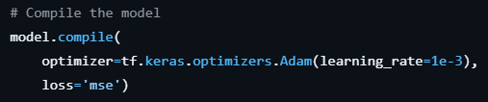
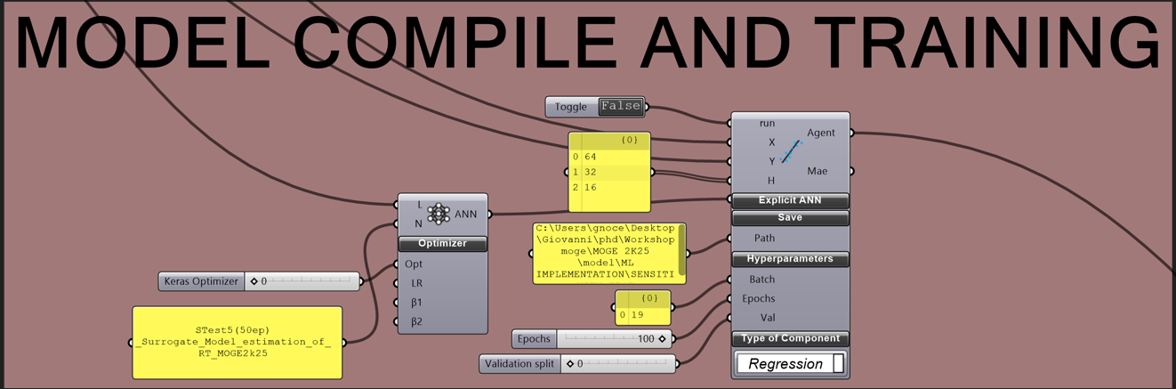
3. Compile the model
We need now to compile the model. This means that we must provide the following information:
Optimizer: Adam (to solve the gradient descent)
Loss function: mean square error
Learning rate: 0.001

Slide 25
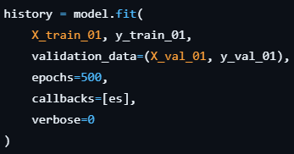
4. Train the neural network
The last step is to train the neural network.
We need to provide the following information:
Inputs (from pre-processing)
Epochs: how many times we must process the dataset
Batch size: how many instances provided at the same time
Gradient descent

Slide 26
Be aware of overfitting
Overfitting occurs when a neural network learns the details and noise in the training data to such an extent that it performs poorly on new, unseen data.
Instead of generalizing to capture the underlying patterns in the data, the model becomes overly specialized to the training dataset, resulting in high accuracy on the training data but poor performance on validation or test datasets.
Overfitting can be caused by training for too long (too many epochs!)

Slide 27
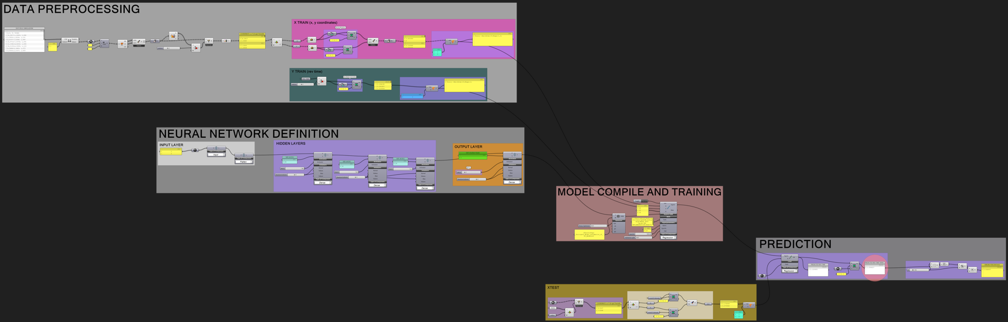
Good luck with your implementation!
Later you will perform the previous steps in Grasshopper to implement a neural network able to compute the reverberation time.
Download this presentation from the repository and check the details of the implementation.
Thanks for your kind attention!
If you have additional questions, ask me, or send me an email at laudato@kth.se .
Ciao!

Slide 28
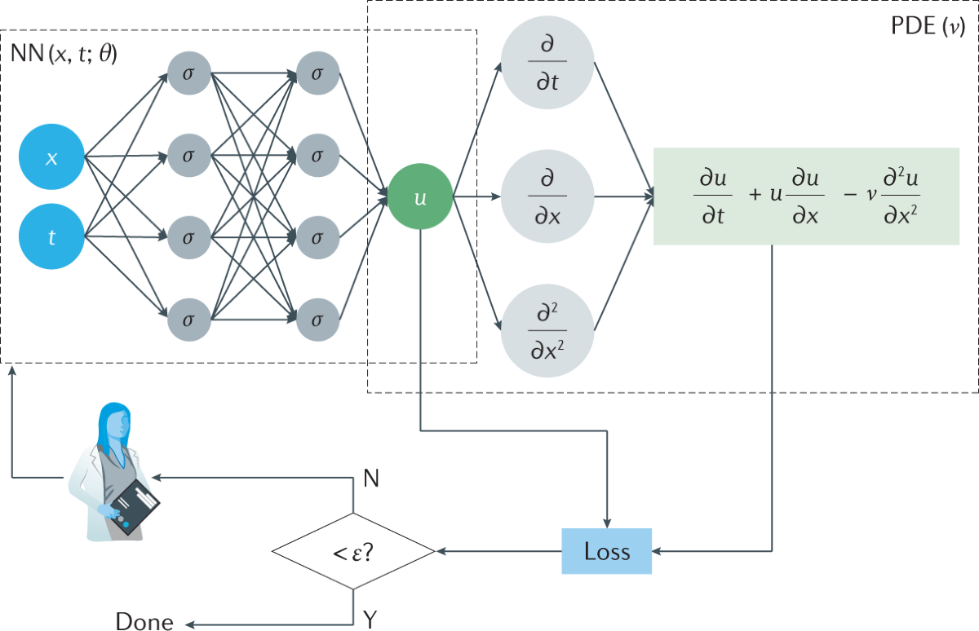
Physics-Informed Neural Network (PINN)
Physics-Informed Neural Networks (PINNs) are a type of neural network that incorporates physical laws and equations into the learning process.
Other kinds of NN do not know the physics of the process they are learning!
Implemented as a FNN (easy!)
MAIN IDEA: NN can approximate functions. We can require these functions to solve a PDE.

Slide 29

Example: 1D Wave Equation
1D Wave Equation:
The function u(x,t) is the displacement of the string
The FNN yields u(x,t)
The loss function enforces the wave function
We will see more in the practical module!

Slide 30


PINN implementation
We will see a Python implementation in detail in the next few days.
PREPARATION for the Python primer:
Install Spyder (https://www.spyder-ide.org/)
Google Colab (https://colab.research.google.com/)

