Slide 1

Critical Energy Infrastructure
Resilience of Critical Infrastructure
Professor : Nasi Greta
Academic Year : 2022 / 2023
Campo Marco Lorenzo - 103213
Grazioli Davide – 992467
Santomauro Carmine - 995752
Savino Matteo - 994779

Slide 2
Prof : Nasi Greta
AY: 2022 / 2023
INDEX
PART 1 : Key Characteristics of the CEI (Critical Energy Infrastructures) 2
KEY CHARACTERISTICS AND RELEVANCE 3
RELEVANCE 4
TRENDS 5
INTERDEPENDENCIES WITH OTHER INFRASTRUCTURES 6
MAIN KNOWN ATTACKS 7
WHAT IS AT RISK? 8
PART 2 : Regulative Frameworks 9
EU STRATEGY FOR RESILIENCE 10
STAKEHOLDERS INVOLVEMENT 11
KEY REGULATORY FRAMEWORKS (1/2) 12
KEY REGULATORY FRAMEWORKS (2/2) 13
RISK ASSESSMENT MODELS AND ISO STANDARDS 14
PART 3 : Assets and Vulnerabilities 15
ASSETS 16
VULNERABILITIES 17
THREATS 18
RELIABLE DATA SOURCES 19
PART 4 : Recommendations for the CI 20
SECURITY AND RESILIENCY 21
SUSTAINABILITY AND GREEN 22
DO NOT FORGET STAKEHOLDERS! 23
THANKS 24
REFERENCES 25
1

Slide 3
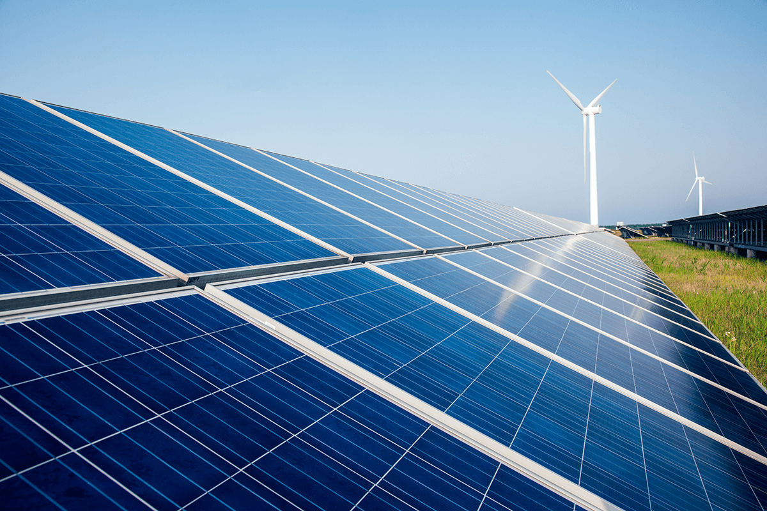
Prof : Nasi Greta
AY: 2022 / 2023
1. Key Characteristics of the CEI (Critical Energy Infrastructure)
2

Slide 4
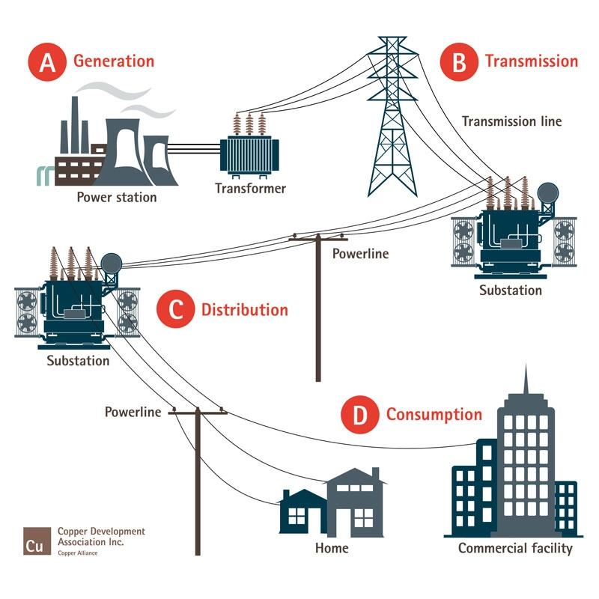
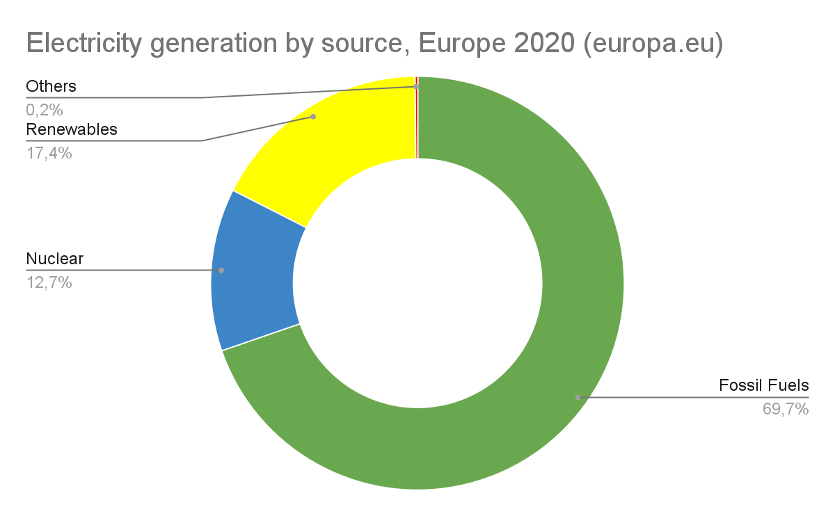
Prof : Nasi Greta
AY: 2022 / 2023
KEY CHARACTERISTICS
Power Stations
- Fossil Fuels
- Nuclear
- Renewables
Transmission Lines
Control Centers
3
Notes:
The Energy infrastructure is composed by three main structures: power station, transmission lines and control centers. Power stations transform the primary energy (including nuclear energy, fossil energy -- like oil, coal and natural gas -- and renewable sources like wind, solar, geothermal and hydropower) into electricity. Transmission lines serve two primary purposes: They move electricity from generation sites to customers and they interconnect systems. A transmission substation located near a power plant uses large transformers to increase the voltage to higher levels. At the other end of the transmission line, a substation uses transformers to step transmission voltages back down to distribution voltages so the electricity can be distributed to customers. Control centers have sophisticated monitoring and control systems and are staffed by operators 24 hours per day, 365 days per year. These operators are responsible for several key functions, including balancing power generation and demand, monitoring flows over transmission lines, planning and configuring the system to operate reliably, maintaining system stability and preparing for emergencies. Operators are helped by Supervisory Control and Data Acquisition Systems (SCADA) and other control systems that monitor the system itself. These electronic systems enable efficient operation and management of electric systems using automated data collection and equipment control. In the EU fossil fuels are the most used primary source.

Slide 5
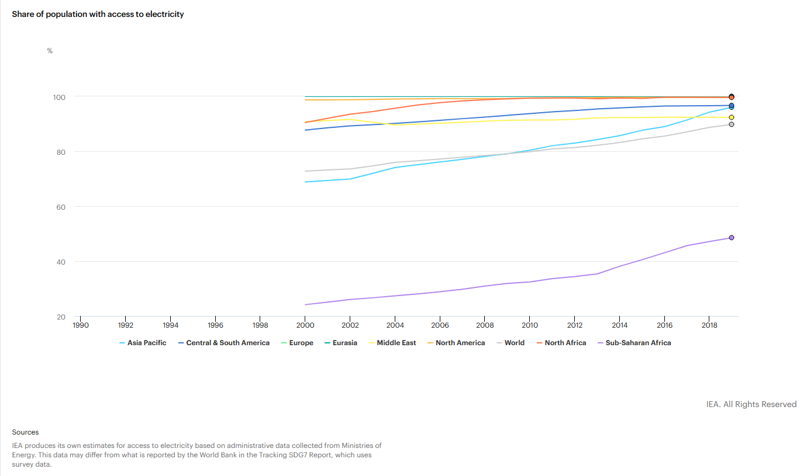
Prof : Nasi Greta
AY: 2022 / 2023
RELEVANCE
89,8%
4
Notes:
The graph, taken from the IEA website, shows the percentage of the population in time with access to electricity. A look at the data clearly shows how important this sector is. In Europe, North America and North Africa, almost all citizens have access to electricity. In Asia-Pacific and Central America, it is about 96% of the population. In last place is sub-Saharian Africa, where 48,5% of the population has access to infrastructure. The global percentage is 89.8%.

Slide 6
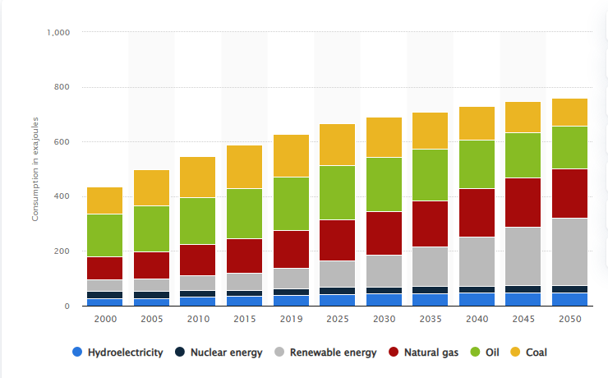
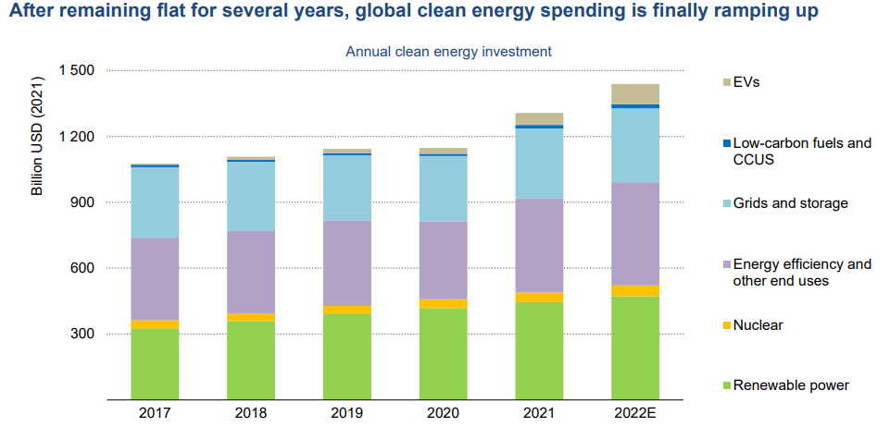
Prof : Nasi Greta
AY: 2022 / 2023
TRENDS
Energy consumption has risen steadily from 2000 to the present, and studies indicate that this increase will continue in the future.
Investments in the energy market in recent years have focused on carbon-free production sources and storage and transportation efficiency
5
Notes:
Key trends show that global energy consumption has steadily increased from 2000 to the present, and studies indicate that this increase will continue in the future. This consistently positive trend underscores the importance of the energy sector. Another important trend is evident in global investment in the energy market graph. Clean energy investment is beginning to pick up and is expected to exceed USD 1.4 trillion in 2022, accounting for nearly three-quarters of the growth in total energy investment. Energy production and use account for more than 75% of greenhouse gas emissions in the EU. Decarbonization and efficiency of the EU energy system is therefore key to achieving the EU's 2030 climate targets and implementing the long-term strategy aiming at carbon neutrality by 2050. For this reason, money has been poured into research to increase the efficiency of energy storage and transport, and there are increasing investments in carbon-free energy sources.

Slide 7
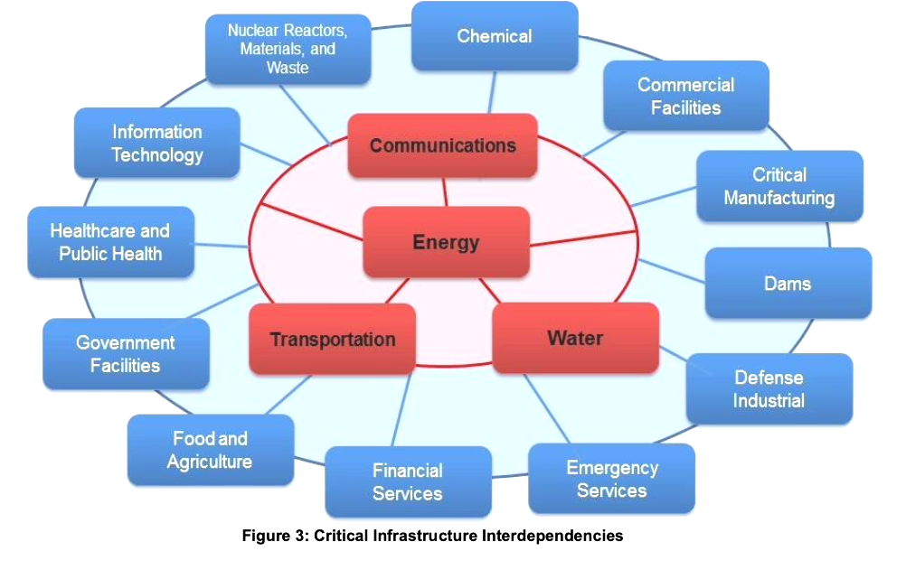
Prof : Nasi Greta
AY: 2022 / 2023
INTERDEPENDENCIES WITH OTHER
INFRASTRUCTURES
6
Notes:
Due to the central role of the energy sector, it becomes crucial to keep the infrastructure continuously working. During the last half of the 20th century, technical innovations and developments in digital information and telecommunications dramatically increased interdependencies among the Nation’s critical infrastructures. Each infrastructure depends on other infrastructures to function successfully. Disruptions in a single infrastructure can generate disturbances within other infrastructures and over long distances, and the pattern of interconnections can extend or amplify the effects of a disruption. There are also interdependencies within the energy infrastructure itself, particularly the dependence of petroleum refineries and pipeline pumping stations on a reliable electricity supply and backup generators and utility maintenance vehicles to be supplied with diesel and gasoline fuel. The interconnectedness of energy infrastructures also cross international borders. Oil and natural gas pipelines and electric transmission lines have helped integrate the energy systems of different nations, as in Europe, which was 45% dependent on Russian natural gas by the early 2020s.

Slide 8
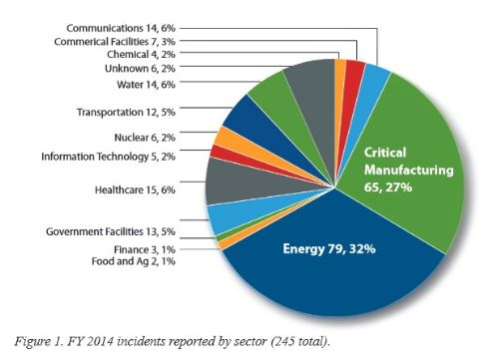
Prof : Nasi Greta
AY: 2022 / 2023
MAIN KNOWN ATTACKS
Ukraine Power Grid Attack (2015)
NordStream2 Attack (2022)
7
Notes:
Considering the importance of energy in our life and its influence on other critical infrastructures, CEI requests significant attention. As reported by the US Department for Homeland Security, during 2015, the Industrial Control Systems Cyber Emergency Response Team responded to 245 incidents; the Energy sector tops the list with 79% incidents. The trend shown in the graph can be assumed the same also for the EU where the energy infrastructure resulted one of the more targeted among critical ones. All modern critical infrastructures are increasingly evolving into distributed, complex cyber-physical systems that must be proactively protected and rapidly recovered to mitigate physical or cyber incidents or attacks. One of the most high-profile cyber attack is the 2015 attack on Ukraine's distribution system during the Russo-Ukrainian war. The attack led to a disruption of supply and a power outage that affected 27 substations and about 225,000 end users. The attackers used targeted emails carrying Microsoft Word and Excel attachments. Opening the files by employees installed a specific Remote Access Tool (a type of malware) on the workstations. From there, the attackers gained access privileges until they fully installed the specially designed malware on the SCADA systems. This allowed them to attack multiple substations. Eventually, they were able to trigger the power outage. Seven 110 kV and twenty-three 35 kV substations were shut down. This incident attracted worldwide attention and helped raise public awareness of the vulnerabilities of electric power systems. But it's not just about cyber threats; physical damage to infrastructure is also programmed to cause disruption. The last major physical attack was on the NordStream2 pipeline for transporting gas to Europe. In 2021, Russia supplied about 45% of the natural gas imported by the countries of the European Union. This meant a huge economic loss for the Russian country and a challenge for some European countries dependent on Russian gas.

Slide 9
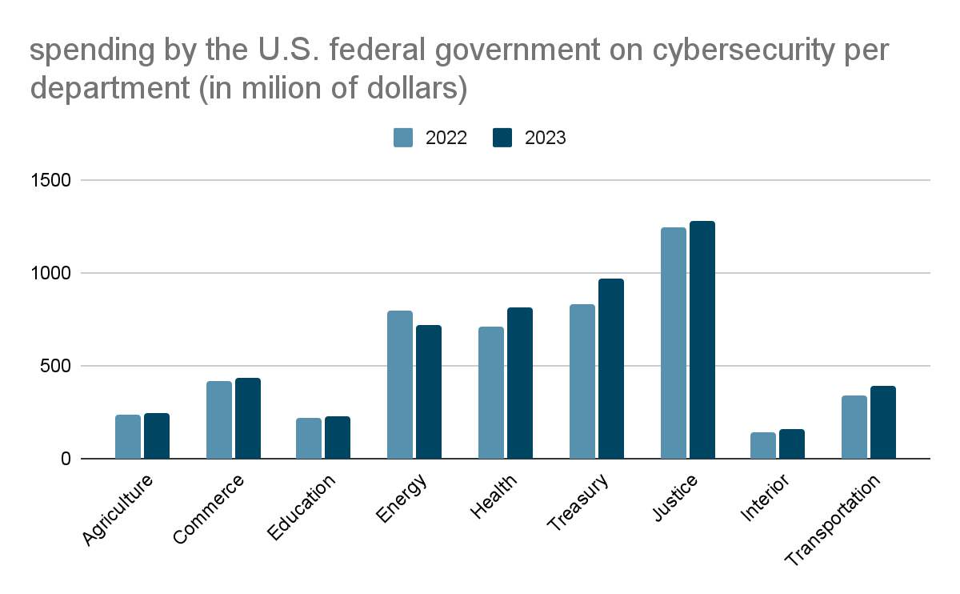
Prof : Nasi Greta
AY: 2022 / 2023
WHAT IS AT RISK?
Critical Infrastructures
Population
Environment
Data
Reputation
8
Notes:
As we said, the energy infrastructure provides essential fuel to all of the other critical infrastructures, and in turn depends on the Nation’s transportation, communications, finance, and government infrastructures. Power outages have the potential to disrupt communications, water, and transportation systems; impact businesses by reducing productivity or closing the facility; cause food spoilage and water contamination and prevent the use of medical devices. Populations that are dependent upon access to electricity can also be impacted, including people with health problems that depend on caretakers, electric medical devices, and have limited mobility. When a breach occurs, data is always at risk. A disclosure can mine our privacy or an agency's strategic data and can cause problems in managing records and properly managing the infrastructure. In the end, we must always consider the reputation that the agency managing the energy infrastructure, or worse, the state, may lose. Whenever the lives of many people are affected by a lack of service that can results even in loss of life, managers can be held responsible for what happens, and a bad reputation can never be recovered from.

Slide 10
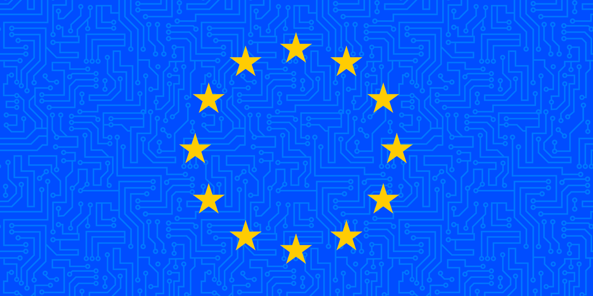
Prof : Nasi Greta
AY: 2022 / 2023
2. Regulative Frameworks
Stakeholders, Objectives, Risk Assessments, ISO Standards
9

Slide 11
É
Prof : Nasi Greta
AY: 2022 / 2023
EU STRATEGY FOR RESILIENCE
From the European Commission Press release of 18/2/2022:
critical infrastructures need to be improved in three priority areas:
Preparedness
Response
International cooperation.
Envisioning increased stakeholder support and coordination.
The Critical Energy Infrastructure is perceived as a priority.
10

Slide 12
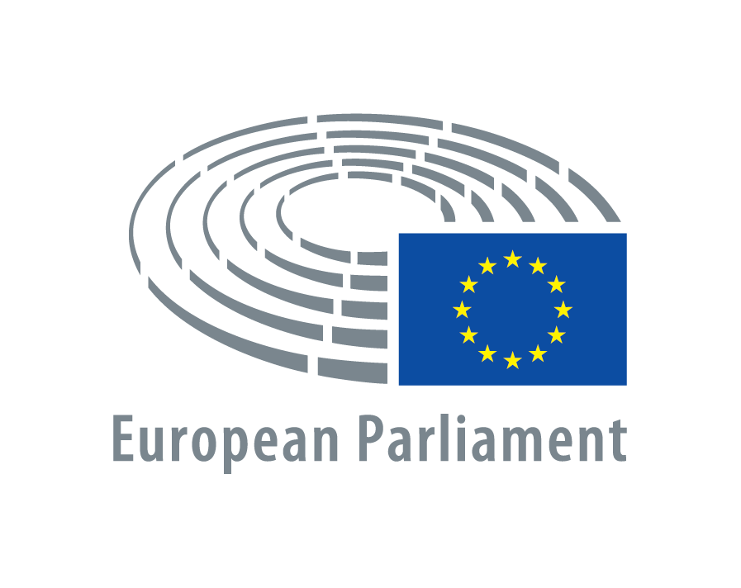

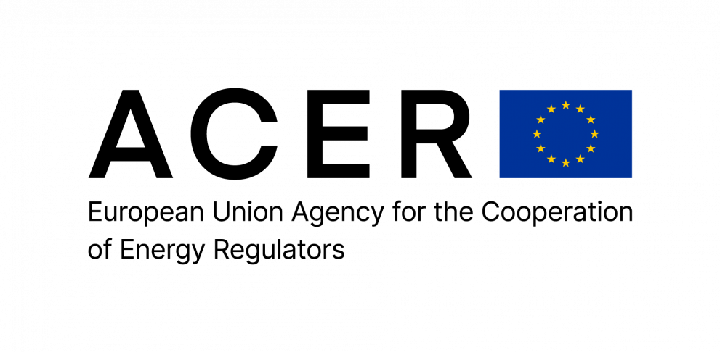

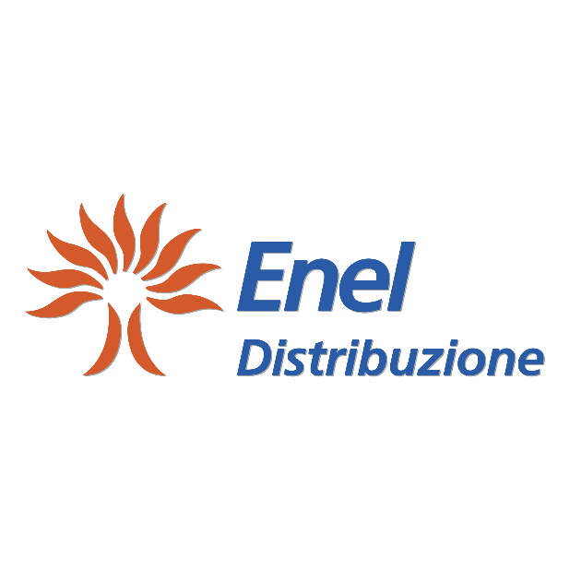



Prof : Nasi Greta
AY: 2022 / 2023
STAKEHOLDERS INVOLVEMENT
GOVERNMENT AGENCIES
REGULATORS
DISTRIBUTORS
PRODUCERS
Involvement of the stakeholders:
European Stakeholders Committee (ESCs)
Energy Stakeholders Dialogues
11
Notes:
The stakeholders involved in critical energy infrastructure are numerous and all have different interests.
End users need a reliable, efficient, and economical energy market. They range from simple end users who need energy to meet their basic needs to larger organizations that base their activities on major energy consumptions.
The energy landscape is managed by Government Agencies. They are interested in providing a fair energy market to end users and ensuring the proper functioning of all activities involved.
The European Commission is the executive arm of the EU administration, proposing legislation and frameworks, managing the EU budget, and (in relation to the energy landscape) implementing new policies or proposing the revision of older ones.
The Council of the European Union represents the member states and is responsible for the coordination of EU policies and the adoption of EU laws.
The European Parliament has three main functions: legislative, supervisory and budgetary. As a co-legislator, the Parliament shares responsibility with the Council of the European Union for passing EU laws. As a supervisory body, it scrutinizes the work of the European Commission.
The European Stakeholder Committees (ESCs) serves as a prime example of Interaction between stakeholders (consumers) and regulator entities. It serves as a platform to share general views on the NetworkCode implementation, and a more informed decision-making process to be developed for the implementation of the NCs.
Energy Stakeholders dialogues are held periodically and very frequently, they are made for national stakeholders to interact with EU regulators and policy makers to discuss the key energy-related matters. A meeting with Italian stakeholders was held on the 22nd of March 2023.

Slide 13
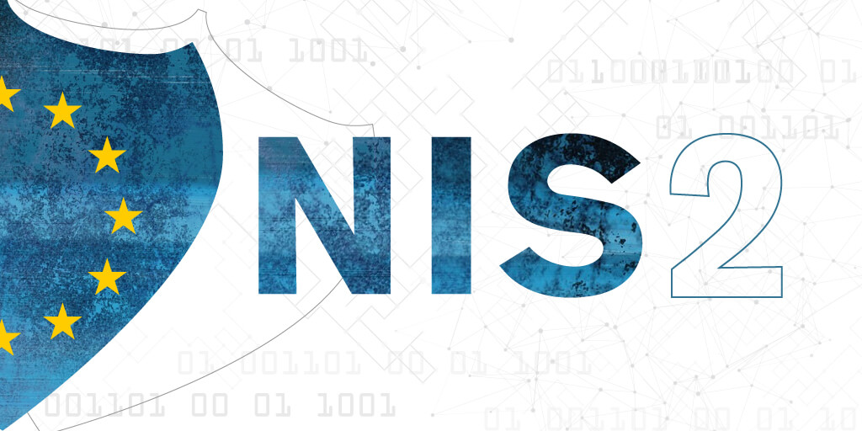
Prof : Nasi Greta
AY: 2022 / 2023
KEY REGULATORY FRAMEWORKS (1/2)
CER Directive (Critical Entities Resilience):
Repeals the ECID (European Critical Infrastructure Directive) of 2008
Strengthens the resilience of Critical Infrastructures
Promotes national strategies for EU members
Promotes regular risk assessments and reporting
NIS2 Directive (Network and Information Systems):
Establishment of a cooperation group on cybersecurity
Establishment of a cybersecurity certification framework
Expansion of the scope (cap-size rule)
Based on the NIS Directive
12
Notes:
CER Directive: Proposed the 16th of December 2020, approved the 22nd of November 2022, it started being enforced the 16th of January 2023.
Aims to reduce the vulnerabilities and strengthen the physical resilience of critical entities. They need to be able to prepare for, cope with, protect against, respond to and recover from natural disasters, terrorist threats, health emergencies or hybrid attacks.
As well as new bullet points to focus on:
Regular Risk Assessments and reports
Rely on EU promoted Directives to provide advice
Allow EU Entities to perform periodic tests and checks on the CI
The documentation available covers in various articles all that is needed in order to increase the resilience of CIs. It gives precise guidelines to follow in order to:
assess the risks
Identify critical entities
understand disruptive effects
description of competent authorities and single point of contact
NIS2 Directive: Proposed the 16th of December 2020, it was officially adopted November the 28th 2022; repealing the NIS Directive.
Features a set of deadlines regarding cybersecurity preparedness to be respected by EU members:
Built on the NIS Directive: member states were responsible for determining which entities would meet the criteria to qualify as CI; NIS2 introduces a size-cap rule. This means that all medium-sized and large entities operating within the sectors or providing services covered by the directive will fall within its scope. More CIs will be included under the directive.

Slide 14
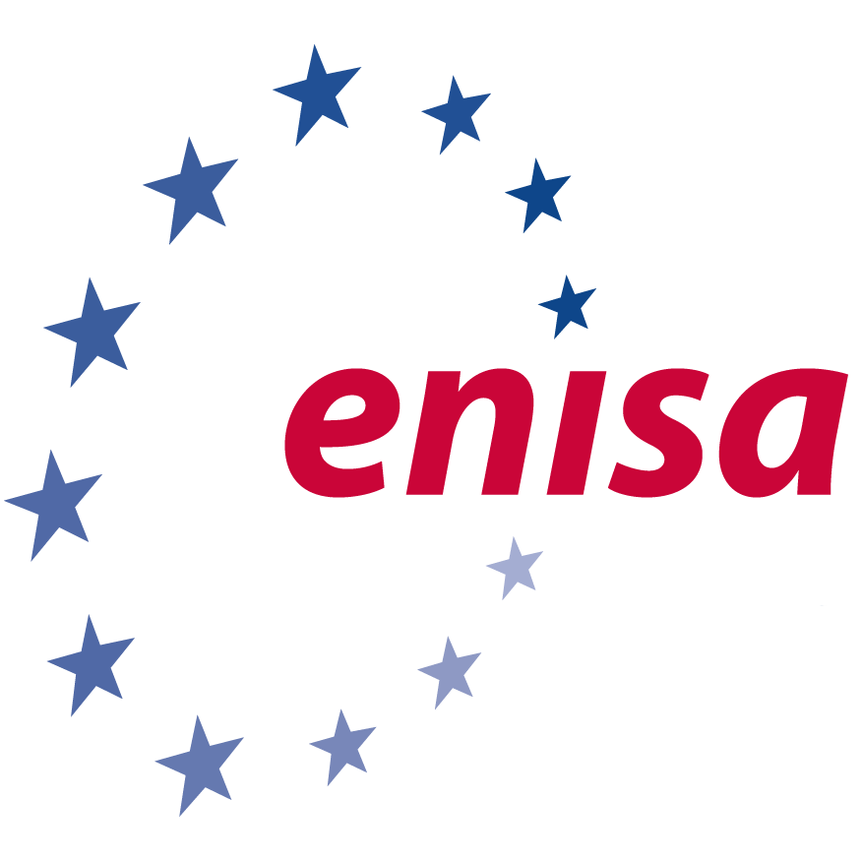
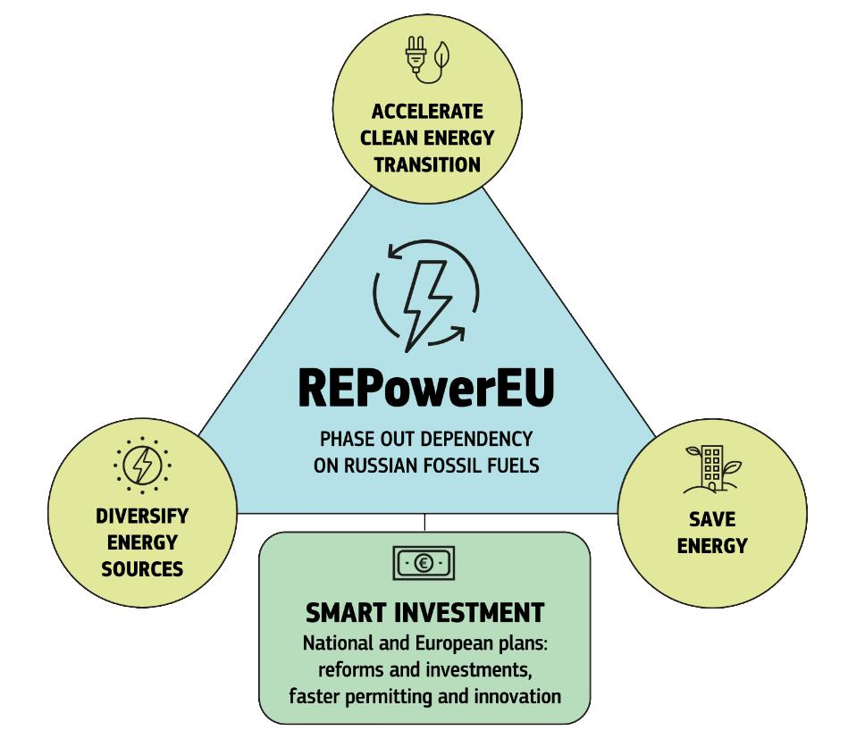
Prof : Nasi Greta
AY: 2022 / 2023
KEY REGULATORY FRAMEWORKS (2/2)
ENISA (European Network and Information Security Agency):
Development policies, strategies, and frameworks
Identification and assessment of cyber risks
Promotion of cybersecurity awareness
Development of technical standards and certifications
Promotion of international cooperation and collaboration
TEN-E (Trans-European Networks for Energy):
Promotion of a cross-border energy infrastructure
Integration of national energy markets into a single, integrated one
Wide range of energy infrastructure
Focus on renewable energy sources
REPowerEU: Energy Independence framework focused on Russian gas, focusing on green energy.
13
Notes:
ENISA: Founded by the European Parliament and of the Council of 10 March 2004.
Dedicated to achieving a high common level of cybersecurity across Europe, it provides a range of services to support its mission, including risk management and incident response guidance, training and awareness-raising programs, and the development of technical standards and best practices.
TEN-E: adopted in 2013, lays down rules for the linkage of Energy Infrastructures in the EU as well as renewable energy sources.
Aims at ensuring the functioning of the internal energy market and security of energy supplies, ending Member States' isolation by improving market integration.
Revised the 15th of December 2020, aims to promote the integration of renewables energy technologies: electricity grids, offshore energy, renewable gasses, hydrogen to facilitate the energy transition and ensure alignment with the EU's climate goals.
REPowerEU: The EU wants to reduce its dependence on Russian gas by diversifying its supply and accelerating the production of green energy. The focus is primarily on gas, but the aim is to phase out dependence on Russian oil and coal as well. This will reduce emissions and protect against price hikes, which hit vulnerable households and businesses particularly hard. The EU needs to take decisive action to provide affordable, secure, and clean energy, starting with price mitigation and storing gas for next winter.

Slide 15

Prof : Nasi Greta
AY: 2022 / 2023
RISK ASSESSMENT MODELS AND
ISO STANDARDS
European Union Agency for Cybersecurity (ENISA) RM/RA (Risk Management/Risk Assessment) inventory.
Final text of the Critical Entities Resilience Directive (CER):
Article 5, Risk assessment by Member States, CER Directive.
Article 12, Risk assessment by Critical Entities, CER Directive.
Employed ISO Standards:
ISO 14001: environmental management systems
ISO 50001: energy management systems
ISO 55001: asset management
14
Notes:
The CER Directive, as stated before, is the most recent and updated framework for Resilience of CI.
It handles many aspects about these entities, in this slide we focused on how the directive manages risk assessment.
In Article 5, the topic is Risk Assessment by EU Member states. It provides guidelines on:
how to evaluate risks (considering internal and external factors)
report and share the results with critical entities
share the results of assessment with the EU Commission within three months
In Article 12, the topic is Risk Assessment by Critical Entities. It provides guidelines on:
how to time Risk Assessments → within nine months after the notification from the EU Member, at least one every four years
how to conduct a Risk Assessment → natural and man-made risks, cross-sectoral or cross-border risks, dependency on other entities
the possible reuse of third-party Risk Assessment reports if needed
The ENISA RM/RA provides an overview of relevant content found in the relevant literature on Risk Management and Risk Assessment. It consists of several sub-processes, including scope and framework definition, risk assessment, risk treatment, risk acceptance, monitoring and review, and risk communication. The processes can be performed individually or as a cycle. ENISA has also identified data elements to describe the information exchange between the different risk management processes.
It consists of 17 methods for RA /RM and is continually updated as new literature becomes available.
Additional methods will be included in the future through a process for submission of additional methods by standards bodies/vendors, etc., as well as a process for updating existing inventory entries.
ISO 14001:2015: helps organizations identify and control their environmental impacts, set environmental objectives and targets, implement operational controls, and monitor and review their performance.
ISO 50001: helps organizations improve their energy performance. Requires organizations to develop an energy policy, establish an energy baseline, identify and prioritize opportunities for energy conservation, implement energy management measures, and monitor and evaluate energy performance.
ISO 55001: requires organizations to develop a systematic approach to asset management, including developing an asset management policy, identifying and assessing asset risks, establishing asset management objectives, and implementing an asset management plan

Slide 16
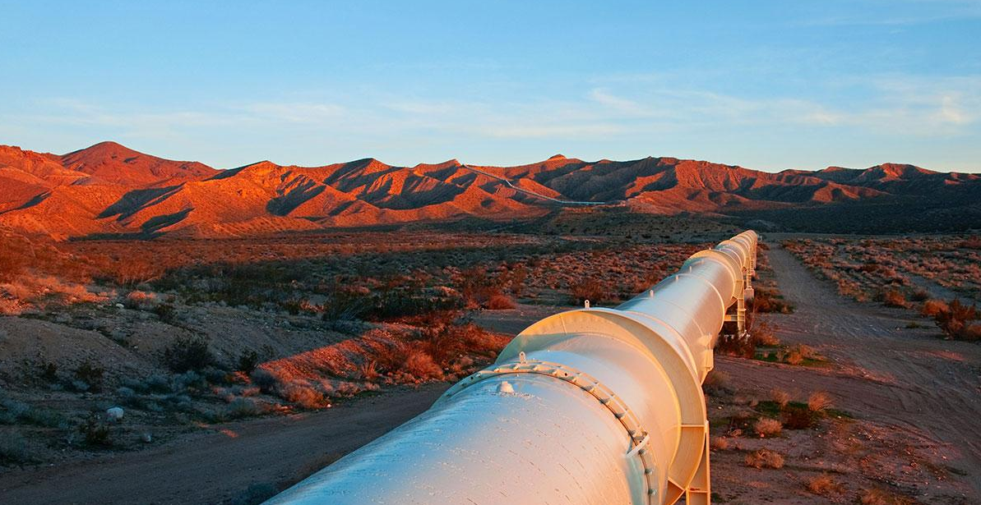
Prof : Nasi Greta
AY: 2022 / 2023
3. Assets and Vulnerabilities
15

Slide 17


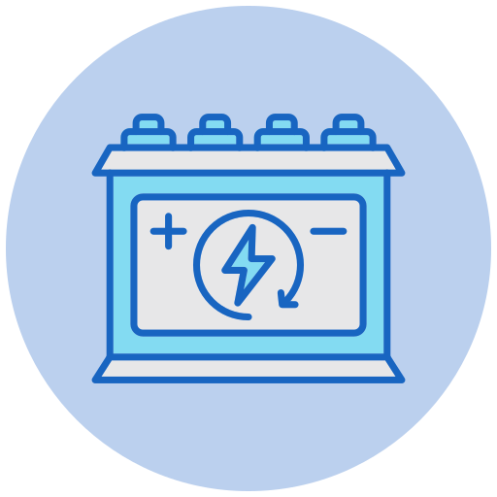

Prof : Nasi Greta
AY: 2022 / 2023
ASSETS
Energy Production:
Power plants: fossil fuel power plants, nuclear power plants, wind farms, solar power plants etc
Energy Distribution and Transportation:
Transmission and distribution networks: High voltage transmission lines, transformers and substations
Oil and gas pipelines: transport from production to refineries and end users
Energy Storing:
Fuel storage facilities: storage tanks for oil and gas
Energy storage facilities: batteries, pumped hydroelectric storage
Energy Control Systems
Energy control systems: this include the computer systems and software used to manage energy production and distribution
16
Notes:
Due to the inherent vastness and heterogeneity of the energy sector there are a wide variety of assets depending on the specific sector and region. The main physical assets can be grouped into four categories:
1. Energy production (where the energy is produced)
power plants: fossil fuel power plants, nuclear power plants, wind farms, solar power plants
2. Energy distribution and transportation (where energy is, first, transported from production sites to urban areas and then distributed to end users like offices and homes)
Transmission and distribution networks: High voltage transmission lines, transformers and substation (distribute energy)
Oil and gas pipelines: transport from production to refineries and end users(transport energy)
3. Energy storing(where energy is stored)
Fuel storage facilities: storage tanks for oil and gas (storing energy)
Energy storage facilities: batteries, pumped hydroelectric storage (renewable storage)
4. Energy control systems(hardware and software necessary to make the infrastructure work)
Energy control systems: this include the computer systems and software used to manage energy production and distribution
There are also nonphysical assets like patents, brand value, human capital but we decided to focus on the physical ones.

Slide 18



Prof : Nasi Greta
AY: 2022 / 2023
VULNERABILITIES
Aging Infrastructure: if we take the US as example, 70% of transmission lines are at least 25 years old and 60% of circuit breakers are more than 30 years old. Aging infrastructure increases the risk of equipment failure, which can result in outages or other disruptions.
Aging Workforce: Human Factor is always a vulnerability. However, the growing potential gap in available skilled personnel to replace the retiring workforce has been a real concern in the Energy Sector for some time. Retiring people take years of experience with them and it is crucial to train new generation of skill workers.
Dependance on Limited Resources: heavily relying on stock-limited resources such as fossil fuels (coal, petroleum, natural gas) which are not equally available to every nation
17
Notes:
The vulnerabilities of the energy sector are of particular concern to national security due to its enabling function across all critical infrastructure systems. With electricity and fuels used to power transportation, water facilities, hospitals and communications. A successful attack on the nation’s energy sector could snowball to affect many of these other systems.
Aging Infrastructure: Many of Europe's power plants, pipelines, and transmission networks were built decades ago and need upgrades or replacement.
Aging Workforce: Human Factor is always a vulnerability. However, the growing potential gap in available skilled personnel to replace the retiring workforce has been a real concern in the Energy Sector for some time. Retiring people take years of experience with them and it is crucial to train new generation of skill workers.
Dependance on limited resources: 60% of energy needs, in Europe, are met through imports. In 2021 Europe imported almost 40% of natural gas and almost 25% of oil from Russia. This turned out to be a big vulnerability since a change in the political landscape turned into a threat to the energy sector.

Slide 19


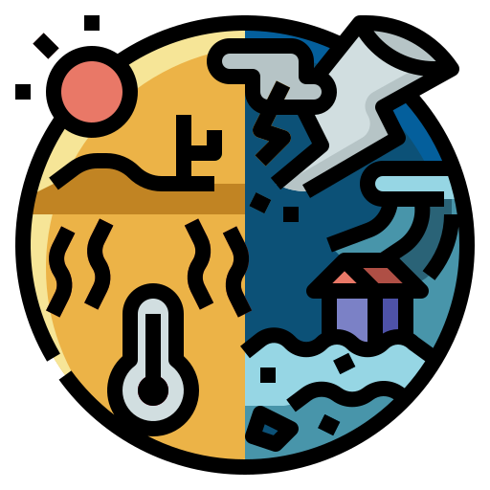
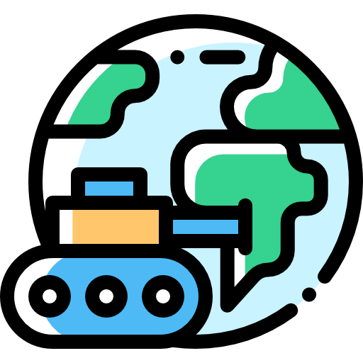
Prof : Nasi Greta
AY: 2022 / 2023
THREATS
Cyberattacks: As the energy sector relies heavily on technology and the internet, it is vulnerable to cyberattacks.
Physical Attacks: The energy sector's physical infrastructure, such as power plants and pipelines, is also vulnerable to physical attacks
Natural Disasters: The energy sector is also vulnerable to natural disasters, such as hurricanes, earthquakes, and wildfires, which can damage infrastructure and disrupt energy supplies.
Geopolitical Risks: The energy sector is often affected by geopolitical risks, including political instability, war, and sanctions, which can disrupt energy supplies and increase prices.
18
Notes:
As for the threats we have multiple types spreading over multiple surfaces:
Cyberattacks: As the energy sector relies heavily on technology and the internet, it is vulnerable to cyberattacks. Hackers may target critical infrastructure, such as power grids and pipelines, to disrupt services or cause physical damage. (Ex. stuxnet, Ransomware Attack on US Colonial Pipeline, Enel group attack)
Physical attacks: The energy sector's physical infrastructure, such as power plants and pipelines, is also vulnerable to physical attacks, including sabotage and terrorist attacks.(Ex. Nord Stream pipeline sabotage)
Natural disasters: The energy sector is also vulnerable to natural disasters, such as hurricanes, earthquakes, and wildfires, which can damage infrastructure and disrupt energy supplies. (Ex. Fukushima earthquake, Hurricane Sandy (2012, referred to as Sandy) was among the most devastating storms to impact Connecticut’s overhead electric distribution network, resulting in over 15,000 outage locations that affected more than 500,000 customers, Amatrice earthquake)
Geopolitical risks: The energy sector is often affected by geopolitical risks, including political instability, war, and sanctions, which can disrupt energy supplies and increase prices. (Ex.Ukraine war)

Slide 20

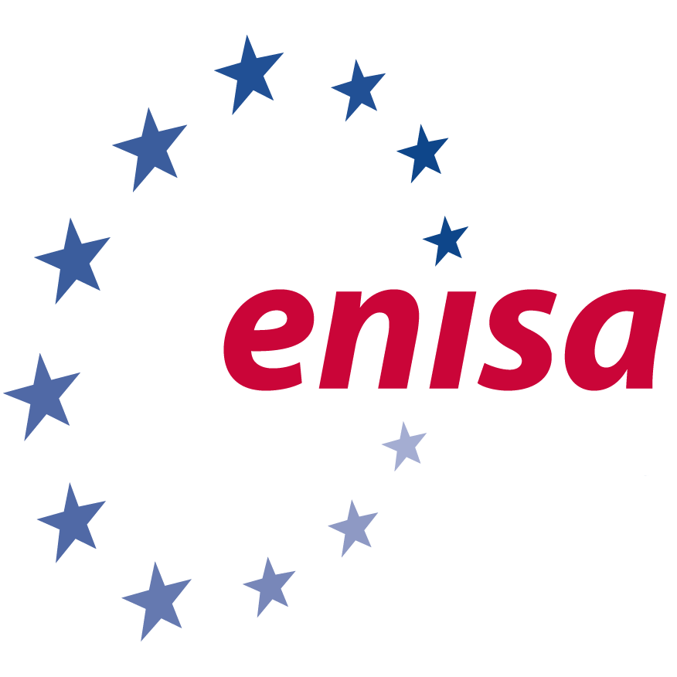
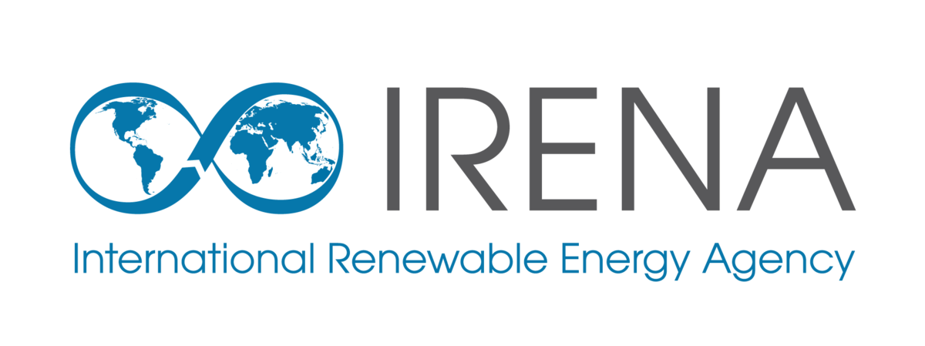

Prof : Nasi Greta
AY: 2022 / 2023
RELIABLE DATA SOURCES
IEA(International energy agency): The IEA is at the heart of global dialogue on energy, providing authoritative analysis, data, policy recommendations, and real-world solutions to help countries provide secure and sustainable energy for all.
ENISA(European Network and Information Security Agency): focuses on improving cybersecurity across all sectors in the EU and produces reports and provides guidance on best practices for securing energy infrastructure.
IRENA(International renewable energy agency): The International Renewable Energy Agency (IRENA) is a lead global intergovernmental agency for energy transformation that serves as the principal platform for international cooperation, supports countries in their energy transitions, and provides state of the art data and analyses on technology, innovation, policy, finance and investment.
Eurostat: Eurostat is the statistical office of the European Union and provides a wide range of statistics on energy, including production, consumption, and renewable energy sources.
19
Notes:
Some of the best places we found to look for data on the energy sector are:
IEA(International energy agency):The IEA is at the heart of global dialogue on energy, providing authoritative analysis, data, policy recommendations, and real-world solutions to help countries provide secure and sustainable energy for all.
ENISA: focuses on improving cybersecurity across all sectors in the EU and produces reports and provides guidance on best practices for securing energy infrastructure.
IRENA(International renewable energy agency): The International Renewable Energy Agency (IRENA) is a lead global intergovernmental agency for energy transformation that serves as the principal platform for international cooperation, supports countries in their energy transitions, and provides state of the art data and analyses on technology, innovation, policy, finance and investment.
Eurostat: Eurostat is the statistical office of the European Union and provides a wide range of statistics on energy, including production, consumption, and renewable energy sources.
ENTSO-E:the European Network of Transmission System Operators for Electricity, is the association for the cooperation of the European transmission system operators (TSOs). The 39 member TSOs representing 35 countries are responsible for the secure and coordinated operation of Europe’s electricity system, the largest interconnected electrical grid in the world. In addition to its core, historical role in technical cooperation, ENTSO-E is also the common voice of TSOs.

Slide 21
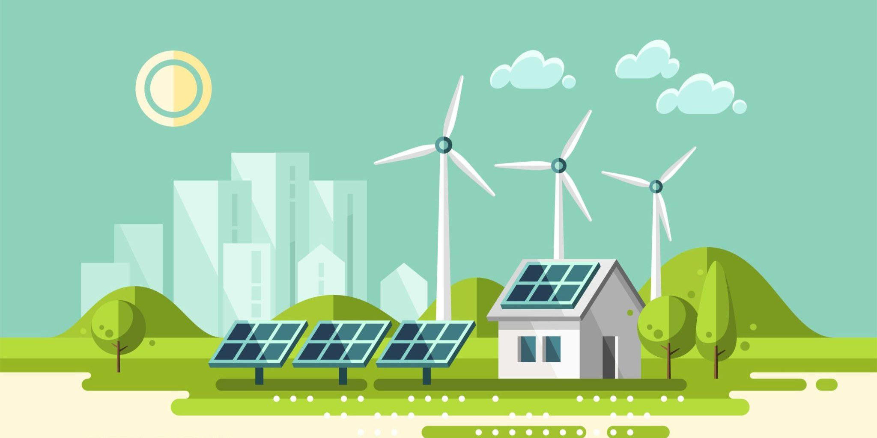
Prof : Nasi Greta
AY: 2022 / 2023
4. Recommendations for the CI
20

Slide 22
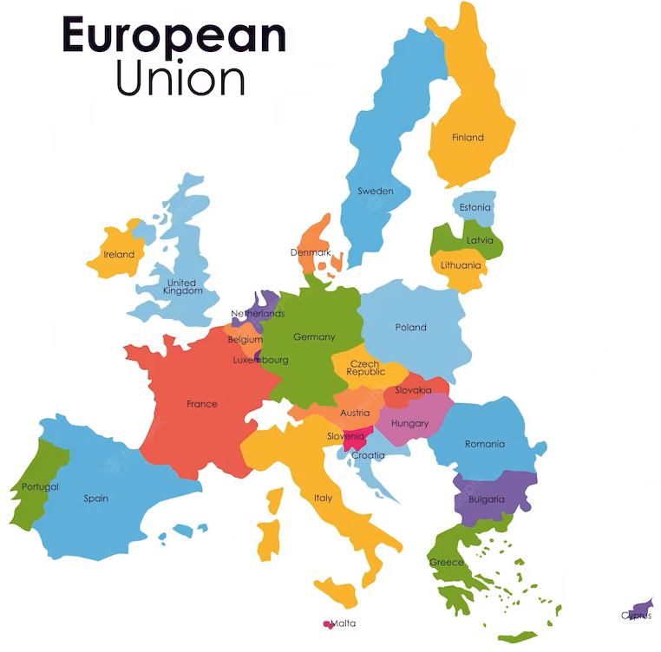
Prof : Nasi Greta
AY: 2022 / 2023
SECURITY AND RESILIENCY
Diversify energy sources, suppliers and routes.
Create a deeper collaboration plan between EU countries at an international level.
Invest in energy storage technologies.
Adapt/Substitute legacy systems and invest in automated threats detection tools.
21
Notes:
Europe has a limited amount of energy resources inside domestic borders and thus it heavily relies on imports. Recent events have clearly highlighted that several EU countries have concentrated their energy suppliers too much, resulting in single governments prioritizing their own interests during times of crisis, jeopardizing the entire infrastructure. Therefore, we suggest working on creating a more diversified pool of suppliers and developing a strategic plan to improve collaboration between EU countries.
This collaboration should focus not only on diversification but on all aspects of the energy infrastructure which is inherently distributed over all EU territory in order to create a long-term vision. (e.g. improve Ten-e even more)
At the same time, it is crucial to improve our energy storage capabilities in order to ensure Business Continuity in case of a temporary interruption of the supply. Currently, most of the energy storage capabilities consist of gas pits and hydroelectric dams. We believe that the EU should invest in developing cost-effective energy storage technologies such as new batteries and/or hydrogen fuel cells, that can efficiently store excess energy generated, complementing existing solutions.
Digitalization and the introduction of the Internet of Things have brought significant benefits to the energy sector, but they have also increased cybersecurity risks by expanding the attack surface. Therefore, at first it is necessary to address the issue of legacy systems which were not designed with cyber attacks in mind and hence are harder to properly secure. Moreover, cyber attacks are cheaper, easier to organize and evolve faster than physical attacks. Therefore, policymakers must frequently update their assessment models and data collection techniques to keep pace with emerging threats. Current models used to evaluate the cybersecurity level of energy critical infrastructure are far from being perfect and there is space for improvements. This may require investing in advanced data analytics and machine learning tools to enable early or even real-time detection of threats. Effective detection is the initial step towards enhancing prevention strategies.

Slide 23

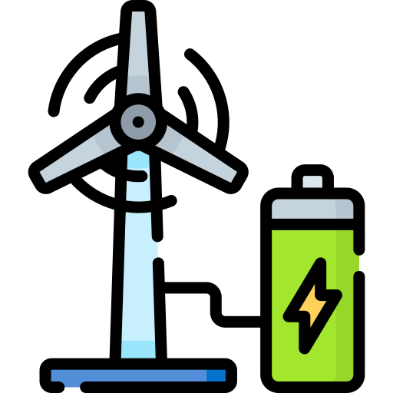
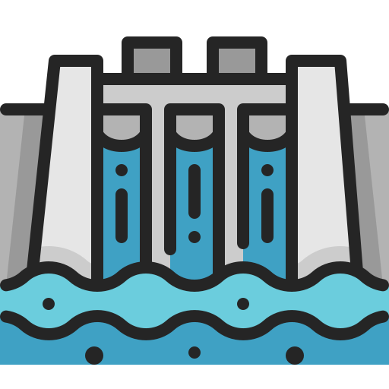
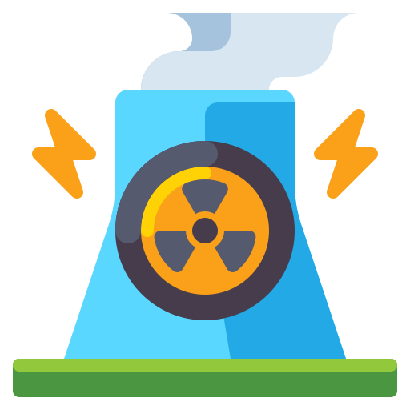
Prof : Nasi Greta
AY: 2022 / 2023
SUSTAINABILITY AND GREEN
Improve energy efficiency
Increase investment in renewable energy sources
22
Notes:
As previously mentioned, Europe is not self-sufficient in terms of energy resources. Therefore, it is of fundamental importance to optimize usage and minimize waste of energy by increasing efficiency. On the other hand, the EU can also increase its energy production by adopting renewable energy sources. These two points not only increase environmental sustainability but also help in multiple ways such as reducing costs, reducing dependence from exporting countries (and hence improving security) and pushing forward innovation. Actually, the EU is already working on these aspects (e.g. energetic class of buildings and ban on polluting fuel cars) but we believe that many more steps towards this direction are possible.
Since current technologies are far away from making the EU completely independent from foreign countries, it is essential to invest in research to enhance existing technologies while also developing new ones. Again, a long-term vision is required.
Examples: Nuclear energy, Solar Energy, Batteries, Industry processes.

Slide 24

Prof : Nasi Greta
AY: 2022 / 2023
DO NOT FORGET STAKEHOLDERS!
As we have previously highlighted, there are multiple stakeholders in the Energy Critical Infrastructure:
Companies
Governments
Regulators / Policy Makers
Consumers
More stakeholders (e.g. Investors, Local Communities)
Their interests and concerns must all be considered while creating new policies, even though they have a very diverse point of view.
23
Notes:
Improving the security and resilience of critical energy infrastructure requires a coordinated and collaborative approach that involves both regulators, governments, companies in the sector and other stakeholders. This concept is particularly important in the European Union (EU) given that it is composed of multiple countries each with their unique characteristics. Hence, new policies should be developed in close contact with all relevant entities to ensure the feasibility and applicability of the entire strategy.
Examples: Companies focus on earning money while regulators focus on stability, integrity of the industry, consumer protection and ensuring fair competition.

Slide 25
Thank you!
Campo Marco Lorenzo - 103213
Grazioli Davide – 992467
Santomauro Carmine - 995752
Savino Matteo - 994779
24

Slide 26
Prof : Nasi Greta
AY: 2022 / 2023
RESOURCES
Critical infrastructure and cybersecurity (europa.eu)
Cyber-Incidents in the Energy Sector - Ecofys
CEI Security Stakeholder Group Manifest
National Infrastructure Protection Plan - Department of Energy - Homeland Security
Where does our energy come from? (europa.eu)
World Energy Investment 2022 - IEA
Access to electricity – SDG7: Data and Projections – Analysis - IEA
Energy consumption by source - Statista
Energy sector tops list of US industries under cyber attack - Homeland Security report
Cybersecurity Special: Energy industry cyberattack target number one (hornetsecurity.com)
U.S. government cybersecurity spending FY 2023 - Statista
The Critical Entities Resilience Directive (CER)
Critical Infrastructure Resilience: stronger rules
Critical Infrastructure: Commission accelerates work to build up European resilience
Energy security
Critical Infrastructure Resilience: stronger rules
Energy security
METHODOLOGY FOR SECTORAL CYBERSECURITY ASSESSMENTS
Critical infrastructure and cybersecurity
Energy storage
Digitalization set to transform global energy system with profound implications for all energy actors - News - IEA
Ukrainian experience | building cyber resilience - KPMG Ukraine
Accelerating energy efficiency: What governments can do now to deliver energy savings – Analysis - IEA
REGULATION AND STANDARDS FOR A RESILIENT EUROPEAN ENERGY SYSTEM
Cyber-attacks to critical energy infrastructure and management issues
National conference on state legislatures, 2020
https://www.uscybersecurity.net/csmag/accelerating-critical-infrastructure-security-in-the-energy-sector/
https://www.iea.org/about/mission
https://www.irena.org/about
https://ec.europa.eu/eurostat
Germany, EU remain heavily dependent on imported fossil fuels | Clean Energy Wire
25

