Slide 1
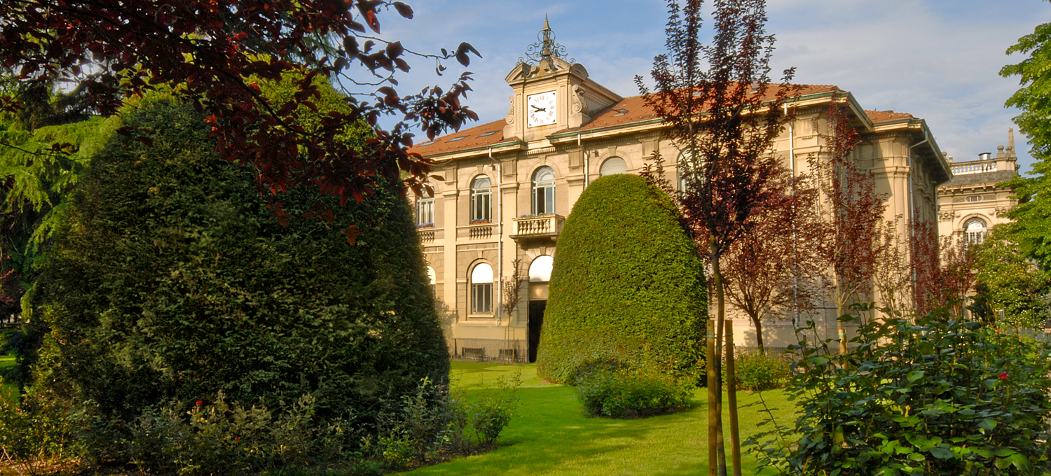

Titolo presentazione sottotitolo
System and Methods for Big and Unstructured Data Project
Milano, XX mese 20XX
Group 09
Francesco Riccardi
10651584
Alessandro Romito
10661916
Marco Luca Previtera
10682248
Professors:
Prof. Marco Brambilla
Dr. Andrea Tocchetti
2022 - 2023
Simone Lo Gatto
10736180
Lorenzo Ferretti
10713719

Slide 2

Firma convenzione
Politecnico di Milano e Veneranda Fabbrica del Duomo di Milano
Inserimento secondo logo
Fare clic per modificare lo stile del titolo
Fare clic per modificare lo stile del sottotitolo dello schema
Aula Magna – Rettorato
Mercoledì 27 maggio 2015

Slide 3

Introduction to the project

Slide 4



Introduction to the project
The aim of the project is to show that our group is are able to manage a very large quantitative of data.
Delivery requests:

Slide 5

Introduction to the project
Our Goals:
Collecting and storing large volumes of data in relation to effectiveness for queries quality
Cleaning and preprocessing the data to ensure it is of high quality and ready for analysis
Computing efficiency
Notes:
GB 3.4 neo4j, > min requirements.
Citation Score

Slide 6
Introduction to the project
The chosen Dataset is the DBLP computer science bibliography.
Main characteristics:
  On-line reference for bibliographic information on major computer science publications
  It contains more than 4.4 million publications, published by more than 2.2 million authors (Source: official website, January 2019)
  It is divided in different types of publication: article, book, incollection, proceedings, inproceedings, www, mastersthesis
Notes:
Variety, volume

Slide 7

Introduction to the project
The Dataset has been subject to a process of data extraction and data elaboration in order to:
  clean the data
  take care of data quality
Low quality data could cause a series of consequences like:
  day by day more difficult to obtain high data quality
  Inaccurate analysis
Notes:
Data produces data

Slide 8
Assumptions

Slide 9
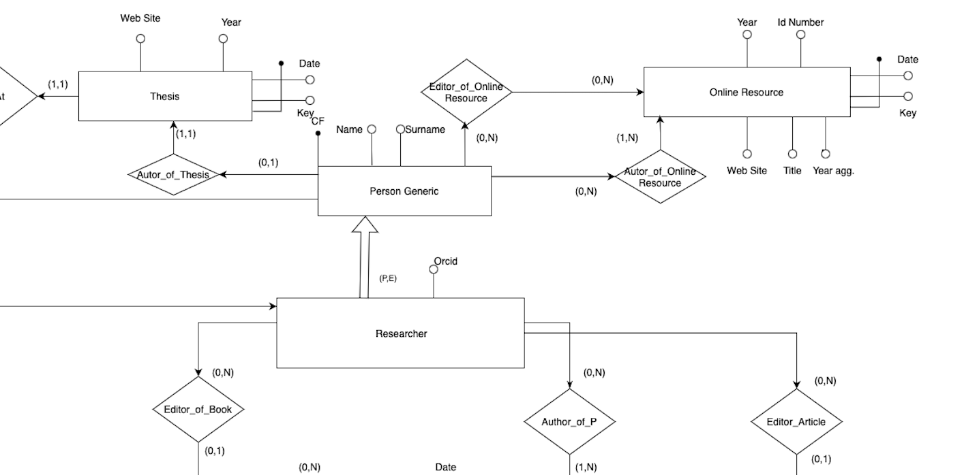
Assumptions
Data correctness and truth
Insert inconsistency
Publication : Book, Article, Thesis, Online
Resource(Www), Proceeding, Inproceeding and Incollection;
Orcid is mandatory
Notes:
Data produces data

Slide 10
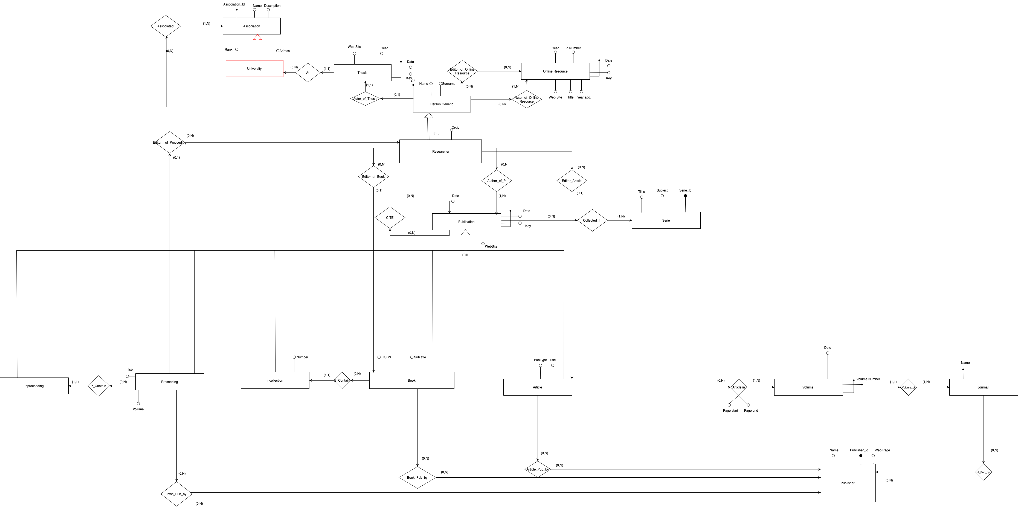
ER-DIAGRAM

Slide 11
ER-Diagram in details

Slide 12
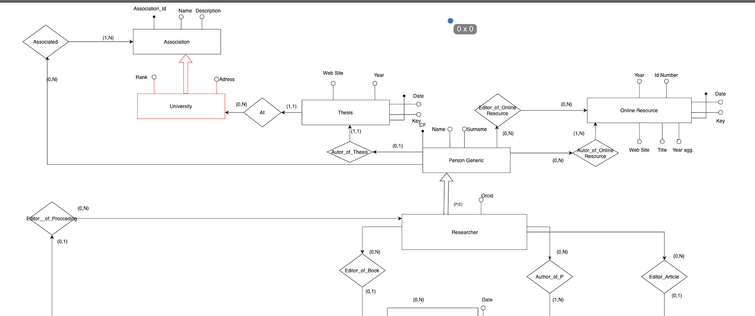
ER-Diagram in details

Slide 13
ER-DIAGRAM

Slide 14
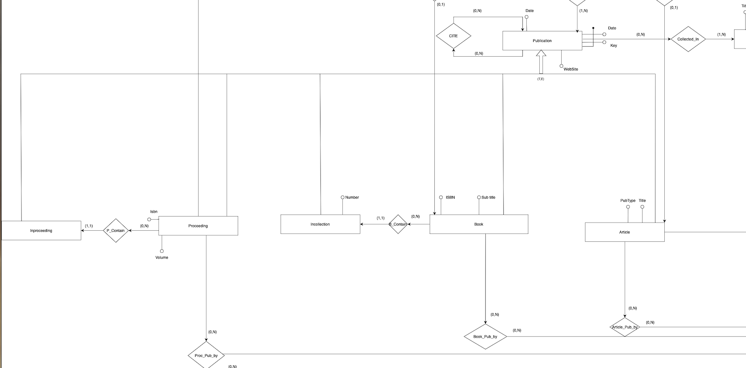
ER-Diagram in details

Slide 15
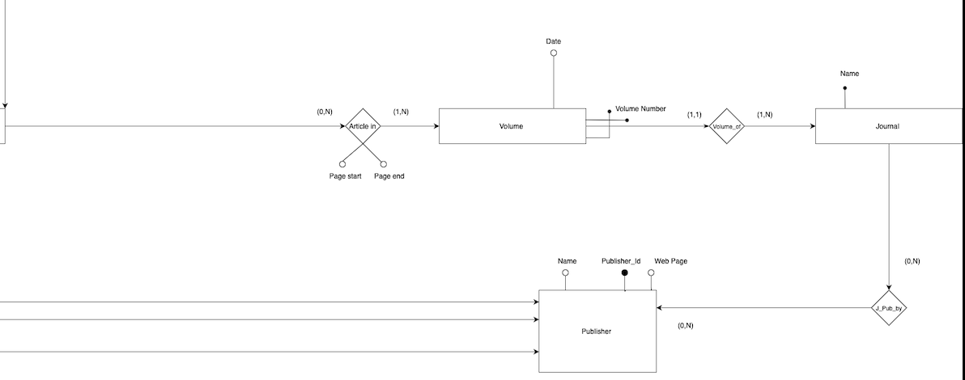
ER-Diagram in details

Slide 16
Data Import & Generation
Download of the DBLP database dump in XML format
Cut in a smaller chunk and UTF-8 conversion (Python script)
Neo4J
CSV output, one for every node type (Python script)
MongoDB
Use of Mookaroo online tool to generate the basic structure of the document
Creation of relationships between articles and authors (Python script)
JSON output (Python script)
Spark
Use of Neo4J to extract data
Relationships as arrays inside the table instead of using bridge tables (Python script)
CSV output (Python script)

Slide 17
First part (graph DB): Neo4J

Slide 18
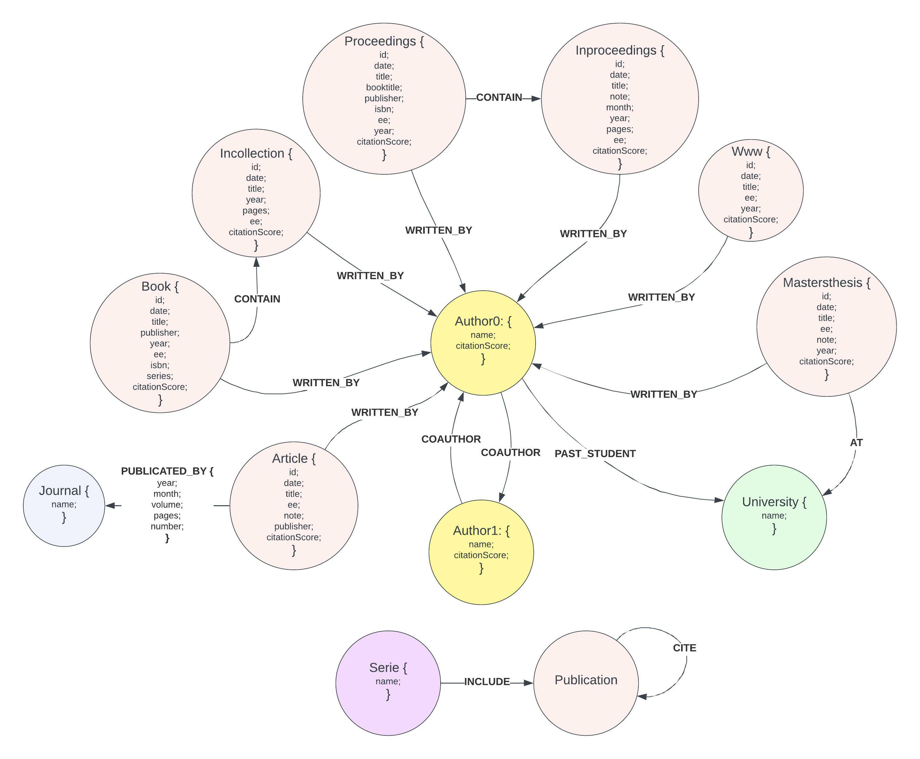
First part (graph DB): Neo4J
The aim of this assignment is to design a query graph data structure in Neo4j for supporting the chosen dataset.

Slide 19
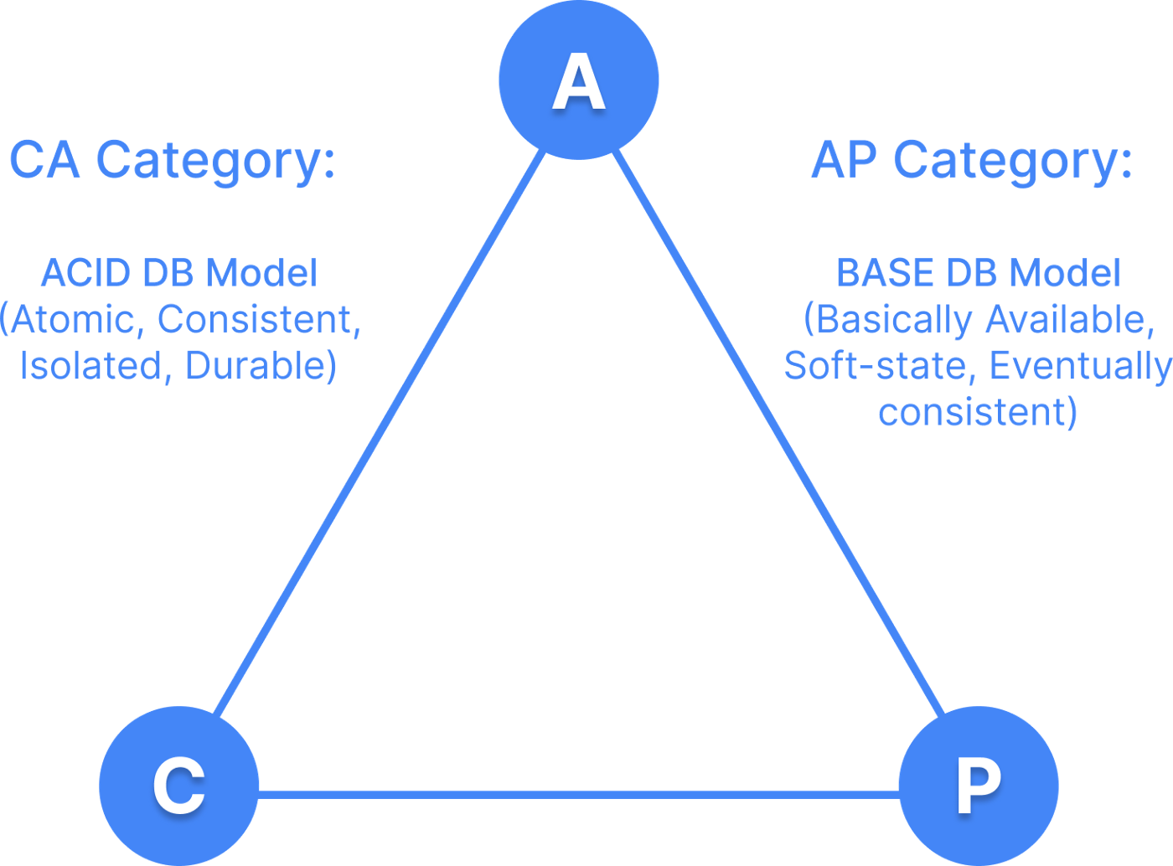
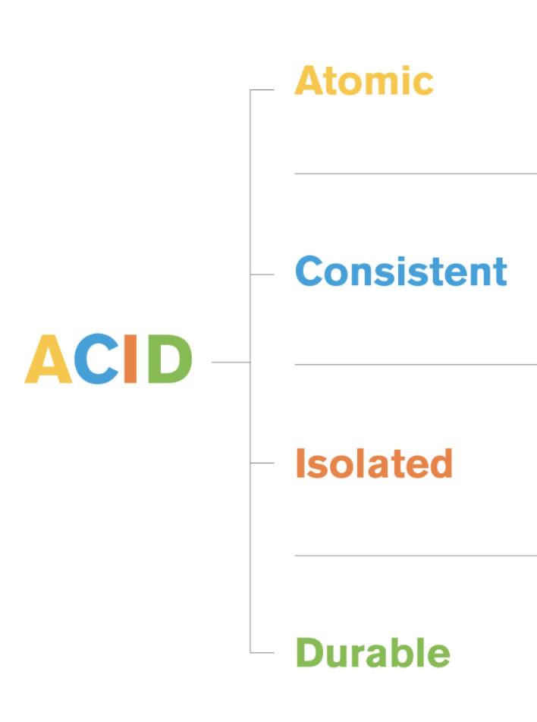
First part (graph DB): Neo4J
Neo4j:
open-source
NoSQL
Cypher language
Manage complex and
interconnected data
Ensure data integrity
Availability
Consistency
Partition Tolerance

Slide 20
First part (graph DB): Neo4J
How did we design the DB?
Notes:
Omitted some links like CITE.
Publication tag contained in ... Not to specify 7 nodes every times in the match statement

Slide 21
Author, Article, Journal, Book, Incollection, Proceedings, Inproceedings, Www, Mastersthesis, Publication, University and Serie are Node labels and their attributes are shown in the graph diagram near. The relationships of the database are WRITTEN_BY, CONTAIN, PUBLICATED_BY, COAUTHOR, AT, CITE, INCLUDE. We omitted some links using the publication note make graph diagram more readable and understandable.
The nodes Article, Book, Incollection, Proceedings, Inproceedings, Www, Mastersthesis contain the Publication tag in order to perform and understand queries easily since you don't need to specify 7 different nodes in the MATCH statement every time.

Slide 22
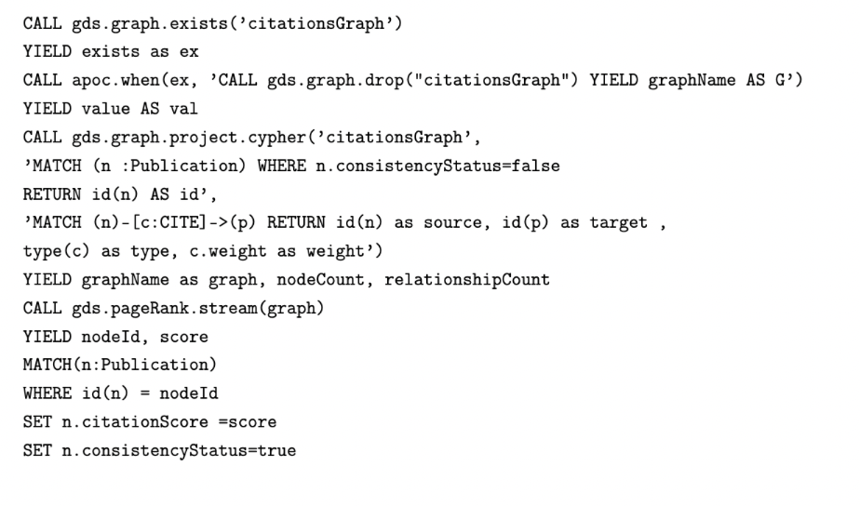
Command 1 Neo4J
Citation score with Neo4J Graph Data Science:
Graph Creation
Graph Projection
Query for projection
Call pageRank algorithm
Update citation score and consistency status

Slide 23
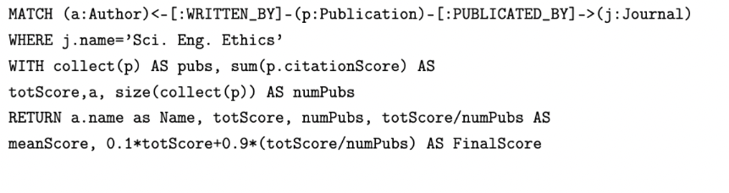

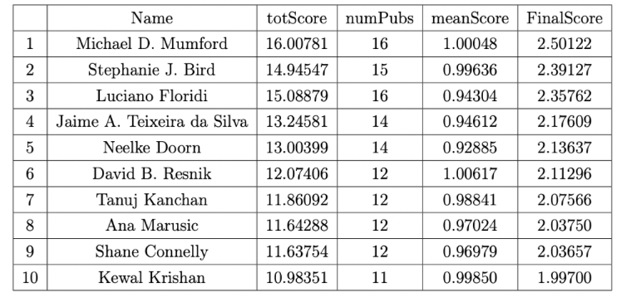
Query 5 in Neo4J
Now ’’citation score’’ can be used to compute useful ranking …
What matter to be a good writer of a Journal ?
Probably a good balance between quality and quantity

Slide 24
Second Part (documental DB): MongoDB

Slide 25
Second Part (documental DB): MongoDB
The aim of this second part is to design, structure and implement a document database in MongoDB to store a collection of articles.
MongoDB:​
High scalability
Flexibility
Schemaless​
NoSQL
Availability
Consistency
Partition Tolerance

Slide 26
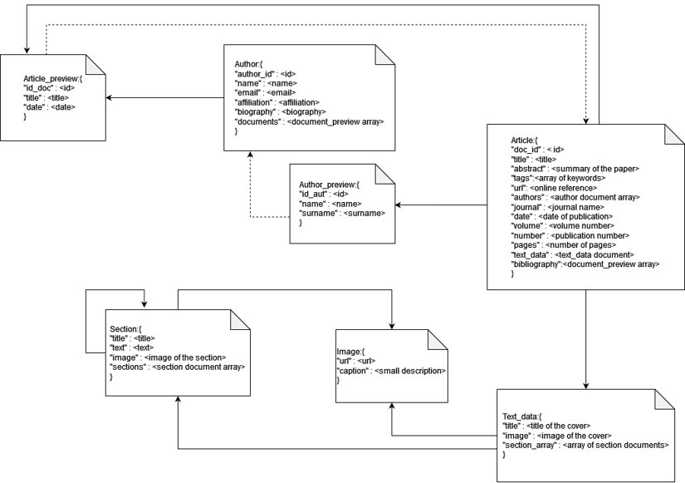
Document Diagram

Slide 27
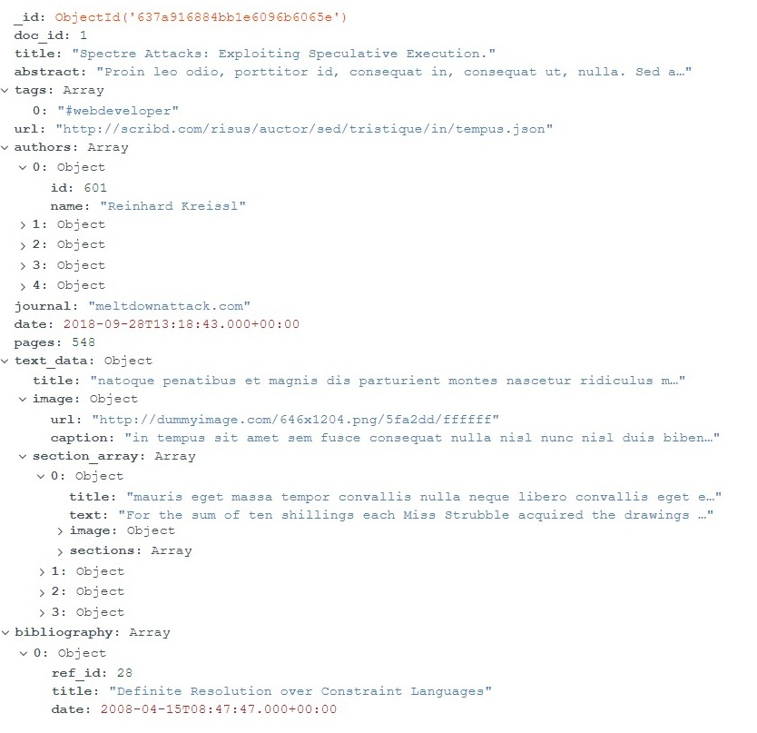
Document example

Slide 28
An example of a query with its result (query 9):
This query takes all documents with more than 500 pages and date less than 2013-04-11, there is a sorting by the pages in ascending order, an unwind by referenced articles (bibliography) and takes all those with date greater than 2013-04-11 returning only the title of the ref and the doc_id of the source document. It shows only the first 10 results.
Complexity: Filtering (with subdocs), aggregation, unwind, refs.
db.articles.aggregate([
{ $match: { $and: [
{ pages: { $gte: 500 } },
{ date: { $lt: ISODate('2013-04-11T00:00:00.000Z') } } ] } },
{ $sort: { pages: 1 } },
{ $unwind: { path: '$bibliography' } },
{ $match: { 'bibliography.date': {
$gte: ISODate('2013-04-11T00:00:00.000Z') } } },
{ $project: { 'bibliography.title': 1, doc_id: 1,
_id: 0 } },
{ $limit: 10 }
])
[{ doc_id: 29,
bibliography: { title:'Datenbankkonzepte für wissensbasierte
Systeme'}},
{ doc_id: 280,
bibliography: { title: 'Temporales Schließen in einem
natürlichsprachlichen System' } },
{ doc_id: 383,
bibliography: { title: 'Chart-Parsing of Unification-Based
Grammars with ID/LP-Rules' } },
{ doc_id: 383,
bibliography: { title: 'Locating Matches of Tree Patterns
in Forests' } },
{ doc_id: 383,
bibliography: { title: 'Object Oriented DBMS as a Generalization
of Relational DBMS' } }, …

Slide 29
An example of a query with its result (query 9):
This query takes all documents with more than 500 pages and date less than 2013-04-11, there is a sorting by the pages in ascending order, an unwind by referenced articles (bibliography) and takes all those with date greater than 2013-04-11 returning only the title of the ref and the doc_id of the source document. It shows only the first 10 results.
Complexity: Filtering (with subdocs), aggregation, unwind, refs.
db.articles.aggregate([
{ $match: { $and: [
{ pages: { $gte: 500 } },
{ date: { $lt: ISODate('2013-04-11T00:00:00.000Z') } } ] } },
{ $sort: { pages: 1 } },
{ $unwind: { path: '$bibliography' } },
{ $match: { 'bibliography.date': {
$gte: ISODate('2013-04-11T00:00:00.000Z') } } },
{ $project: { 'bibliography.title': 1, doc_id: 1,
_id: 0 } },
{ $limit: 10 }
])
[{ doc_id: 29,
bibliography: { title:'Datenbankkonzepte für wissensbasierte
Systeme'}},
{ doc_id: 280,
bibliography: { title: 'Temporales Schließen in einem
natürlichsprachlichen System' } },
{ doc_id: 383,
bibliography: { title: 'Chart-Parsing of Unification-Based
Grammars with ID/LP-Rules' } },
{ doc_id: 383,
bibliography: { title: 'Locating Matches of Tree Patterns
in Forests' } },
{ doc_id: 383,
bibliography: { title: 'Object Oriented DBMS as a Generalization
of Relational DBMS' } }, …

Slide 30
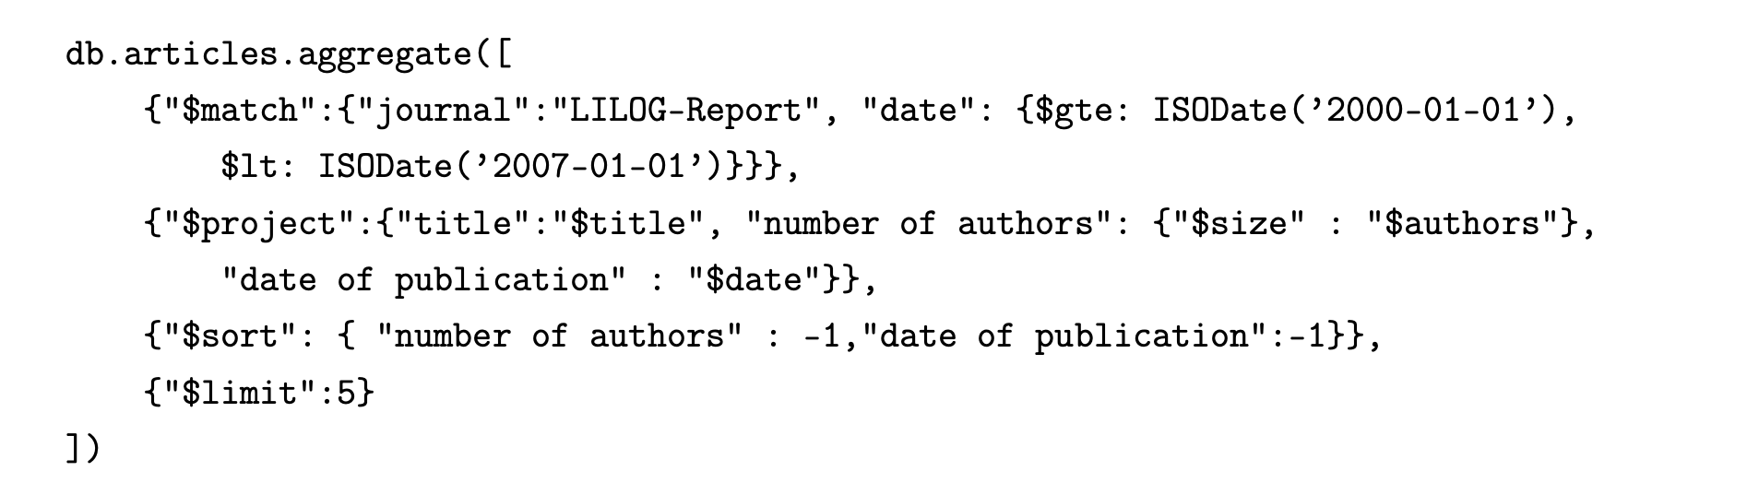
An example of a query with its result (query 2):
So far we have explained that we designed the Document schema to best fit the application domain… But what does it mean in practice ?
Imagine that a user accesses an article, probably he is interested in the author’s general information
like name and surname, probably not in bibliography…
We can perform query that involeves articles and authors without costly joins, thanks to the authors_array preview !
Results:
[{ _id: ObjectId("637a5e477cc4275cf6f3e1a4"),
title: 'Datenbankunterstützung für wissensbasierte Systeme',
'number of authors': 5,
'date of publication': 2005-10-30T20:29:07.000Z },
{ _id: ObjectId("637a5e477cc4275cf6f3e1fb"),
title: 'A Conceptual Model for Time',
'number of authors': 5,
'date of publication': 2004-05-07T23:47:03.000Z }, …

Slide 31
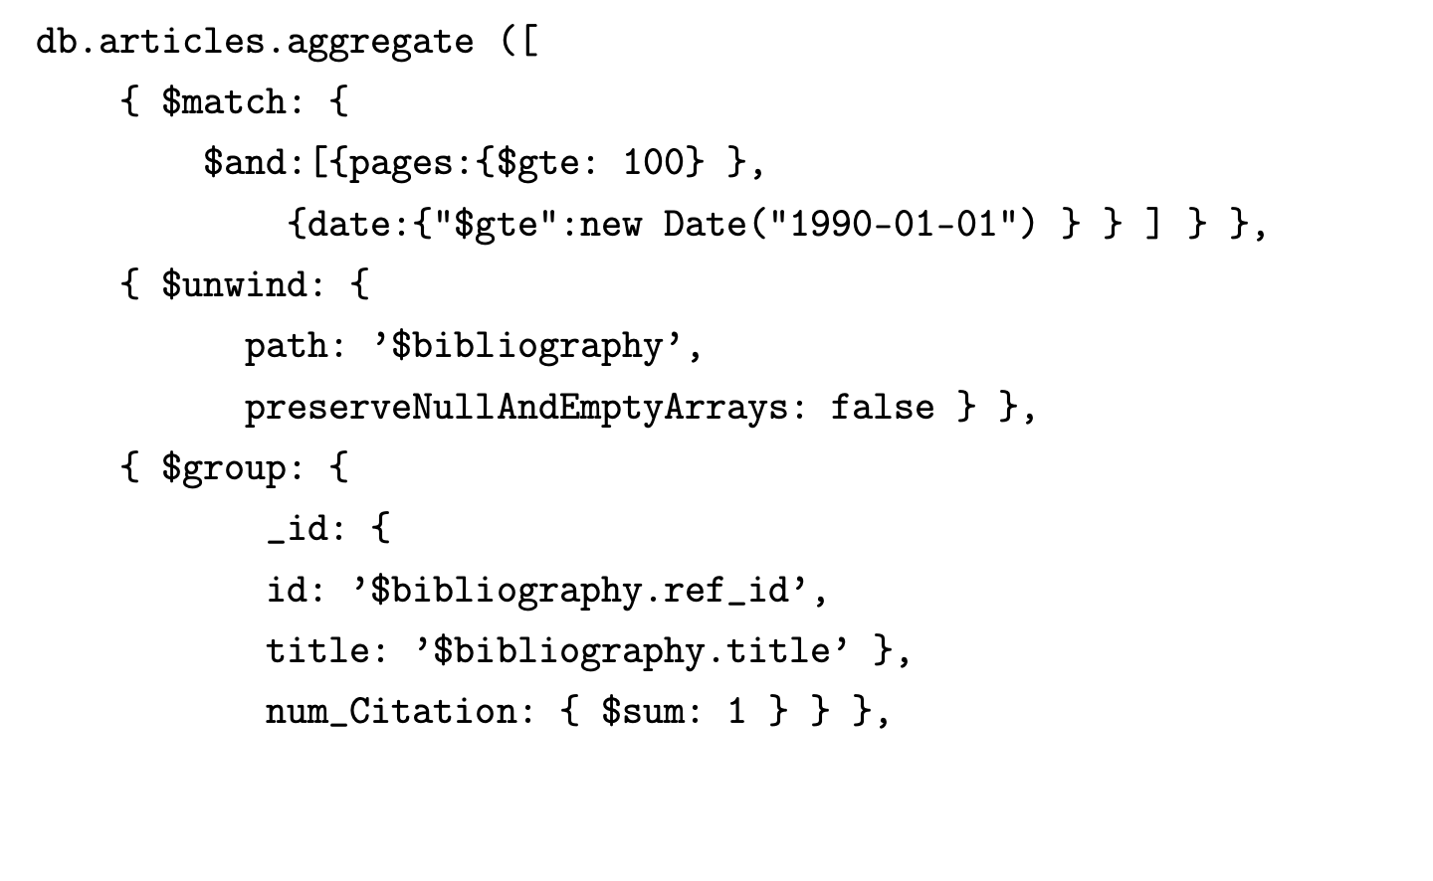
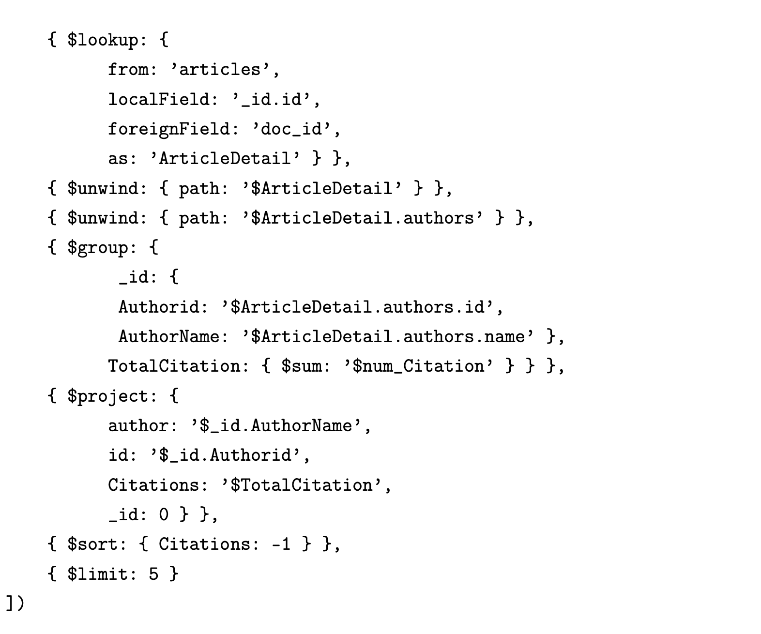
An example of a query with its result (query 14):
In this way only in really complex and rare case
a join is required (from different collections or for groups) !
For example here we didn’t need to access
to the attributes of the real documents, but we needed to
access the group.
This query retrieve the top 5 authors (from the join on the group) with the major number of citations related to articles published after 1990 and with more than 100 pages.
Results:
[{ author: 'Rebecca Davnall', id: 672, Citations: 25 },
{ author: 'Erich Gehlen', id: 19, Citations: 22 },
{ author: 'Quinn Grundy', id: 936, Citations: 21 },
{ author: 'Holger M. Wittmann', id: 75, Citations: 20 },
{ author: 'Edoardo Datteri', id: 894, Citations: 20 }]

Slide 32
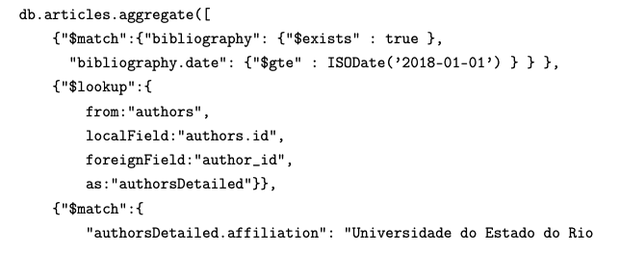
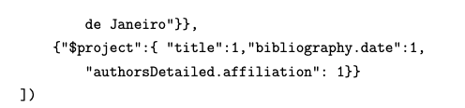
An example of a query with its result (query 4):
In this way only in really complex and rare case a join is required (from different collections or for groups) !
For example here we need to access to the authors collection because the attributes of the preview are not enough.
This query returns the articles (with all the filtered fields) that have at least one document of their bibliography published after 2018 (included) and that one of the authors is affiliated to Universidade do Estado do Rio de Janeiro.
Results:
[{…
title: 'Numerical Solution of a Semilinear Parabolic Control Problem',
bibliography:
[ { date: 2008-07-29T20:20:08.000Z },
{ date: 2021-02-10T23:37:46.000Z },
{ date: 2013-09-11T16:02:31.000Z } ],
authorsDetailed:
[ { affiliation: 'Faculté Polytechnique de Mons' },
{ affiliation: 'Universidade do Estado do Rio de Janeiro' },
…] }]

Slide 33
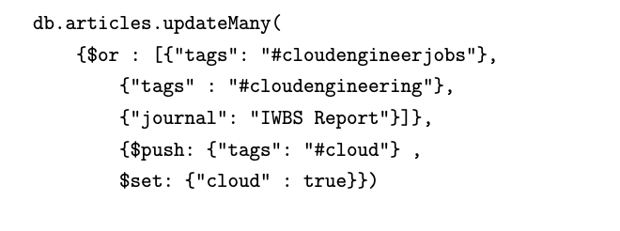
An example of a command (command 1):
What if a new kind of attribute is needed ?
We exploit the flexibility of the
doucumental structure !
A new field is added !

Slide 34
Third part (large-scale data analysis): Spark

Slide 35
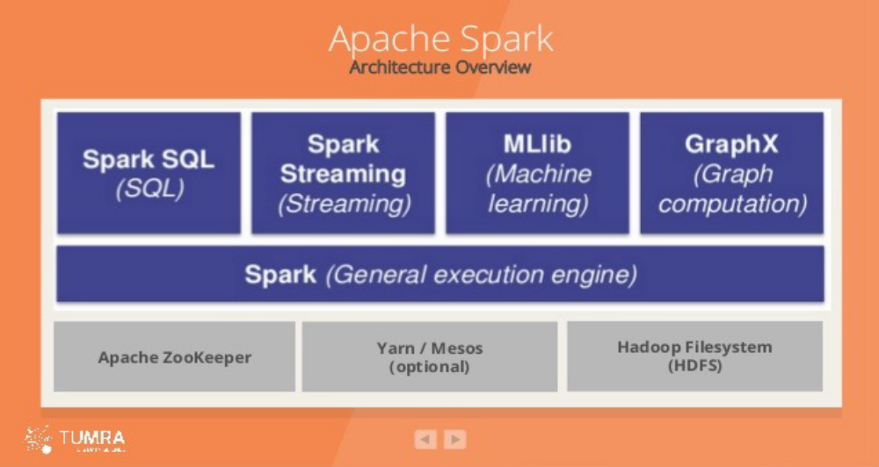
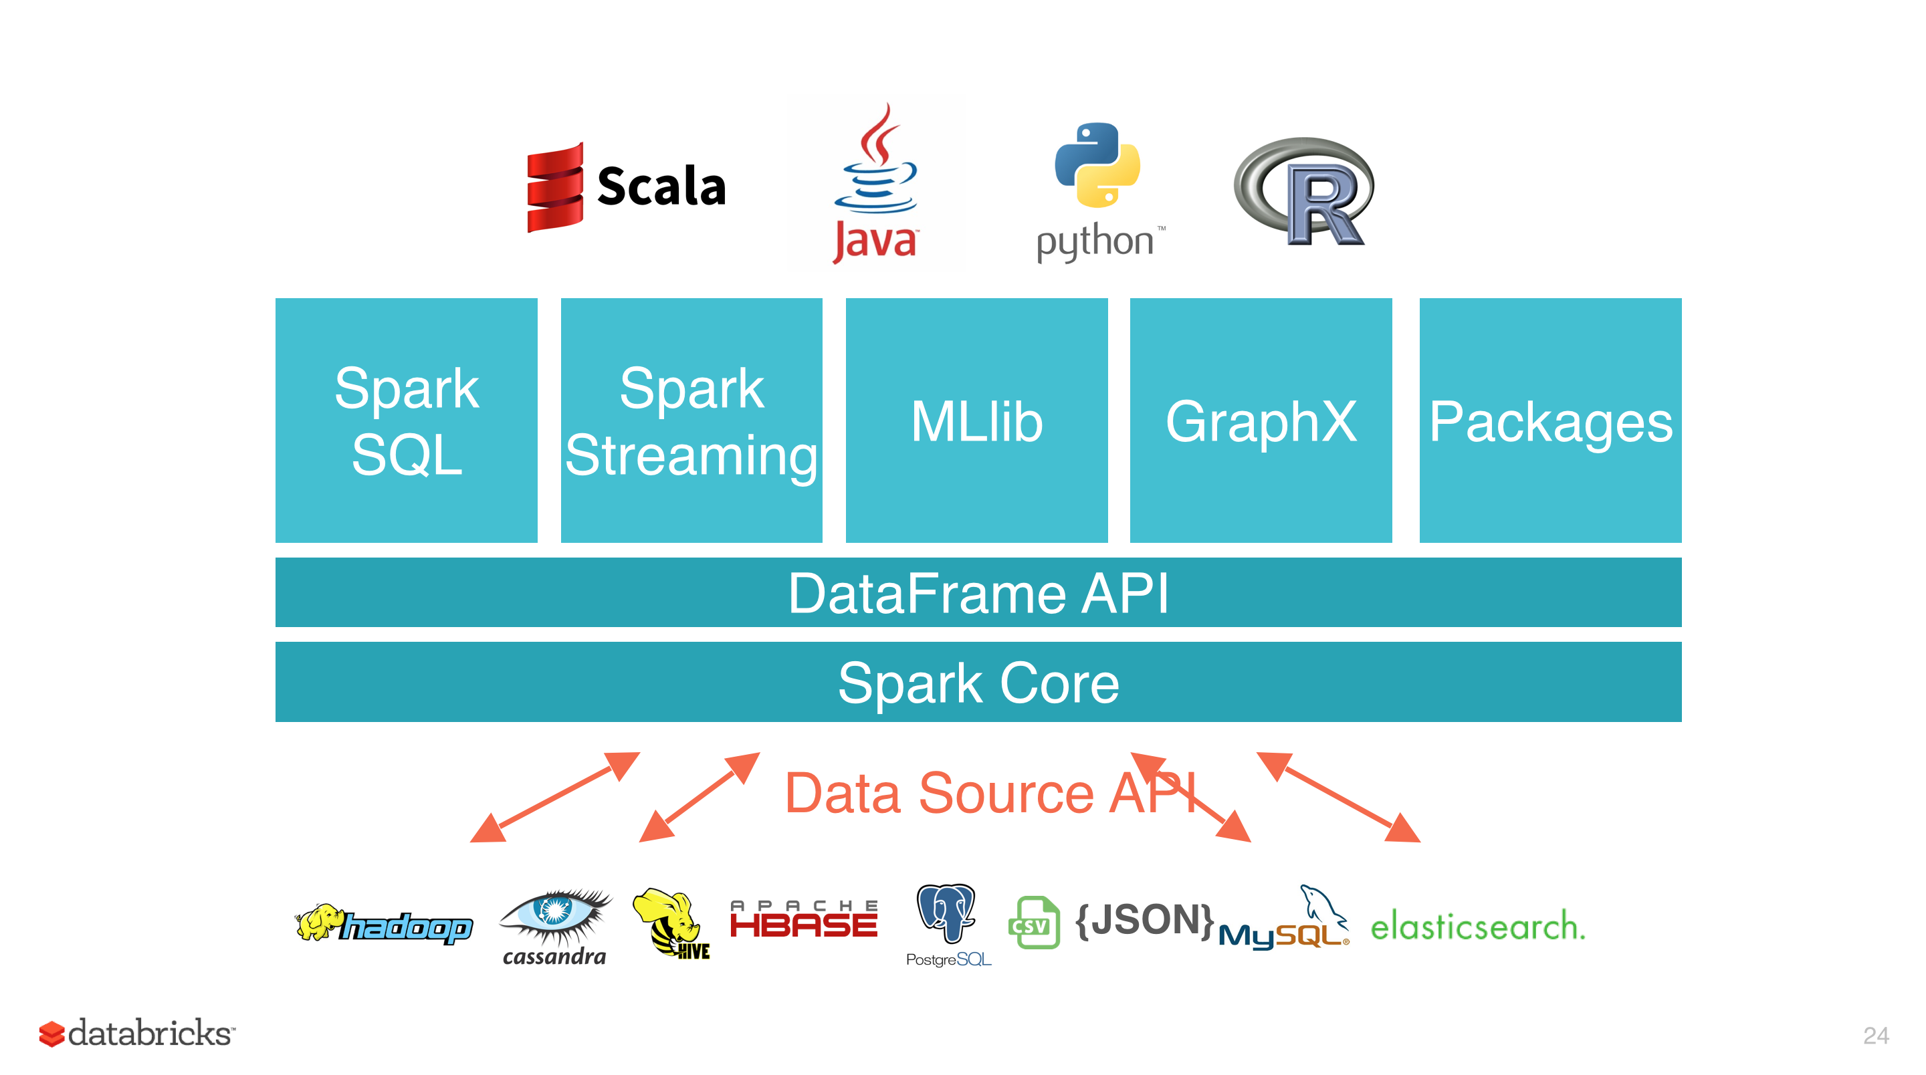
Third Part: Apache Spark
The aim of the third part is to load the data used in Neo4J on the Apache Spark distributed framework to perform analysis on them.
Data is loaded and managed into Spark using the Python library PySpark and Spark SQL is a module which lies above the Spark core and gives an higher level of abstraction in the system. It allows to work on the data as in a relational database.
It allows to work with a lot programming languages…
DBs →

Slide 36
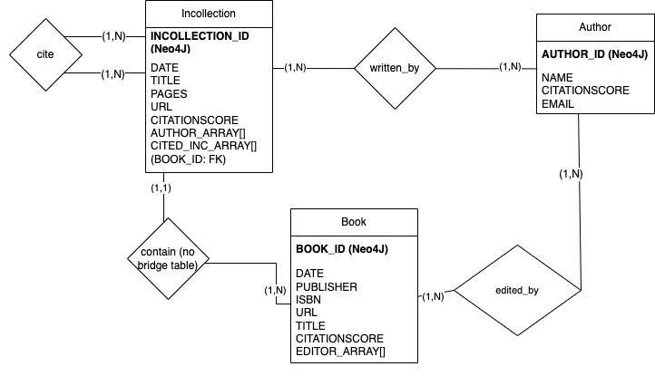
ER Diagram (for the spark assignment)

Slide 37
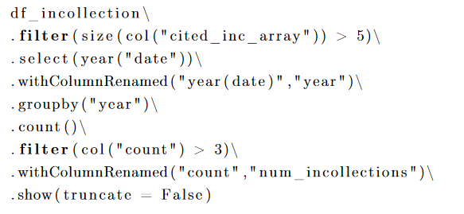
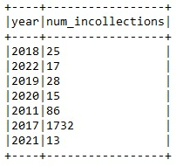
Example of a query (Query 6)
Da scegliere insieme!
This query returns the years when were published more than 3 incollections citing at least 5 other incollections.

Slide 38
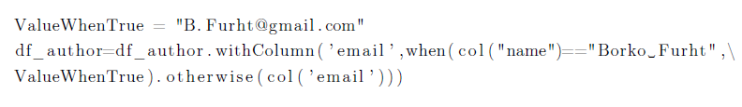
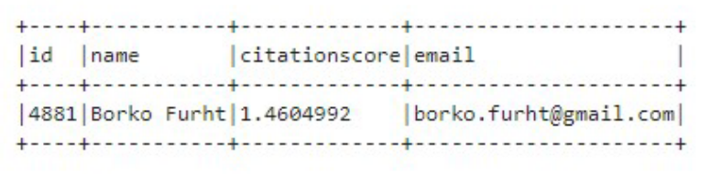
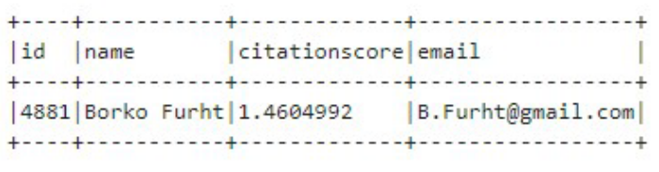
Example of a command (Command 5)
This command updates the email address of the author called «Borko Furht»
DataFrame is immutable!
Before
After

Slide 39
Conclusion

Slide 40

Conclusions:
Big challenges:
data cleaning and formatting processes
query efficiency
What we learned:
big data are important to make more accurate decisions
initially it is very easy to overestimate data quality
References:
https://github.com/alessandroromito/SMBUD-project2022
https://www.overleaf.com/project/63515ce30659266f3659cda8
Notes:
data cleaning script in python x

Slide 41

Titolo presentazione sottotitolo
Thank you for your attention!
Group 09
Francesco Riccardi
10651584
Alessandro Romito
10661916
Marco Luca Previtera
10682248
Milano, XX mese 20XX
Simone Lo Gatto
10736180
Lorenzo Ferretti
10713719
Professors:
Prof. Marco Brambilla
Dr. Andrea Tocchetti
2022 - 2023

