Slide 1

Lo sputo del secolo, siamo tutti delle merde calpestate da Tocchetti.
Politecnico di MIlano, Gli sputatori:
Dr. Andrea Tocchetti ,Prof. Marco Brambilla
SMBUD Project Presentation
AA 2022-2023
Politecnico di Milano
Professors:
Prof. Marco Brambilla
Dr. Andrea Tocchetti
Francesco Riccardi (10651584)
Alessandro Romito (10661916)
Marco Luca Previtera (10682248)
Simone Lo Gatto (10736180)
Lorenzo Ferretti(10713719)
Group-09

Slide 2
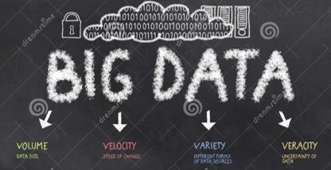
Introduction to the project
(Frenk è il migliore)
The aim of the project is to show that we are able to manage a very large quantitative of data. We had to use three different type of databases as show next.
The chosen Dataset is the DBLP computer science bibliography. It is the on-line reference for bibliographic information on major computer science publications. As January 2019 DBLP contains over 4.4 million publications, published by more than 2.2 million authors. The Dataset is divided in different types of publication (article, book, incollection, proceedings, inproceedings, www, mastersthesis) followed by their features and details.
The Dataset has been subject to a process of elaboration and extraction in order to clear the data and take care of their quality, indeed, limited quality data could "cause a series of consequences for efficiency".

Slide 3
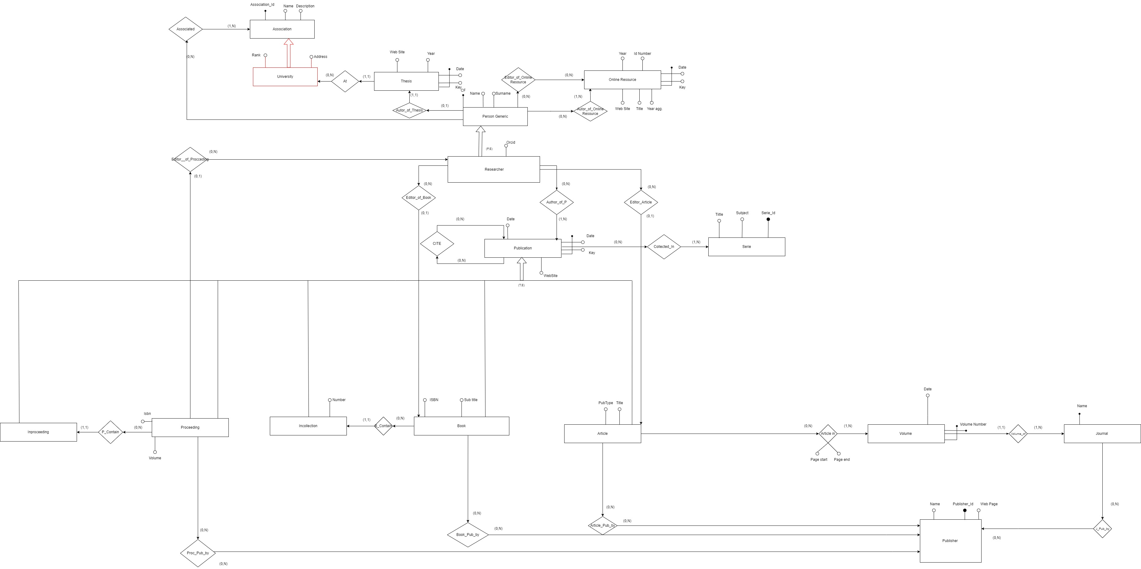
ER Diagram
The designed ER diagram contains the following entities: Person generic, Researcher, Book, Article, Journal, Proceeding, Inproceeding, Incollection, Publisher, Thesis, Online Resource, Association, Serie. Some classes have been introduced due to ER diagram correctness reasons, but they haven’t been taken into account during the design of the databases used in the assignments for ease of management.
Entities are retrieved through a process of data analysis in which the hierarchy has been structured according to the XML file, instead, attributes are selected in a way that only the most relevant ones are kept for the project.

Slide 4
First part (graph DB): Neo4J
(che merda)
The aim of this assignment is to design a query graph data structure in Neo4j for supporting a bibliographic Database. The database must store a large scale Dataset recording publications with their features and their descriptions in order to have an overview of the library.
Neo4j is an open-source, NoSQL, native graph database that provides an ACID-compliant transactional backend for your applications that has been publicly available since 2007.
In the next slide there is a figure that represents the type of database.

Slide 5
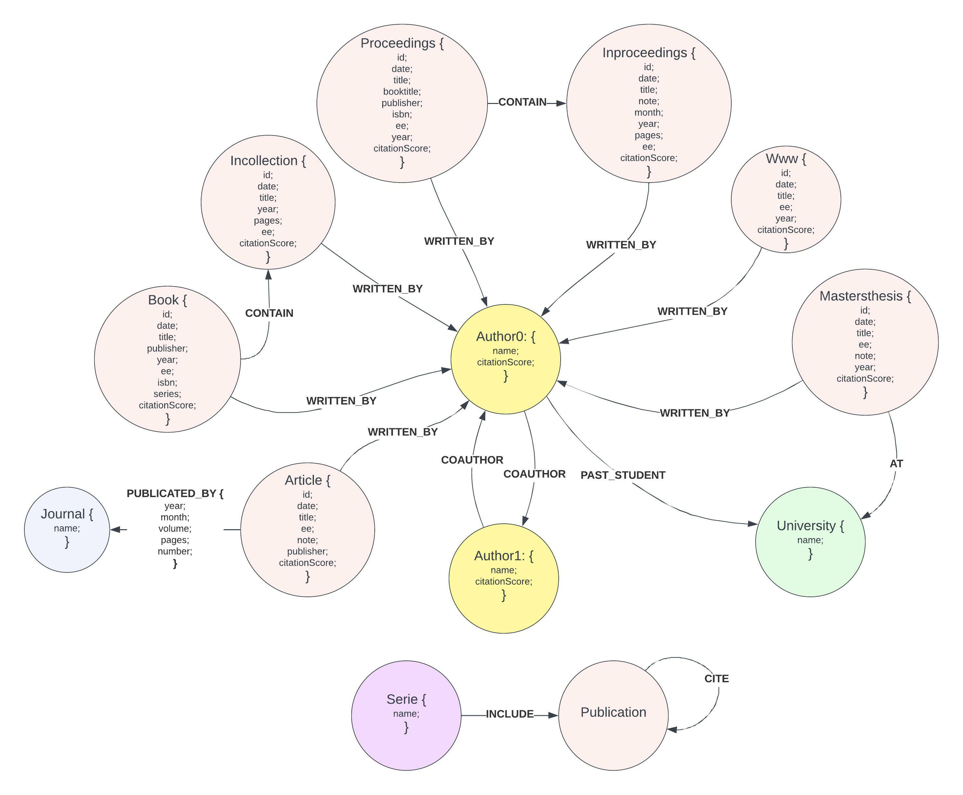
Author, Article, Journal, Book, Incollection, Proceedings, Inproceedings, Www, Mastersthesis, Publication, University and Serie are Node labels and their attributes are shown in the graph diagram near. The relationships of the database are WRITTEN_BY, CONTAIN, PUBLICATED_BY, COAUTHOR, AT, CITE, INCLUDE. We omitted some links using the publication note make graph diagram more readable and understandable.The nodes Article, Book, Incollection, Proceedings, Inproceedings, Www, Mastersthesis contain the Publication tag in order to perform and understand queries easily since you don't need to specify 7 different nodes in the MATCH statement every time.

Slide 6
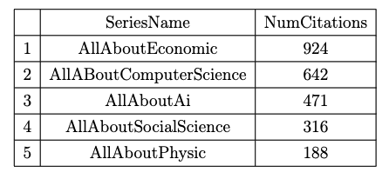
An example of a query with its result (query 12):
In this query there is a match of series that contains a type of publications with the quotes to other publications. After there is (again) a match with all the quotes to publications (that are in the specific serie, except other that are already in that serie). Finally there is a collect of the number of citations (found before) in a best 5 classification.
The complexity is: 3 nodes + conditions + aggregations + limit.
MATCH(s:Serie)-[:CONTAIN]->(p1:Publication)<-[c:CITE]-(p2:Publication)
WITH s , collect(p2) AS pubs, p1
MATCH (p1)<-[c2:CITE]-()
WHERE NOT p1 IN pubs
WITH size(collect(c2)) AS NumCitation2,s
RETURN s.name, NumCitation2
ORDER BY NumCitation2 DESC
LIMIT 5

Slide 7
An example of a command(command 1):
This command is used to update the citationScore attribute of the publications. In the first part of the command it is checked if already exist a graph called “citationsGraph” in the gds library. If this graph already exist, it is dropped.
In the second part of the command we create a new graph in the gds library (using the command project) containing all the CITATION relationships between publications. Finally on this graph it is launched the PageRank algorithm (gds.pageRank.stream) which calculates all the indexes that will be written as attribute in the corresponding publication nodes.
CALL gds.graph.exists('citationsGraph')
YIELD exists as ex
CALL apoc.when(ex, 'CALL gds.graph.drop("citationsGraph") YIELD graphName AS G')
YIELD value AS val
CALL gds.graph.project.cypher('citationsGraph',
'MATCH (n :Publication) WHERE n.consistencyStatus=false
RETURN id(n) AS id',
'MATCH (n)-[c:CITE]->(p) RETURN id(n) as source, id(p) as target ,
type(c) as type, c.weight as weight')
YIELD graphName as graph, nodeCount, relationshipCount
CALL gds.pageRank.stream(graph)
YIELD nodeId, score
MATCH(n:Publication)
WHERE id(n) = nodeId
SET n.citationScore =score
SET n.consistencyStatus=true

Slide 8
Second Part (documental DB): MongoDB
Ma documentami sta minchia
The aim of this second part is to design, structure and implement a document database in MongoDB to store a collection of articles.
Comparing this assignment to the first, the focus of the specification has moved from the generic description of the publications and their relationships to the detailed description of a single article.
In fact, it is asked to create a DB capable of containing many information about the article and also its complete text, divided into sections and paragraphs.

Slide 9
Articles and authors are our collections of documents.
Each article contains the main information needed:
Relevant information stored in different attributes including the tile, an url representing the correlated online resource, date of publication.
The doc_id that is a unique identifier associated with each article, it's assigned to each article when it's published.
List of tags (such as \#cloud)
List of authors, stored as an array of Author_preview sub-documents. The Author_preview sub-document is designed with the aim to provide the most relevant information of an author that usually, in our application domain, it's accessed together with the related article.
The Text_data sub-document which includes all the article text structure and the related data.
The Section sub-document represent a section of an Article.
Bibliography with the list of all the referenced articles.
An Article_preview sub-document include all the principal information related to an article that are usually accessed.
Each author in the authors collection contains several attributes that give more personal information (such as biography, email, affiliation) and also a list of all the articles written by himself, stored as an array of Article_preview.
In the next slide there are the document schema and an example of article.

Slide 10
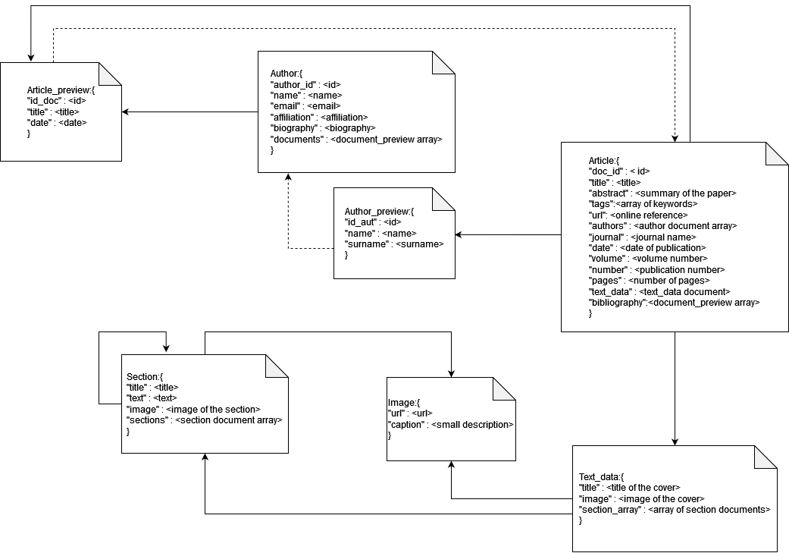
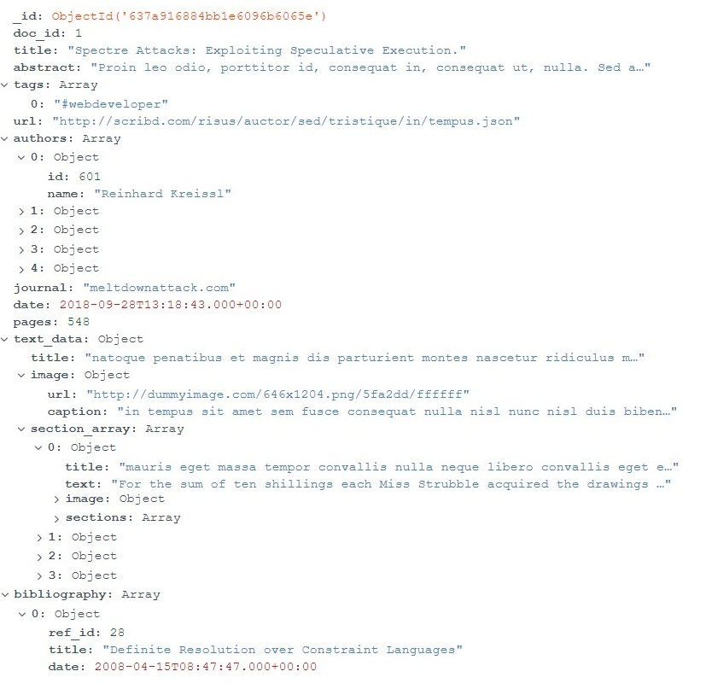

Slide 11
An example of a query with its result (query 9):
This query takes all documents with more than 500 pages and date less than 2013-04-11, there is a sorting by the pages in ascending order, an unwind by referenced articles (bibliography) and takes all those with date greater than 2013-04-11 returning only the title of the ref and the doc_id of the source document. It shows only the first 10 results. Complexity: Filtering (also con subdocs), aggregation, unwind, refs.
db.articles.aggregate([
{ $match: { $and: [
{ pages: { $gte: 500 } },
{ date: { $lt: ISODate('2013-04-11T00:00:00.000Z') } } ] } },
{ $sort: { pages: 1 } },
{ $unwind: { path: '$bibliography' } },
{ $match: { 'bibliography.date': {
$gte: ISODate('2013-04-11T00:00:00.000Z') } } },
{ $project: { 'bibliography.title': 1, doc_id: 1,
_id: 0 } },
{ $limit: 10 }
])
[{ doc_id: 29,
bibliography: { title:'Datenbankkonzepte für wissensbasierte
Systeme'}},
{ doc_id: 280,
bibliography: { title: 'Temporales Schließen in einem
natürlichsprachlichen System' } },
{ doc_id: 383,
bibliography: { title: 'Chart-Parsing of Unification-Based
Grammars with ID/LP-Rules' } },
{ doc_id: 383,
bibliography: { title: 'Locating Matches of Tree Patterns
in Forests' } },
{ doc_id: 383,
bibliography: { title: 'Object Oriented DBMS as a Generalization
of Relational DBMS' } }, …

Slide 12
An example of a command(command 3):
This command updates the articles that have the tag "#information" and adds the article with id 250 in bibliography if the articles we are updating already don’t contain doc_id and ref_id equal to 250 which is the document we are trying to insert. In this way we are avoiding adding the article in its own bibliography or to have the same articles twice if it already exists in bibliography. In this scenario, we are assuming that the articles we are adding in the bibliography are already contained in the db.
db.articles.updateMany(
{
"doc_id":{$ne:250},
"bibliography.ref_id":{$ne:250},
"tags":"#information"},
{“$push”: {bibliograpy: { ref_id: 250, “title”:
" Die Sloppy/Referenzielle Ambiguität: Bildungssyntax oder
Diskursrepräsentationstheorie?",
“Date": new ISODate("1998-08-16") } } } )

Slide 13
Third part (high scaling DB): Spark
E chi cazz o sap cosa ci daranno

Slide 14
Examples of queries and commands:
Da scegliere insieme!

Slide 15
Conclusions:
Guardate che bel template che vi ha fatto il vostro napoletano del cuore
Ovviamente I link sotto non potranno aprirli loro quindi sucano ciao
This project was very useful to understand how to manage a lot of unstructured datas, also using script to “purify” them!
The group works well together.
References:
https://github.com/alessandroromito/SMBUD-project2022
https://www.overleaf.com/project/63515ce30659266f3659cda8

Slide 16
The day of the final presentation is approaching. Hence, here are the guidelines for the presentations
All team members must be present for the presentation. In that case, another team member will pitch the part assigned to that team member. Furthermore, the unmotivated absence of a team member will affect the final evaluation of the whole group.
Every single team member will present a part of the project (i.e., assumptions & problem presentation, the most important part of the ER diagram, Neo4j data structure & 1 important query with the results, MongoDB data structure & 1 important query with the results, Spark data structure and 1 important query with the results; be sure that the queries are all different and present the parts of the ER diagram that are meaningful to perform them).
The time slot will last 20 minutes (15 minutes for the presentation, around 3 minutes for each team member, and potentially 5 minutes for the questions).
The slides must be in English, while the oral pitch can be performed in Italian and English (do not mix between them, please).
Use the standard Polimi slides. You can find them on the web.
The evaluation will be assigned based on the performance of the whole group.
Each group member should be prepared to answer questions regarding any part of the presentation and project. The fact that you presented the 1st part doesn't mean we can't ask you questions on the last one. Keep in mind that we can also ask questions on the part of the project you are not going to present. Hence, keep the final document at hand.
We are still trying to get a classroom to simplify the presentation process. We'll let you know about the rooms in the following weeks.
Be there at least 5 minutes before the presentation. If we tell you that you can join the presentation room even if it is not your turn, please be quiet.
If you can, also prepare a small part about the scripts or the extra code you implemented so you can present it if there's some leftover time

