Slide 1

ANALYSIS OF AN AIRPORT NETWORK DISEASE SPREAD MODEL
Marco Minchella
marco.minchella@studenti.unipd.it

Slide 2
CONTENT ROADMAP
Research questions
The network:
dataset, degree distributions, centralities, assortativity, robustness
The epidemic model:
SEIR model on the WAN
Community structure:
Louvain and InfoMap
Vaccination strategies :
Strategies results analyisis
Conclusions

Slide 3

WHAT ARE THE RESEARCH QUESTIONS?
  What are the characteristics of the World Airport Network? Does it have any interesting properties?
  Is hub targeting the best way to obstruct a disease spread? Are there other preferable approaches?
  How do our results change if we factor in the economic aspect of shutting down entire airports?

Slide 4

THE NETWORK

Slide 5

WHY THE GLOBAL AIRPORT NETWORK?
  Air transport is defined as a major channel for the spread of epidemics [1]
  Airport networks are also used as benchmarks to verify whether a centrality measure really works [2]
  On a global scale, the WAN is the primary driver of viral seeding across distant urban hubs. Given its massive throughput and point-to-point topology, air traffic data provides a high-fidelity approximation for long-range epidemic forecasting [3]

Slide 6

THE DATASET
  Airports & routes taken from OpenFlights.org
  Mean daily flights taken from FlightConnections.com
  Airports/city population taken from WorldPopulationReview.com
NODES | EDGES | POPULATION
3933 | 50158 | 2.685.490.062

Slide 7
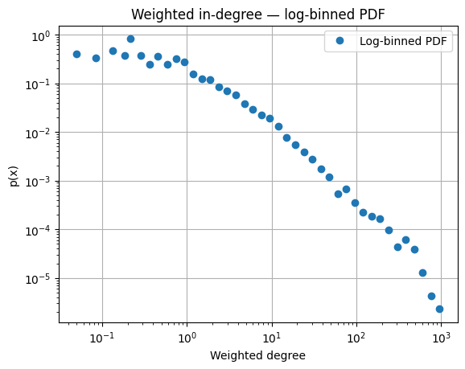
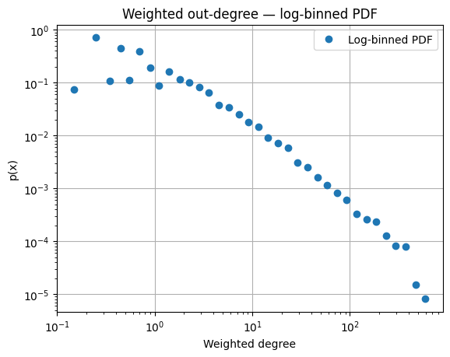
DEGREE CENTRALITIES DISTRIBUTIONS

Slide 8
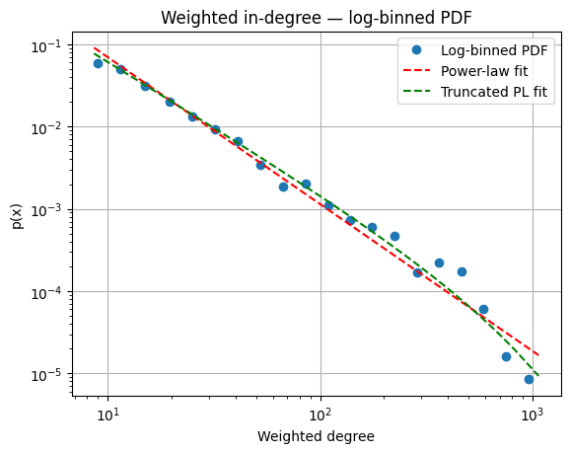


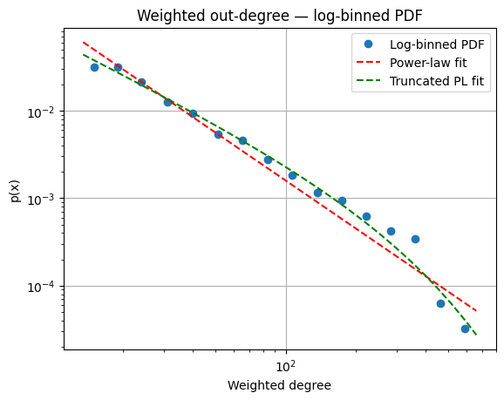
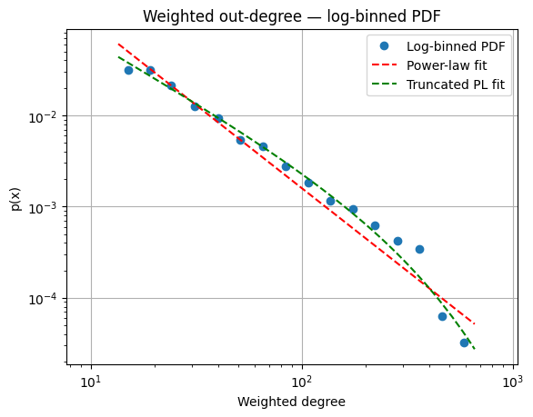
DEGREE CENTRALITIES DISTRIBUTIONS
What do these graphs tell us?
Both weighted degree distributions are heavy-tailed, but neither follows a pure power law
Likelihood-ratio tests favour a truncated power law in both directions, more decisively for out-strength (R = −48.4) than for in-strength (R = −23.7)
 | x min | gamma (pure PL) | k_c (truncated PL) | gamma (truncated PL)
Weighted in-degree | 8,6 | 1,787 | 1/0,0013 = 750 | 1,58
Weighted out-degree | 13,5 | 1,817 | 1/0,0034 = 292 | 1,328
Why does this happen?
Heavy-tailed degree distributions are expected (i.e. demand concentration in major metropolitan areas), but there are strong real-world constraints that introduce a cutoff:
  Finite capacity at airports (runway slots, gates, crew and fleet limitations, etc)
  Scheduling and regulatory constraints
  Demand and operational efficiency saturate

Slide 9
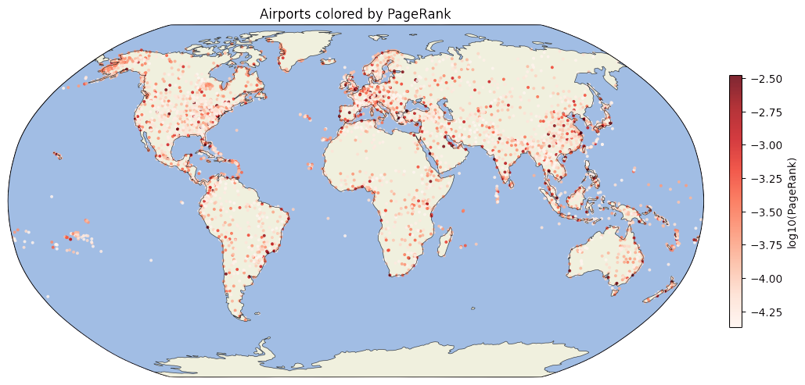
PAGERANK
The majority of high PageRank airports tend to be clustered in North America, Europe and East Asia

Slide 10
PAGERANK
Rank | Airport | PageRank (10^-3)
1 | Chicago O'Hare International Airport | 7.125
2 | Hartsfield Jackson Atlanta International Airport | 6.912
3 | Istanbul Airport | 6.323
4 | Los Angeles International Airport | 5.639
5 | Dallas Fort Worth International Airport | 5.595
6 | Amsterdam Airport Schiphol | 5.573
7 | Charles de Gaulle International Airport | 5.459
8 | Denver International Airport | 5.427
9 | Sydney Kingsford Smith International Airport | 5.372
10 | London Heathrow Airport | 5.339
11 | Sheremetyevo International Airport | 5.152
12 | El Dorado International Airport | 5.090
13 | Frankfurt am Main Airport | 4.887
14 | Indira Gandhi International Airport | 4.855
15 | Adolfo Suárez Madrid–Barajas Airport | 4.767
PageRank can be interpreted as:
“a node is important if it is linked to by important nodes”
Reasonable proxy for arrival risk and for identifying “waypoints” in global spread
Is it the best measure to estimate which nodes should be removed?
It’s a good measure, but literature shows we can do better...[4]

Slide 11
PAGERANK AND WEIGHTED DEGREE
Does it make sense to combine these two measures?
  Weighted degree is a purely local measure. PageRank propagates importance through the whole network.
  Idea: take sᵢ = p̃ᵢ · w̃ᵢ​, the product of min-max normalised weighted PageRank and weighted degree. Look at airports that are both high-volume and structurally central
  Literature shows it’s one of the most powerful combinations for predicting the absolute size of the outbreak[4]

Slide 12
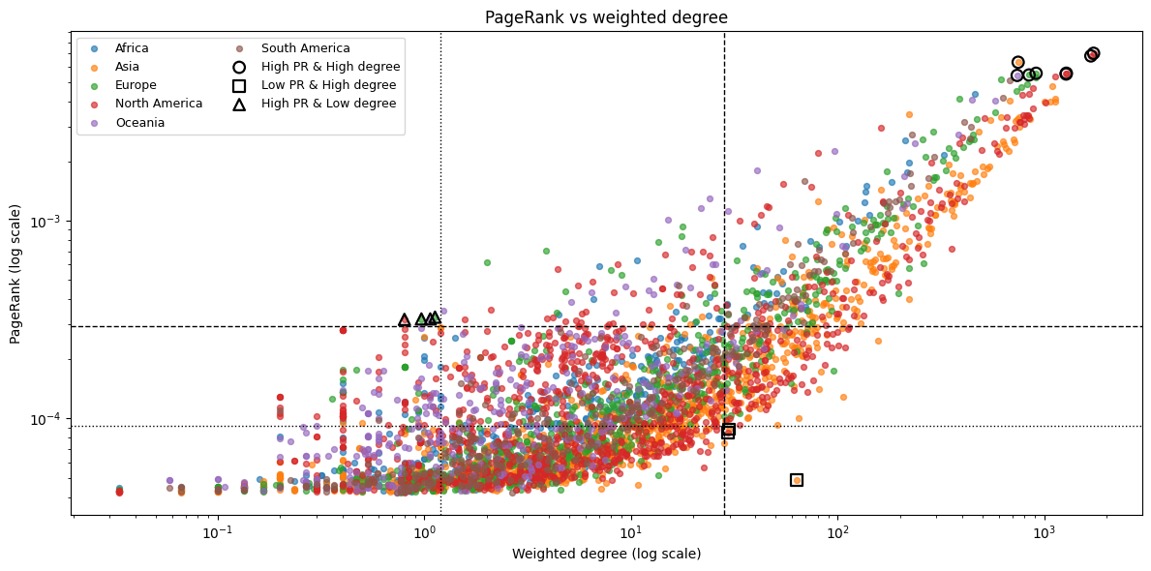
PAGERANK AND WEIGHTED DEGREE
High degree, high PageRank nodes are the main global hubs
High degree, low PageRank nodes tend to be in tightly packed communities [4]

Slide 13
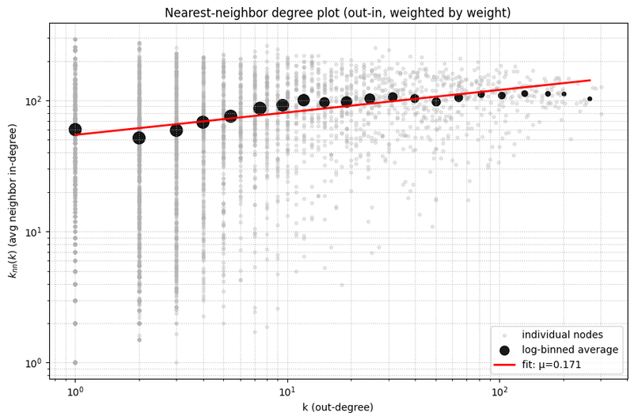
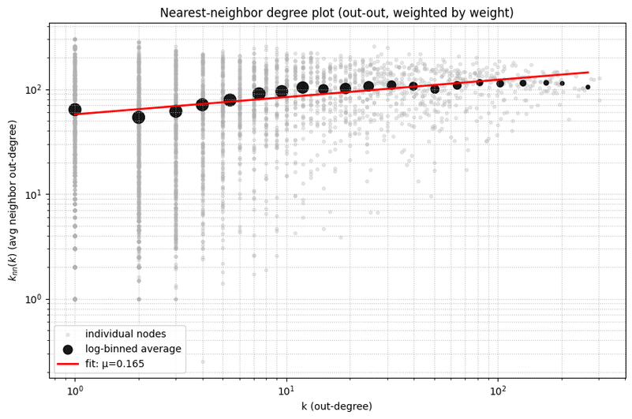
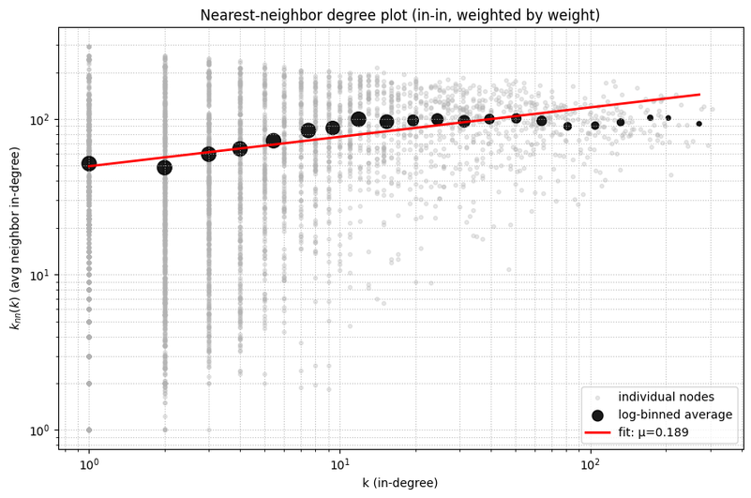

ASSORTATIVITY

Slide 14
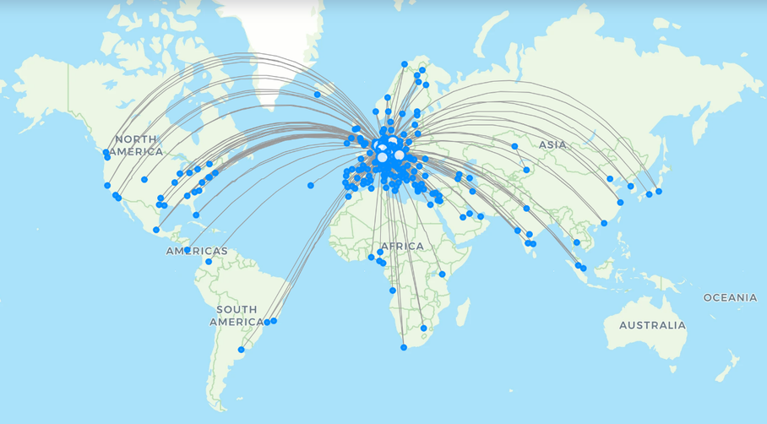
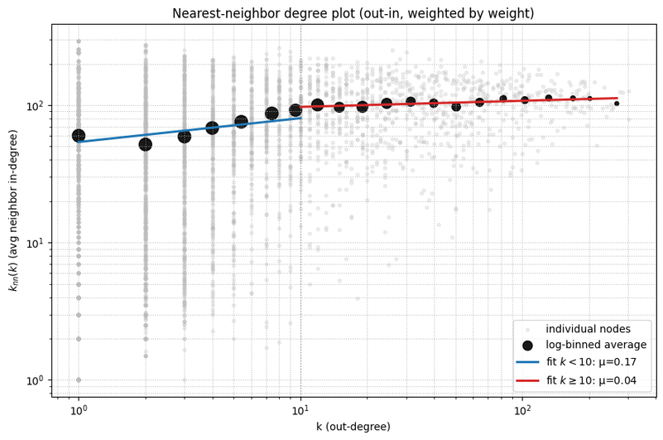
ASSORTATIVITY - A CLOSER LOOK
What do the nn degree plots tell us?
  All fitted exponents are positive, with μ⩾0.165
  The network is assortative
But is the whole network assortative?
  Restricting the fit to k≥10 (major hubs) gives μ≈0.04 i.e. essentially flat
  The positive slope is driven almost entirely by airports with k<10
Lufthansa’s air routes: they connect to other hubs (i.e. LAX) as well as small airports
Why?
  Small/medium airports connect preferentially to similarly-sized peers → the network behaves like an assortative mesh of highly interconnected regional and domestic communities
  Major hubs must connect to airports of highly variable size to fulfill their collecting role → this produces a plateau
  Consistent with Barrat et al. (The architecture of complex weighted networks, 2004)

Slide 15
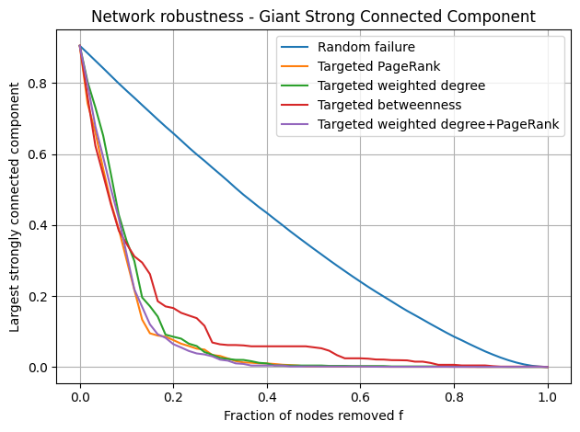
LET’S BREAK THE NETWORK: ROBUSTNESS ANALYSIS
  GSCC starts at 0.905, around 370 airports lie outside the giant strongly connected component
  Targeted attacks: f ≈ 0.15 collapses the core, except betweenness, which leaves a residual periphery up to f ≈ 0.65
  The residual core under betweenness attack is the assortative low-degree mesh seen in assortativity analisys

Slide 16
COMMUNITY STRUCTURE

Slide 17
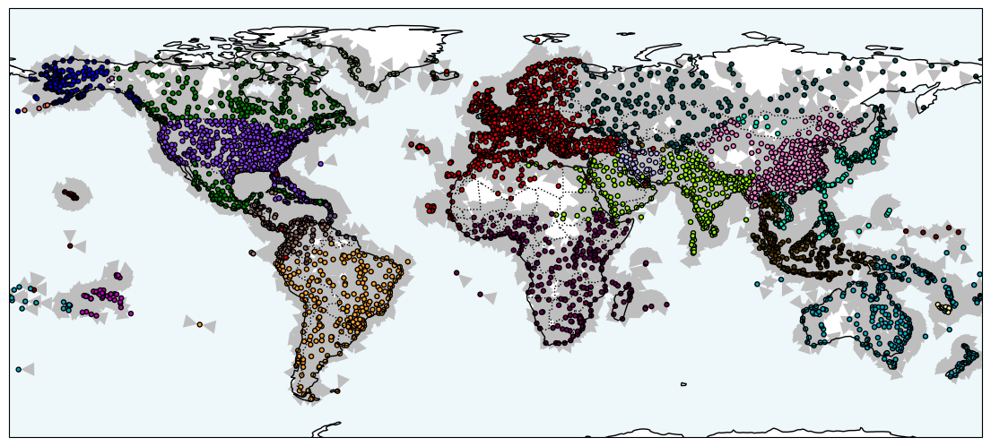
COMMUNITY DETECTION: LOUVAIN
Communities align with geographic and geopolitical regions

Slide 18
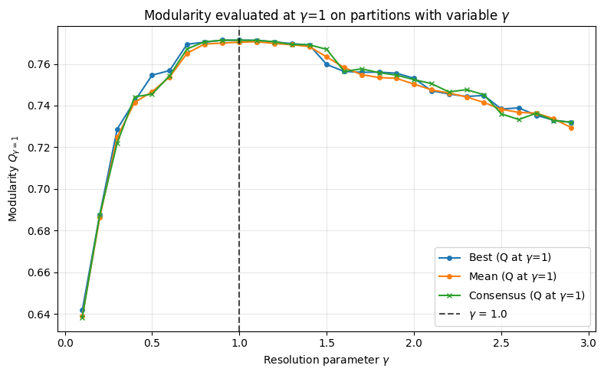
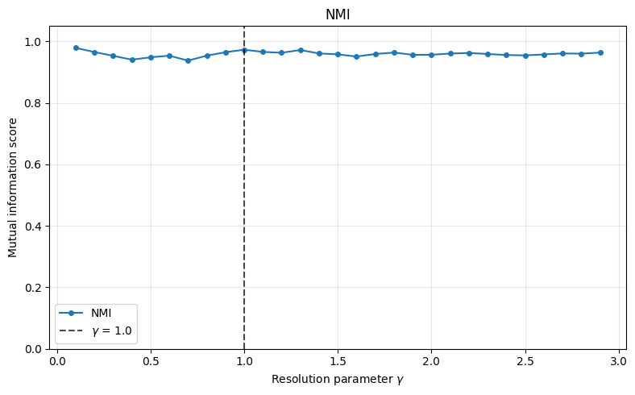
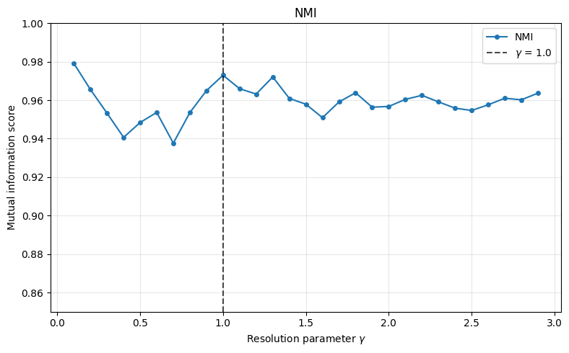
COMMUNITY DETECTION: LOUVAIN
To select the optimal resolution parameter, consensus clustering was employed with 50 iterations.
Observing the modularity score we get its peak value at a resolution value of 1, while also exhibiting a local peak in NMI.
COMMUNITIES | 30
MODULARITY | 0.7714
CODELENGTH | 6.9195
NMI (stability) | 0.9767

Slide 19
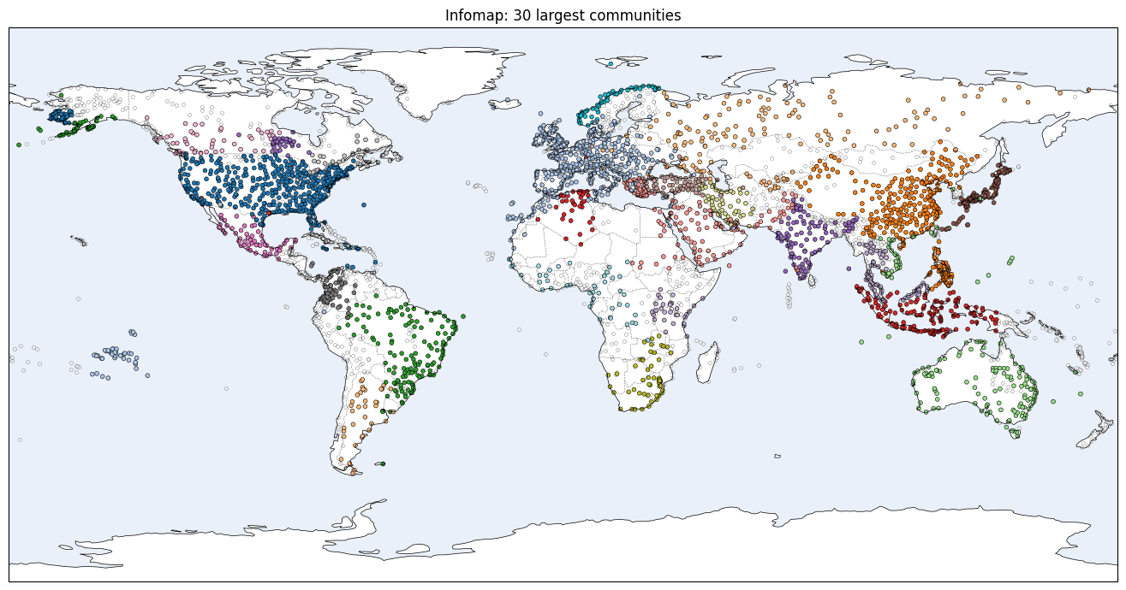
COMMUNITY DETECTION: INFOMAP

Slide 20
COMMUNITY DETECTION: INFOMAP
Minimises the map equation: cost of describing a random walk with a two-level code.
Modules are regions where flow gets trapped. They are plausible epidemic basins .
Consensus clustering was employed with the same number of runs as in Louvain.
COMMUNITIES | 148
MODULARITY | 0.7312
CODELENGTH | 6.5250
NMI (stability) | 0.9859

Slide 21
LOUVAIN VS INFOMAP
 | InfoMap | Louvain
COMMUNITIES | 148 | 30
MODULARITY | 0.7312 | 0.7714
CODELENGTH | 6.5250 | 6.9195
NMI (stability) | 0.9859 | 0.9767
As expected Louvain wins on modularity while InfoMap minimizes the codelength.
These communities results will be used to drive vaccination strategies...

Slide 22


THE EPIDEMIC MODEL

Slide 23

THE EPIDEMIC MODEL
SEIR model
Susceptible
Exposed
Infected
Recovered
β
σ
γ
R0 = Basic reproduction number. Key value, higher rate means increased aggressiveness
β = Transmission rate ≈ γ*R0
σ = Infection rate = 1/Latent period
γ = Recovery rate = 1/Infectious period

Slide 24

THE EPIDEMIC MODEL
Stochastic SEIR model: breakdown on a single node
  The Probability: Continuous rates (like β or γ) are converted into discrete probabilities using
This calculates the chance of a single individual transitioning within the time step dT.
  The Usage: These probabilities act as the "success rate" in a Binomial distribution. The model treats each subsceptible as an independent trial.
  Why Integers: Because the Binomial distribution samples a specific count of successes, the output is always a whole number. This prevents "fractional people" and captures the natural randomness (stochasticity) of real-world outbreaks.

Slide 25


THE EPIDEMIC MODEL
Stochastic SEIR model: inter-nodes infection
  Each infected node (I>0) has a certain probability of infecting successor nodes with at least one susceptible individual
Node k
Node i
  Daily flights are treated in 2 different ways
  Taken from Poisson distribution with mean equal to the edge’s weight if mean flights are less than 20
  Treated as a deterministic value but with a probability of cancellation of 2% if mean flights are equal or more than 20
  P(Node i gets infected) is calculated as follows:
Node u

Slide 26


VACCINATION STRATEGIES

Slide 27
VACCINATION STRATEGIES
Basic hypothesis and rules
  Vaccinating a node = Closing down the airport
  Each strategy selects 5% of the nodes
  Perfect contact tracing
  Vaccination is immediately in effect
  Flight grounding is the only restriction strategy
  Economic impact of a strategy is directly proportional to the foreclosed flights. The cost is calculated on daily grounded planes.

Slide 28
VACCINATION STRATEGIES
The adopted strategies were:
  No vaccination: Serves as baseline
  Random: Nodes were selected at random
  Hub: Targeting nodes with highest weighted degree
  Hub + PageRank: Targeting nodes with highest PR and weighted degree
  Betweenness: Targeting nodes according to their betweenness centrality
  Louvain bridges: Targeting nodes in each community that had many connections to other different communities
  Infomap bridges: same criterion, applied to the Infomap partition
  Collective Influence: Removal is based on scores that measure how much connectivity lies on a node's 2-hop frontier and removes nodes greedily recomputing after each removal.

Slide 29

VACCINATION STRATEGIES - A CLOSER LOOK
How are communities used in this scenario?
For each airport in a community, compute the Shannon entropy of its outgoing traffic across communities
where p_i,c​ is the fraction of out-traffic directed to community c.
Vaccination targets = entropy × total out-traffic, so a bridge only ranks high if it carries meaningful volume and if traffic spread across many communities

Slide 30

VACCINATION STRATEGIES - A CLOSER LOOK
How about the Collective Influence?
It is inspired by the work of Morone & Makse, Influence maximization in complex networks through optimal percolation (2015) adapted to a directed weighted network with the frontier follows outgoing edges only
Scores each airport by the product of its own out-strength and the total out-strength of all nodes exactly 2 hops away
where s is the weighted out strength and g is the max between s and 0. The non-negativity function is retained from the original formulation, where the original argument (i.e. reduced degree k−1) could vanish

Slide 31
VACCINATION GOALS
  Protect as many nodes as possible
  Delay and reduce the peak
  Protect as much population as possible
  Select the most cost efficent strategy

Slide 32
SIMULATIONS
8 different starting seeds were selected: Chicago, Atlanta, Los Angeles, Istanbul, London, New York JFK, Pago Pago and Uzhorod
3 different R0 were selected: 1.2, 1.9 and 2,8
Each combination of seed and R0 was run 30 times, except for R0 = 1.2, which was run 50 times
Due to computational limitations, the runs were capped at 548 days or 1 and a half years

Slide 33
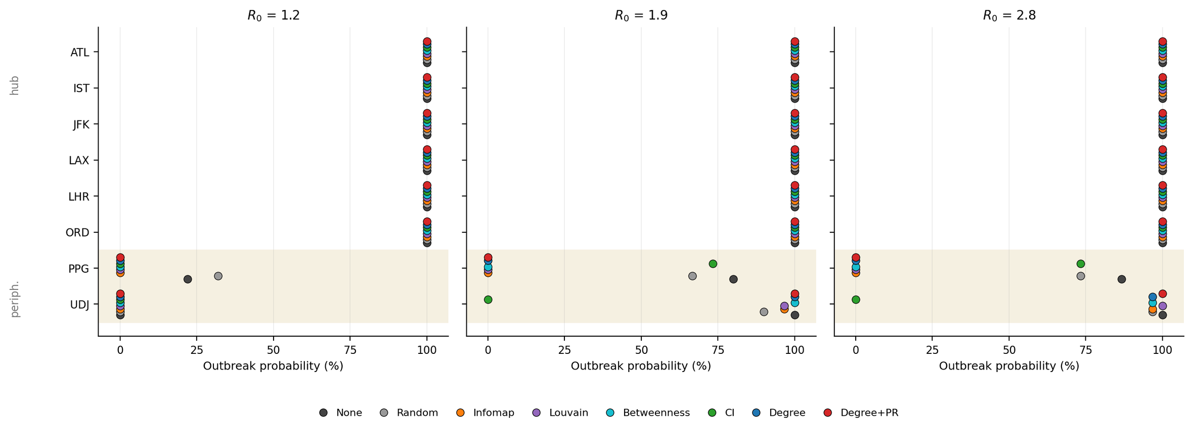
RESULTS - OUTBREAK PROBABILITY
Outbreak = more than 1% of the nodes is infected
Hub seeds: outbreak certain under every strategy, at every R₀
Peripheral seeds: PPG (worst degree) is suppressed by most strategies while UDJ (worst PR) is largely unaffected, CI does the reverse.

Slide 34
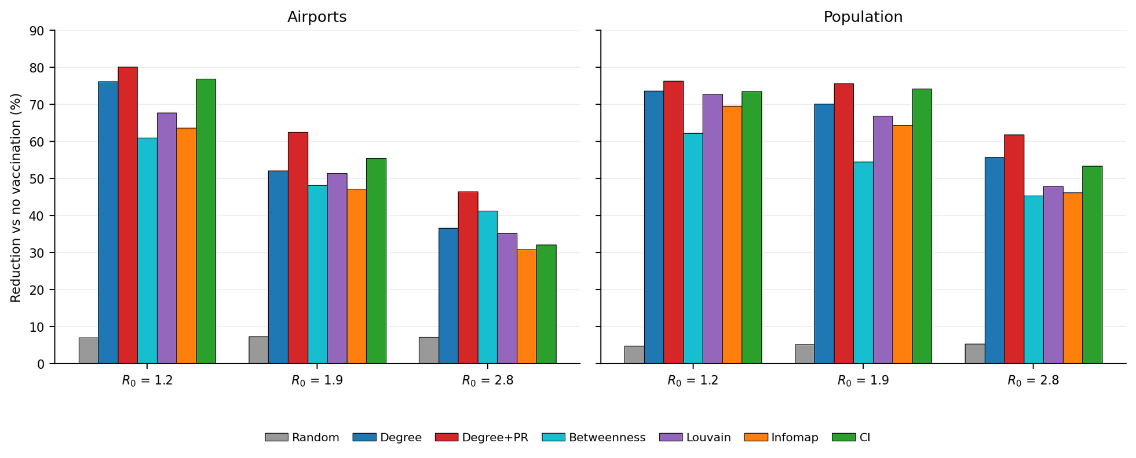
RESULTS - INFECTION REDUCTIONS
Measured on succesful outbreak runs only
Degree+PR leads at every R₀. All strategies degrade as R₀ grows, and the gap between them narrows.

Slide 35
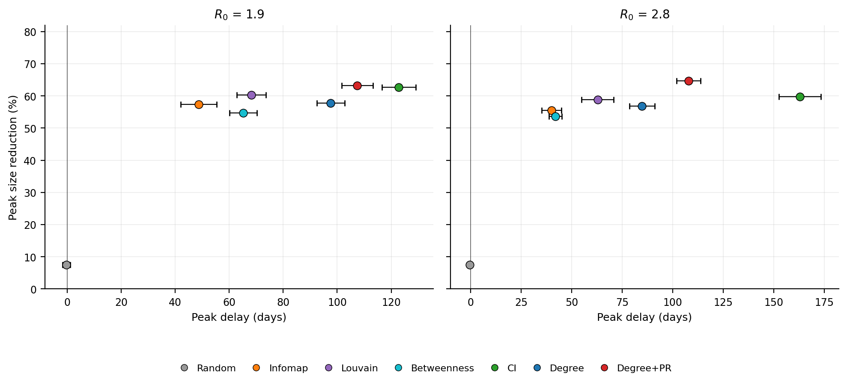
RESULTS - PEAK TIME INCREASE AND SIZE REDUCTION
Hub seeds only, outbreak runs only and R0 of 1.2 removed since many baseline peaks were beyond 548 days.
The Collective Influence approach wins over the weighted degree+PageRank strategy achieving greater epidemic curve flattening

Slide 36
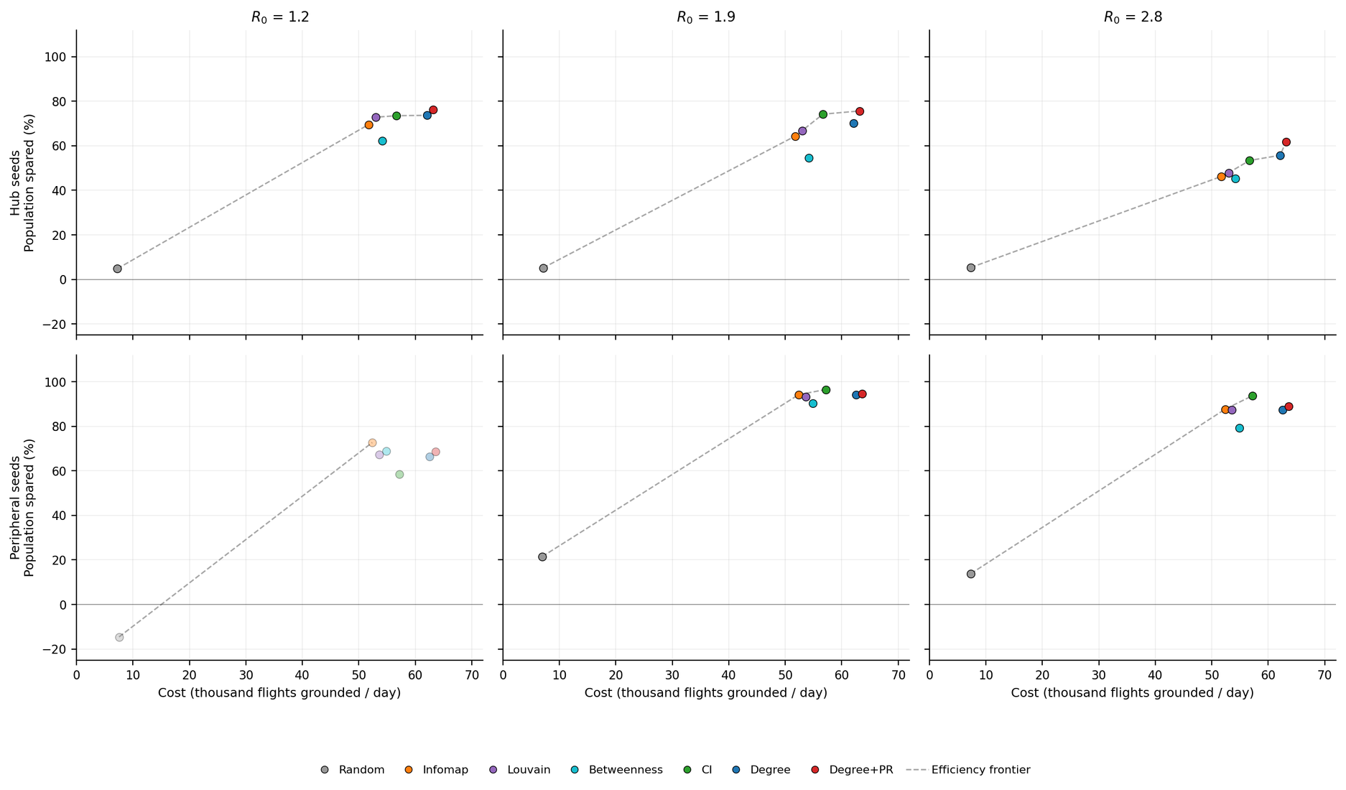
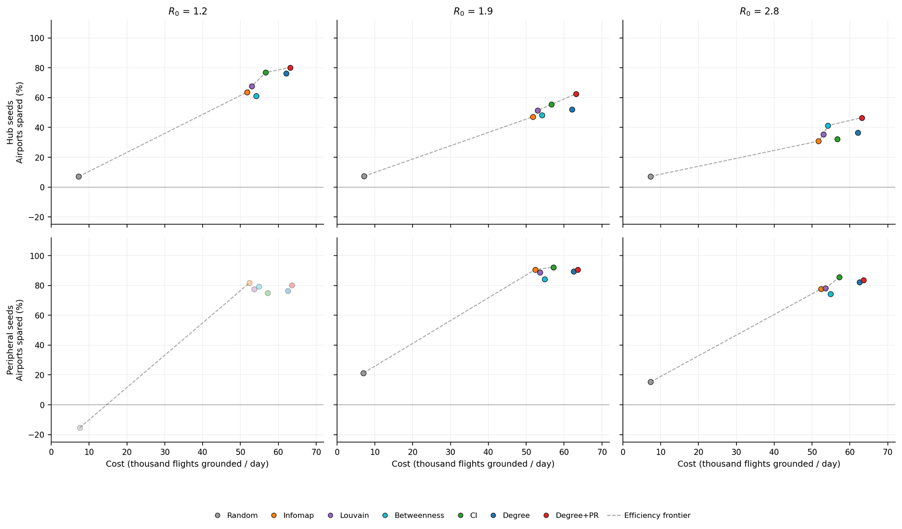
RESULTS - MEASURES EFFICIENCIES FOR NODES

Slide 37
RESULTS - MEASURES EFFICIENCIES FOR POPULATION

Slide 38
ANSWERS TO RESEARCH QUESTIONS
What are the characteristics of the World Airport Network? Does it have any interesting properties?
  The World Airport Network presents a truncated power-law degree distribution and its positive assortativity can be read as a sum of two different “resolutions”
Is hub targeting the best way to obstruct a disease spread? Are there other preferable approaches?
  Targeting nodes with high weighted degree centrality is always suboptimal with respect to the strategy that takes PageRank into account. The CI algorithm is best with respect to peak delay and reduction.
How do our results change if we factor in the economic aspect of shutting down entire airports?
  It is possible to build an efficency frontier to understand which strategies are dominated. All the strategies on the frontier mean that if you spend more you will get more protection, but the steeper the line the more it makes sense to switch the strategy

Slide 39

CONCLUSION
There is no single best answer for all scenarios
Knowledge on disease aggressiveness and starting points is key to selecting the most effective strategy

Slide 40
Thank you for the kind attention!

Slide 41
References
  Colizza, V., Barrat, A., Barthélemy, M., & Vespignani, A. (2006). The role of the airline transportation network in the prediction and predictability of global epidemics. Proceedings of the National Academy of Sciences (PNAS), 103(7), 2015-2020
  Şimşek, A. (2021). Estimating the Expected Influence Capacities of Nodes in Complex Networks under the Susceptible-Infectious-Recovered (SIR) Model. Complexity, 2021
  Balcan, D., Colizza, V., Gonçalves, B., Hu, H., Ramasco, J. J., & Vespignani, A. (2009). Multiscale mobility networks and the spatial spreading of infectious diseases. Proceedings of the National Academy of Sciences (PNAS), 106(51), 21484-21489
  Doina BucurI, Petter Holme (2020). Beyond ranking nodes: Predicting epidemic outbreak sizes by network centralities
  A. Barrat, M. Barthélemy, R. Pastor-Satorras, and A. Vespignani (2004) The architecture of complex weighted networks

