Slide 1






HATE SPEECH DETECTION ON TWITTER
TEXT MINING & SEARCH
Luzzi Federico 861…
Peracchi Marco 800578

Slide 2



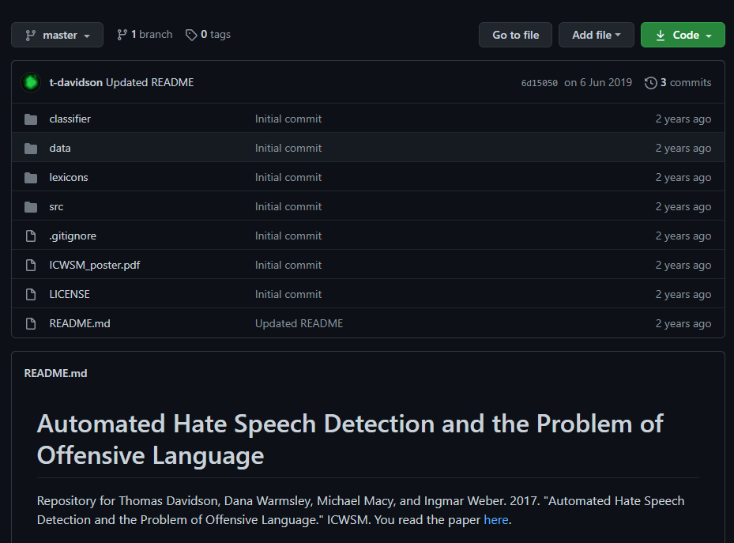



DATASET
THREE CATEGORIES
GITHUB REPOSITORY
HATE-SPEECH
ALMOST
25 000
TWEETS
OFFENSIVE-SPEECH
NEUTRAL SPEECH
BASED ON USER’S REPORT

Slide 3
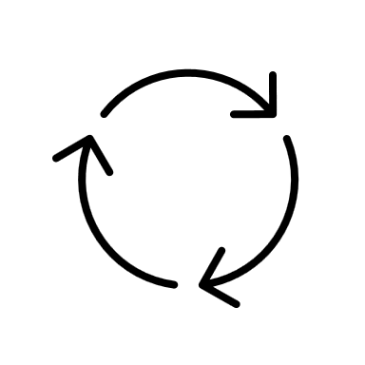





TEXT PROCESSING
RAW TWEET
PREPROCESSING
LOWER CASE
REMOVING URL AND TAG
REMOVE PUNCTUATION & NUMBER
REMOVE EXCEEDING SPACES
RT @shakiraevanss: Criticize Amanda for saying the n word, sure, but don't make jokes about her sexual assault, don't be trash.
rt criticize amanda for saying the n word sure but dont make jokes about her sexual assault dont be trash
TOKENIZATION &
STOP WORDS REMOVAL
critic, amanda, say, n, word, sure, dont, make, joke, sexual, assault, dont, trash
STEMMING
TWEET CLEAN
criticize, amanda, say, n, word, sure, dont, make, joke, sexual, assault, dont, trash
criticize, amanda, saying, n, word, sure, dont, make, jokes, sexual, assault, dont, trash
LEMMATIZATION

Slide 4



TEXT REPRESENTATION
TF-IDF
DOC2VEC
$$w_{t,d}=\frac{{tf}_{t,d}}{\max_{ti}{tf}_{ti,d}} ∙\log_{10}\left(\frac{N}{{df}_{t}}\right)$$
EVERY TWEETS REPRESENTED BY A DENSE VECTOR
EVERY WORDS HAVE A WEIGHT ASSOCIATED
WORD REPRESENTED BY 3614 ELEMENTS
MAX DOCUMENT FREQUENCY TO 50%
MIN DOCUMENT FREQUENCY TO 5
WINDOW OF 10 ELEMENTS
VECTOR SIZE OF 4000

Slide 5



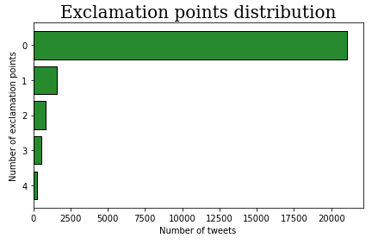


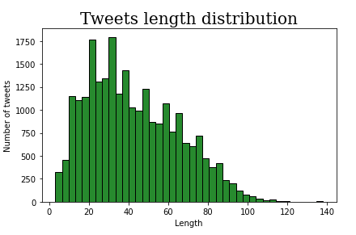

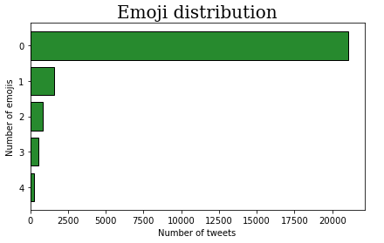
FEATURE EXTRACTION
VADER SENTIMENT ANALYSIS
EXCLAMATION POINT
OTHERS FEATURES
NEGATIVE
NEUTRAL
POSITIVE
COMPOUND
RETWEET
TWEETS LENGTH
TAGS
NUMBER OF EMOJI

Slide 6


TEXT CLASSIFICATION
SUPPORT VECTOR MACHINE
ADABOOST
LOGISTIC REGRESSION
RANDOM FOREST
NEURAL NETWORKS

Slide 7

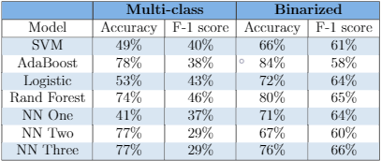
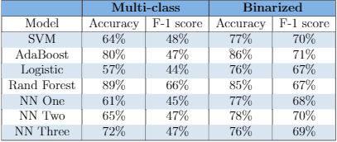
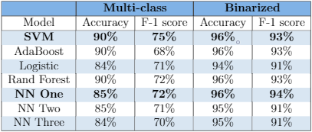
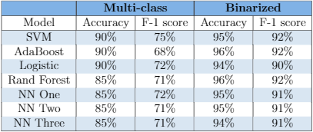
RESULTS
SENTIMENT ANALYSIS
DOC2VEC
TFID & STEMMING
TFID & LEMMATIZATION

Slide 8
RESULTS

Slide 9
CONCLUSIONS

Slide 10
THANKS FOR YOUR ATTENTION

