Slide 1






HATE SPEECH DETECTION ON TWITTER
TEXT MINING & SEARCH
2020/21
Luzzi Federico 816753
Peracchi Marco 800578
Notes:
Non presentiamo tutto ma solo i modelli più interessanti
Dire che facciamo test classification

Slide 2



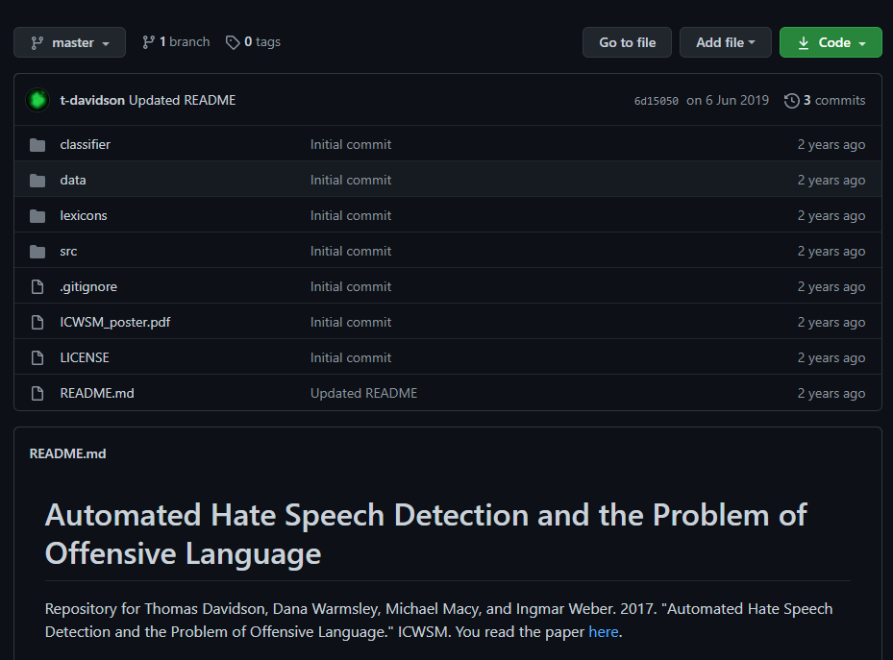



DATASET
THREE CATEGORIES
GITHUB REPOSITORY
HATE-SPEECH
ALMOST
25 000
TWEETS
OFFENSIVE-SPEECH
NEUTRAL SPEECH
BASED ON USER’S REPORT
Text Mining & Search 2020/21
Luzzi Federico
Peracchi Marco
Notes:
Specificare quali colonne sono presenti
Specificare che la maggioranza vince sulla classificazione
UNBALANCED

Slide 3






TEXT PROCESSING
RAW TWEET
PREPROCESSING
LOWER CASE
REMOVING URL AND TAG
REMOVE PUNCTUATION & NUMBER
REMOVE EXCEEDING SPACES
RT @shakiraevanss: Criticize Amanda for saying the n word, sure, but don't make jokes about her sexual assault, don't be trash.
rt criticize amanda for saying the n word sure but dont make jokes about her sexual assault dont be trash
TOKENIZATION &
STOP WORDS REMOVAL
critic, amanda, say, n, word, sure, dont, make, joke, sexual, assault, dont, trash
STEMMING
TWEET CLEAN
criticize, amanda, say, n, word, sure, dont, make, joke, sexual, assault, dont, trash
criticize, amanda, saying, n, word, sure, dont, make, jokes, sexual, assault, dont, trash
LEMMATIZATION
Text Mining & Search 2020/21
Luzzi Federico
Peracchi Marco
Notes:
Presentare gli esempi
Specificare le stop words rimosse ulteriori
Specificare anche le ulteriori operazioni di preprocessing

Slide 4


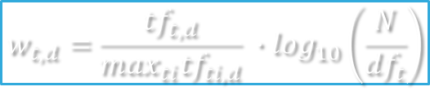
TEXT REPRESENTATION
TF-IDF
DOC2VEC
$$w_{t,d}=\frac{{tf}_{t,d}}{\max_{ti}{tf}_{ti,d}} ∙\log_{10}\left(\frac{N}{{df}_{t}}\right)$$
EVERY TWEETS REPRESENTED BY A DENSE VECTOR
EVERY WORDS HAVE A WEIGHT ASSOCIATED
WORD REPRESENTED BY 3614 ELEMENTS
MAX DOCUMENT FREQUENCY TO 50%
MIN DOCUMENT FREQUENCY TO 5
WINDOW OF 10 ELEMENTS
VECTOR SIZE OF 4000
Text Mining & Search 2020/21
Luzzi Federico
Peracchi Marco
Notes:
Ulteriori rappresentazioni (Bag Of Words, Count Matrix)

Slide 5



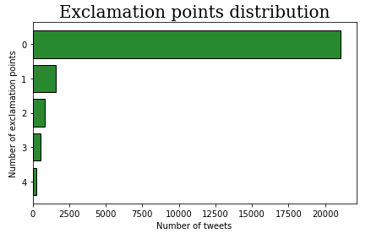


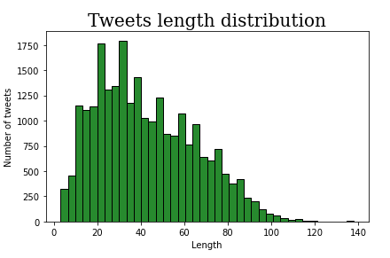

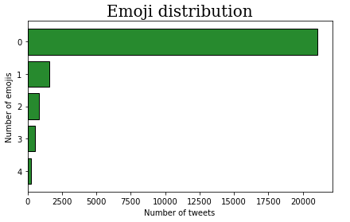
FEATURE EXTRACTION
VADER SENTIMENT ANALYSIS
EXCLAMATION POINT
OTHERS FEATURES
NEGATIVE
NEUTRAL
POSITIVE
COMPOUND
RETWEET
TWEETS LENGTH
TAGS
NUMBER OF EMOJI
Text Mining & Search 2020/21
Luzzi Federico
Peracchi Marco
Notes:
Emoji come codici html
Retweet identificati con RT

Slide 6


TEXT CLASSIFICATION
MODELS
CONFIGURATIONS
SUPPORT VECTOR MACHINE
SENTIMENT & FEATURES
ADABOOST
DOC2VEC
LOGISTIC REGRESSION
BINARIZATION
RANDOM FOREST
TF-IDF & STEMMING
NEURAL NETWORKS
TF-IDF & LEMMATIZATION
DECISION TREES AS WEAK CLASSIFIER
THREE DIFFERENT NEURAL NETWORKS
DIFFERENT LENGTH’S VECTOR
DIFFERENT WINDOWS
CLASS WEIGHTS
Text Mining & Search 2020/21
Luzzi Federico
Peracchi Marco
Notes:
Neural network STRUTTURA
Word cloud identificano la somiglianza tra hate e offensive
Sottolineare la questione della binarizzazione
PESIAMO LE CLASSI NEI MODELLI

Slide 7

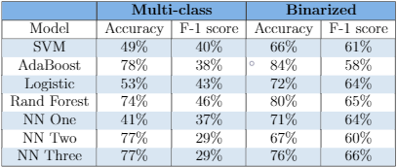
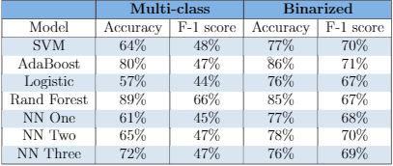

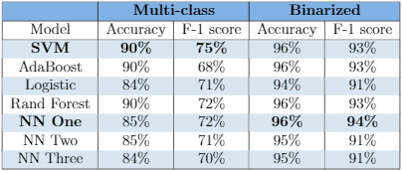
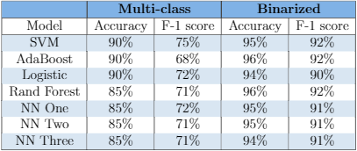

RESULTS
SENTIMENT ANALYSIS
DOC2VEC
TF-IDF & STEMMING
TF-IDF & LEMMATIZATION
Text Mining & Search 2020/21
Luzzi Federico
Peracchi Marco
Notes:
-

Slide 8



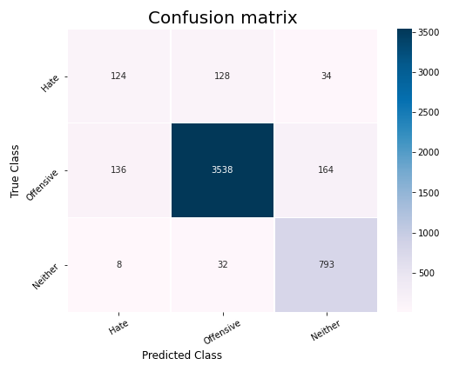
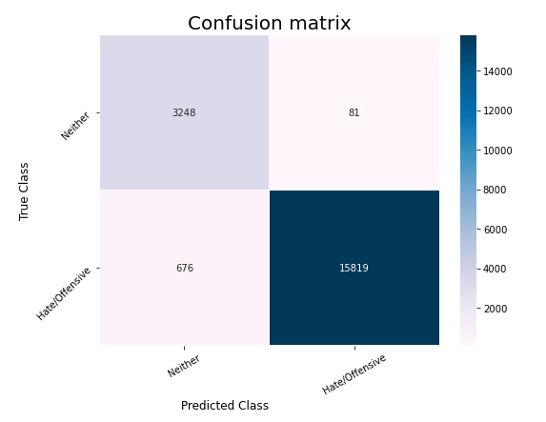
RESULTS
TF-IDF & STEMMING
SVM
NEURAL NETWORK ONE
MULTI-CLASS
BINARY
ACCURACY
F1 MEASURE
ACCURACY
F1 MEASURE
90%
75%
96%
94%
Text Mining & Search 2020/21
Luzzi Federico
Peracchi Marco

Slide 9



CONCLUSIONS
TF-IDF BEST REPRESENTATION
BINARIZATION OPTIMAL SOLUTION
SUPPORT VECTOR MACHINE WORKED WELL IN ALL CASES
RANDOM FOREST’S OVERFITTING
MORE DATA FOR NEURAL NETWORKS
BEST SCORES
SVM
NEURAL NETWORK ONE
TF-IDF
Text Mining & Search 2020/21
Luzzi Federico
Peracchi Marco
Notes:
Neural network migliore è quella più semplice. Probabilmente quelle più complesse con più dati funzionerebbero meglio
Sviluppi futuri: cambiare le frequenze di tagli della tfidf

Slide 10
THANKS FOR YOUR ATTENTION

