Slide 1






HATE SPEECH DETECTION ON TWITTER
TEXT MINING & SEARCH
Luzzi Federico 816753
Peracchi Marco 800578

Slide 2



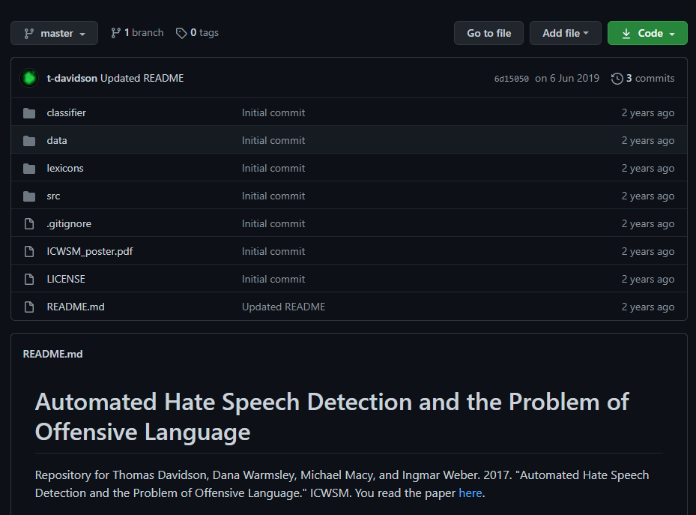



DATASET
THREE CATEGORIES
GITHUB REPOSITORY
HATE-SPEECH
ALMOST
25 000
TWEETS
OFFENSIVE-SPEECH
NEUTRAL SPEECH
BASED ON USER’S REPORT
Text Mining & Search 2020/21
Luzzi Federico
Peracchi Marco

Slide 3






TEXT PROCESSING
RAW TWEET
PREPROCESSING
LOWER CASE
REMOVING URL AND TAG
REMOVE PUNCTUATION & NUMBER
REMOVE EXCEEDING SPACES
RT @shakiraevanss: Criticize Amanda for saying the n word, sure, but don't make jokes about her sexual assault, don't be trash.
rt criticize amanda for saying the n word sure but dont make jokes about her sexual assault dont be trash
TOKENIZATION &
STOP WORDS REMOVAL
critic, amanda, say, n, word, sure, dont, make, joke, sexual, assault, dont, trash
STEMMING
TWEET CLEAN
criticize, amanda, say, n, word, sure, dont, make, joke, sexual, assault, dont, trash
criticize, amanda, saying, n, word, sure, dont, make, jokes, sexual, assault, dont, trash
LEMMATIZATION
Text Mining & Search 2020/21
Luzzi Federico
Peracchi Marco

Slide 4



TEXT REPRESENTATION
TF-IDF
DOC2VEC
$$w_{t,d}=\frac{{tf}_{t,d}}{\max_{ti}{tf}_{ti,d}} ∙\log_{10}\left(\frac{N}{{df}_{t}}\right)$$
EVERY TWEETS REPRESENTED BY A DENSE VECTOR
EVERY WORDS HAVE A WEIGHT ASSOCIATED
WORD REPRESENTED BY 3614 ELEMENTS
MAX DOCUMENT FREQUENCY TO 50%
MIN DOCUMENT FREQUENCY TO 5
WINDOW OF 10 ELEMENTS
VECTOR SIZE OF 4000
Text Mining & Search 2020/21
Luzzi Federico
Peracchi Marco

Slide 5



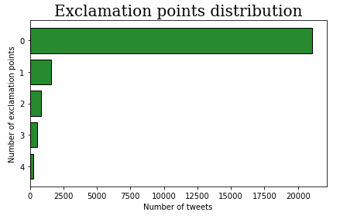


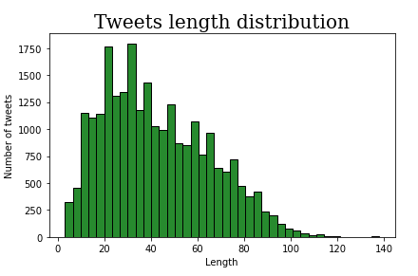

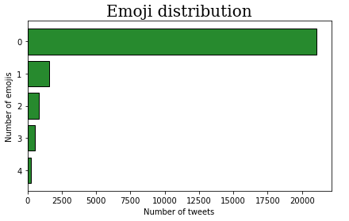
FEATURE EXTRACTION
VADER SENTIMENT ANALYSIS
EXCLAMATION POINT
OTHERS FEATURES
NEGATIVE
NEUTRAL
POSITIVE
COMPOUND
RETWEET
TWEETS LENGTH
TAGS
NUMBER OF EMOJI
Text Mining & Search 2020/21
Luzzi Federico
Peracchi Marco

Slide 6


TEXT CLASSIFICATION
MODELS
CONFIGURATIONS
SUPPORT VECTOR MACHINE
SENTIMENT & FEATURES
ADABOOST
DOC2VEC
LOGISTIC REGRESSION
BINARIZATION
RANDOM FOREST
TF-IDF & STEMMING
NEURAL NETWORKS
TF-IDF & LEMMATIZATION
DECISION TREES AS WEAK CLASSIFIER
THREE DIFFERENT NEURAL NETWORKS
DIFFERENT LENGTH’S VECTOR
DIFFERENT WINDOWS
Text Mining & Search 2020/21
Luzzi Federico
Peracchi Marco

Slide 7

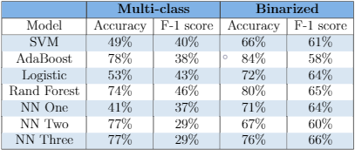
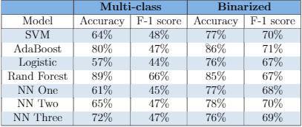

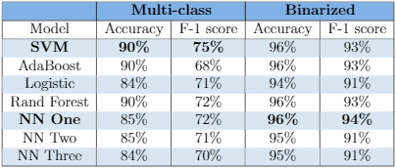
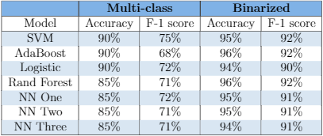

RESULTS
SENTIMENT ANALYSIS
DOC2VEC
TF-IDF & STEMMING
TF-IDF & LEMMATIZATION
Text Mining & Search 2020/21
Luzzi Federico
Peracchi Marco

Slide 8



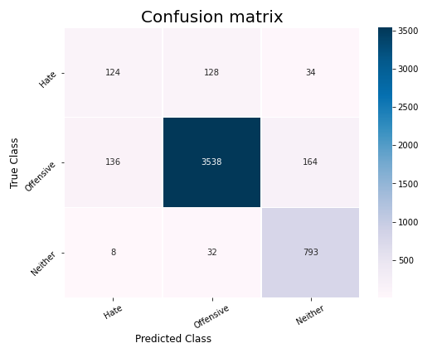
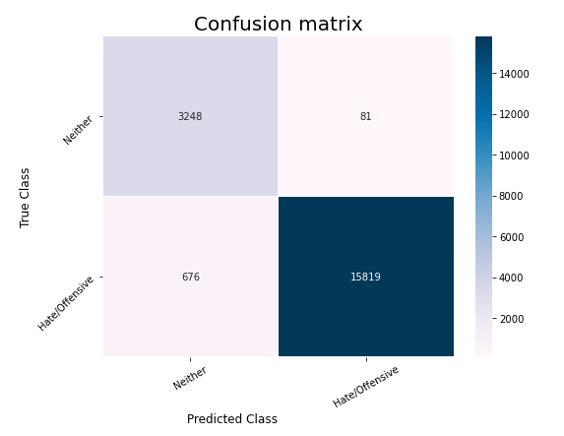
RESULTS
TF-IDF & STEMMING
SVM
NEURAL NETWORK ONE
MULTI-CLASS
BINARY
ACCURACY
F1 MEASURE
ACCURACY
F1 MEASURE
90%
75%
96%
94%
Text Mining & Search 2020/21
Luzzi Federico
Peracchi Marco

Slide 9



CONCLUSIONS
TF-IDF BEST REPRESENTATION
BINARIZATION OPTIMAL SOLUTION
SUPPORT VECTOR MACHINE WORKED WELL IN ALL CASES
RANDOM FOREST’S OVERFITTING
MORE DATA FOR NEURAL NETWORKS
BEST SCORES
SVM
NEURAL NETWORK ONE
TF-IDF
Text Mining & Search 2020/21
Luzzi Federico
Peracchi Marco

Slide 10
THANKS FOR YOUR ATTENTION

