Slide 1






HATE SPEECH DETECTION ON TWITTER
TEXT MINING & SEARCH
Luzzi Federico 861…
Peracchi Marco 800578

Slide 2



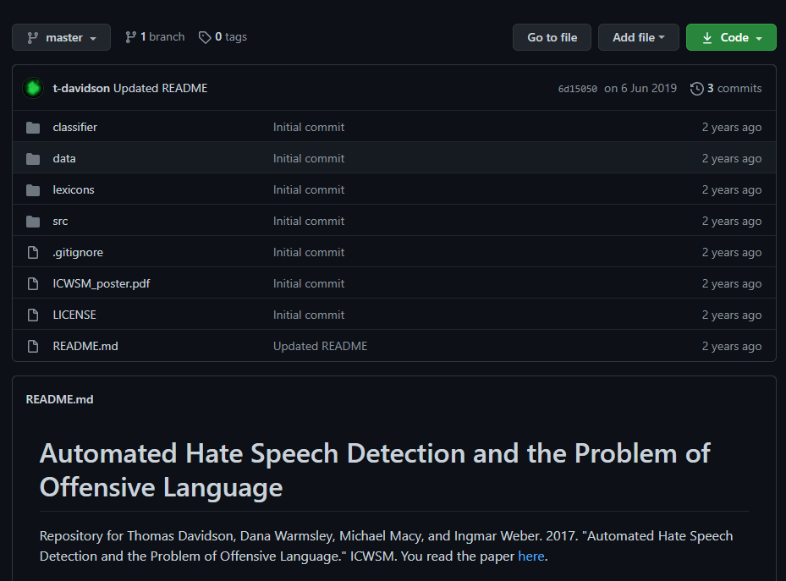



DATASET
THREE CATEGORIES
GITHUB REPOSITORY
HATE-SPEECH
ALMOST
25 000
TWEETS
OFFENSIVE-SPEECH
NEUTRAL SPEECH
BASED ON USER’S REPORT

Slide 3
TEXT PROCESSING

Slide 4
TEXT REPRESENTATION

Slide 5
TEXT CLASSIFICATION

Slide 6
RESULTS

Slide 7
CONCLUSIONS

Slide 8
THANKS FOR YOUR ATTENTION

