Slide 1

FlowCastAI: Predicting Traffic with Machine Learning
A data-driven framework for forecasting hourly traffic volume across New South Wales by combining vehicle count data with station-level metadata and weather conditions.

Slide 2




Project Overview
Data Integration
Machine Learning
Weather Awareness
Historical traffic records + station metadata
Predict traffic volume with road characteristics impact
Environmental conditions affect traffic patterns

Slide 3




Problem Statement
Sub-problem A: Baseline Prediction
Learn traffic trends using temporal features
Sub-problem B: Weather Impact
Learn how weather modifies baseline traffic
Combined Solution
Vpredicted = Vbaseline + Weather Effect

Slide 4
Daily_total feature statistics:
mean: 11523.46
Sd: 12780.47
Min: 0
Max: 146723
Data Pre-Processing
Traffic Data
Weather Data
Missing values handled
Key features extracted
Timestamps structured
Geospatial matching
Quality stations filtered
Missing data interpolated (there was no missing data)
- Remove unnecessary columns
- Gather weather data from API
- Final cleaned dataset has ≈ 3.5 million rows, and 35 columns
- Organise weather record indexes to match traffic record indexes
- max, min, and daily rainfall was retrieved
- Some important columns include: date, public_holiday, school_holiday, daily_total, and hourly traffic counts
- Records from 532 different traffic recording stations around NSW are used

Slide 5
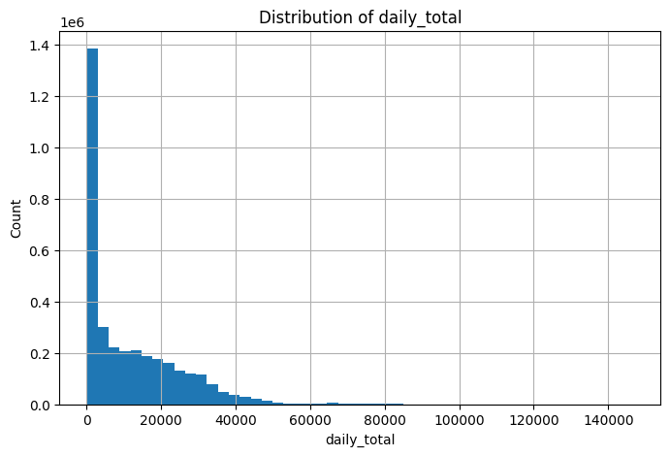
Since the median value is heavily impaced by the
Large amount of zero counts, the mean is a better indicator of congestion
We will classify into two classes: “congested” and “not congested”, with the data belonging to the congested class if daily_total is more than the mean (11523.56)
Categorical features will also be one-hot encoded before training the model

Slide 6
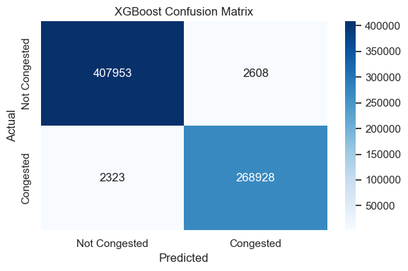
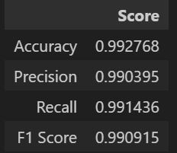
Gradient Boosting Model (subproblem A) results
We trained it on the following features:
- 'road_functional_hierarchy’
- 'road_classification_type’
'suburb’
'traffic_direction_seq’
'cardinal_direction_seq’
'classification_seq’,
'year’
'month’
'day’
'day_of_week’
'public_holiday’
'school_holiday’
'lane_count’
'wgs84_latitude’
'wgs84_longitude'
With the goal of classifying into congested and non congested

Slide 7

**Not sure what the points of this slide is. What information does it give?
Feature Extraction
Temporal Features
Environmental Features
Hour, day, month, holidays
Rainfall, min/max temperature
Encoding Methods
Categorical encoding, standardization

Slide 8

Model Selection
Model Type
Strengths
Weaknesses
Random Forest
Non-linear, resistant to overfitting
Misses time dependencies
Gradient Boost
High performance, handles missing data
Complex tuning needed
MLP
Complex patterns, flexible inputs
Requires large datasets

Slide 9








Weather Impact Analysis
Rainfall
Maximum Temperature
Influences road conditions and driving behavior
Affects comfort and travel patterns
Minimum Temperature
Traffic Adjustment
Impacts morning commute conditions
Weather-aware volume prediction

Slide 10






Business Applications
Smart City Integration
Future-proof urban planning
Adaptive Traffic Systems
Real-time signal optimization
Navigation Platforms
Enhanced route recommendations

Slide 11
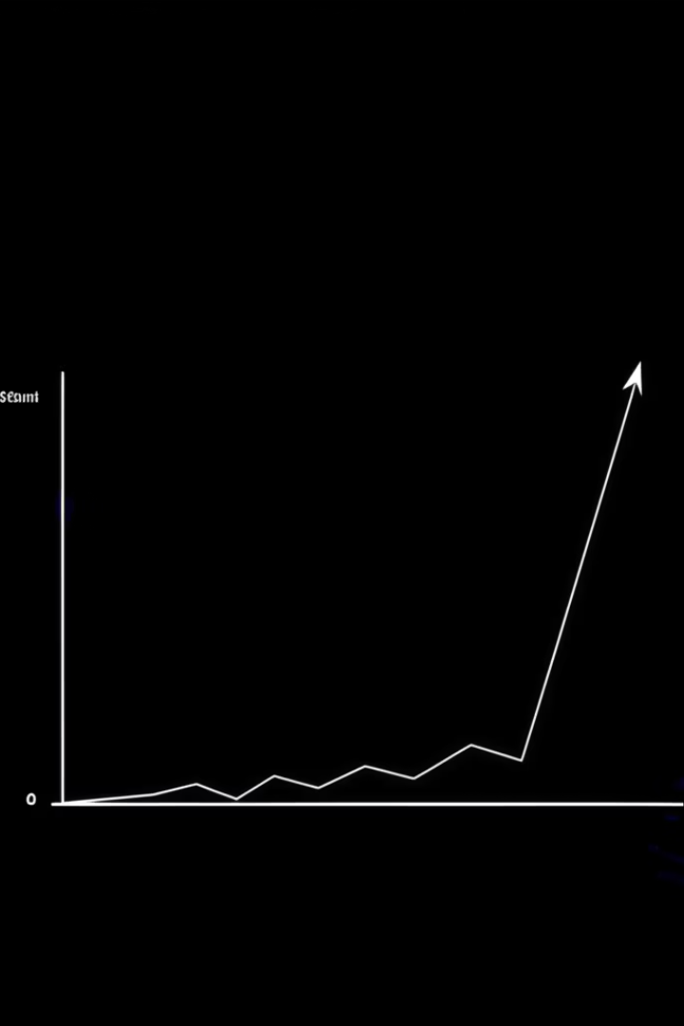
Revenue Potential
$2.5M
15%
Infrastructure Savings
Efficiency Gain
Reduced congestion costs
Improved traffic flow
$1.2M
Licensing Revenue
API access for developers

Slide 12



Next Steps
Scale deployment
Expand to additional regions
Real-time integration
Live data feeds and API development
Partner engagement
Transportation agencies and navigation platforms

