Slide 1
Alloy - Signatures
Some basic signatures:
sig Integer {}
sig Strings {}
sig Date {}
sig Time {}
sig Coordinate{}
enum DriverStatus {Busy, Available}
enum RideStatus {Annulled, Assigned, Completed, NotAssigned}
Integer, Date and Time are used only to identify the type of attributes of some entities. String have been used also to show the difference between users (i.e. email and telephone number cannot be equal among users).

Slide 2
Alloy - Signatures
User signatures:
abstract sig User {}
sig Guest extends User {}
sig Admin extends User{
name: one Strings,
surname: one Strings,
email: one Strings,
password: one Strings
}
abstract sig RegUser extends User{
name: one Strings,
surname: one Strings,
password: one Strings,
birth: one Date,
email: one Strings,
telephone: one Strings
}
sig Customer extends RegUser{}
sig TaxiDriver extends RegUser{
status: one DriverStatus,
taxi: one Taxi
}

Slide 3
Alloy - Signatures
System signatures:
sig TaxiQueue {
hasTaxi: set Taxi
}
sig TaxiZone {
hasTaxiQueue: one TaxiQueue
}
one sig Map {
hasZone: some TaxiZone
}
one sig System {
map: one Map,
users: set User,
taxiRide: set TaxiRide
}

Slide 4
Alloy - Signatures
Taxi ride signatures:
abstract sig TaxiRide {
origin: one Coordinate,
destination: lone Coordinate,
date: one Date,
time: one Time,
waitingTime: lone Integer,
taxi: lone Taxi,
rideStatus: one RideStatus,
hasCustomer: one Customer
}
sig Request extends TaxiRide{
}
sig Reservation extends TaxiRide {
}
sig Taxi {
code: one Integer,
position: one Coordinate
}

Slide 5
Alloy - Facts
No users have the same email address and telephone number (i.e. there are no duplicate users).
fact noDuplicateUsers{
no disj u1,u2: RegUser| (u1.email = u2.email) or
(u1.telephone = u2.telephone)
no disj a1,a2:Admin | (a1.email = a2.email)
no disj a1:Admin, u1:RegUser | (a1.email = u1.email)
}
Every taxi zone has exactly one taxi queue.
fact queueOneZone{
TaxiZone <: hasTaxiQueue in TaxiZone one -> TaxiQueue
}

Slide 6
Alloy - Facts
There are no drivers with the same taxi (and therefore every taxi has exactly one different driver).
taxiOneDriver{
no disj d1,d2:TaxiDriver | d1.taxi = d2.taxi
#TaxiDriver = # Taxi
}
Every taxi can be assigned to one and only one queue.
fact taxiOneQueue{
all t1:Taxi | no disj q1,q2:TaxiQueue | (t1 in q1.hasTaxi and t1 in q2.hasTaxi)
all t2:Taxi | lone q3:TaxiQueue | t2 in q3.hasTaxi
}

Slide 7
Alloy - Facts
The map has the reference to every taxi zone.
fact taxiZoneInMap{
TaxiZone in Map.hasZone
}
A taxi (driver) cannot have more than one TaxiRide with the status “Assigned”.
fact driverOneRide{
no disj r1,r2:TaxiRide | (r1.taxi = r2.taxi) and (r1.rideStatus = Assigned) and (r2.rideStatus = r1.rideStatus)
}

Slide 8
Alloy - Facts
No more than one “Assigned” taxi ride for customer and no more than one request for customer.
fact RideLimit{
no disj r1,r2:TaxiRide | (r1.rideStatus = r2.rideStatus) and (r2.rideStatus = Assigned) and (r1.hasCustomer = r2.hasCustomer)
no disj r1,r2:Request | (r1.rideStatus = r2.rideStatus) and (r2.rideStatus = NotAssigned) and (r1.hasCustomer = r2.hasCustomer)
no disj r1,r2:Request | (r1.rideStatus = Assigned) and (r2.rideStatus = NotAssigned) and (r1.hasCustomer = r2.hasCustomer)
no disj r1:Request, r2:Reservation| (r1.rideStatus = NotAssigned) and (r2.rideStatus = Assigned) and (r1.hasCustomer = r2.hasCustomer)
}

Slide 9
Alloy - Facts
There are not taxi paired with a ride with the “Not Assigned” status.
fact noTaxiNotAssigned{
all r1:TaxiRide | (r1.rideStatus = NotAssigned) implies (r1.taxi = none)
}
“Assigned” and “Completed” rides must be bound to a taxi.
fact TaxiRideStatus{
all r1:TaxiRide | (r1.rideStatus != NotAssigned and r1.rideStatus!= Annulled) implies (#r1.taxi=1)
}

Slide 10
Alloy - Facts
The system must have the reference to all users and rides.
fact systemUserRide{
all u1:User | u1 in System.users
all r1:TaxiRide | r1 in System.taxiRide
}
Annulled rides must not be linked to any taxi.
fact AnnulledNoTaxi{
all r:TaxiRide | r.rideStatus = Annulled implies r.taxi = none
}
The origin of a ride cannot be equal to its destination.
fact originDifferentDestination{
no r1:TaxiRide | (r1.origin = r1.destination)
}

Slide 11
Alloy - Facts
A busy taxi must not be in a queue (because, of course, it contains only available taxis).
fact taxiBusyQueue{
all d1:TaxiDriver | ((d1.status = Busy) implies (no q1:TaxiQueue | d1.taxi in q1.hasTaxi))
}
An available taxi must be in a queue.
fact taxiAvailableQueue{
all d1:TaxiDriver | ((d1.status = Available) implies (some q1:TaxiQueue | d1.taxi in q1.hasTaxi))
}

Slide 12
Alloy - Facts
An “Assigned” taxi must imply that its driver is busy.
fact assignedEqualBusy{
no t:Taxi | taxi.t.rideStatus in Assigned and taxi.t.status=Available
}
An “Avaliable” taxi driver must not have any ride “Assigned”.
fact availableEqualnotAssigned{
all t:Taxi,d:TaxiDriver | (d.taxi = t and d.status = Available) implies(no r:TaxiRide | r.taxi = t and r.rideStatus = Assigned)
}

Slide 13
Alloy - Predicates
These are some of the predicates that we have used with some assertions and in the show() predicate in order to generate some specific worlds:
//Add an assigned ride
pred addAssignedRide(s1,s2:System){
one r1:TaxiRide | r1.rideStatus = Assigned and s2.taxiRide=s1.taxiRide + r1
}
//Add an annulled ride
pred addAnnulledRide(s1,s2:System){
one r1:TaxiRide | r1.rideStatus = Annulled and s2.taxiRide=s1.taxiRide + r1
}
//Add a completed ride
pred addCompletedRide(s1,s2:System){
one r1:TaxiRide | r1.rideStatus = Completed and s2.taxiRide=s1.taxiRide + r1
}

Slide 14
Alloy - Predicates
//Add 2 customers
pred add2Customer(s1,s2:System,c1,c2:Customer){
s2.users=s1.users + c1+c2
}
//Add 2 reservations
pred add2Reservation(s1,s2:System, res1,res2:Reservation){
s2.taxiRide=s1.taxiRide + res1 + res2
}
//Add 2 requests
pred add2Request(s1,s2:System, req1,req2:Request){
s2.taxiRide=s1.taxiRide + req1 + req2
}
//Add 1 busy and 1 available taxi driver
pred atleast1busy1available{
some d:TaxiDriver | d.status = Busy
some d:TaxiDriver | d.status = Available
}

Slide 15
Alloy - Assertions
These are some of the assertions that we have used to verify the consistency of our model:
// All these cardinality equivalences must be satisfied
assert numbersEquivalence{
#Taxi = #TaxiDriver
#TaxiZone = #TaxiQueue
#System.users = # User
#System.taxiRide = #TaxiRide
#(status.Available).taxi = #TaxiQueue.hasTaxi // the number of available taxi must be equal to the number of taxi in all the queues
}
// Busy taxi drivers may not be assigned to a ride, because of the possibility of standard customers
assert driversStandardCustomer{
all s1,s2:System | addBusyWithoutRide[s1,s2] implies !(status.Busy in (TaxiDriver <: taxi).(TaxiRide.(TaxiRide <:taxi)))
}

Slide 16
Alloy - Assertions
//All the available taxi belongs to a taxi zone
assert allAvailableInOneZone{
all t:Taxi | ((TaxiDriver <: taxi).t).status = Available implies one z:TaxiZone | t in z.hasTaxiQueue.hasTaxi
}
//There are no taxi without drivers
assert noTaxiWithoutDrivers{
all t:Taxi | one d:TaxiDriver | d.taxi=t
}
//There are no drivers without taxi
assert noDriversWithoutTaxi{
all d:TaxiDriver | one t:Taxi | d.taxi=t
}
// no ride without customers
assert noRideWithoutCustomer{
all r:TaxiRide | one c:Customer| r.hasCustomer = c
}

Slide 17
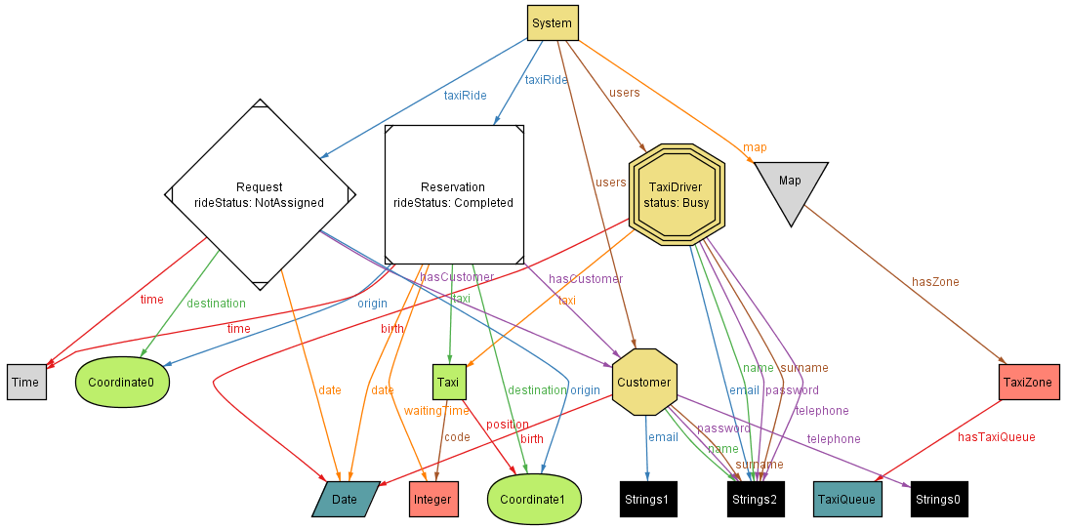
Alloy - Worlds
This is a possible world with two taxi rides, a single taxi driver and a customer.

Slide 18
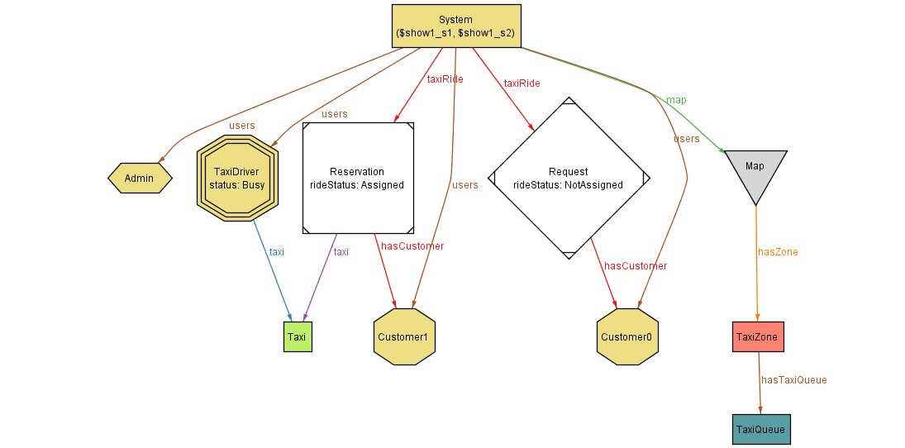
Alloy - Worlds
In the following alternative worlds, Strings and other non-essential signatures have been removed in order to clarify the relation between the main entities.

Slide 19
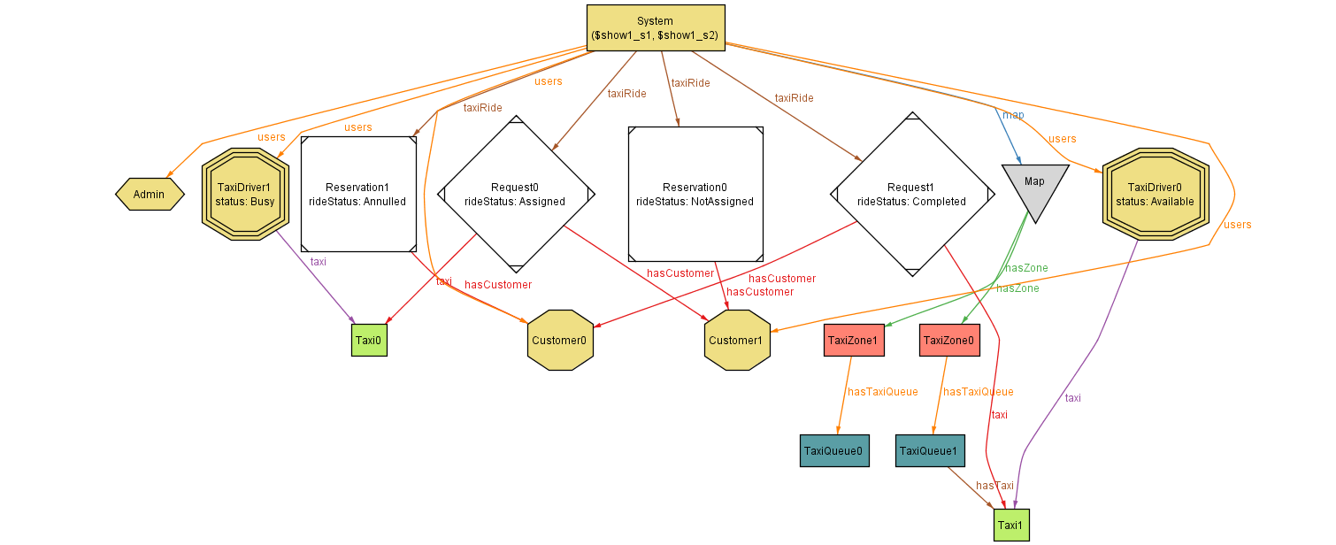
Alloy - Worlds

