Slide 1
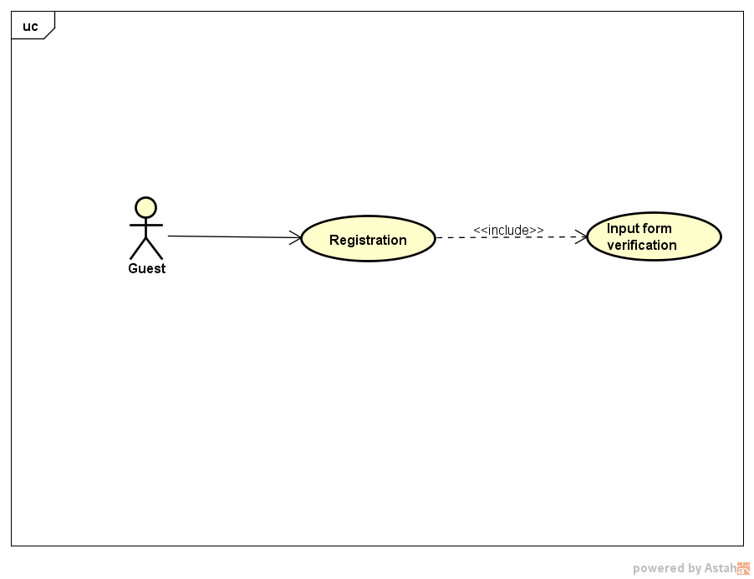
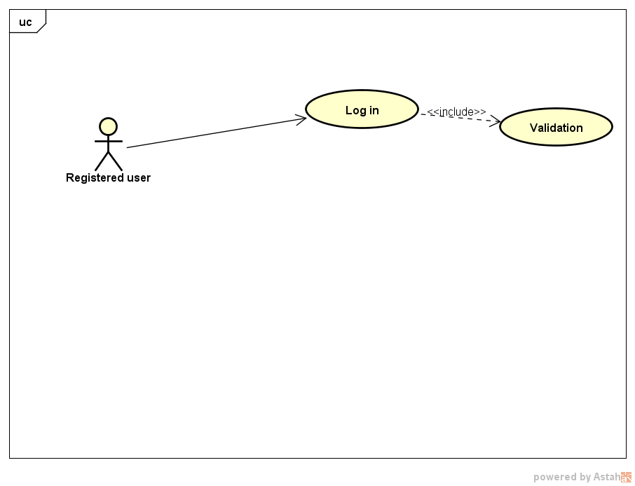
Use Cases
Registration
Log in

Slide 2
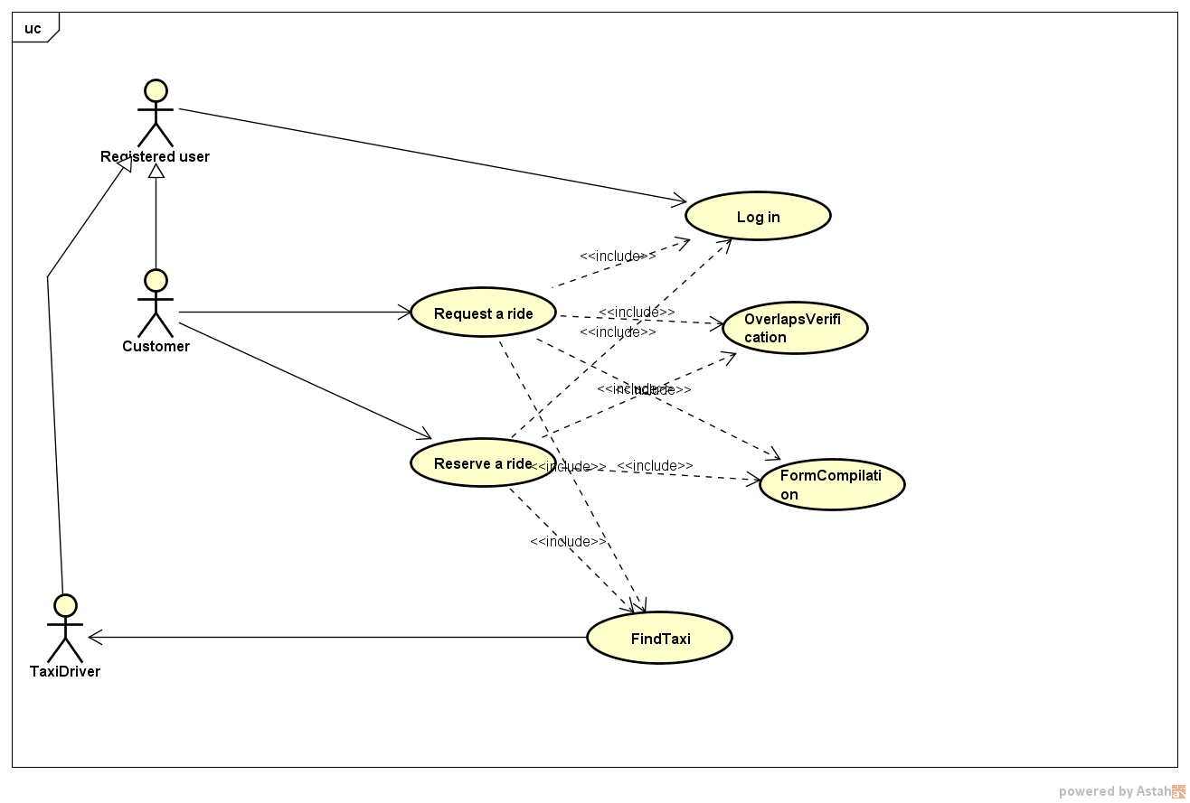
Use Cases – Request & Reservation
The two main features of the application involve the same set of internal functionalities.
Even if externally they are different functionalities, from the system’s point of view a reservation is basically a request delayed in time.
The main differences between the two will be the event flow visible in the sequence diagram.

Slide 3
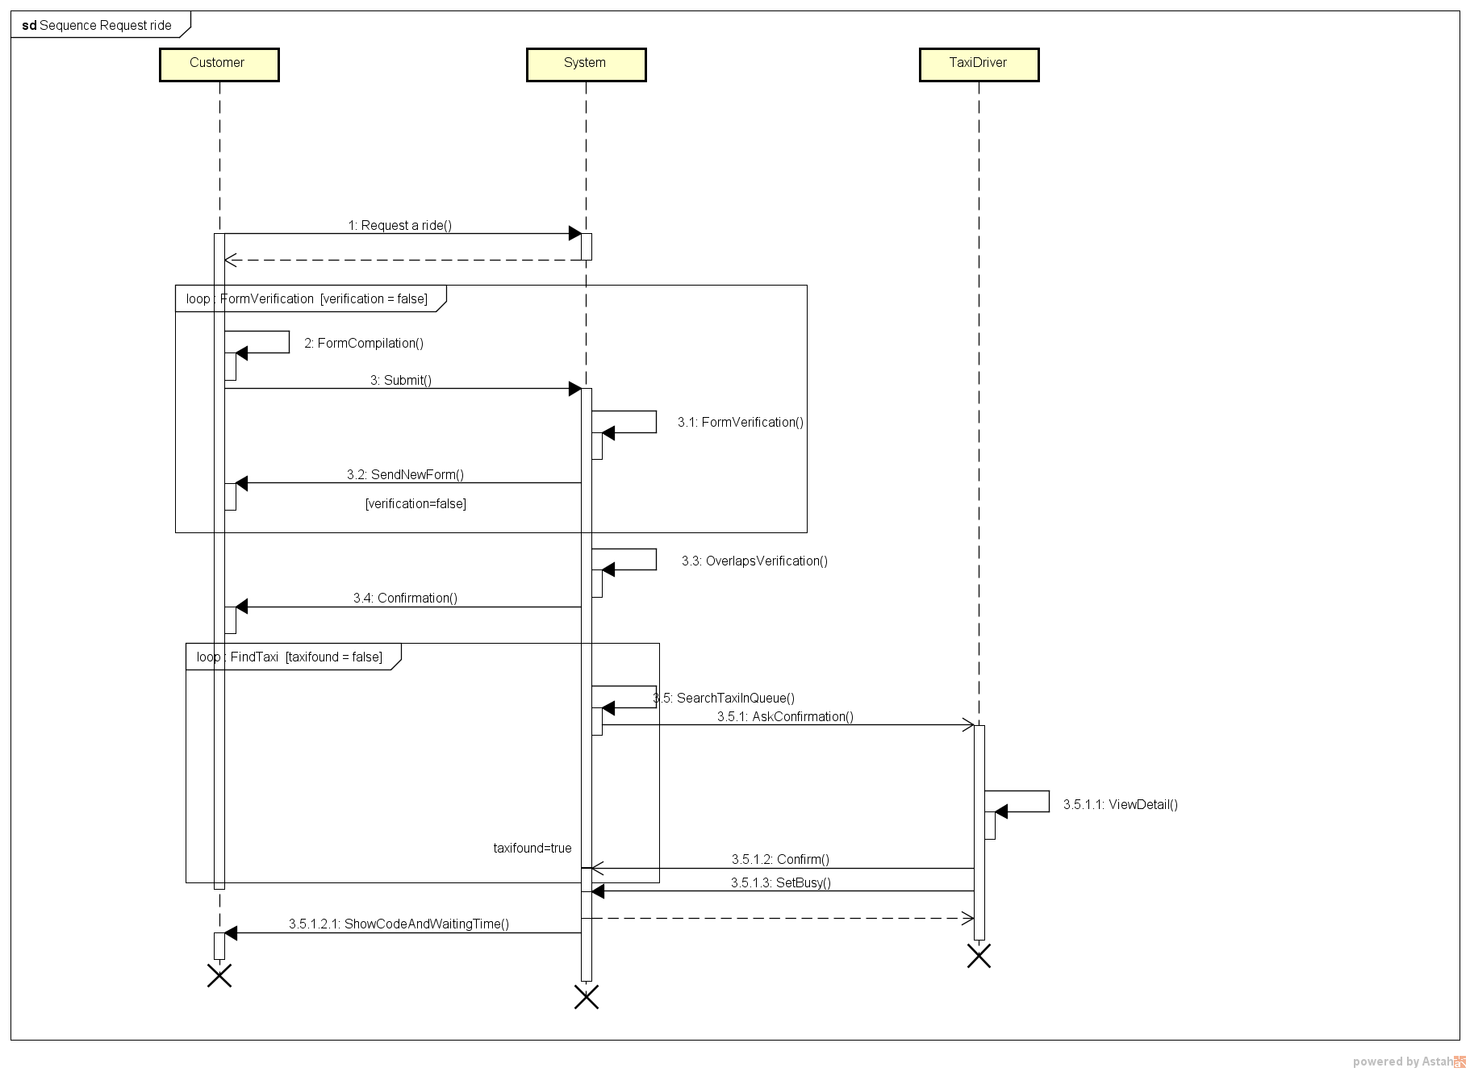
Successful request’s event flow
After the confirmation the system immediately starts to search a taxi.
Before the confirmation, the request has no state, because it doesn’t exist yet in the system.
After the confirmation, the request’s state is NotAssigned.
After the last operation, the request’s state is Assigned.

Slide 4
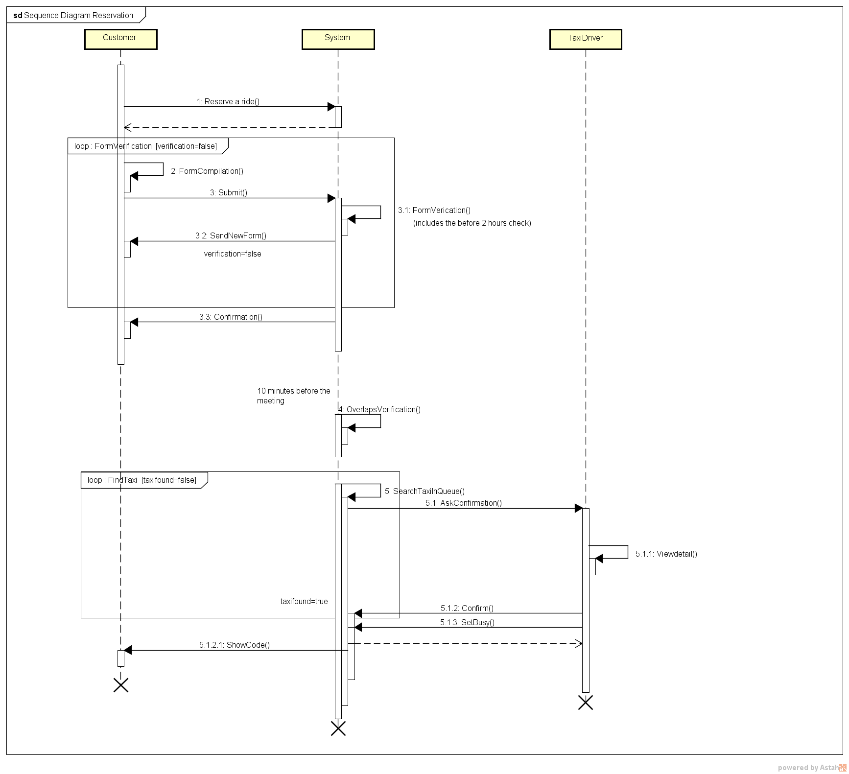
Successful reservation’s event flow
The overlaps verification and the taxi search are delayed until the last 10 minutes before the established time.
During that arbitrarily long time the reservation’s state is NotAssigned.
All the other steps and ride’s states are basically the same as in the request’s event flow.

Slide 5
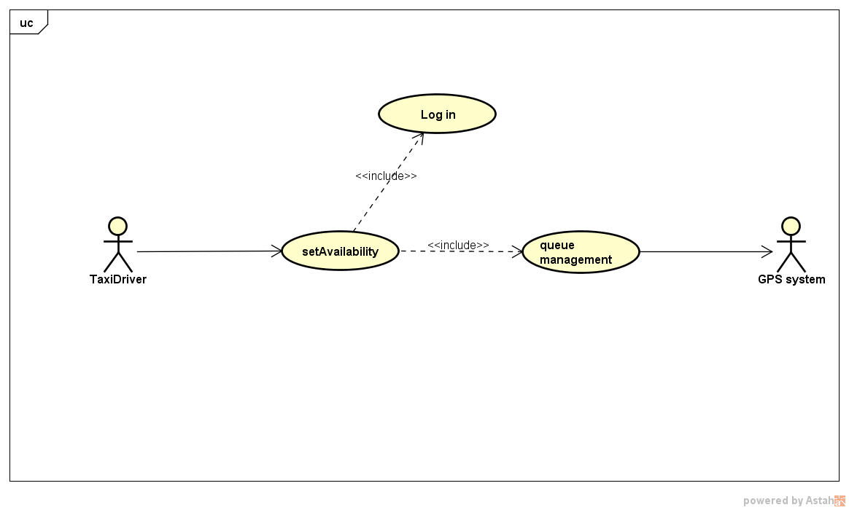
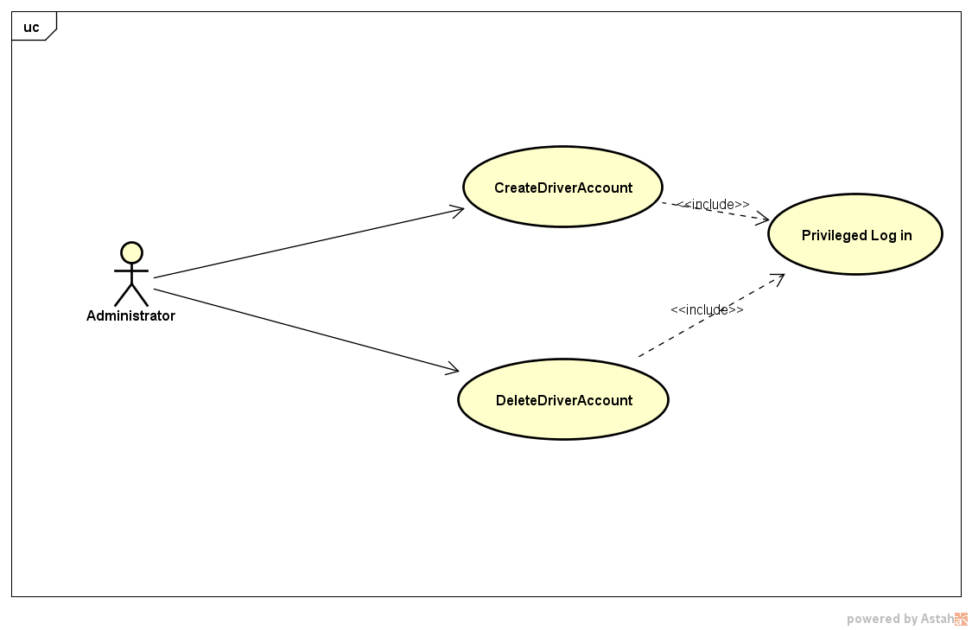
Use Cases
Set Availability
Create/Delete drivers

Slide 6
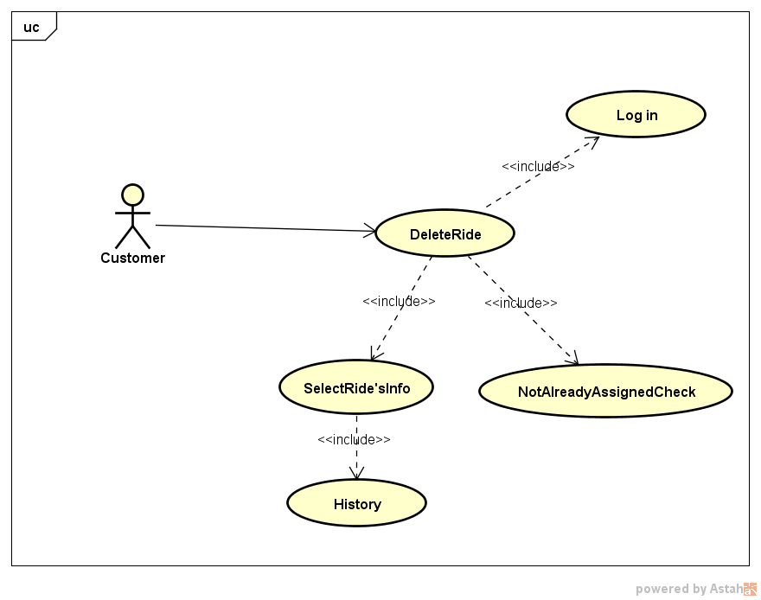
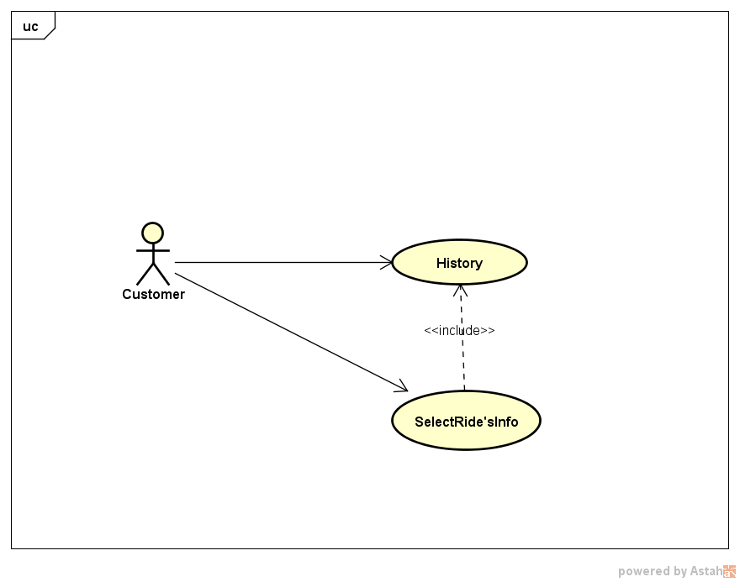
Use Cases
Delete a Ride
History
Rides, either requests or reservations, can be deleted by the customer if and only if the system hasn’t already assigned a taxi to them.

Slide 7
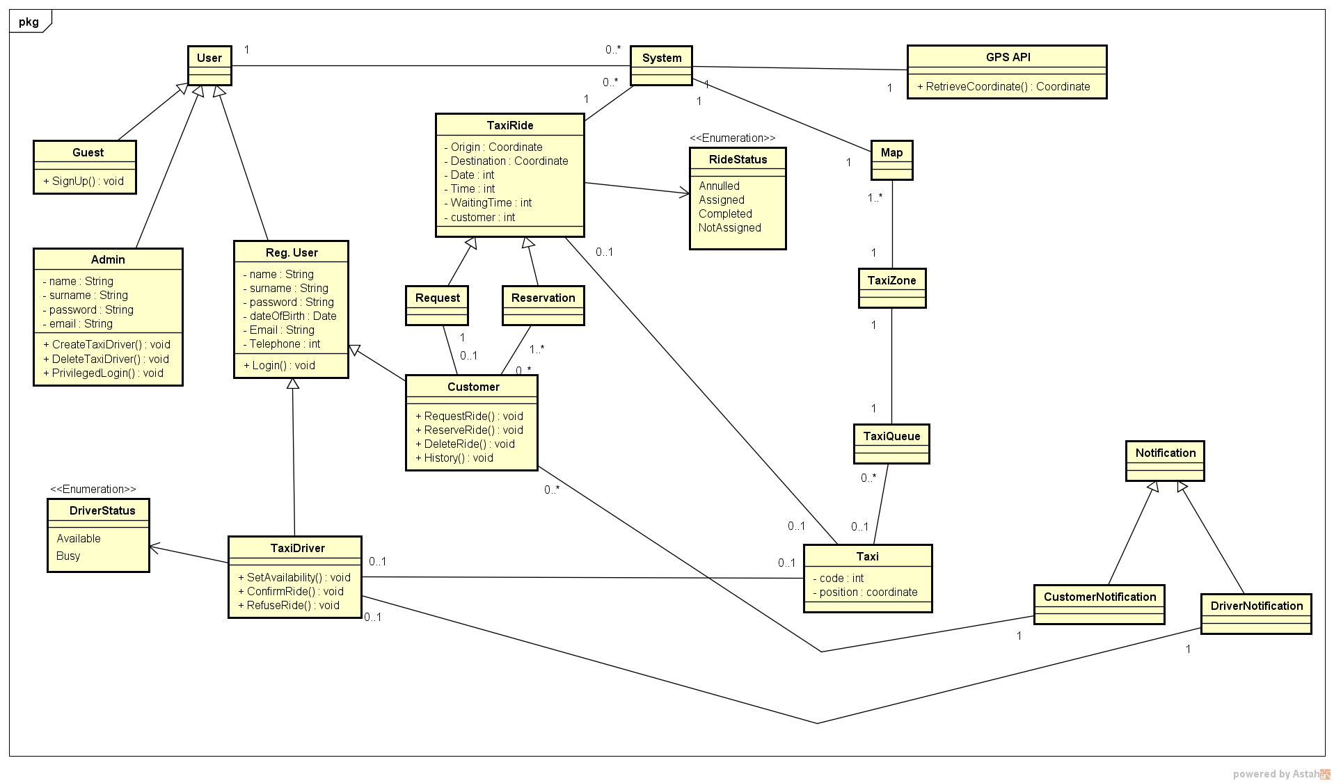
Class Diagram

