Slide 1



SMS SPAM FILTERING
WITH MACHINE LEARNING
UNIVERSITY OF PISA DEPARTMENT OF INFORMATION ENGINEERING MASTER’S DEGREE IN CYBERSECURITY
Marco Ruta

Slide 2
STEPS OF THE WORK
Set the goal
Dataset analysis
Data Preprocessing
Presentation of the methods used
Classification
Blacklist Approach
LSH Approach
Naïve Bayes and SVM
Results discussion
Conclusion &
Improvements
Mock-up application
Marco Ruta

Slide 3
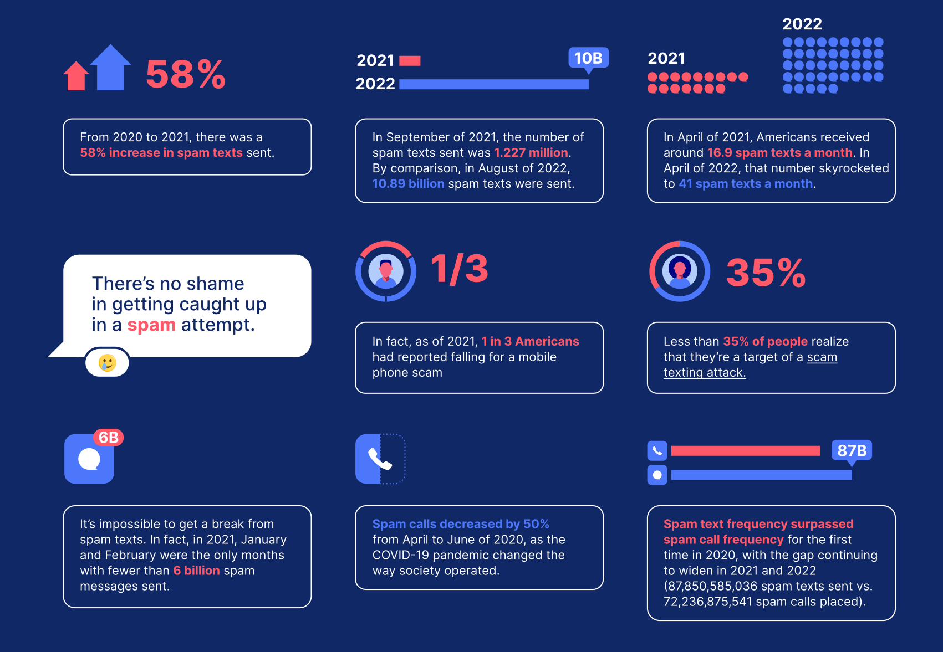
GOAL OF THE WORK
Develop a SPAM filtering system with ML classification techniques.
Marco Ruta
Reach a good level of confidence in detecting SPAM SMS.
Create a simple WebApp for SPAM filtering capable also of collecting new data.

Slide 4
DATASET ANALYSIS
This dataset was composed by integrating several pre-existing datasets:
A collection of 425 SMS spam messages was manually extracted from the Grumbletext Web site.
A subset of 3,375 SMS ham messages randomly chosen from the NUS SMS Corpus (NSC).
A list of 450 SMS ham messages collected from Caroline Tag's PhD Thesis available at [Web Link].
1,002 ham messages and 322 spam messages were retrieved from the SMS Spam Corpus v.0.1 Big.
Total number of instances: 5574
Ham instances: 4827 (86%)
Spam instances: 747 (14%)
https://archive.ics.uci.edu/ml/datasets/sms+spam+collection
Marco Ruta

Slide 5
DATASET PREPROCESSING
Drop unused features)
Encode categorical feature v1
Drop duplicate instances
(309 ham and 94 spam messages)
New feature: “chars”
Rename v1 and v2 in “label” and “sms”
New feature: “words”
New feature: “currency”
New feature: “numbers”
New feature: “links”
Marco Ruta
Final dataset features:
label: label (ham or spam)
sms: sms body (raw text)
chars: number of chars in the sms body
words: number of words in the sms body
currency: presence of currency symbols (€, $, £ ..)
numbers: presence of numbers
links: presence of links
Initial dataset features:
v1: label (ham or spam)
v2: sms body (raw text)
v3: unused feature
v4: unused feature
v5: unused feature
preprocessing

Slide 6
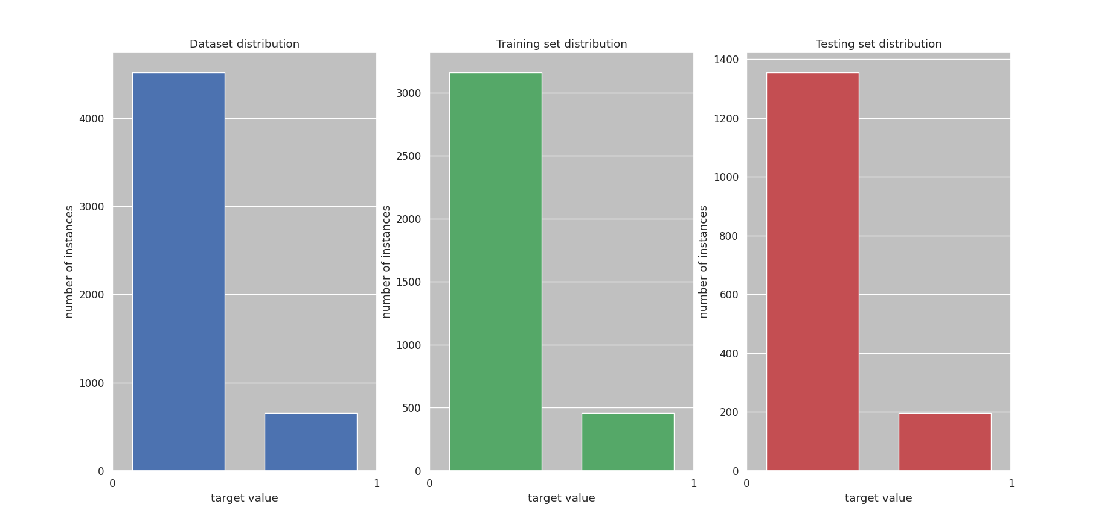
DATASET ANALYSIS
Unbalanced classification problem:
Undersampling
Text augmentation
Use the right metrics: recall, precision, ROC
Marco Ruta

Slide 7
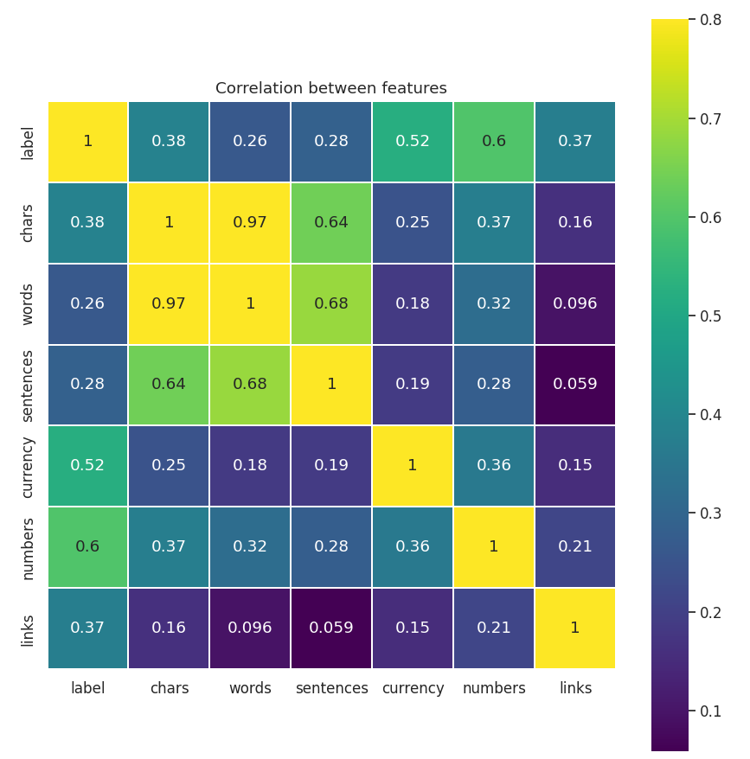
DATASET ANALYSIS
The most correlated features with the label are:
numbers
currency
links
Marco Ruta
How are distributed these feature in the two classes?

Slide 8
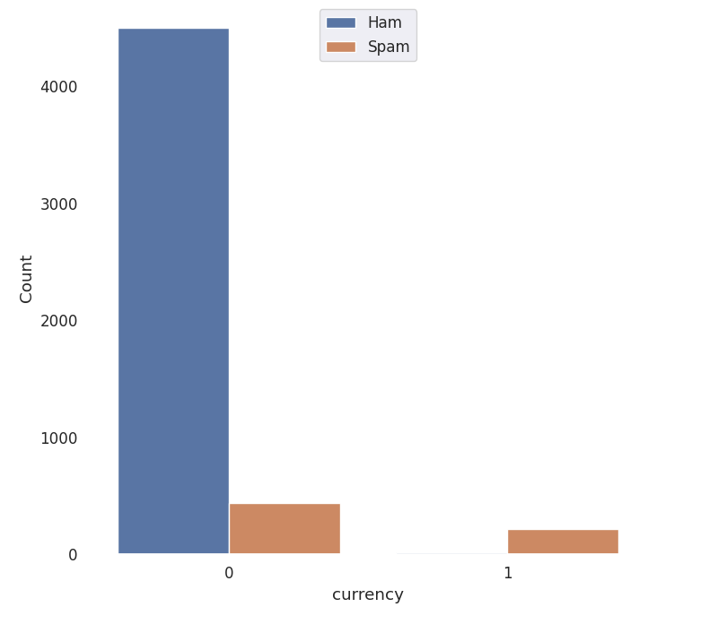
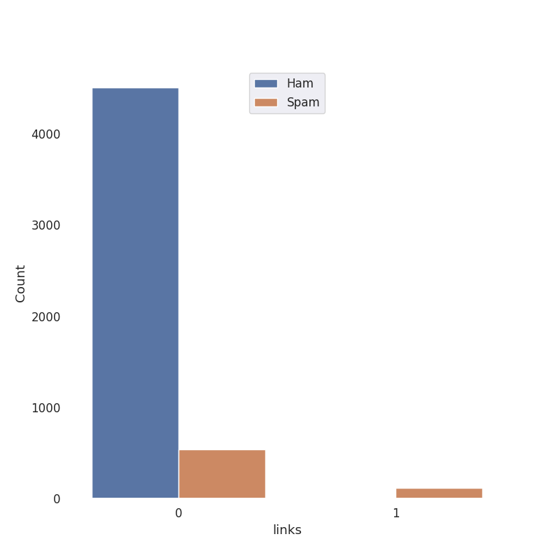
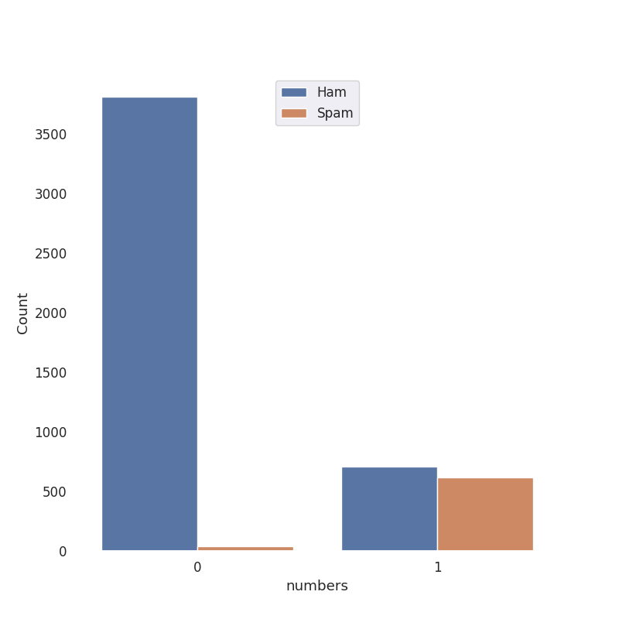
DATASET ANALYSIS
Marco Ruta
Currency symbols are mainly present in spam messages.
Links are mainly present in spam messages.
Numbers are evenly distributed between the two classes.

Slide 9
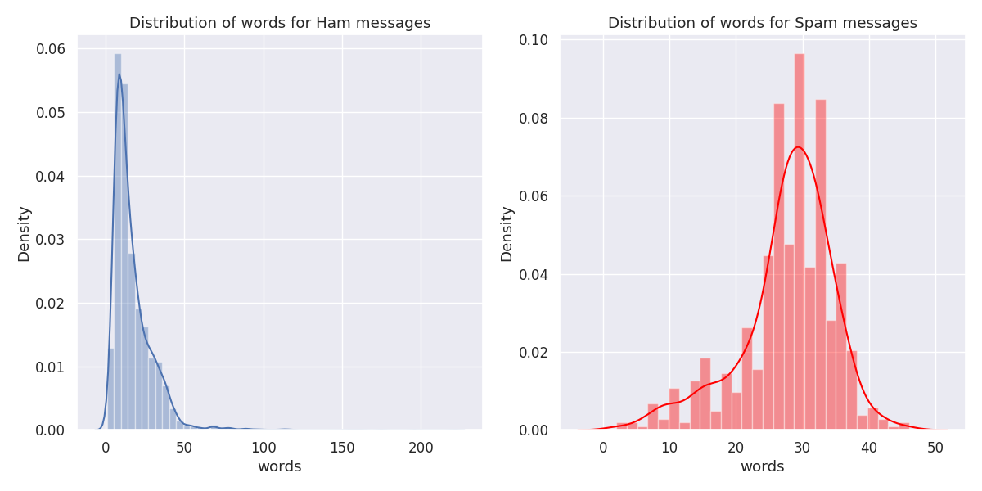
DATASET ANALYSIS
Marco Ruta

Slide 10
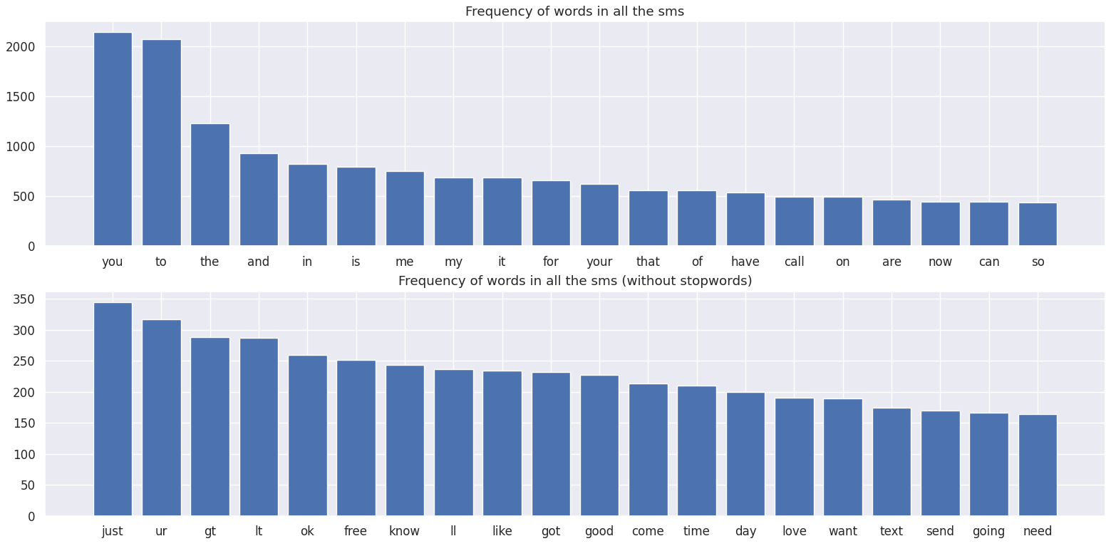
DATASET ANALYSIS
Marco Ruta

Slide 11
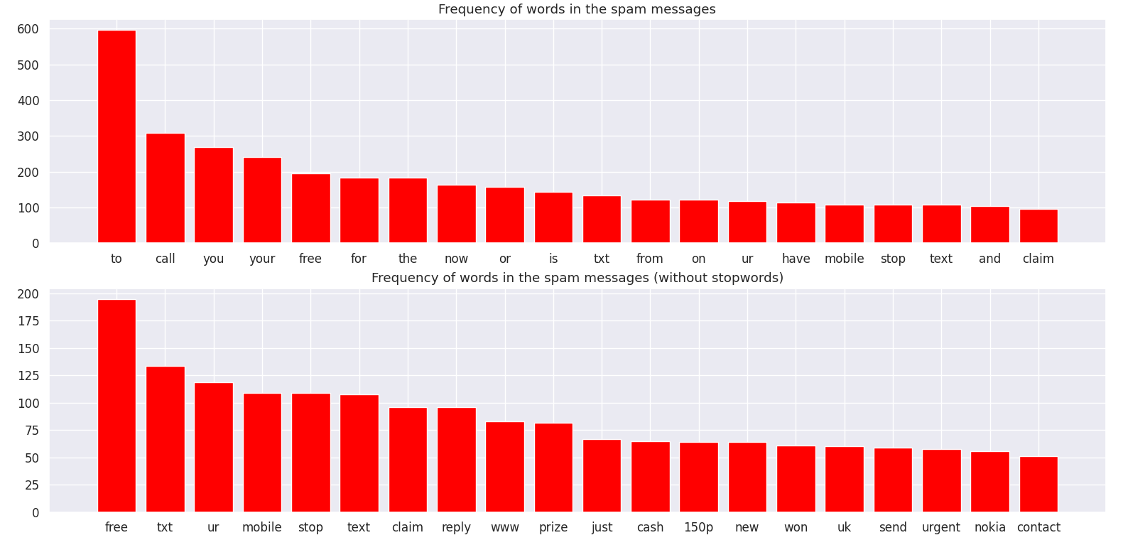
DATASET ANALYSIS
Marco Ruta

Slide 12
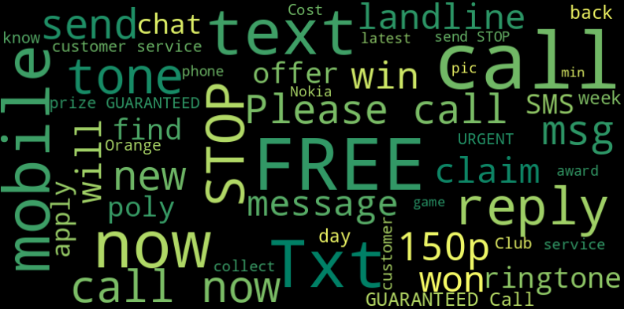
DATASET ANALYSIS
Marco Ruta

Slide 13
BLACKLIST APPROACH
SPAM
WORDS
LEGIT
WORDS
NLTK
WORD
Marco Ruta
Dirty Blacklist = {Spam words} – {Legit words} = 1468 Tokens
Cleaned Blacklist = {Dirty Blacklist} ∩ {NLTK words} = 172 Tokens
Blacklist | Confusion Matrix | Accuracy | Precision | Recall | F1
Dirty | [1336 11] [51 145] | 0.95 | 0.84 | 0.74 | 0.80
Cleaned | [1344 11] [134 145] | 0.90 | 0.85 | 0.32 | 0.46

Slide 14
LSH APPROACH
Stemming
Minhash (n=128)
Bucket analysis
(testing)
Number of permutation n = 128
Snowball stemmer
Jaccard similarity Threshold = 0.5
Populate the LSH matcher
(training)
Remove punctuation
Remove stopwords
Stem tokens
Marco Ruta
Confusion Matrix | Accuracy | Precision | Recall | F1
[1340 0] [102 94] | 0.93 | 1.00 | 0.48 | 0.65

Slide 15
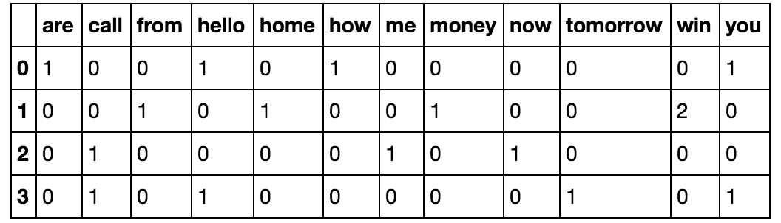
COUNT VECTORIZER
“Wow. I never realized that you were so embarassed by your accomodations. I thought you liked it, since i was doing the best i could and you always seemed so happy about \the cave\". I'm sorry I didn't and don't have more to give. I'm sorry i offered. I'm sorry your room was so embarassing.”
Count Vectorizer
Extract stems
Convert in lowercase
Remove stopwords
Strip Accents
Convert in a sparse matrix
Marco Ruta
['wow', 'never', 'realiz', 'embarass', 'accomod', 'i', 'thought', 'like', 'sinc', 'best', 'could', 'alway', 'seem', 'happi', 'cave', '', 'sorri', "n't", 'give', 'sorri', 'offer', 'i', 'room']
Is time to check two different families of classificators suited for the spam classification:
Naïve Bayes
Support Vector Machine
https://ieeexplore.ieee.org/document/7743279

Slide 16
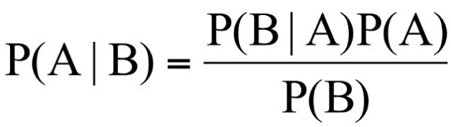
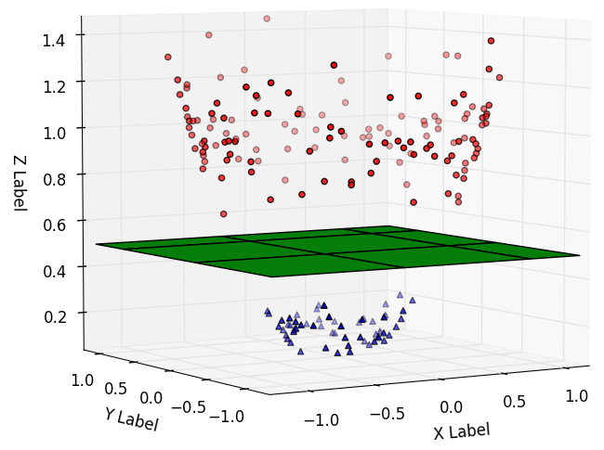
CLASSIFICATION
Naïve Bayes family
Multinomial NB:
One of the most used for text classification
Complement NB:
Implement the CNB complement Naïve Bayes algorithm
Marco Ruta
Support Vector Machine family
SVC:
Uses RBF kernel
SGD SVM:
SVM that uses stochastic gradient descent learning

Slide 17
CLASSIFICATION RESULTS
Sklearn confusion matrix
[TN FP]
[FN TP]
70% training, 30% testing with stratification
Classifier | Confusion Matrix | Accuracy | Precision | Recall | F1
SVC | [1355 0] [26 170] | 0.98 | 1.00 | 0.87 | 0.93
SGD SVM | [1351 4] [31 165] | 0.98 | 0.98 | 0.84 | 0.90
C-Naïve Bayes | [1298 57] [8 188] | 0.96 | 0.76 | 0.96 | 0.85
M-Naïve Bayes | [1346 9] [11 185] | 0.99 | 0.95 | 0.94 | 0.95
Marco Ruta

Slide 18
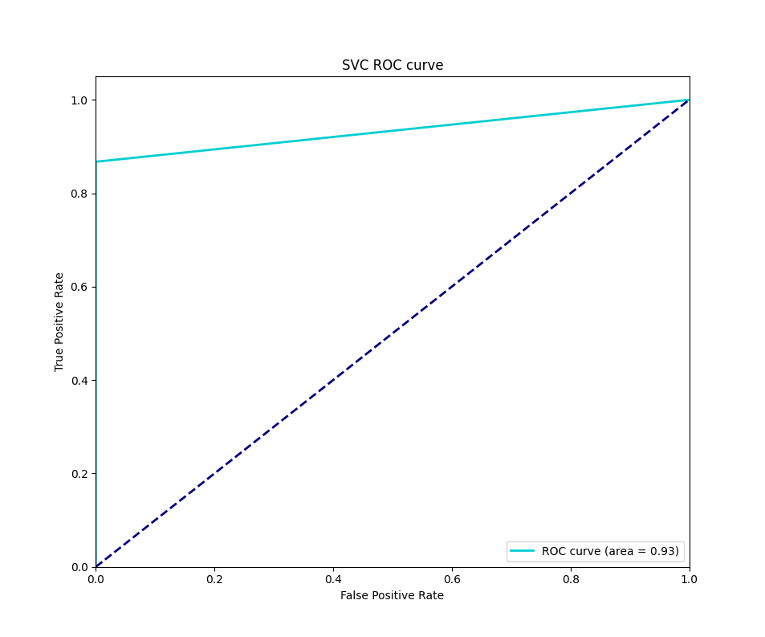
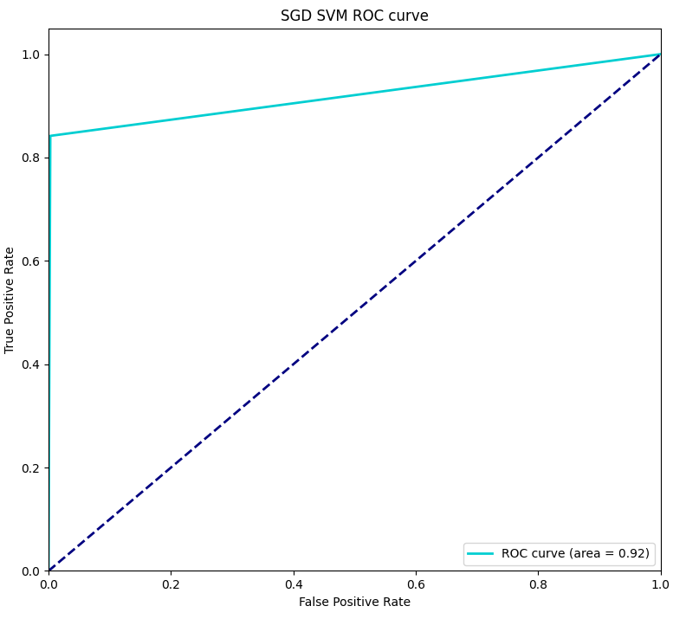
CLASSIFICATION RESULTS
Marco Ruta

Slide 19
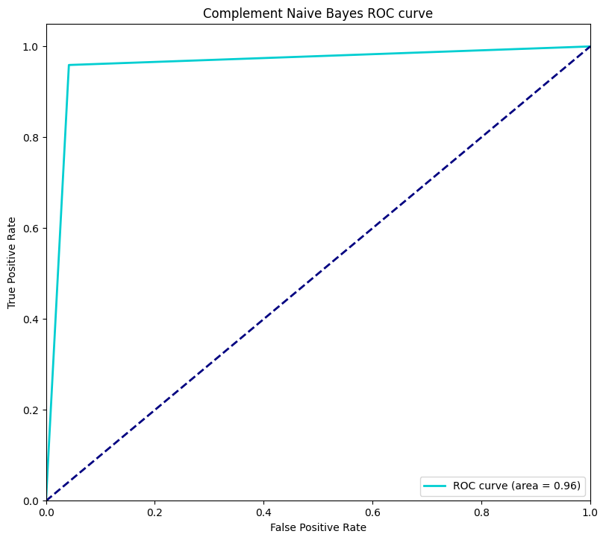
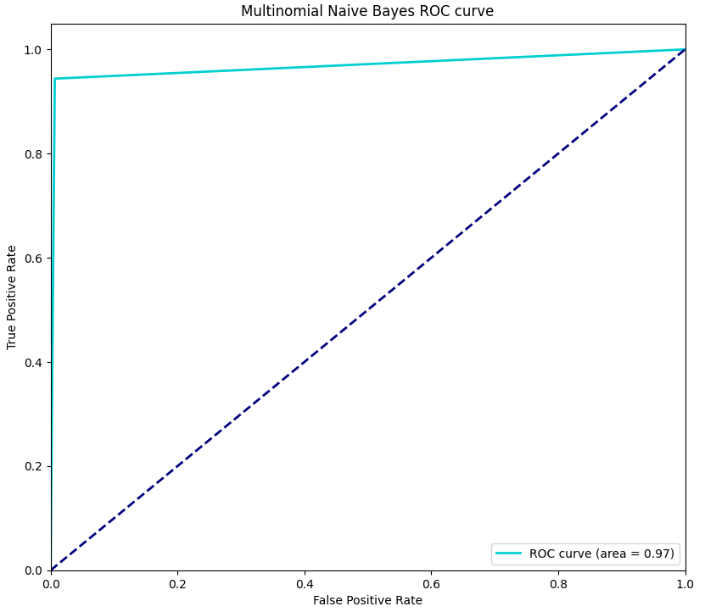
CLASSIFICATION RESULTS
Marco Ruta

Slide 20
VALIDATION
K-Cross-Validation stratified with 10 folds
Classifier | Accuracy | Precision | Recall | F1
SVC | 0.97 | 0.98 | 0.90 | 0.94
SGD SVM | 0.98 | 0.98 | 0.93 | 0.95
C-Naïve Bayes | 0.94 | 0.84 | 0.95 | 0.88
M-Naïve Bayes | 0.98 | 0.95 | 0.97 | 0.96
Marco Ruta

Slide 21
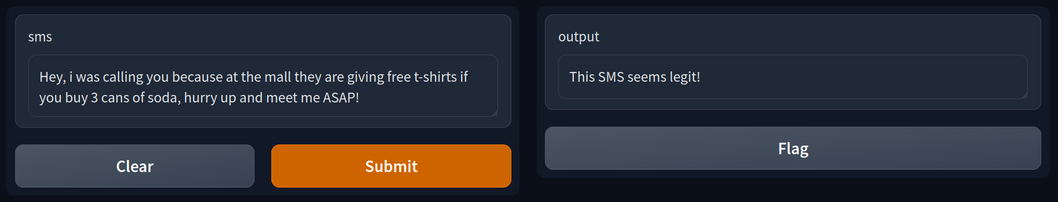
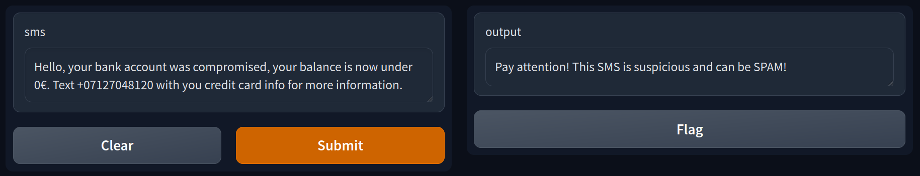
WEBAPPP MOCKUP
Marco Ruta

Slide 22
CONCLUSIONS
ML Algorithms outperforms classical techniques as Blacklist and LSH, I have tried two classes of ML algorithms widely used in the SPAM detection field as Naïve Bayes and Support Vector Machine and the most performant one (in terms of precision, recall, and AUC) was Multinomial Naïve Bayes with the following metrics:
{AUC = 0.97} {Accuracy = 0.98} {Precision = 0.95 } {Recall = 0.97 } {F1= 0.96}
Marco Ruta
POSSIBLE IMPROVEMENTS:
Increase the dataset: try to find new datasets online to integrate (until now it is the best one).
Augment the data: augment the sms spam messages with NLP techniques.
Hyperparameter optimization: use grid search or random search to improve performances.
Solve the link bias: incorporate a ML algorithm capable of discriminate malicious link.

