Slide 1




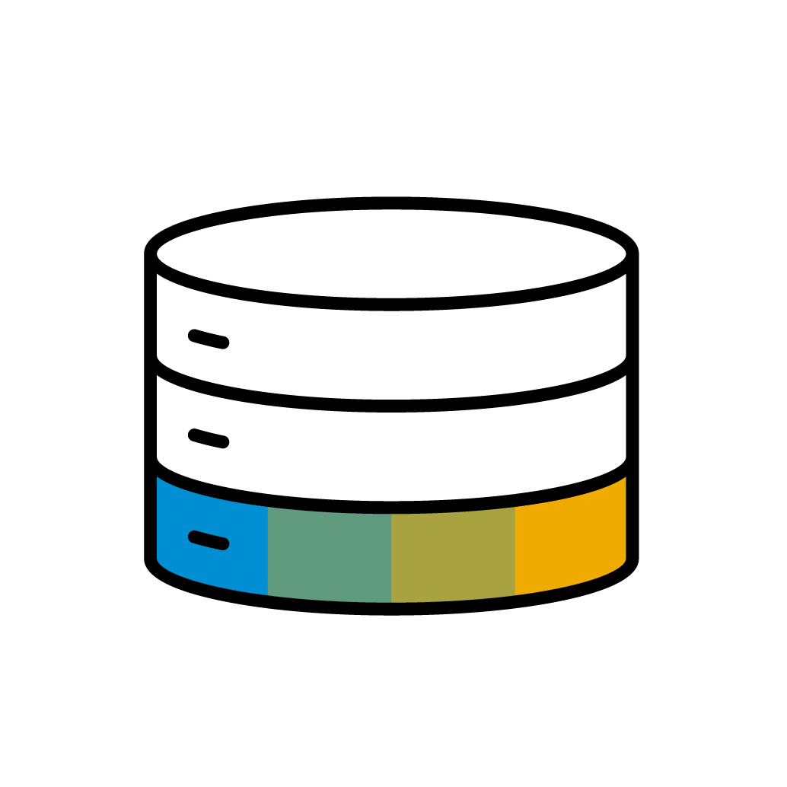



SAP Logistics Business Network - Integration
Request for Quotation management
SAP Logistics Business Network
Freight Tendering management
Rate Quotation or RFQ rejection
Carrier Systems & Mobile Apps
Shipper TMS
Logistics Business Network
Freight Order management
Subcontracting management
Carrier Network
Freight Order confirmation or rejection
Freight Tracking
Freight Tracking
Freight Tracking
SAP Customer Experience
Carrier Experience

Slide 2
Freight Collaboration Tendering
API Name | Description | API document
Consumer API for Freight Tendering | This interface is called by SAP Logistics Business Network to Carrier or partner system when an ordering party creates, updates or deletes a freight request for quotation | https://api.sap.com/api/FreightTendering_Consumer/resource -Freight Request for Quotation
Provider API for Freight Tendering | Creates a freight quotation for a freight request for quotation in SAP Logistics Business Network. This api is called by the carrier or partner system | https://api.sap.com/api/FreightTendering_Provider/resource
Consumer API for Freight Tendering – Freight Quotation | This interface is called by SAP Logistics Business Network when an ordering party awards or rejects a freight quotation. | https://api.sap.com/api/FreightTendering_Consumer/resource Freight Quotation
LBN
Consumer API for Freight Tendering
Carrier/Partner system
Provider API for Freight Tendering

Slide 3
Freight collaboration Subcontracting
LBN
Consumer API for Freight Subcontracting
Carrier/Partner system
API Name | Description | API document
Consumer API for Freight Subcontracting | This interface is called by SAP Logistics Business Network to carrier or partner system when an ordering party creates, updates or deletes a freight order for subcontracting. | https://api.sap.com/api/FreightOrderForSubcontracting_Consumer/resource
Provider API for Freight Subcontracting | Creates a carrier response for a freight order for subcontracting in SAP Logistics Business Network.This API is called by carrier or partner system | https://api.sap.com/api/FreightOrderForSubcontracting_Provider/resource
Provider API for Freight Subcontracting

Slide 4
Freight collaboration Tracking
LBN
Consumer API for Order Tracking
Carrier/Partner system
API Name | Description | API document
Consumer API for Order Tracking | This interface is called by SAP Logistics Business Network to carrier or partner system when an ordering party sets the orders for execution or initiates orders for tracking | https://api.sap.com/api/OrderForTracking_Consumer/resource
Provider API for Freight Subcontracting | Creates an event in SAP Logistics business Network. This API is called by carrier or partner system | https://api.sap.com/api/OrderEvents_Provider/resource
Provider API for Order Events

