Slide 1

SAP Logistics Business Network An Introduction for Carrier Networks
Product Management, SAP SE
October 2020

Slide 2
What is SAP Logistics Business Network?

Slide 3




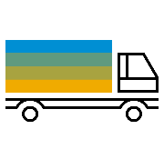











SAP Logistics Business Network Increased business speed through an always on, secure network of networks
Global
Onboard once – collaborate with many, anywhere and anytime
Allow different stake-holders to consume logistics services and share insights
Out-of-the-box integration for SAP customers with their back-end systems
Multi-party
Interoperable
Shippers
Freight Forwarders
Logistics
Business Network
Carriers
Other Networks
Freight Collaboration
Track and Trace
Suppliers
Capability
Global Track and Trace
Material Traceability
…
Customers
Connectivity & Platform
Intelligent Suite
Multi-modal
Robust, scalable cloud service with global coverage
Connect multiple business partners for inter-company collaboration and transparency
Standardized services for logistics collaboration and insights
2020 SAP SE or an SAP affiliate company. All rights reserved. | PUBLIC
3
Notes:
Onboard once - collaborate with many, anywhere and anytime. Break up siloed operations to manage freight more efficiently. Benefit from situational awareness and eased decision making through Track & trace

Slide 4















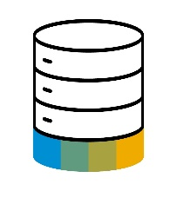


SAP Logistics Business Network openness Extend the reach and accelerate innovation with established partner services
Carriers
Mode-specific / regional networks /
Shippers
B2B integration
Digital carrier networks
Instant pricing & subcontracting
SAP Logistics Business Network
Partner content & applications
Visibility networks
Expected time of arrival, milestone and geo- tracking in real-time
Multi-network and partner collaboration for end-to-end logistics execution
2020 SAP SE or an SAP affiliate company. All rights reserved. | PUBLIC
4

Slide 5
Which services can you offer through SAP Logistics Business Network?

Slide 6
What the shippers use SAP Logistics Business Network, freight collaboration option for…
Connect with your relevant logistics partners for closed-loop, out-of-the box business process collaboration
Jointly manage logistics transactions in the network
Exchange documents and provide insights into process steps operated by others
Offer connectivity as per your logistics partner’s technical ability: online integration for small enterprises / API-based for technology-savvy ones
Natively integrate with your business backend systems
Use 3rd party logistics networks as a lever
Logistics
Business Network
Capability
Freight Collaboration
Global Track and Trace
Material Traceability
Connectivity & Platform
Freight order collaboration
Dock appointment scheduling
Standardized visibility
6

Slide 7
What the shippers use SAP Logistics Business Network, global track and trace option for…
Monitor critical order fulfillment processes by comparing planned versus actual milestones based on a configurable, extensible setup
Receive your own tenant space that allows you to implement available template scenarios, extensions or create your own custom tracking scenarios
Benefit from ready-to-use template scenarios, e.g. sales order fulfillment
Monitor end to end order fulfillment from order placement, delivery and shipment processing in ERP integrated with multi-modal shipment progress visibility captured from your connected carrier and logistics service provider fulfillment network
Connect to visibility providers and receive milestone and geo location tracking data with predictive time of arrival
Understand the impact of shipment delays to your orders
Provide E2E order visibility to your Customers
Send email notifications to stakeholders in case of exceptions or trigger follow-up activities leveraging a rules framework
Logistics
Business Network
Capability
Freight Collaboration
Global Track and Trace
Material Traceability
Connectivity & Platform
Extensible sales order fulfillment and related deliveries and shipments scenario tracking template
Design your own tracking templates
…additional templates planned
7

Slide 8
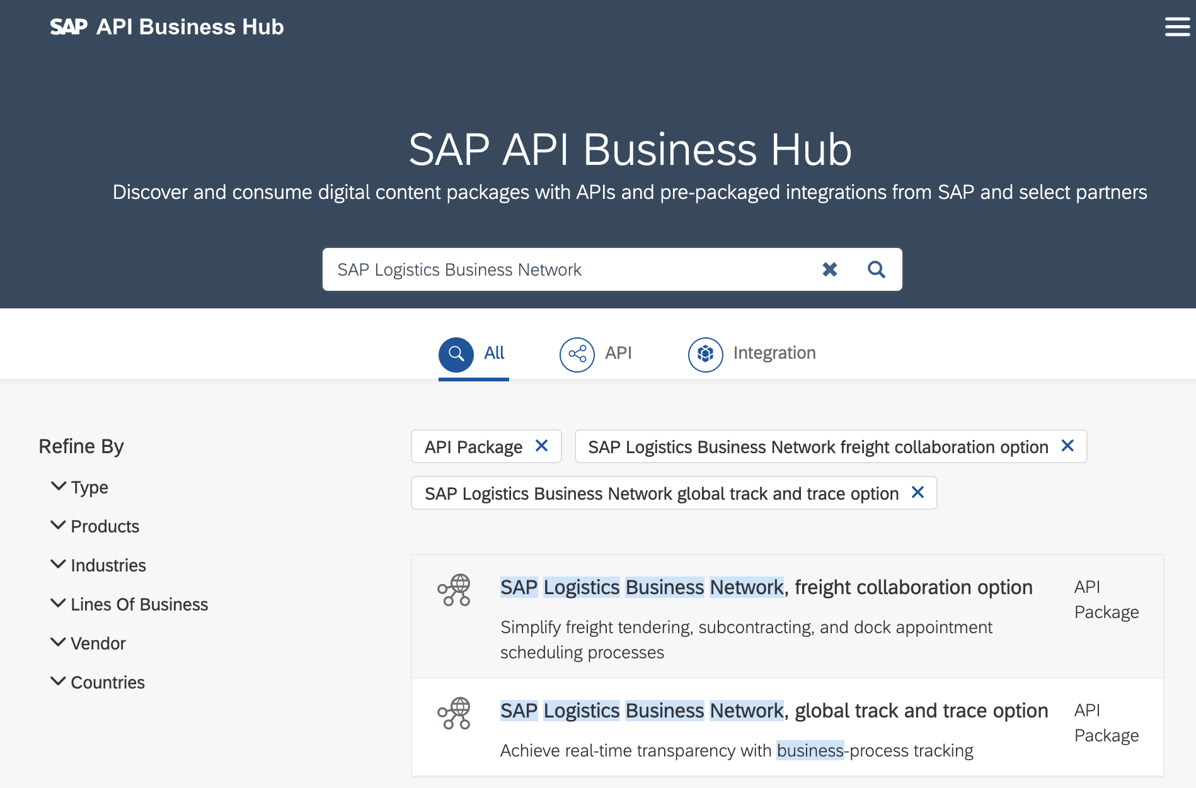
SAP Logistics Business Network Your integration option to support the shippers’ processes with your carrier network
Multi-party
Global
Interoperable
Shippers
Freight Forwarders
Logistics
Business Network
Carriers
Other Networks
Freight Collaboration
Track and Trace
Suppliers
Capability
Global Track and Trace
Material Traceability
…
Customers
Connectivity & Platform
SAP publishes easy to consume APIs for you to connect your own services to the SAP LBN services for the various options – you integrate once to SAP LBN, and with that connect your own carrier network with the shipper network on SAP LBN
Notes:
Onboard once - collaborate with many, anywhere and anytime. Break up siloed operations to manage freight more efficiently. Benefit from situational awareness and eased decision making through Track & trace

Slide 9










Freight Order Collaboration (freight collaboration option) Facilitate end-to-end collaboration for LTL + FTL shipments between shippers and your carriers
WebUI + API
WebUI *
WebUI + API
WebUI *
Contracting
Slot Booking
Execution
Settlement
Quotation processing (tendering) and order confirmation
Appointment booking for pick-up or delivery of goods
Milestone and ETA reporting, as well as document exchange, such as proof of delivery
Self billing, invoicing and dispute management
* process is supported in SAP LBN only via web application today; API enablement is planned
Collaborative
processes
Digital freight
documents
Real-time
insights
Out-of-the-box
integration
2020 SAP SE or an SAP affiliate company. All rights reserved. | PUBLIC
9

Slide 10

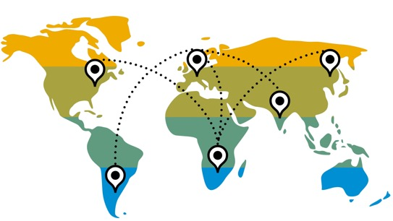









Standardized Multi-Mode Visibility for your shippers’ shipments* (unified API to support freight collaboration and global track and trace options)
Provide visibility to the shippers on the execution of their ocean transportation shipments through your carrier network:
Booking & container tracking with milestones/actual events and geo location at sea
Container Terminal
at Port of Origin
Port of Origin
Transshipment Port
Port of Discharge
Container Terminal at Port of Discharge
Consignee Location
Empty container dispatched for loading
Container received
Container loaded
Vessel departed
Vessel arrived
Container unloaded
Container loaded
Vessel departed
Geo location
Vessel arrived
Container unloaded
Container out for delivery
Empty container returned
Container delivered
* current coverage is for road/ocean movements; further transportation modes as per roadmap

Slide 11




Digitally-enabled Truck Carrier Network --
Provide instant pricing
How
Leverage API integration for automated, streamlined load pricing and subcontracting
Access a vast and growing shipper network for offering on demand road transportation
Provide instant market price with real-time, guaranteed load pricing directly into the shippers’ SAP systems
Carriers
SAP Logistics Business Network
Shipper with SAP Back-End
11
Notes:
The Value of a Networked Approach and the Power of Collaboration
With this partnership SAP and Uber Freight intend to connect both sides of the freight marketplace. This will enable easier, faster decision-making based on real-time pricing for shippers and carriers, empowering organizations to maximize daily work time and make more informed decisions about their operations.

Slide 12






Road Visibility and Collaboration
--
Connect for real-time updates
How
Contracting: receive freight requests for quotes and orders, forward to the carriers in your network and send back quotes and confirmations from the carriers to the shippers
LTL visibility: send actual milestones directly from carrier backend systems to the shippers
FTL visibility: complement milestone tracking by exact geo position and predictive ETA and provide it to the shippers
SAP Logistics Business Network
Shipper with SAP Back-End
12

Slide 13
Freight booking and container visibility
--
Connect for real-time updates
How
Visibility for ocean bookings and containers in execution: provide status updates along the complete journey to the shippers
Complement port-to-port milestone tracking by exact vessel geo position while in-transit
Provide cleansed, high-quality data and predictive ETA considering actual conditions
SAP Logistics Business Network
Shipper with SAP Back-End
Coverage: global port and vessel updates
13

Slide 14
Further Information

Slide 15
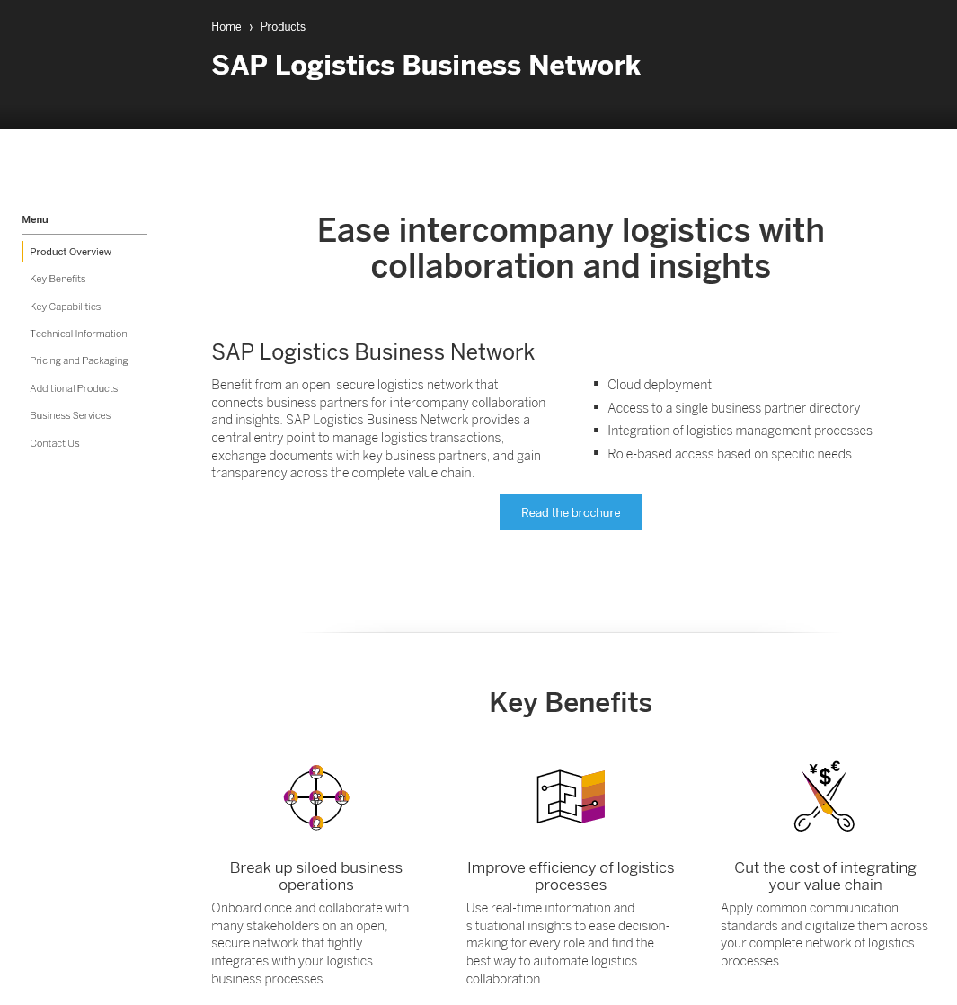
Where to find more information
API Self-Service
SAP.COM
SAP Store
Help Portal

Slide 16
Thank you.
Contact information:
LBN@SAP.COM

