Slide 1
Training time estimation for Convolutional Neural Network in Distributed Systems
Sayak Mukherjee & Marco Schouten

Slide 2
Motivation
Machine Learning entails optimization of multiple hyper parameters
Distributed training environments in cloud offer a variety of hardware choices
Often there is a need for trade-off between performance and cost
Machine Learning approaches proposed to choose the best combination

Slide 3
Research Question
Estimates the training time for a given deep learning model
Optimizes system settings and hyper-parameters in relation to training time

Slide 4
Contribution
Using Design of Experiments (DoE) to analyze factors influencing training time
Comparing single high-performance CPU to multiple low performance CPU
Building a regression model to predict training time
Optimize the highest variability factor to attain a pre-determined training time

Slide 5
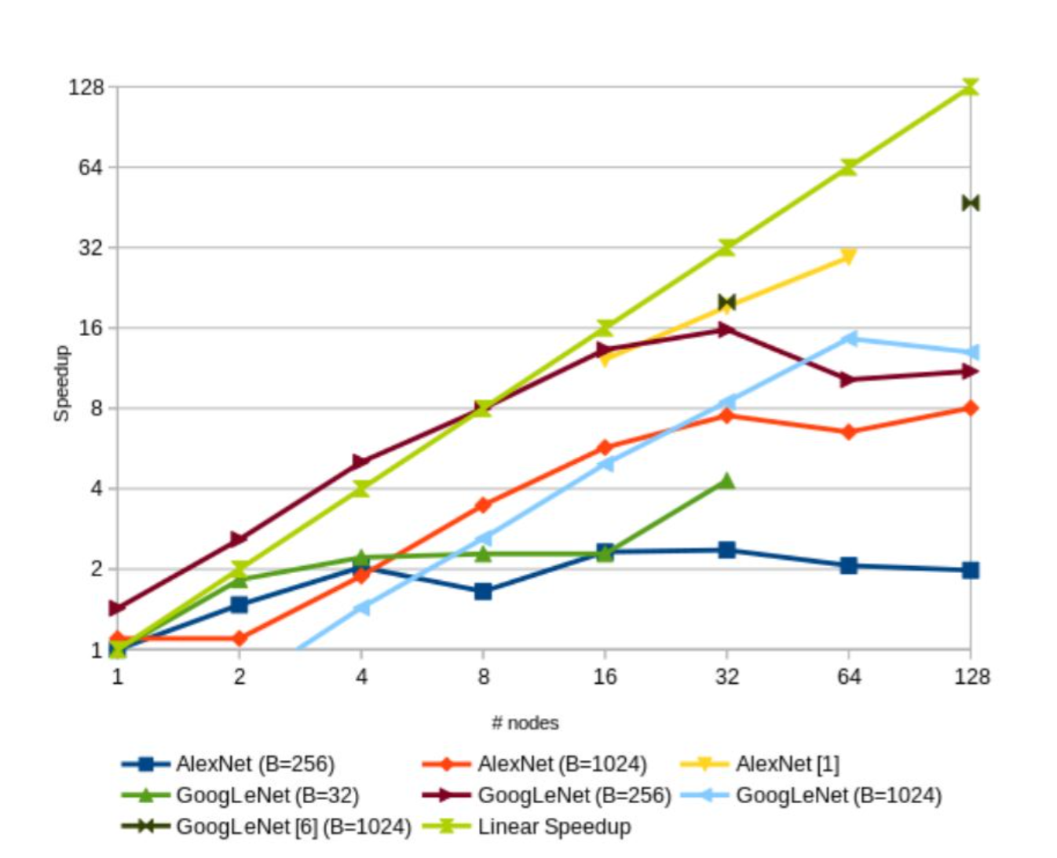
Overhead of Synchronizing model parameters between nodes hinders linear increase in performance
Background

Slide 6
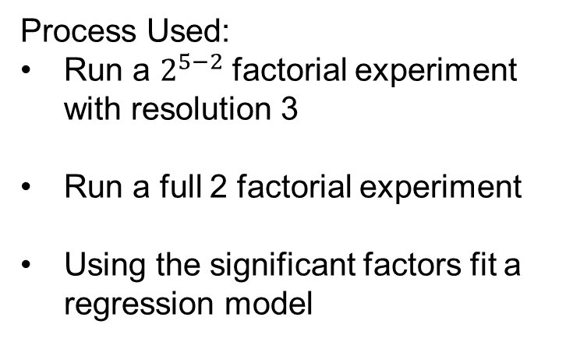
Design of Experiments (DoE)
System parameters to consider:
Number of executor cores (1,2,3)
Data Parallelization (1,2,4)
Hyper parameters to consider:
Batch size (32,64,128,256)
Learning Rate (0.01, 0.02, 0.05)
Maximum Epoch (5, 10, 20)
Process Used:
Run a $2^{5−2}$ factorial experiment with resolution 3
Run a full 2 factorial experiment
Using the significant factors fit a regression model

Slide 7
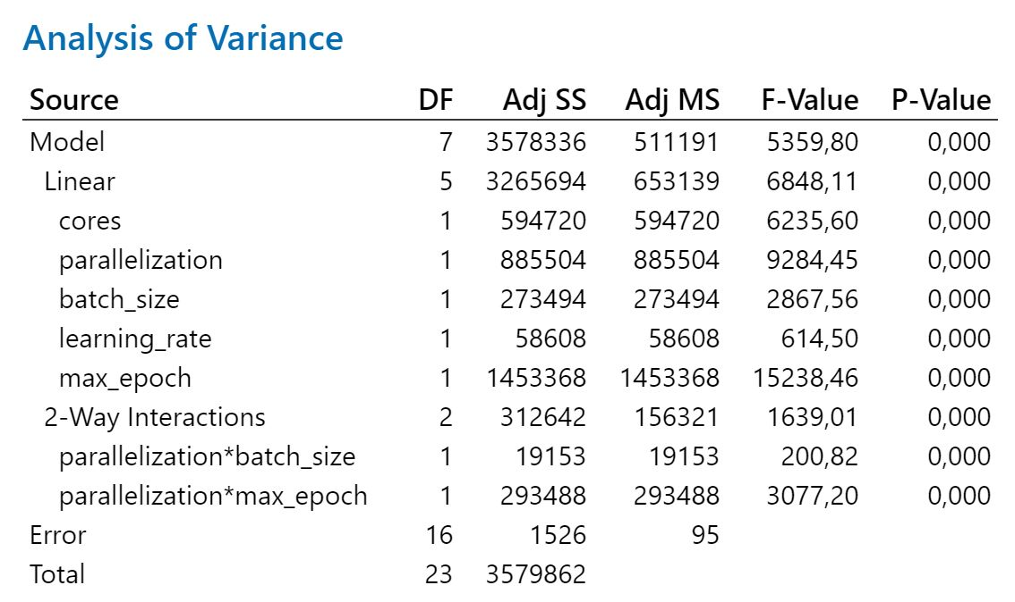

Design of Experiments (DoE)
$2^{5−2}$ Factorial Experiment With Resolution 3

Slide 8
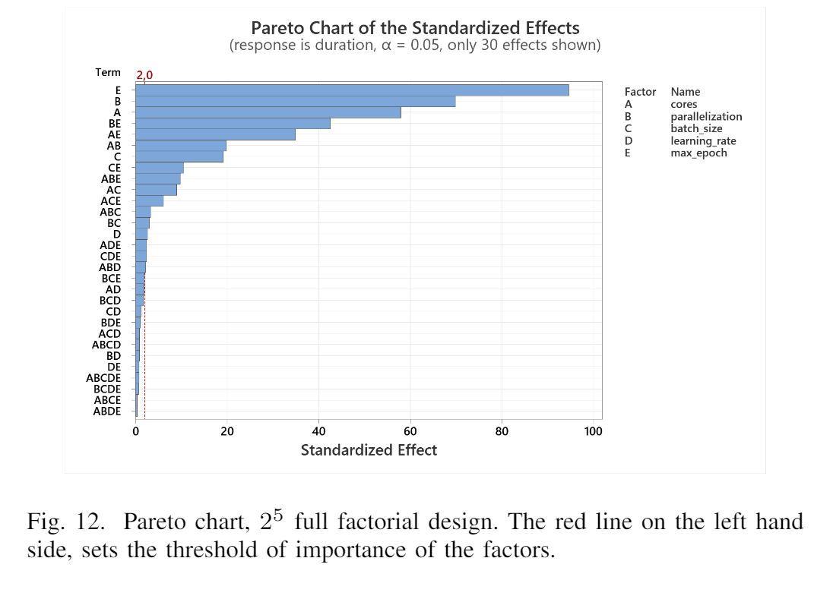
DoE Feature significance

Slide 9
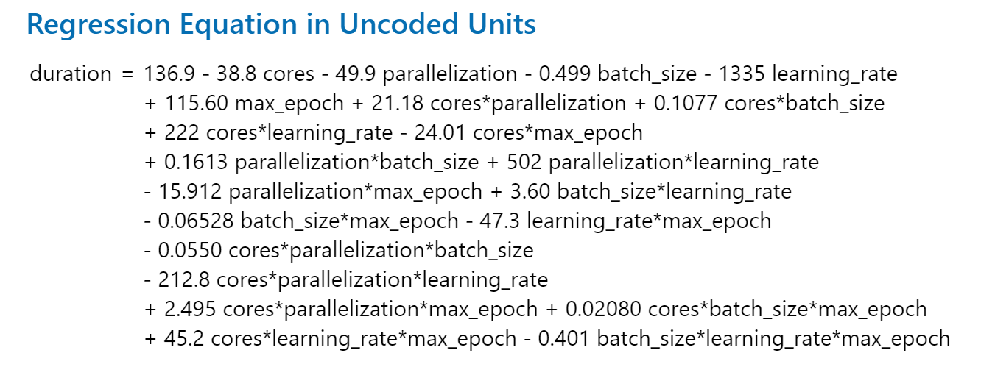
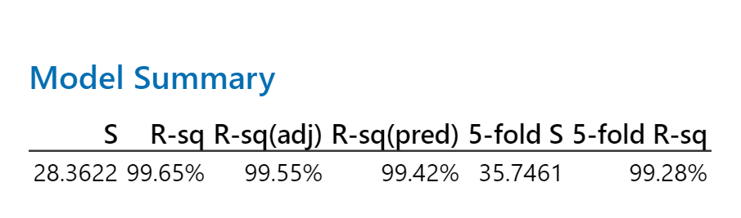
Design of Experiments (DoE)

Slide 10
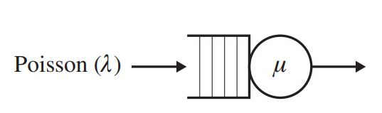
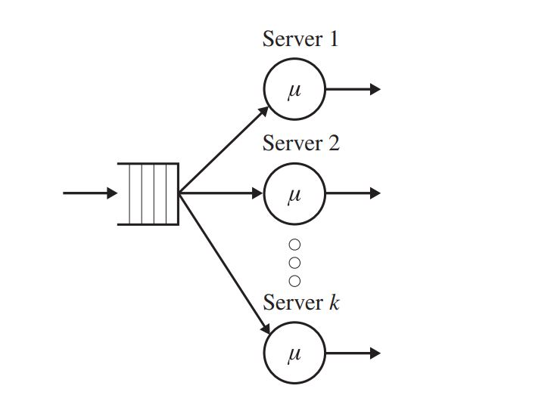
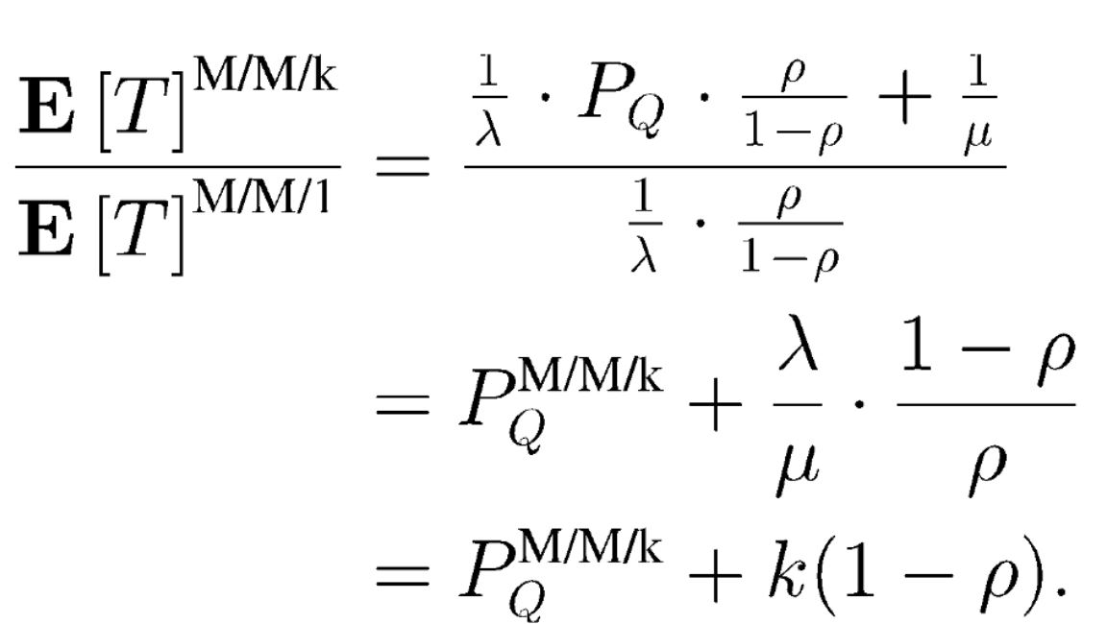
Queueing Theory
Comparing single high-performance CPU to multiple low performance CPUs

Slide 11
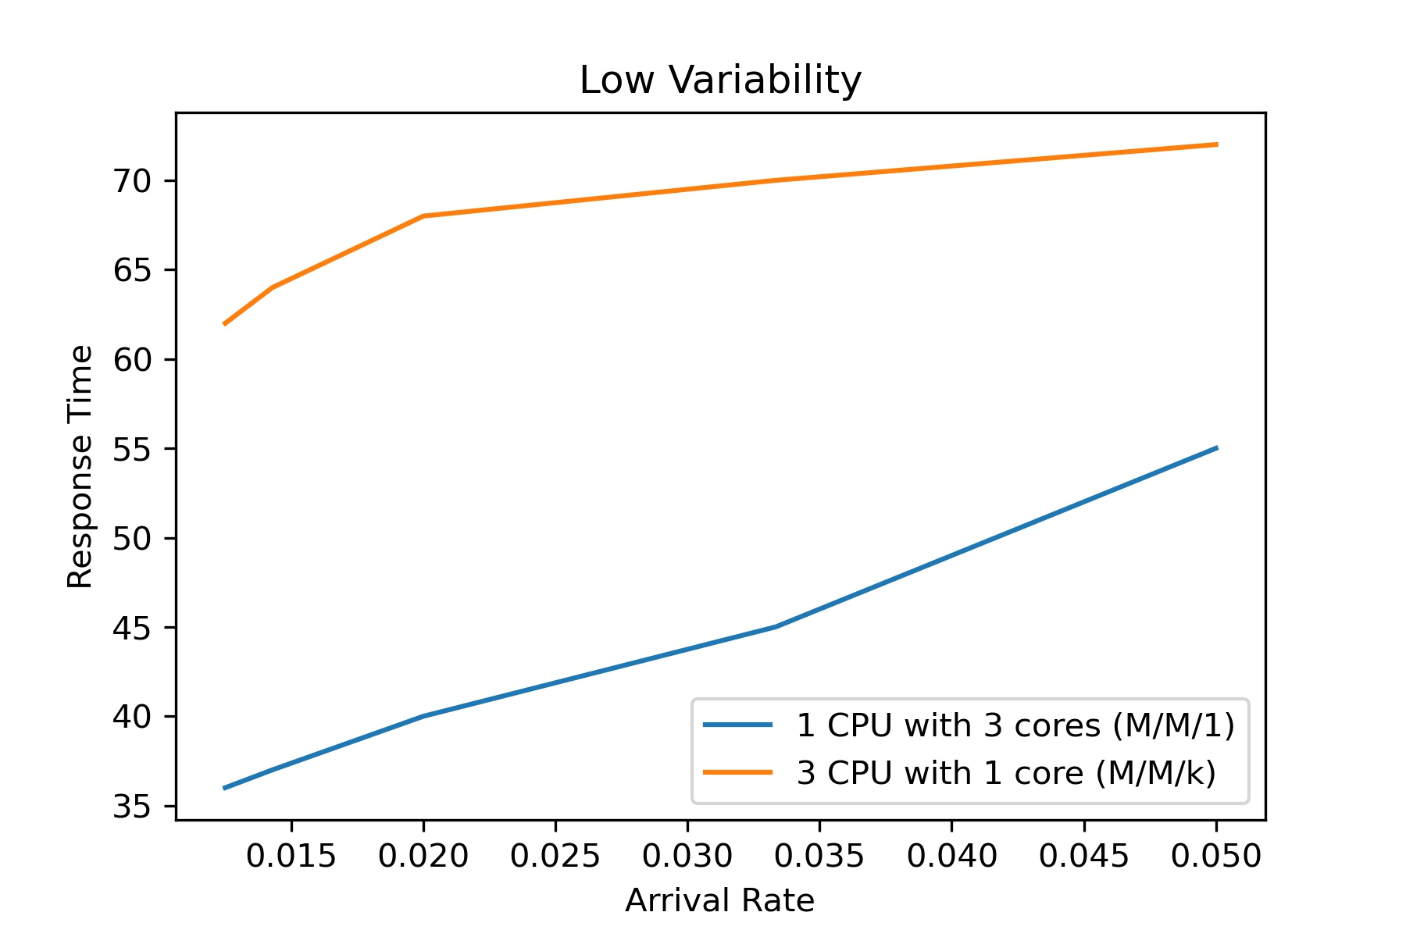
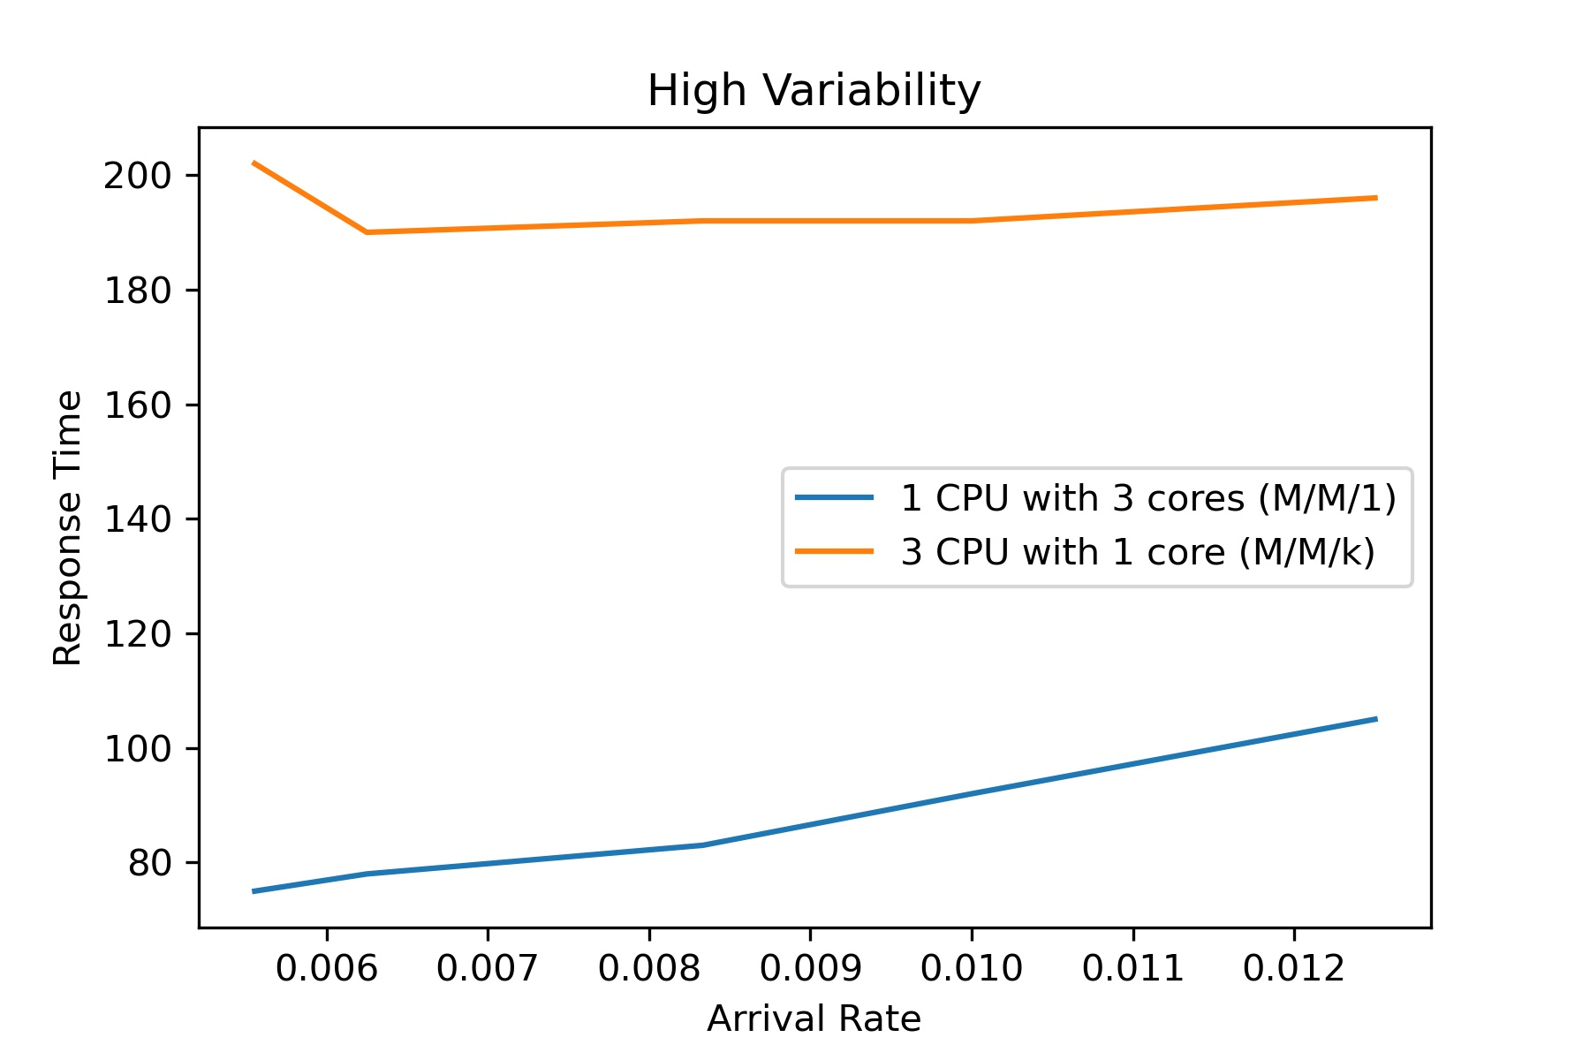
Queueing Theory
Comparing single high-performance CPU to multiple low performance CPUs

Slide 12
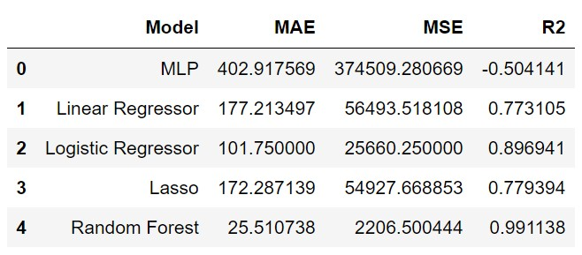
Machine Learning
Data split into train and test sets
Multiple regression models fit to the data

Slide 13
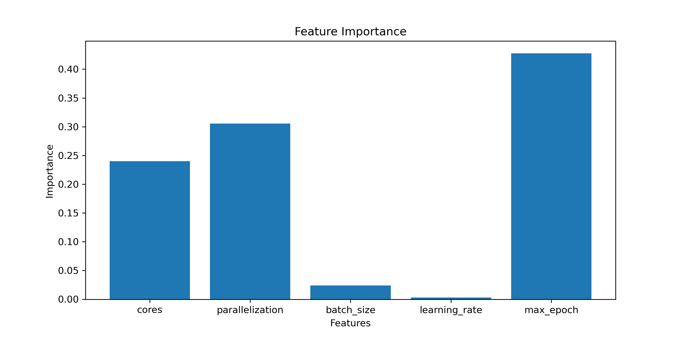
Random Forest Regressor

Slide 14
Optimization Strategy
random forest
Linear Regressor

Slide 15
Optimization Strategy
Max epoch is most important factor
Given Time limit for training time
Find best settings that satisfy this requirement

Slide 16
Results
83% Jobs Completed within time with optimizer
improvement of 33%
50% jobs completed within time for baseline

Slide 17




Limitations
Consider additional factors such as number of hidden layers
Extend this for more detests and different deep learning architectures, like Transformers
Include Accuracy in the modeling
Model costs to determine the best trade-off between training time setup and cost

Slide 18
Thank You

