Slide 1
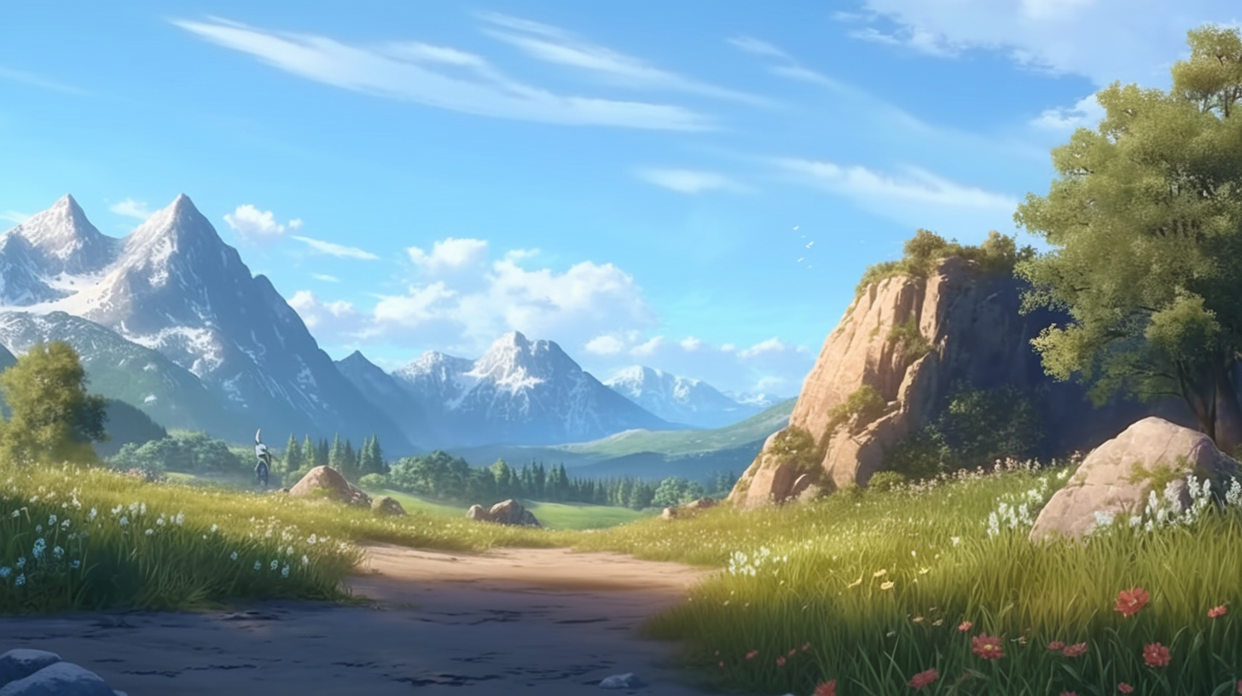
Welcome to Fearless
Welcome to Fearless
Click on the
green button
to continue

Slide 2
This game is composed by many different minigames
Click on the
green button
to continue

Slide 3
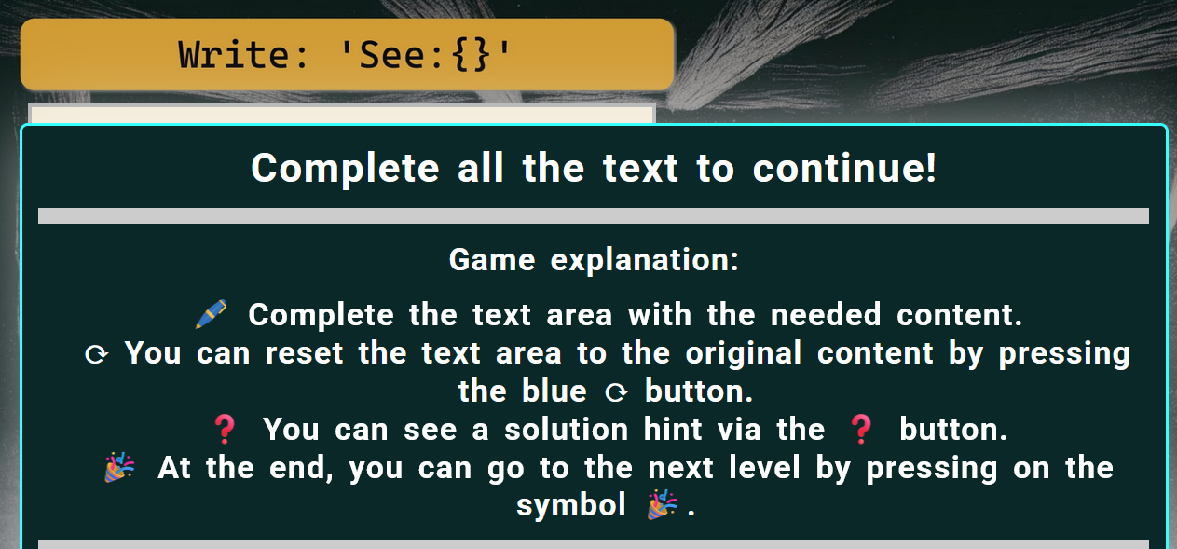
This game is composed by many different minigames
When you make a mistake text like this one shows up
The text explains the minigame and gives hints!

Slide 4
If you are stuck, just make a mistake
and read the text!

Slide 5
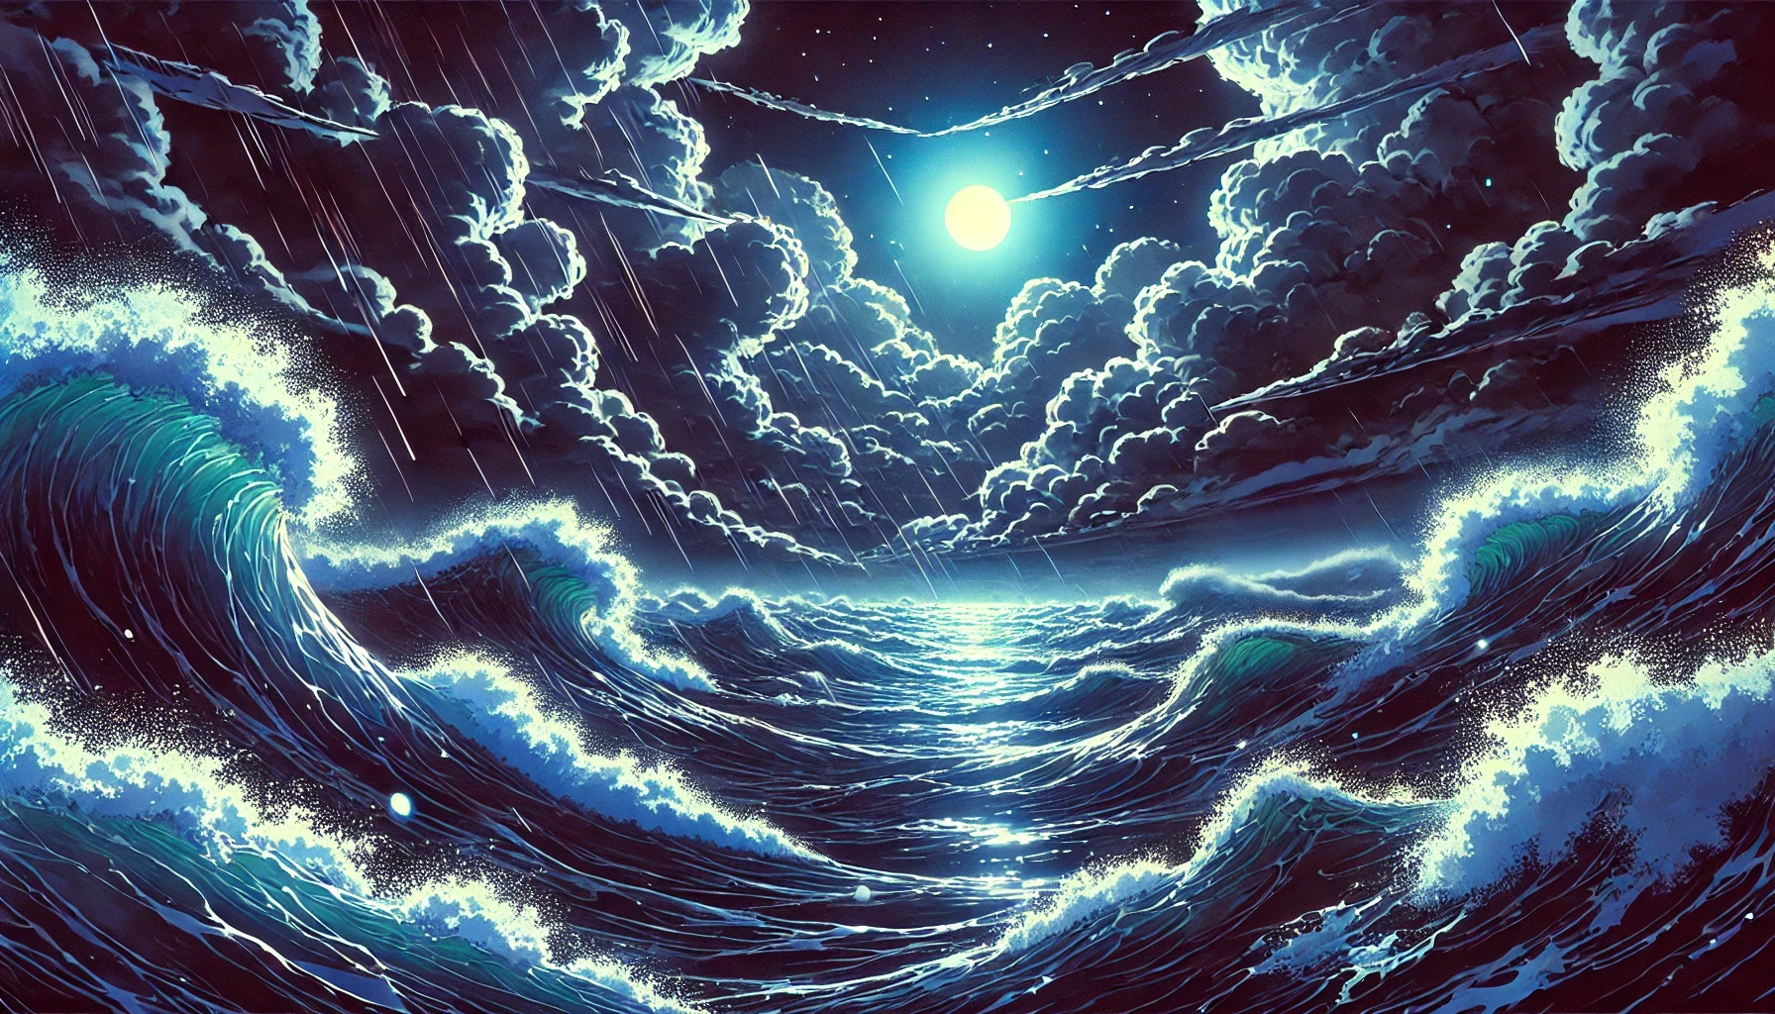
Midnight

Slide 6
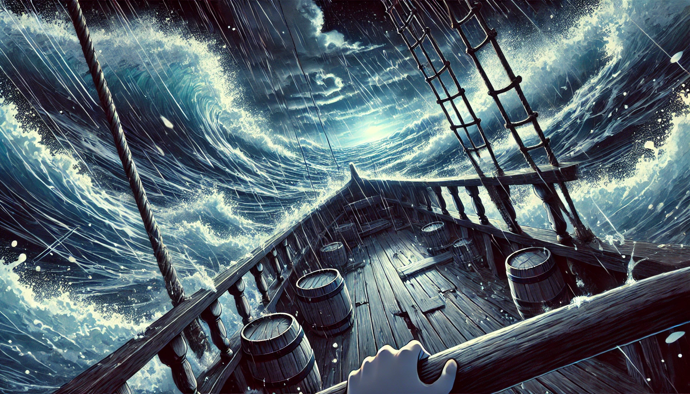
There was ...

Slide 7
no escape

Slide 8

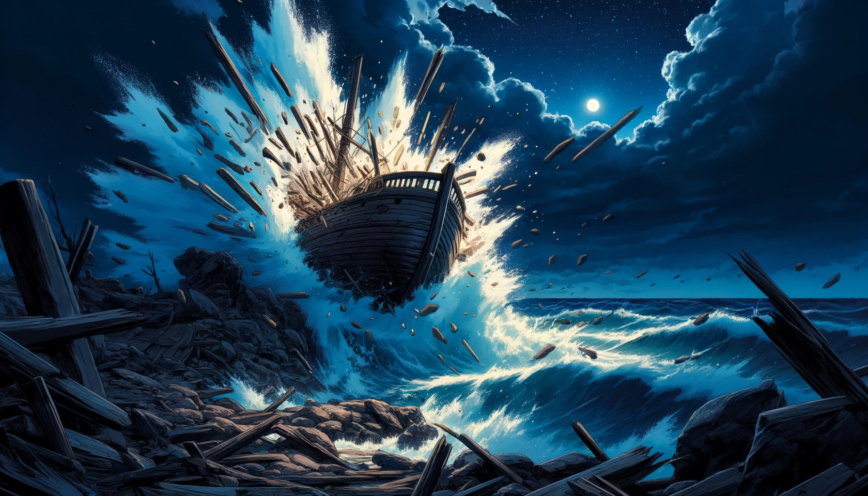


Slide 9
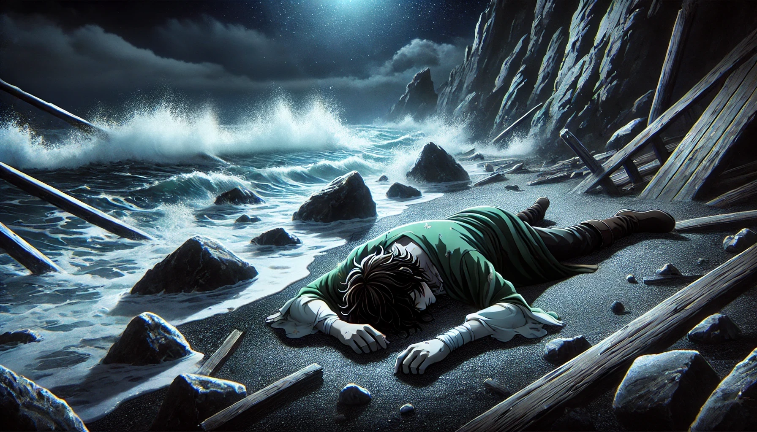

Slide 10
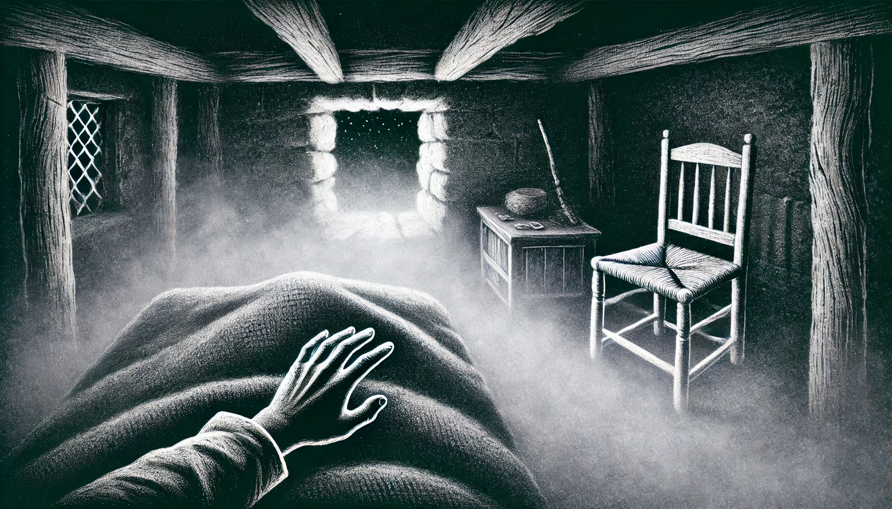

Slide 11

Are you ok?
Can you hear me?

Slide 12
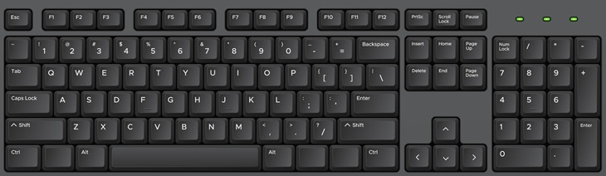
Write: 'Hear:{}'
Write code instructions to make the game progress. Then press >>
Write exactly and only
Hear:{}
To type the { } symbols
use Shift+[ or Shift+]
Some keyboards instead use
AltGr+Shift+[
or Alt+Shift+(

Slide 13
Oh, Good!
Can you see me?

Slide 14
Write: 'See:{}'

Slide 15


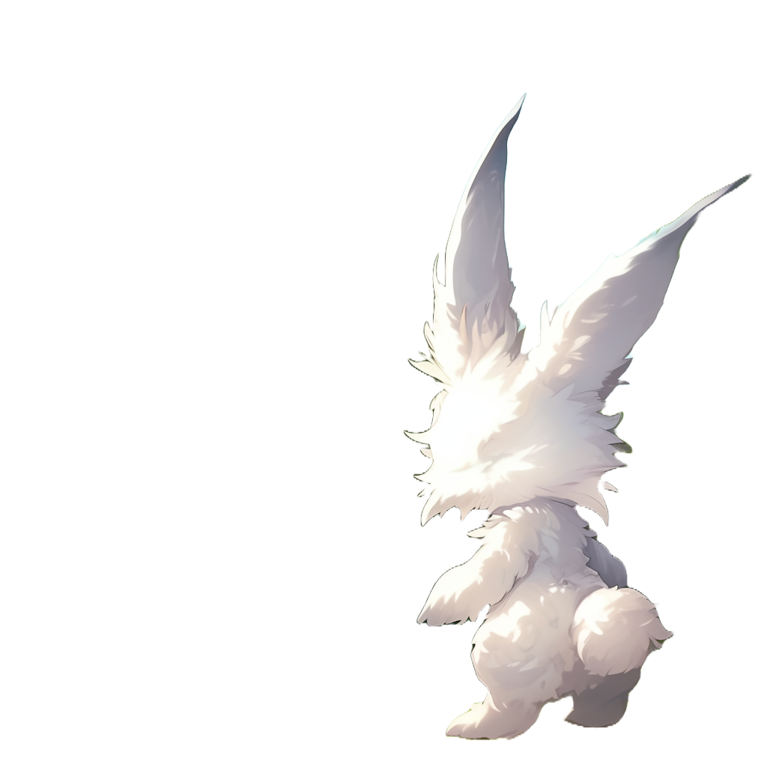
Good, your senses seem
To declare that hearing and seeing
are kind of senses, complete the text
below to be exactly 'Sense:{}'
'See:Sense{}'
'Hear:Sense{}'
to be ok

Slide 16



We found you on the beach yesterday
It seems like your boat collapsed
Where am I?

Slide 17
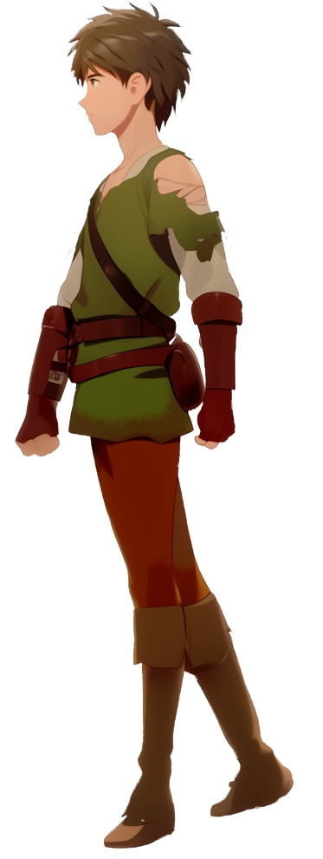

Yeah it’s cool.
Where are we?
I'm Panic. You are in my house
Where are all my companions?
Do you like it?
We were all on my boat

Slide 18

I’m not sure where they are now
You are in Aligard.
It is a small village
Oh no
What country is this?

Slide 19
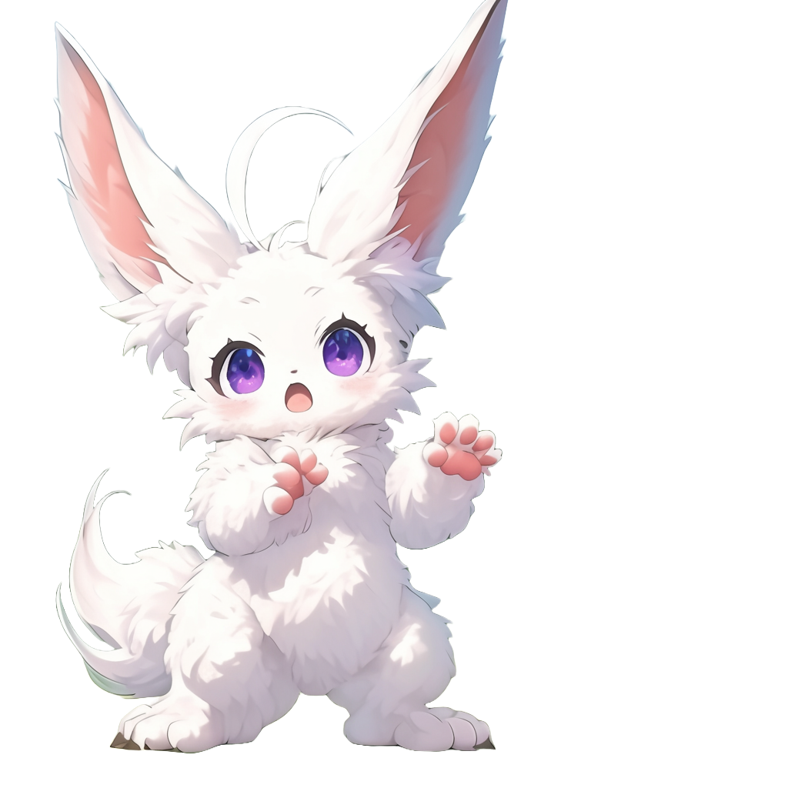
You are in the Kingdom of Gardemar
Or at least what is left of it

Slide 20
Declare the type 'North:{}'
Can you stand?
Try to point at
North, South, East, and West

Slide 21
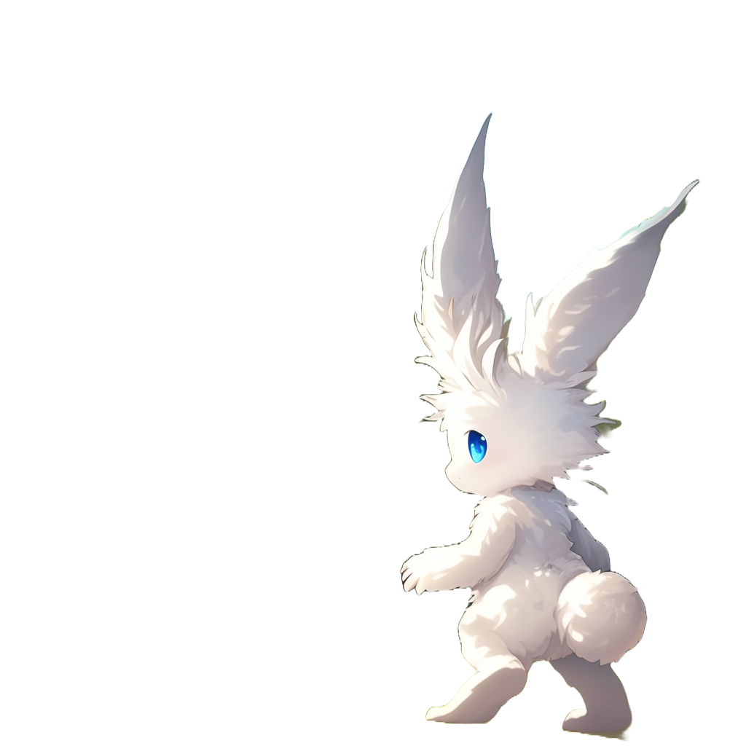

Slide 22

ok, that is North.
By the way,
that is where the
mountains are

Slide 23

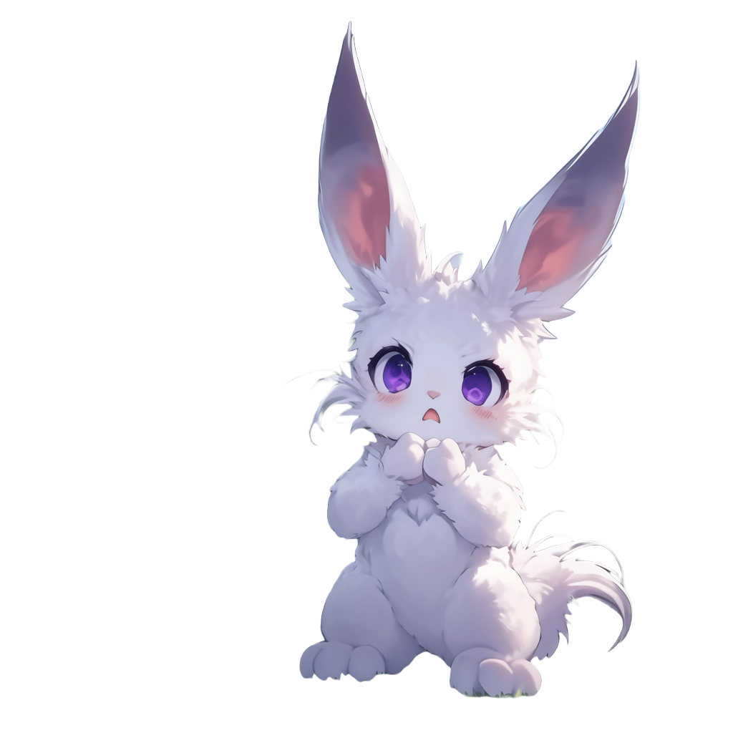
Those mountains look ominous
Yes!
That is where all the monsters are coming from

Slide 24
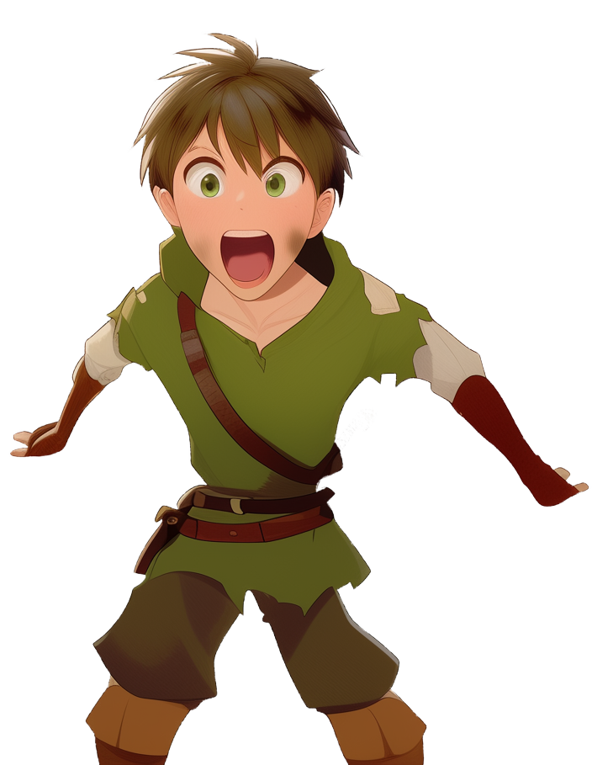
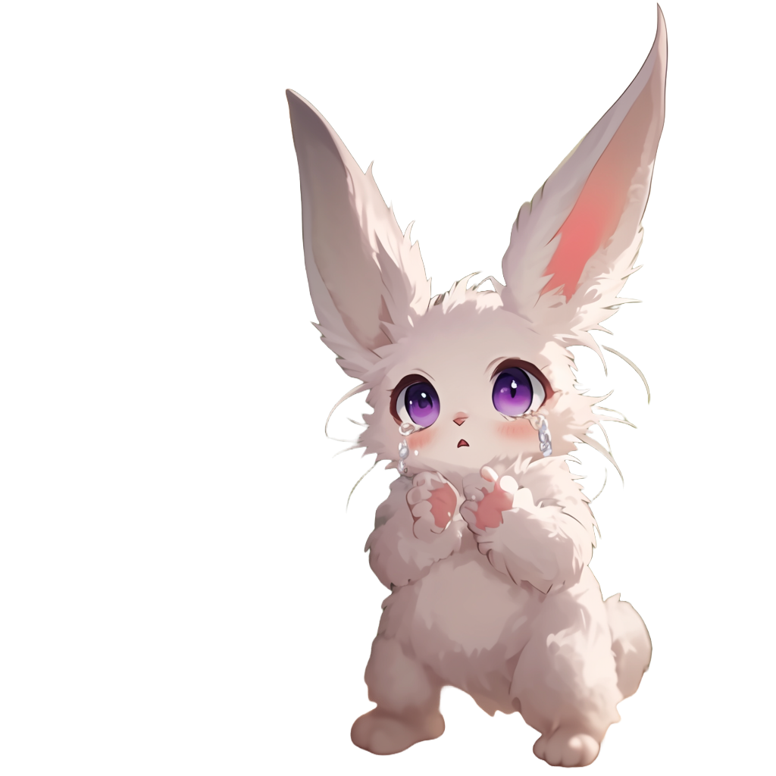
MO.. Monsters?
Yes
They ravage our kingdom and we are now living in fear
scared to leave our villages
at night

Slide 25
Try to include the other
directions too: East, West, and South

Slide 26


Ok, you can now point in all of the four directions
As you can see, I only have a window
to the North

Slide 27
Declare a Direction type and
change the code so that
North, East, South, and West
implement Direction
The code 'See:Sense{}'
Means 'See is a kind of Sense'
Or 'See implements Sense'

Slide 28

Declare a method
'.turn: Direction,'
inside 'Direction'
between the curly brackets.
Note the comma at the end!
Ok!
your mind seems to be working better
Can you now walk and turn without falling?

Slide 29
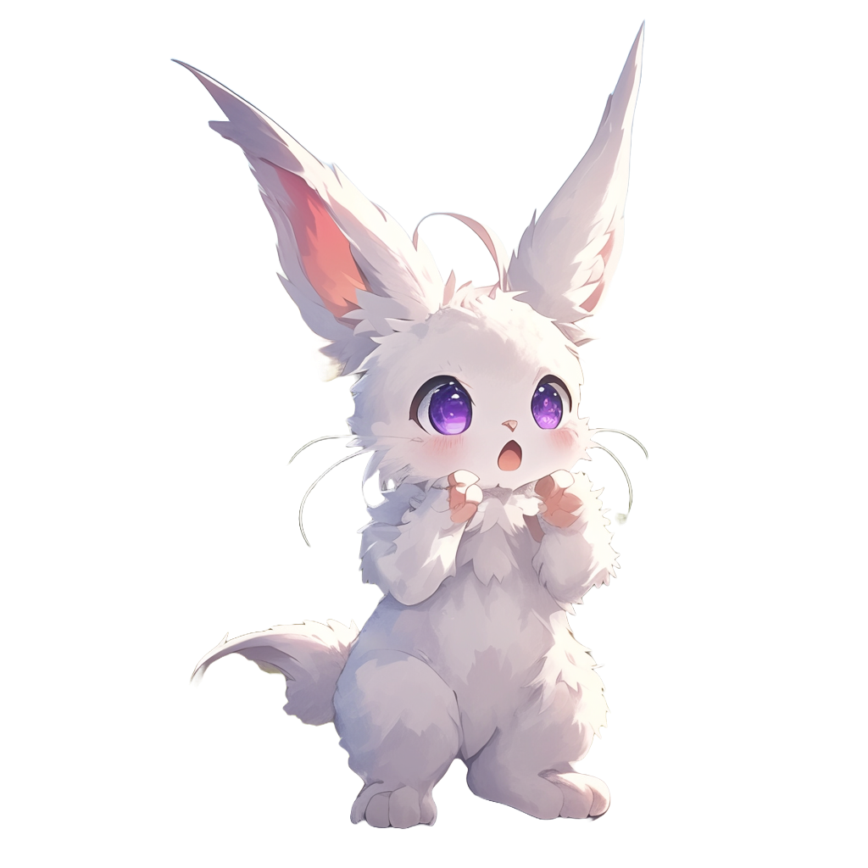
Good
this is an abstract method
now we need to implement it in all directions!
if you are looking
North and
you turn 90 degrees
clockwise
to the right
what direction
would you point to?

Slide 30
Declare a method
'.turn -> East,'
inside North
This represents that
turning clockwise from
North gives you East

Slide 31
Declare the .turn method inside East
Remember, you are turning clockwise!

Slide 32
Keep turning.
Complete South

Slide 33
Ok! One last step

Slide 34
Ok!
It looks like you are now able to walk and turn

Slide 35

Follow me
out to gather some food for dinner

Slide 36
The next minigame is 'Walking'
It is about selecting text
around a highlighted character, to capture a self contained
piece of text
Follow me
out to gather some food for dinner
Follow me
out to gather some food for dinner
Making a mistake will show more instructions and the solution
of the current question
Do not worry about mistakes,
learn by trying

Slide 37

The next minigame is 'Walking'
It is about selecting text
around a highlighted character, to capture a self contained
piece of text
When the
next level
is unlocked,
you will
see the next
level button
Follow me
out to gather some food for dinner
Follow me
out to gather some food for dinner
Making a mistake will show more instructions and the solution
of the current question
Do not worry about mistakes,
learn by trying

