Slide 1
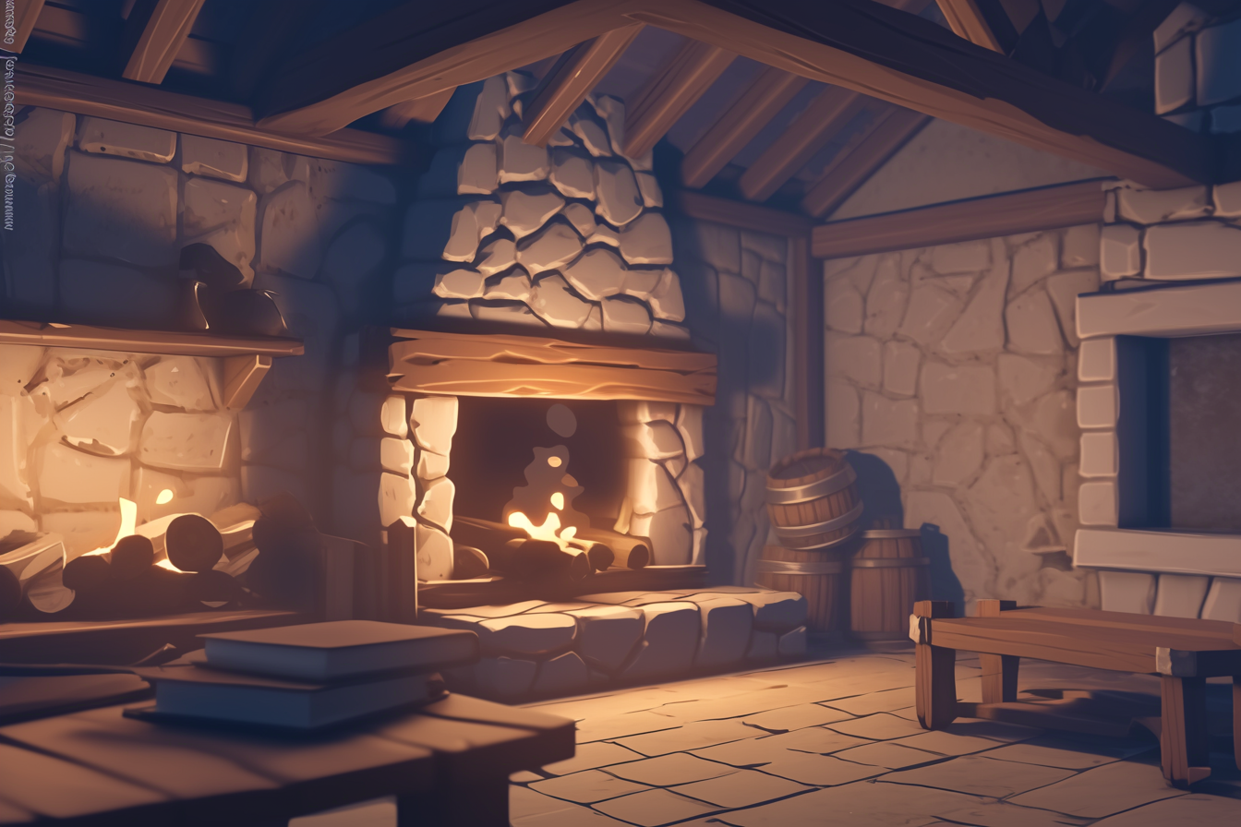
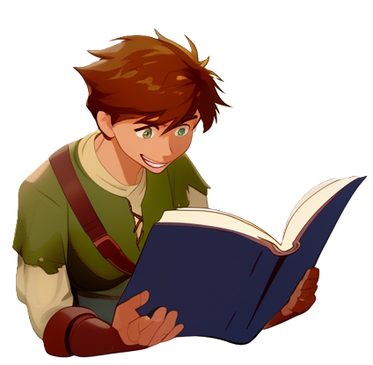
This is going to make code
so ...
so much more compact

Slide 2


With this technique we can create objects
dynamically!
every method call can creates different looking objects

Slide 3

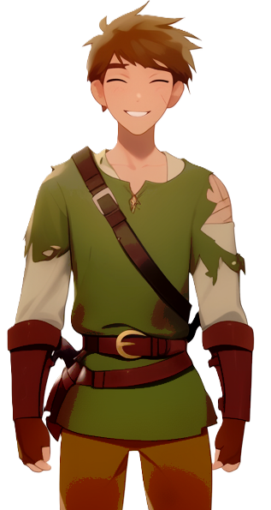
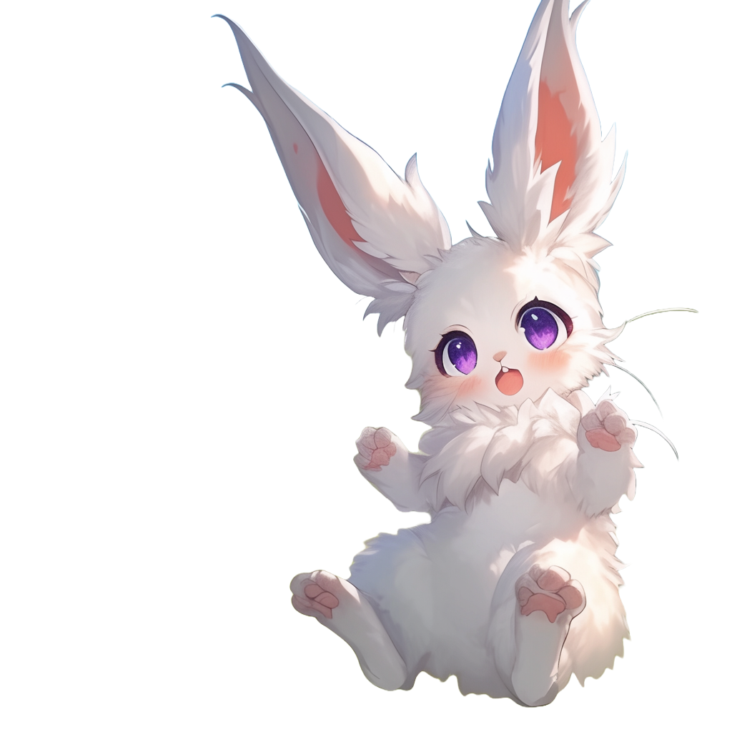
They start walking toward
the training ground again
Let's go!
Second round?

Slide 4
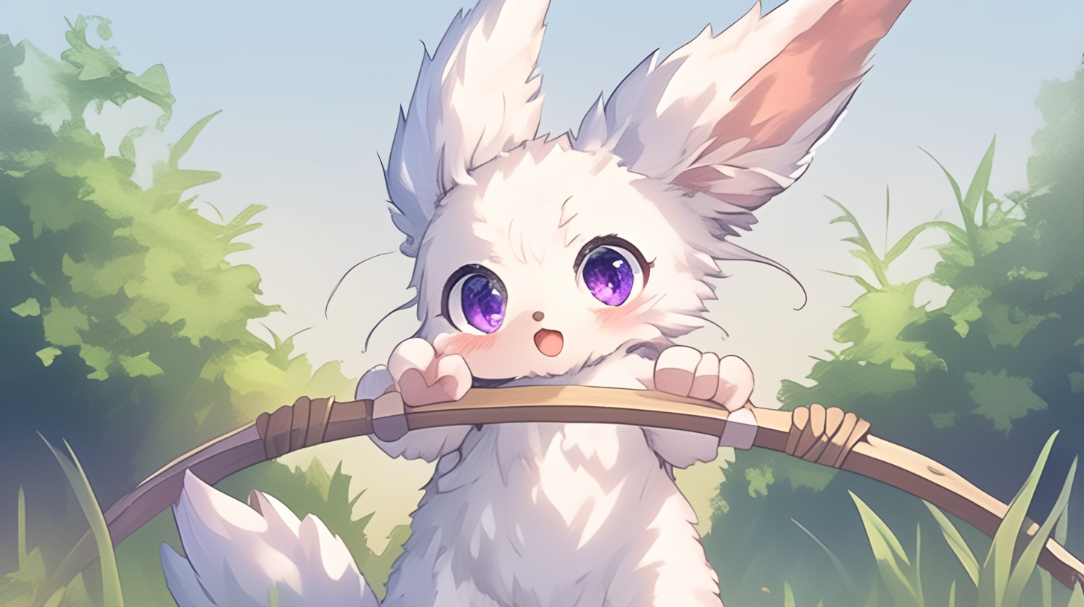
Let's go!

Slide 5
1

Slide 6
2

Slide 7
3

Slide 8
4

Slide 9
5

Slide 10
6

Slide 11
7

Slide 12
8

Slide 13
9

Slide 14
10

Slide 15
11

Slide 16
12

Slide 17
13

Slide 18
14

Slide 19
15

Slide 20
16

Slide 21
17

Slide 22
Very good!
But it is getting late, and we need dinner
let's collect some potatoes
from the walls on the way home

Slide 23
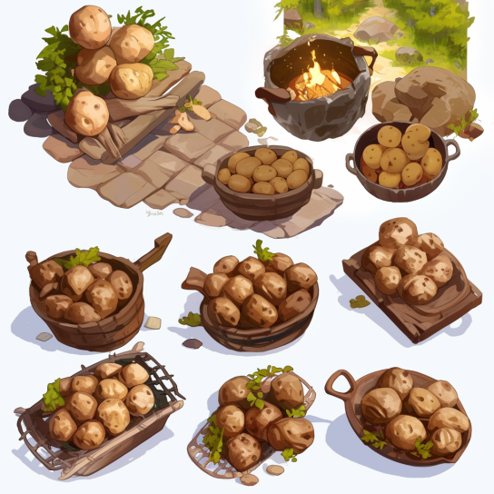
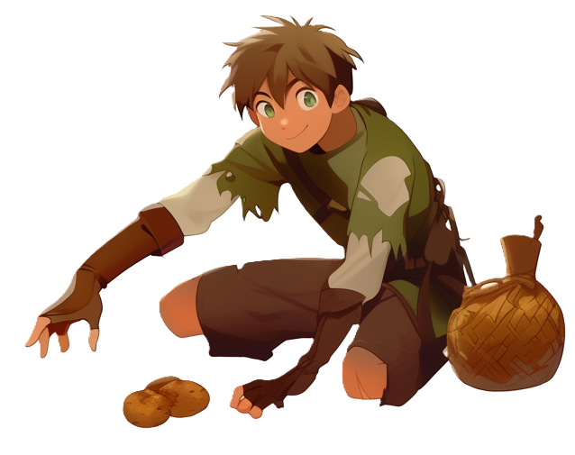
Cool, more potatoes, what are we going to eat them with?

Slide 24
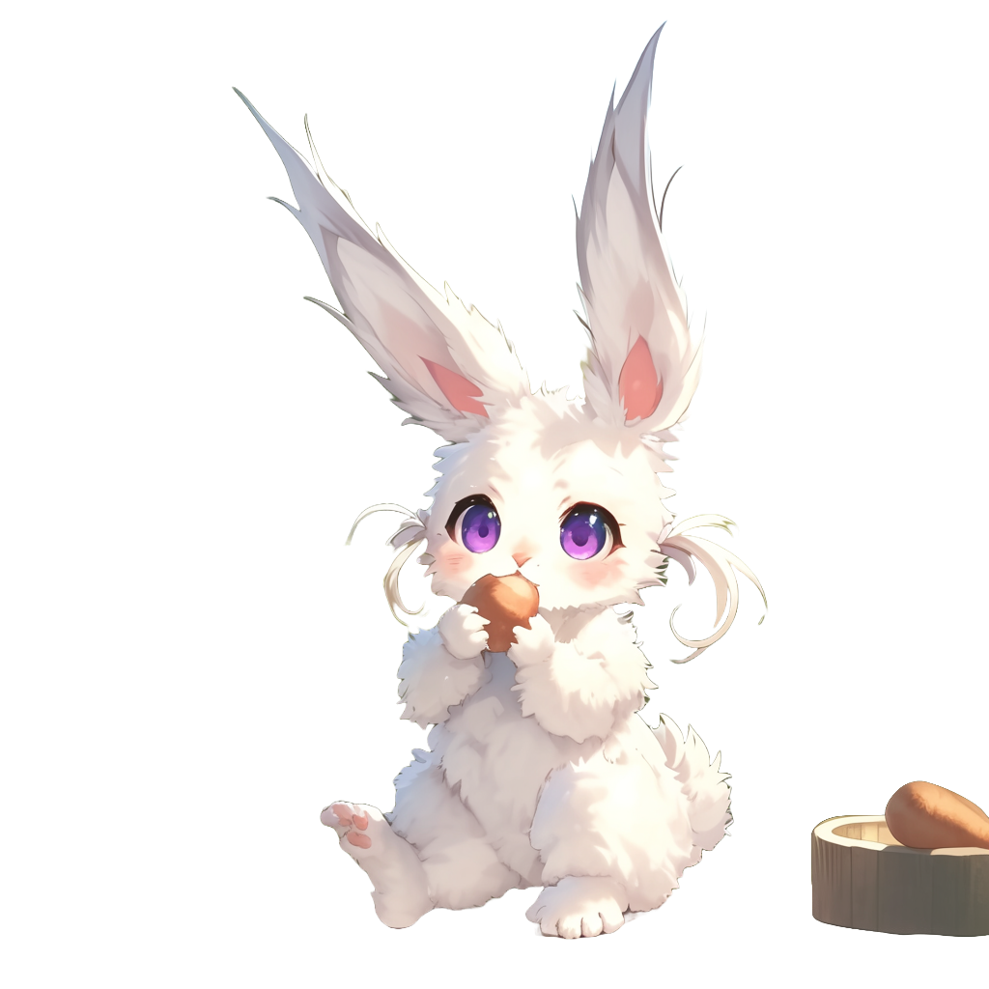
Potatoes with potatoes and potatoes!
We have been in the village all day, right?
we will need to gather more
food tomorrow
We can not just weigh down on
the limited food stores of
the village

Slide 25
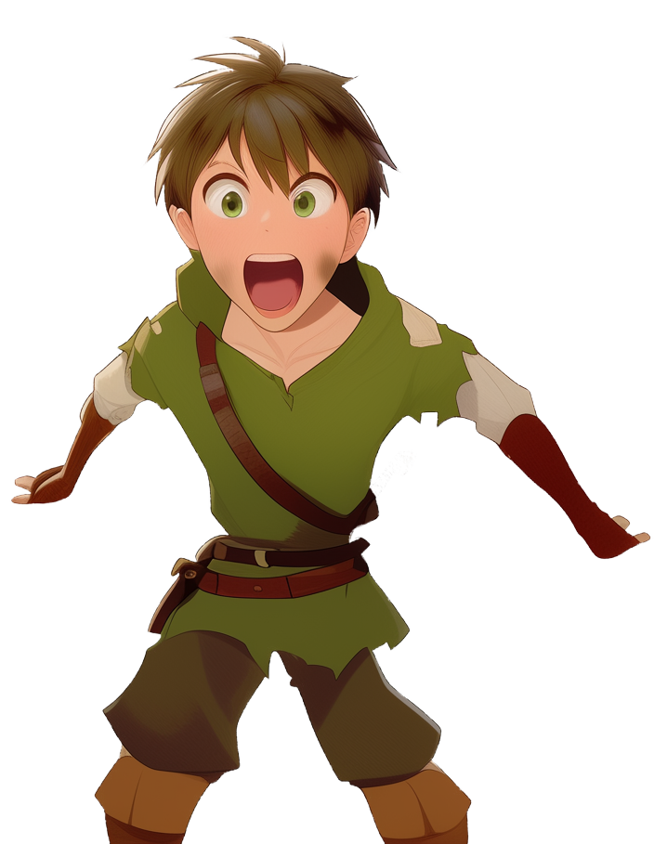
Why is this village so
short on food?
Can we not trade with the other villages for more
food?

Slide 26
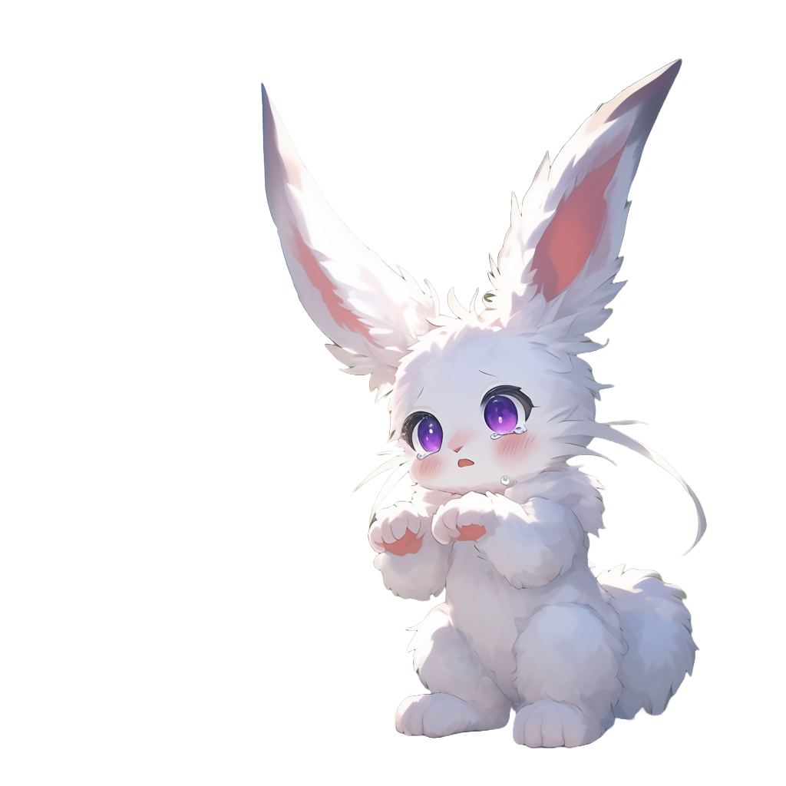
I fear we are all in the same boat here
We used to have cultivated land all around
but now only a few villages survived by building walls around them like us

Slide 27
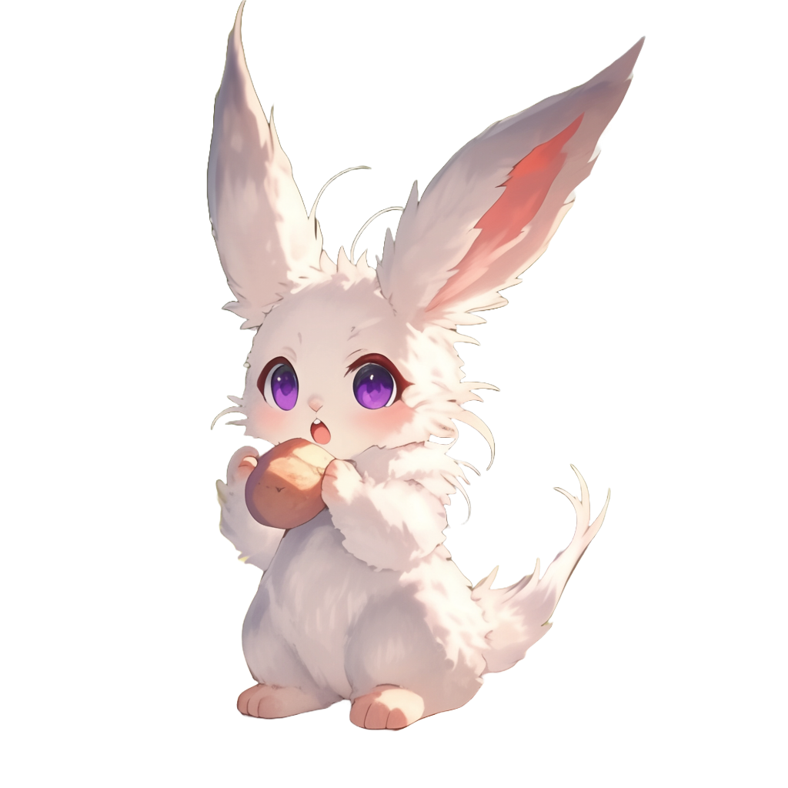
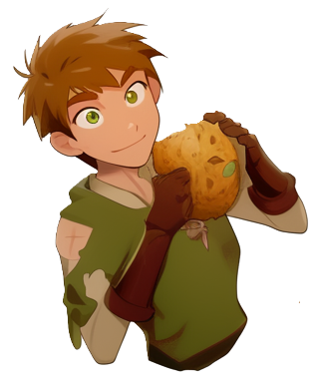
I had a lot of fun training Archery today
Those magic codes are powerful
What language
are they written in?

Slide 28
I had a lot of fun training Archery today
Those magic codes are powerful
Well... nobody really knows
What language
are they written in?
Before magic
books were written, there were old cave paintings discovered, written in this language

Slide 29
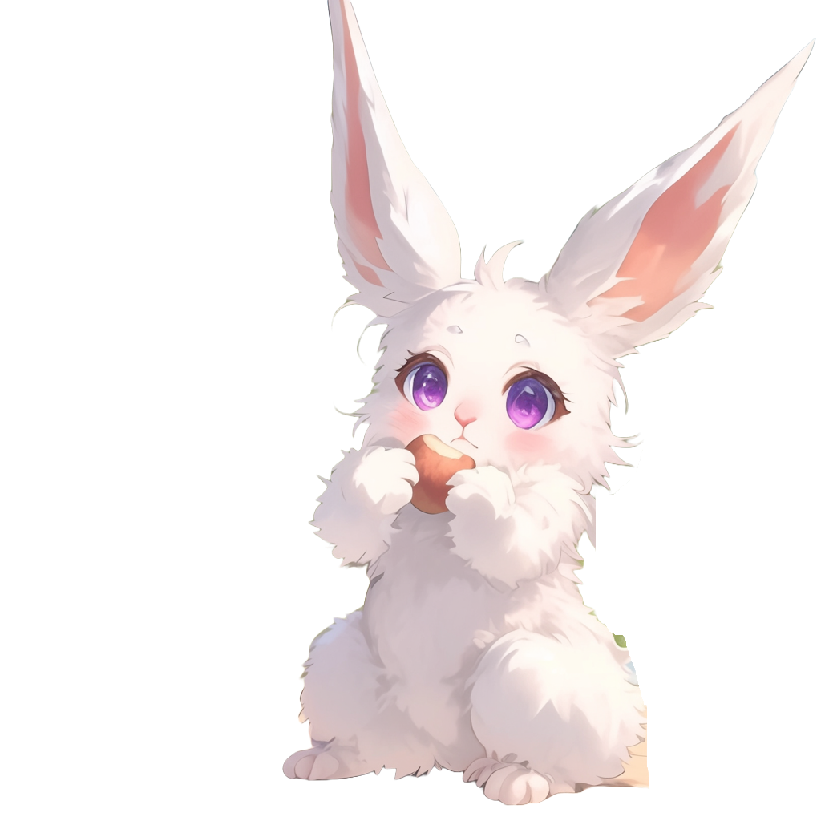
It is from long ago
Some people believe it is the language
of the monsters

Slide 30

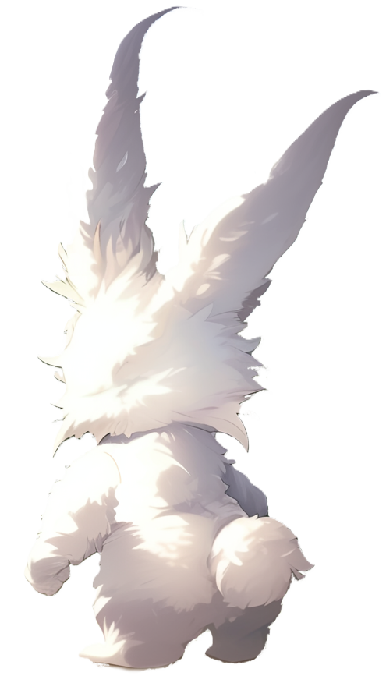

So, how do you call it then?
That magic code help us to grow food and tidy the house
but only a few people can use
it to fight monsters

Slide 31
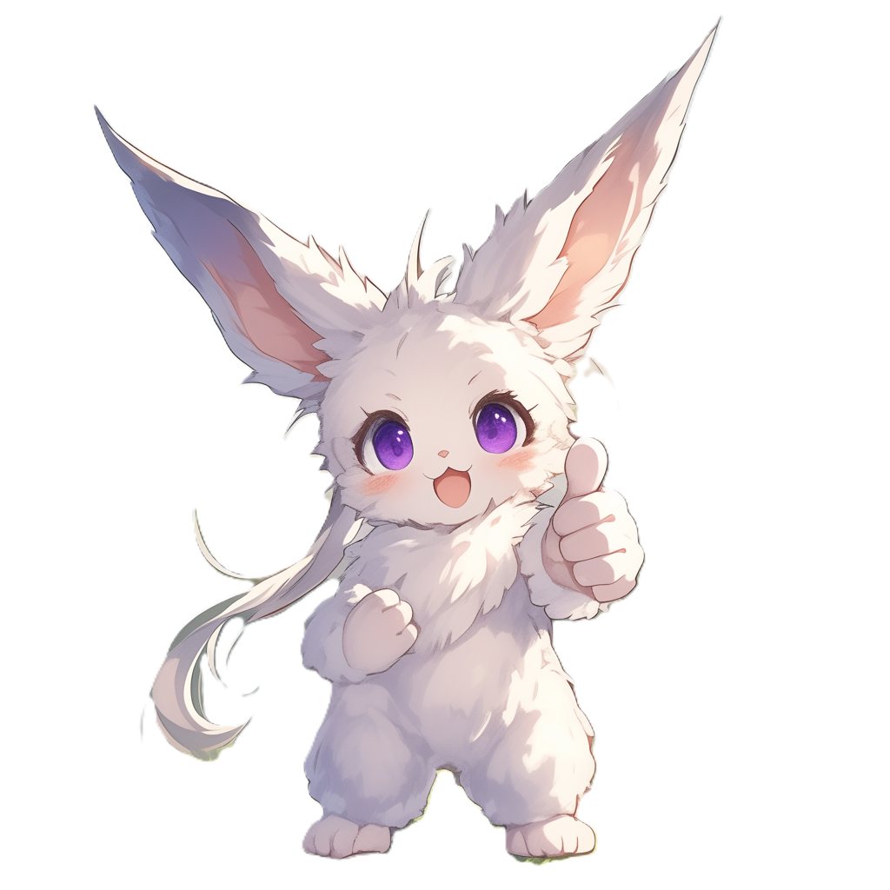
We call these
monster fighters
"the Fearless Few"
and we call the language
"the Language of the Fearless Few" or just "Fearless" for short

Slide 32

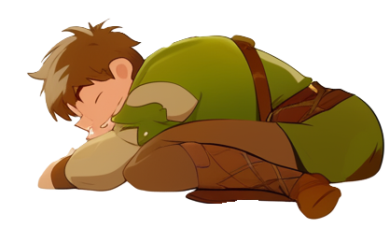
They head to bed, and
dream of fighting
monsters using Fearless

Slide 33
Day 2 completed

