Slide 1

Night

Slide 2
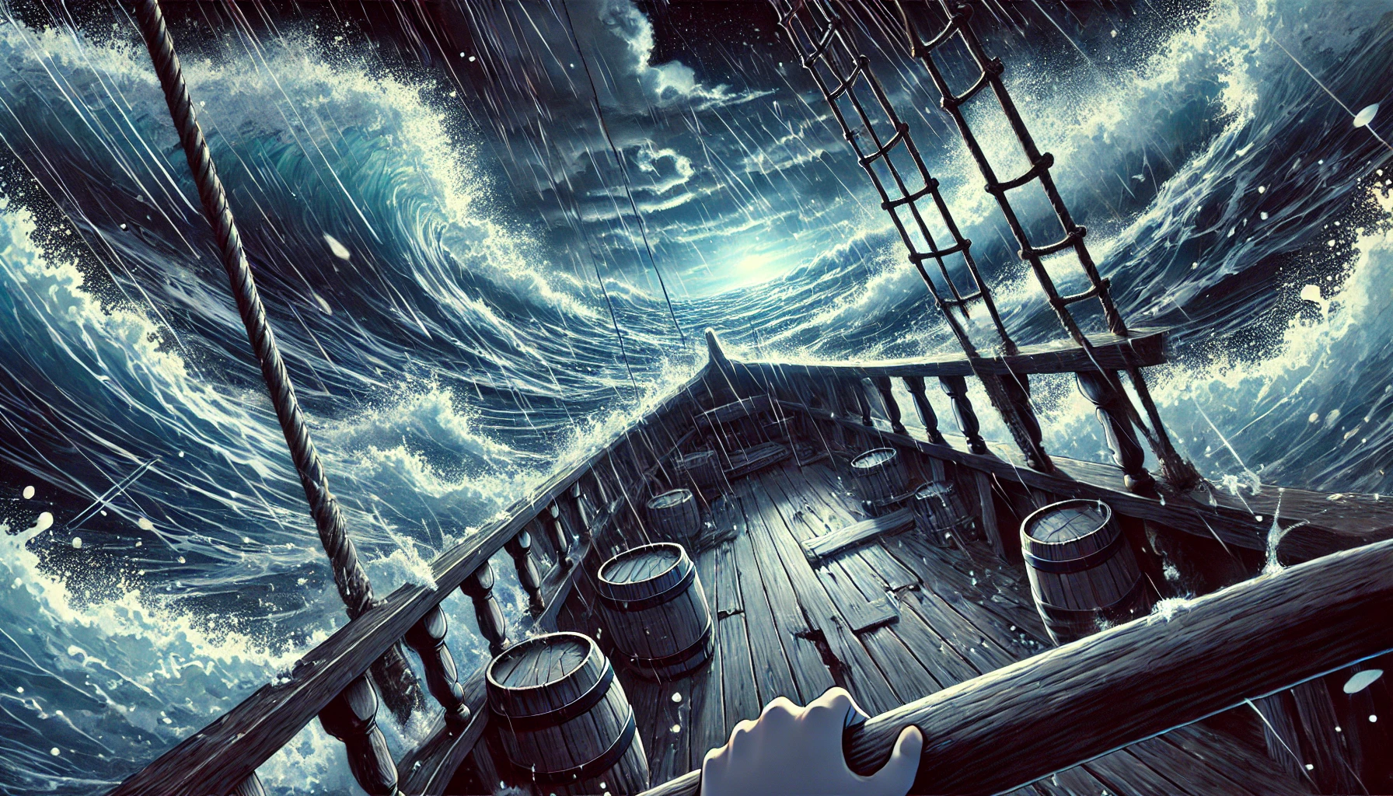
Tempest

Slide 3
It was too much

Slide 4


Crash

Slide 5
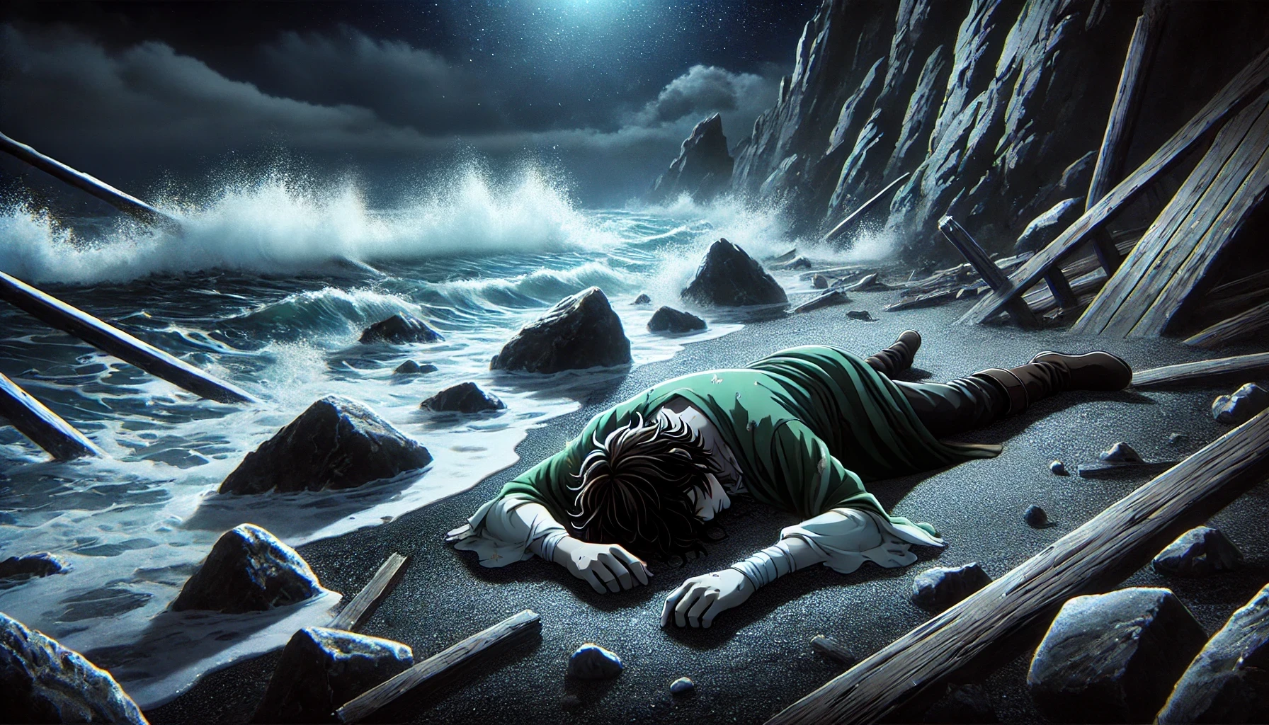

Slide 6
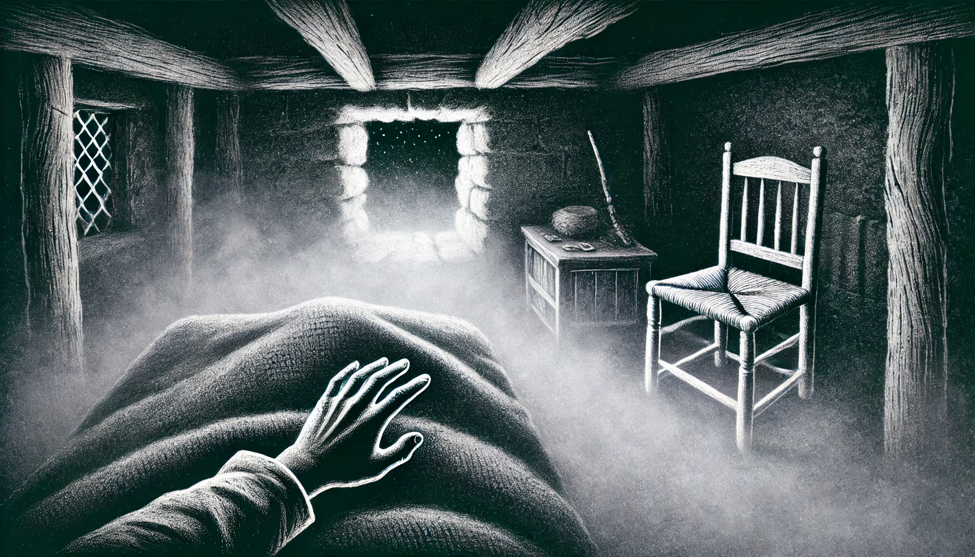
All is dark

Slide 7

Are you ok?
Can you hear me?

Slide 8
Write 'Hear:{}'

Slide 9
Oh, Good!
Can you see me?

Slide 10
Write 'See:{}'

Slide 11

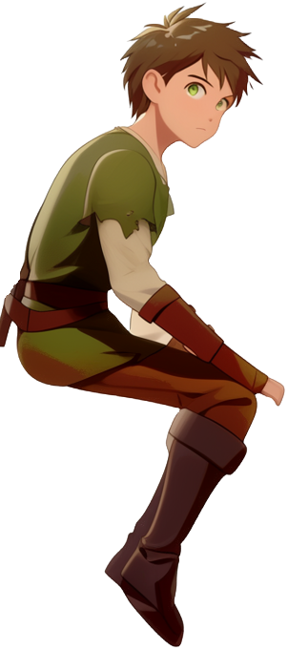
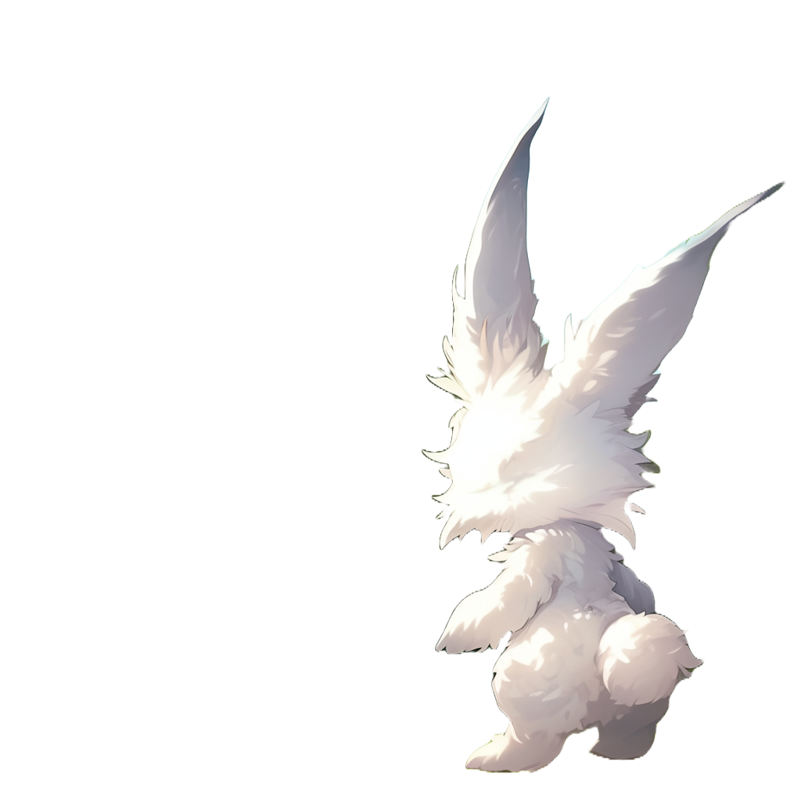
Good, your senses seem
Write 'Sense:{}'
'See:Sense{}'
'Hear:Sense{}'
to declare that hearing and
seeing are kind of senses
to be ok

Slide 12



We found you on the beach yesterday
It seems like your boat collapsed
Where am I?

Slide 13
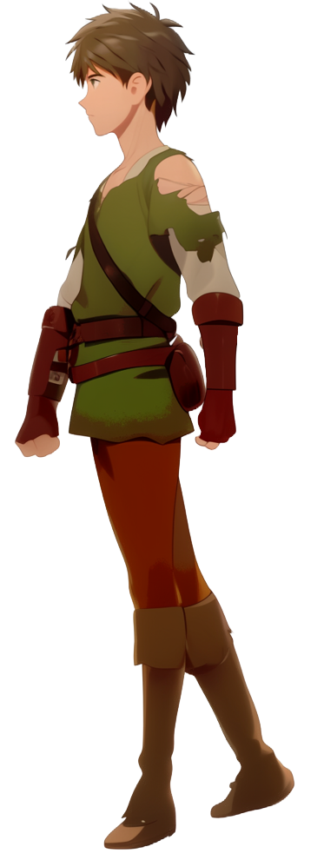

Yeah it’s cool.
Where are we?
You are in my house
Where are all my companions?
Do you like it?
We were all on my boat

Slide 14
I’m not sure where they are now
You are in Aligard.
A small village
Oh no
What country is this?

Slide 15
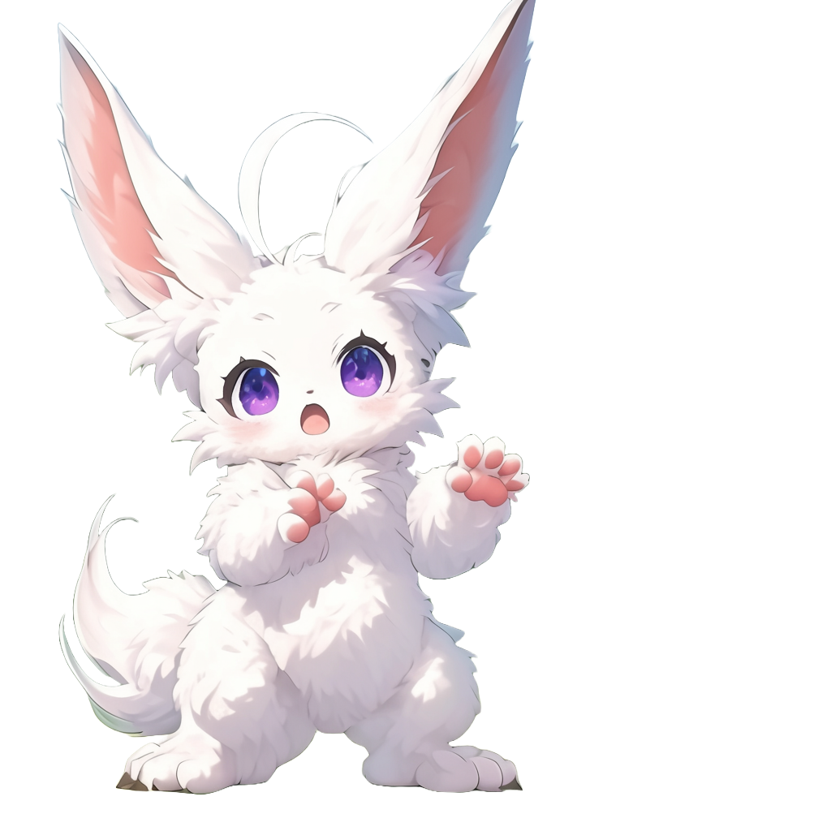
You are in the Kingdom of Gardemar
Or at least what is left of it

Slide 16
Can you stand?
Try to point at
North, South, East, and West

Slide 17
Declare the type 'North:{}'
Can you stand?
Try to point at
North, South, East, and West

Slide 18
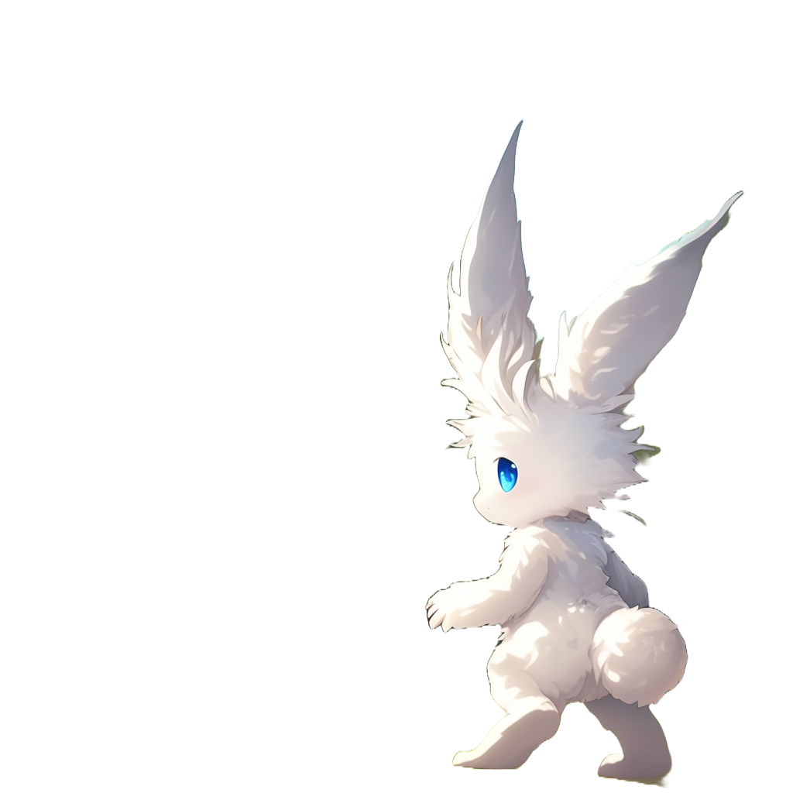

Slide 19

ok, that is North.
By the way,
that is where the
mountains are

Slide 20

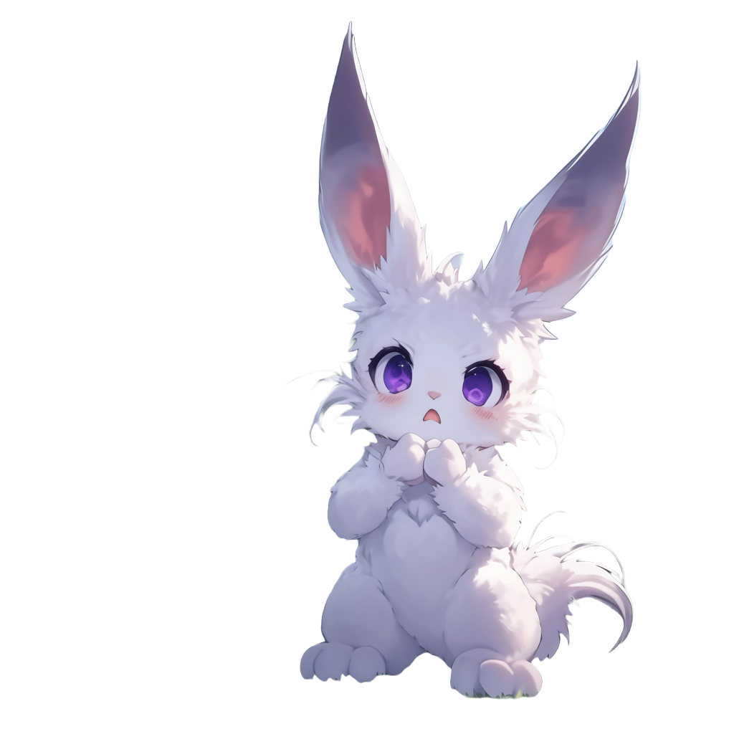
Those mountains look ominous
Yes!
That is where all the monsters are coming from

Slide 21
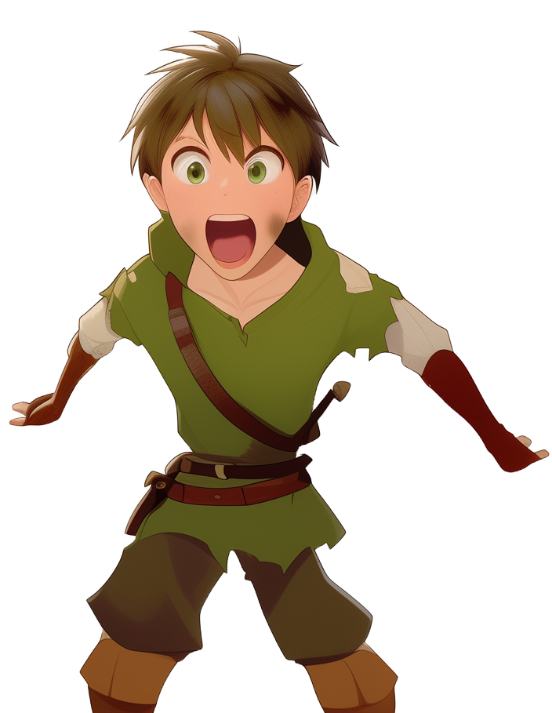
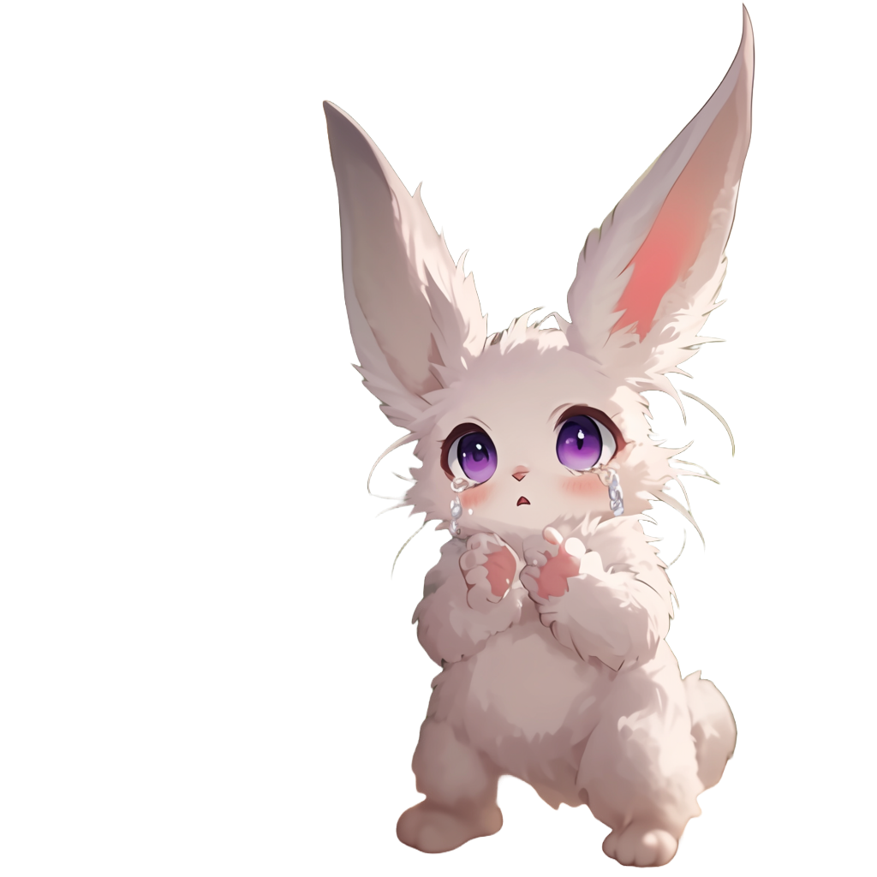
MO.. Monsters?
Yes
They ravage our kingdom and we are now living in fear
scared to leave our villages
at night

Slide 22
Try to include the other
directions too: East, West, and South

Slide 23

Ok, you can now point in all of the four directions
As you can see, I only have a window
to the North

Slide 24
Declare a Direction type and
change the code so that
North, East, South, and West
implement Direction

Slide 25

Declare a method
'.turn: Direction,'
inside 'Direction'
between the curly brackets
Ok!
your mind seems to be working better
Can you now walk and turn without falling?

Slide 26
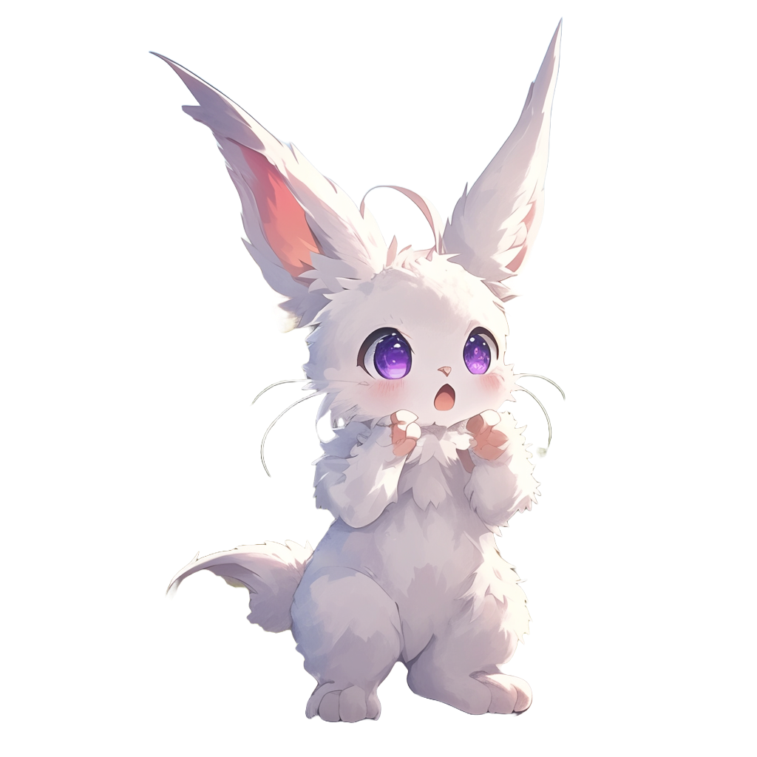
Good
this is an abstract method
now we need to implement it in all directions!
if you are looking
North and
you turn 90 degrees
clockwise
to the right
what direction
would you point to?

Slide 27
Declare a method
'.turn -> East,'
inside North
This represents that
turning clockwise from
North gives you East

Slide 28
Declare the .turn method inside East
Remember, you are turning clockwise!

Slide 29
Keep turning.
Complete South

Slide 30
Ok! One last step

Slide 31
Ok!
It looks like you are now able to walk and turn

Slide 32

Follow me
out to gather some food for dinner

