Slide 1
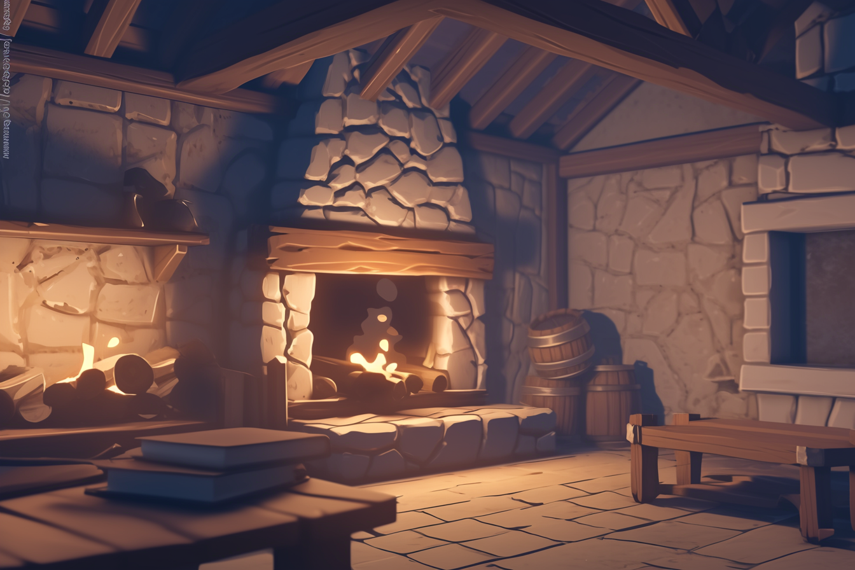
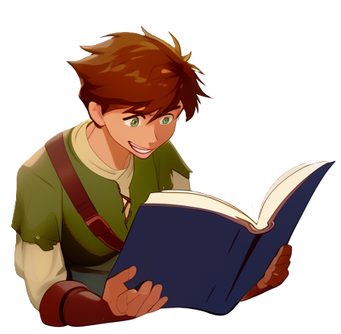

Slide 2
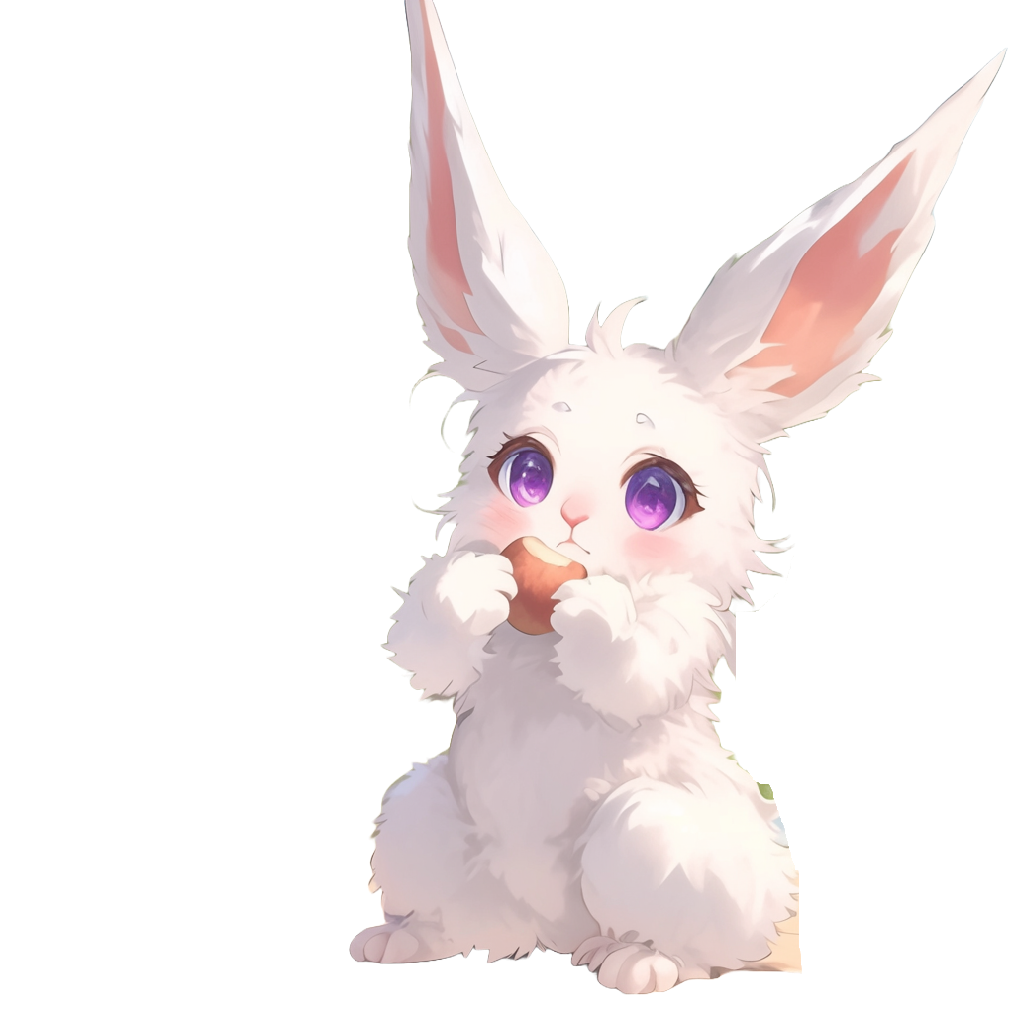
Panic enters the room
with a basket of food
I've got more potatoes for breakfast!

Slide 3


They are so convenient!
This time
I steamed them with the magic hot stones!
After enchanting them, they stay piping hot forever

Slide 4

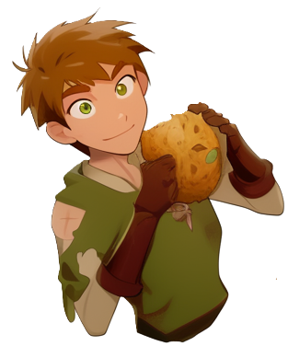
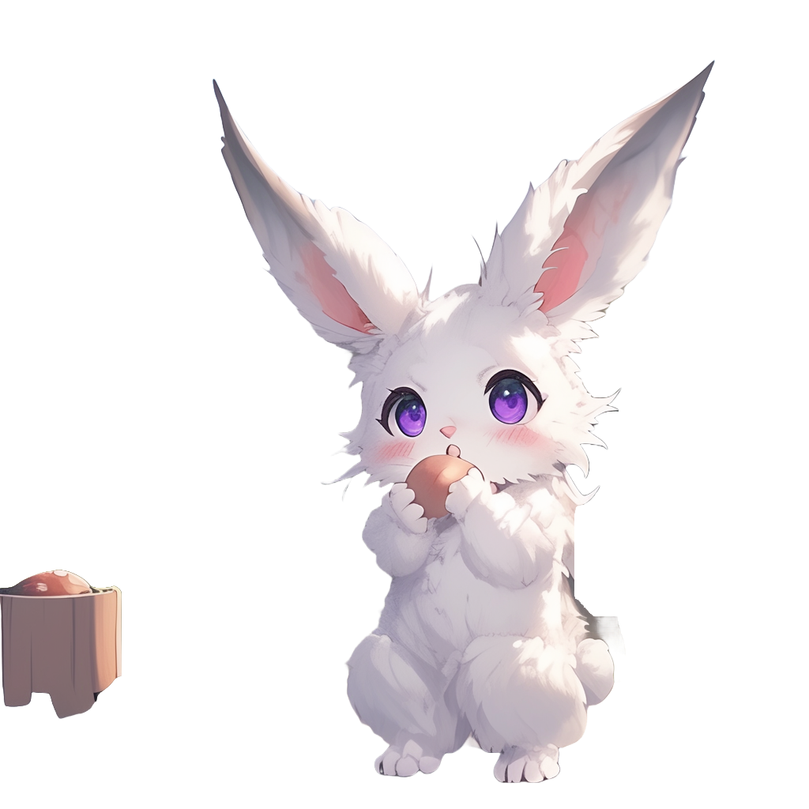
I see you have
been reading my Archery book
Yea, sorry
for that, I was bored

Slide 5

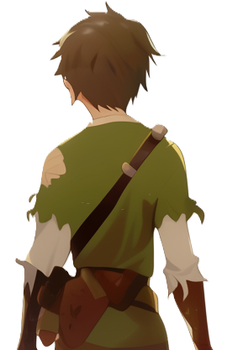

Not to worry! Please read any books you like!
If you want some archery practice, there is a training ground outside
Should we go?

Slide 6


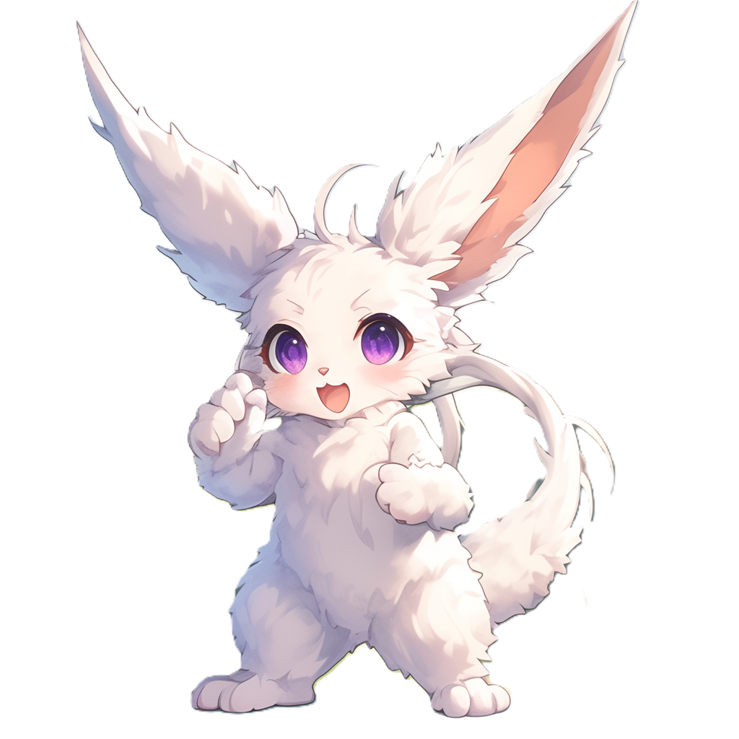
They start walking toward
the training ground
You look way
to excited about it

Slide 7
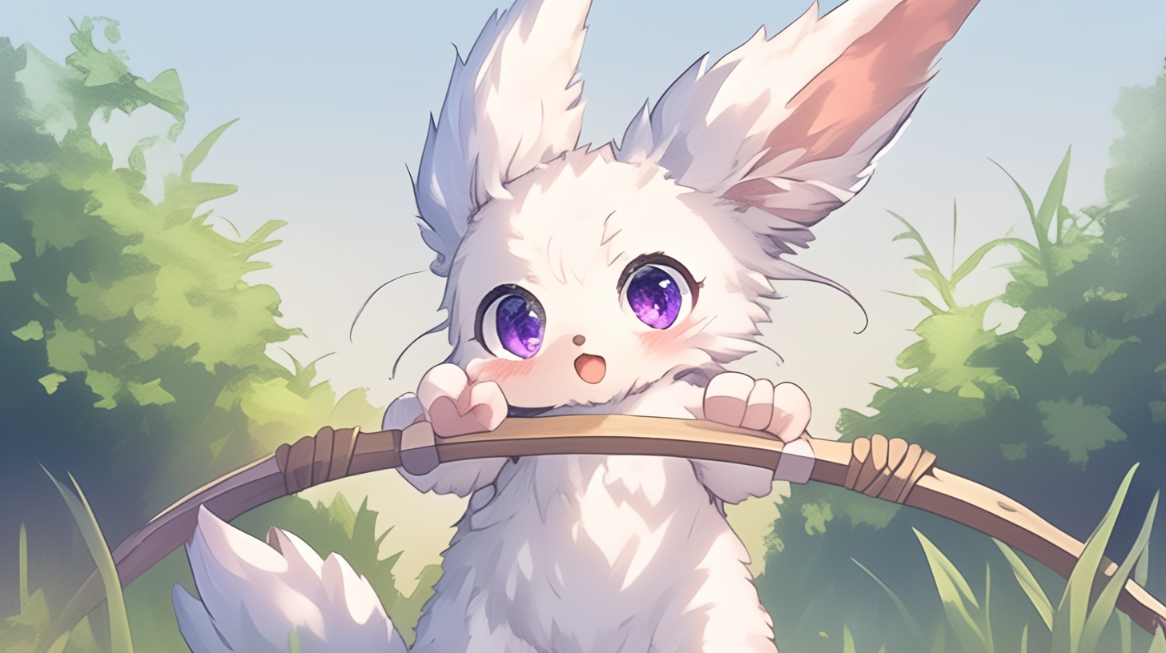
Here you go!

Slide 8


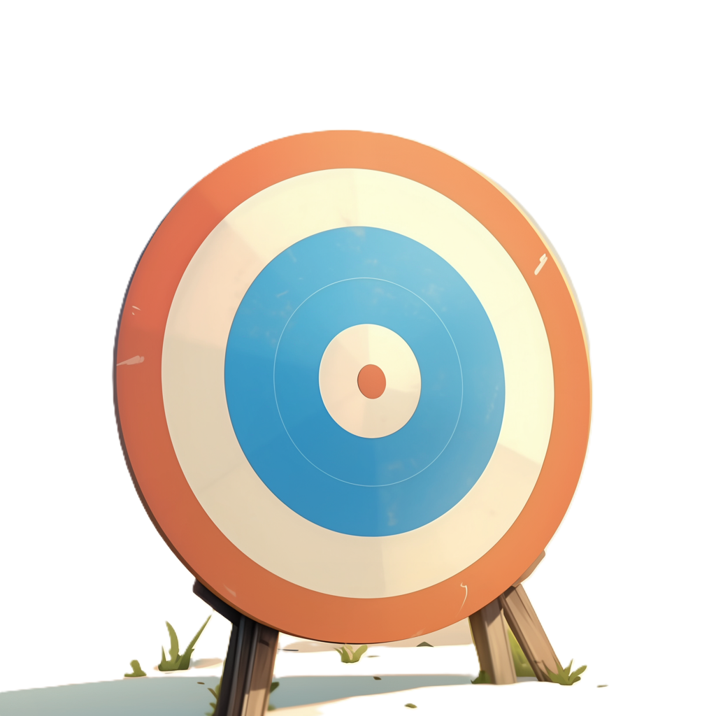

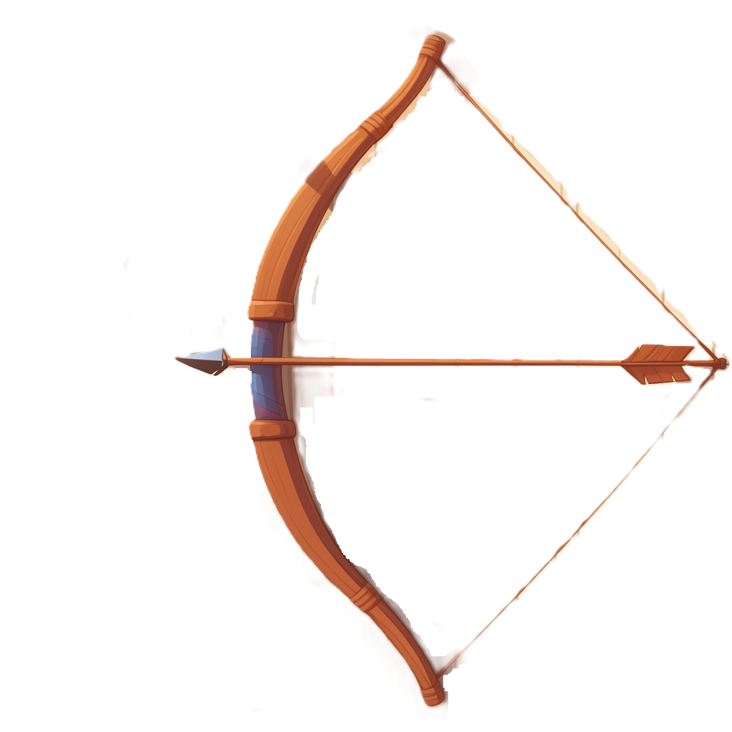
?

Slide 9




