Slide 1
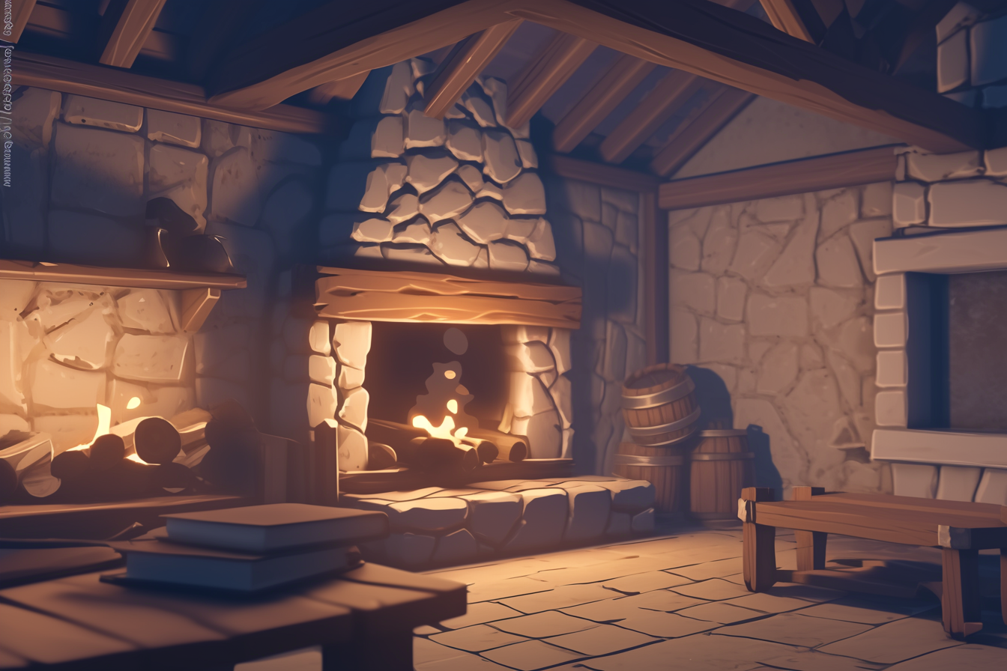
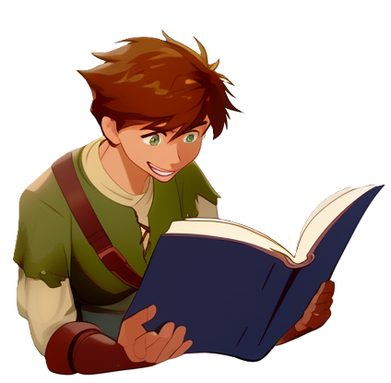

Slide 2
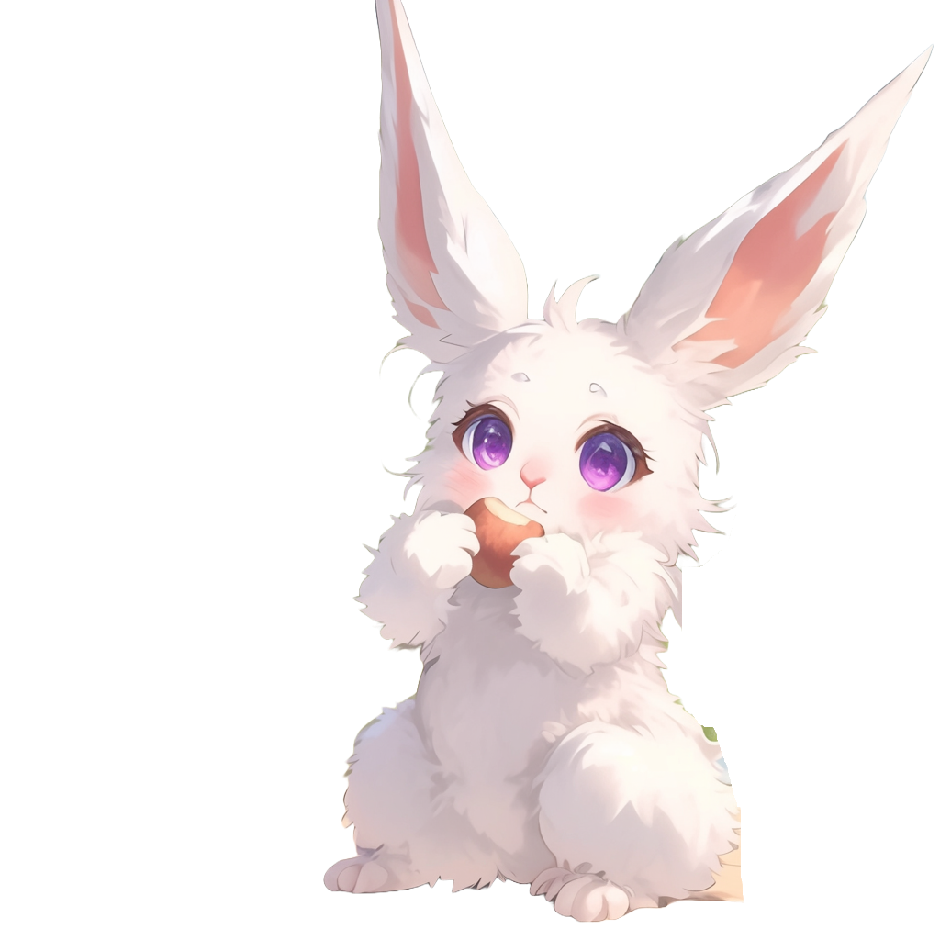
Panic enters the room
with a basket of food
I've got more potatoes for breakfast!

Slide 3


They are so convenient!
This time
I steamed them with the magic hot stones!
After enchanting them, they stay piping hot forever

Slide 4

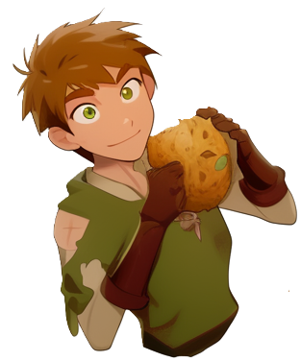
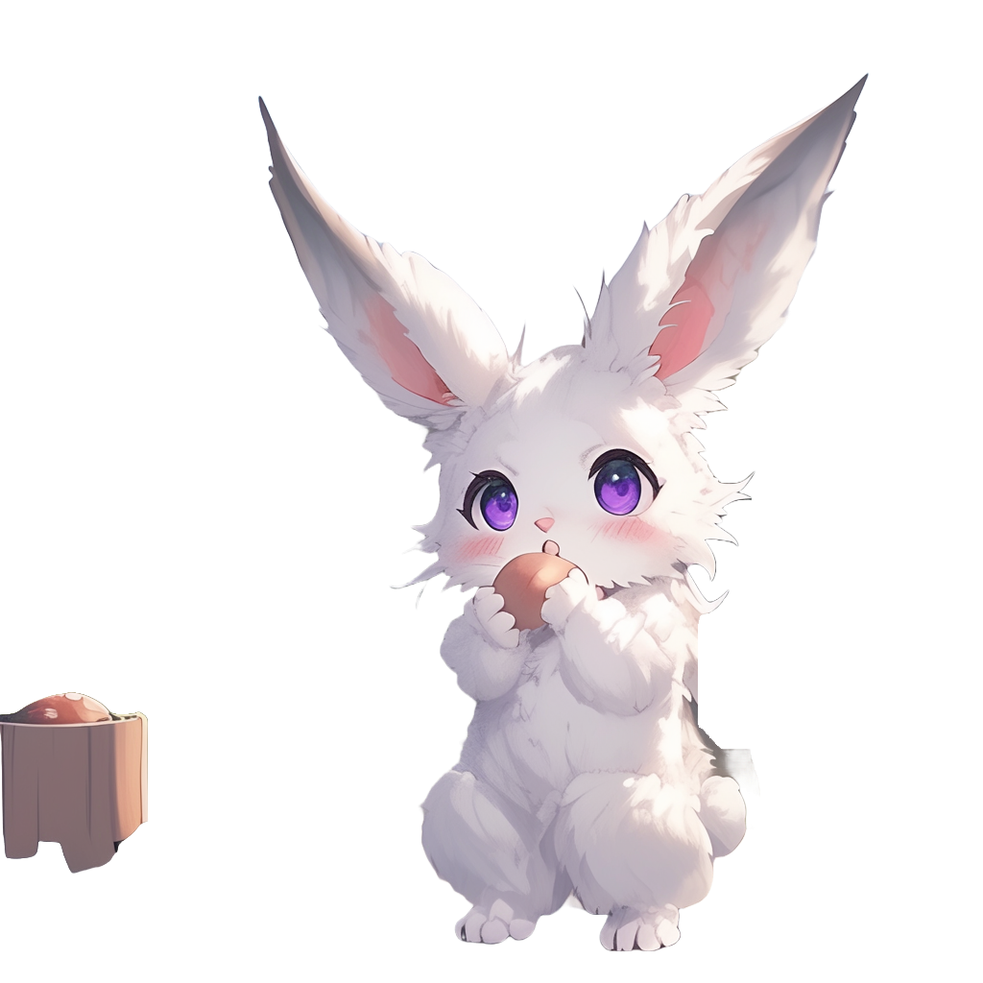
I see you have
been reading my Archery book
Yea, sorry
for that, I was bored

Slide 5

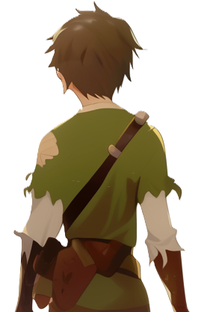

Not to worry! Please read any books you like!
If you want some archery practice, there is a training ground outside
Should we go?

Slide 6


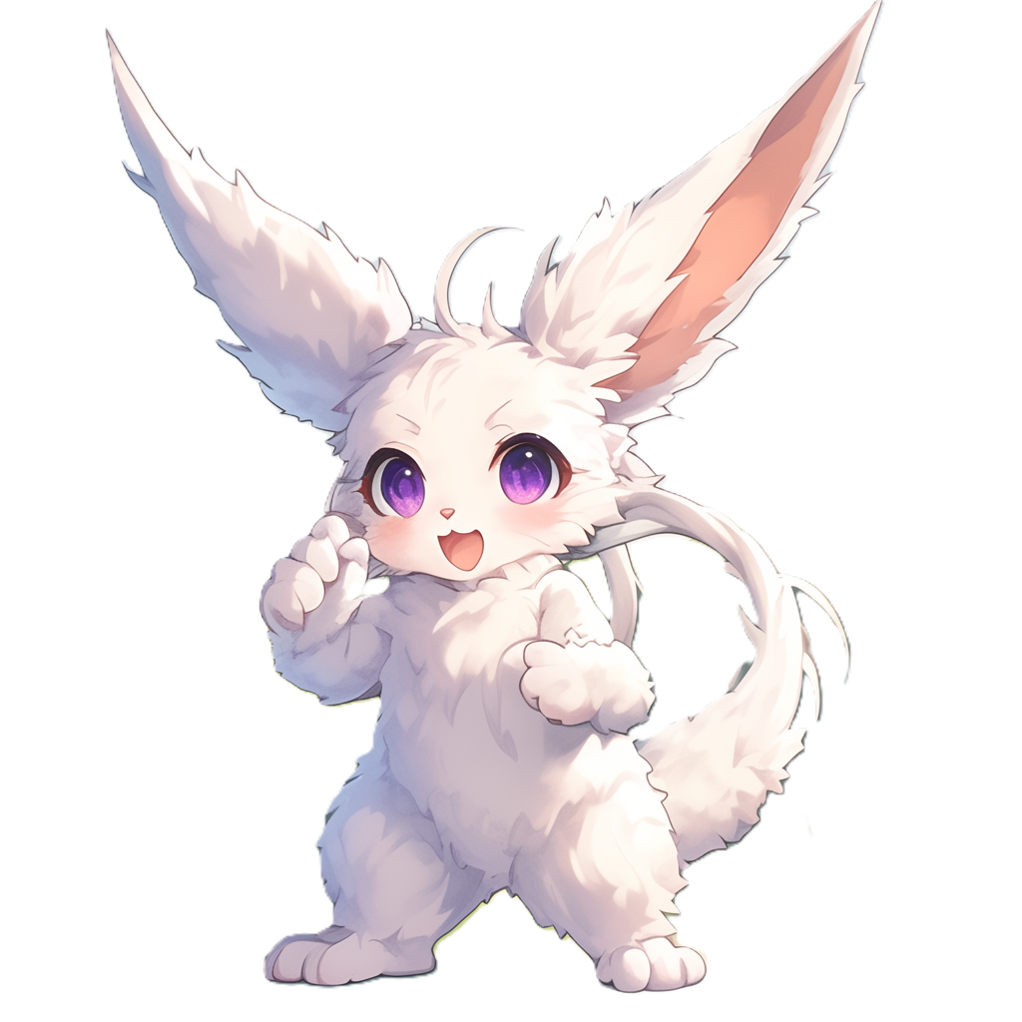
They start walking toward
the training ground
You look way
to excited about it

Slide 7
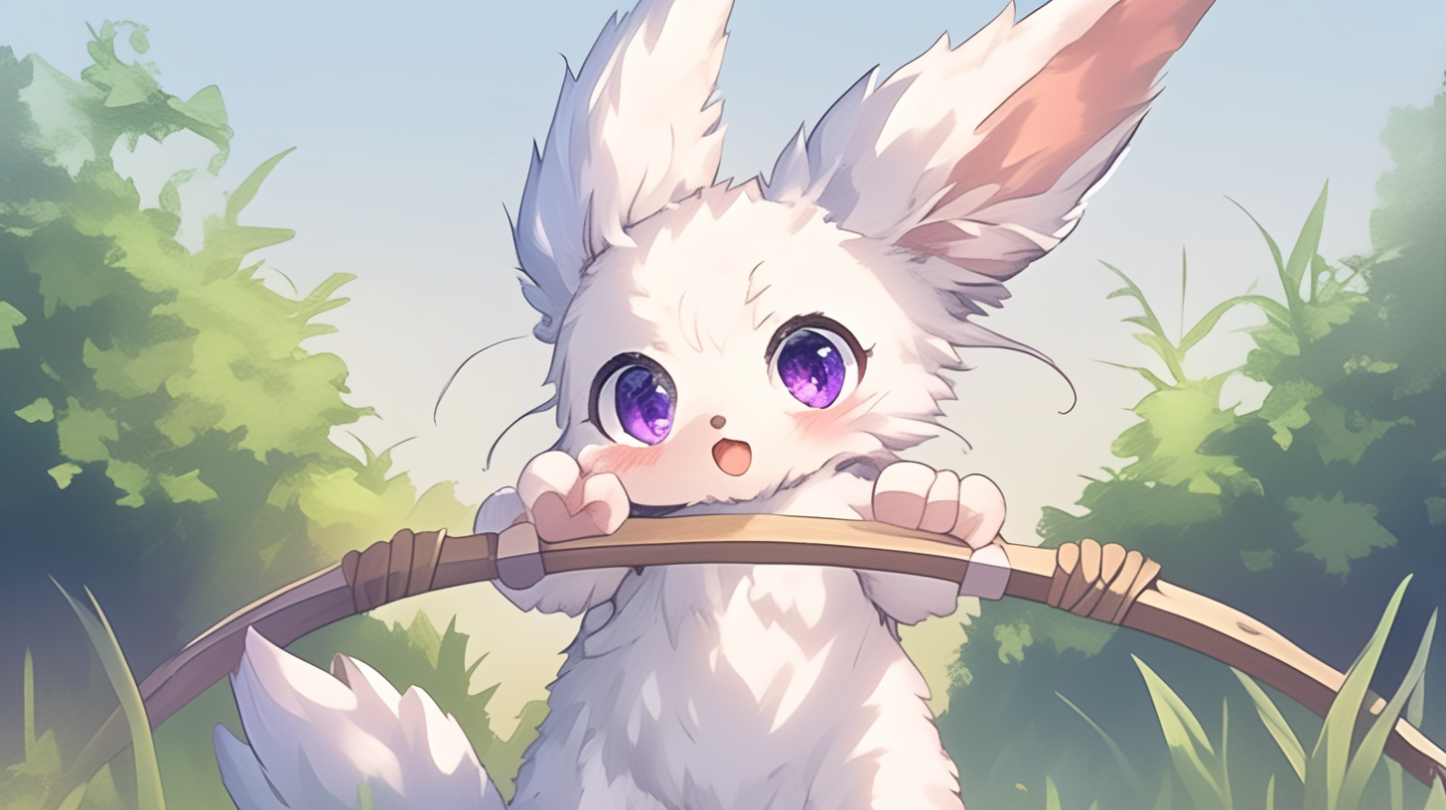
Here you go!

Slide 8
You are now back to safety
in Panic house
The land around the village was
all cultivated fields before the monsters invaded
It is surprising that we managed to find wild tomatoes and wild eggplants!

Slide 9

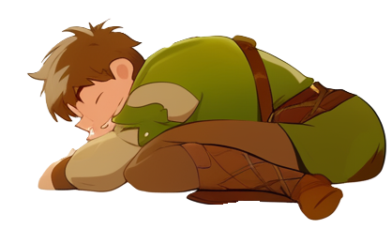
Hyaaaawn…
Might as well get up
not like I’ll be able to sleep more

Slide 10
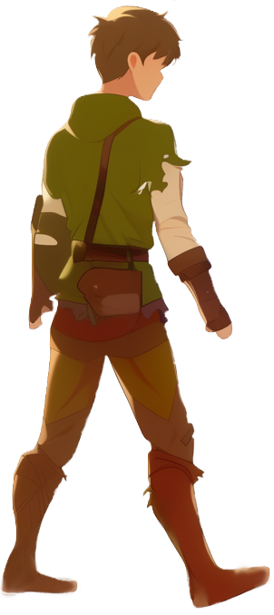
Panic is not in the house

Slide 11

I guess I will read this book while waiting

