Slide 1

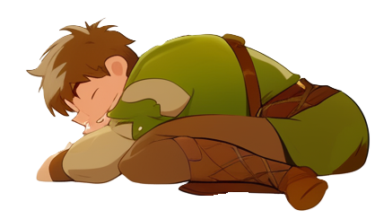

Slide 2

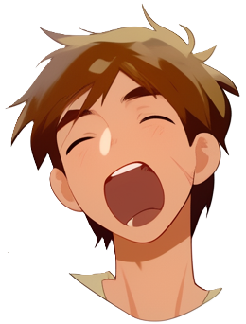
Hyaaaawn…
Might as well get up
not like I’ll be able to sleep more

Slide 3
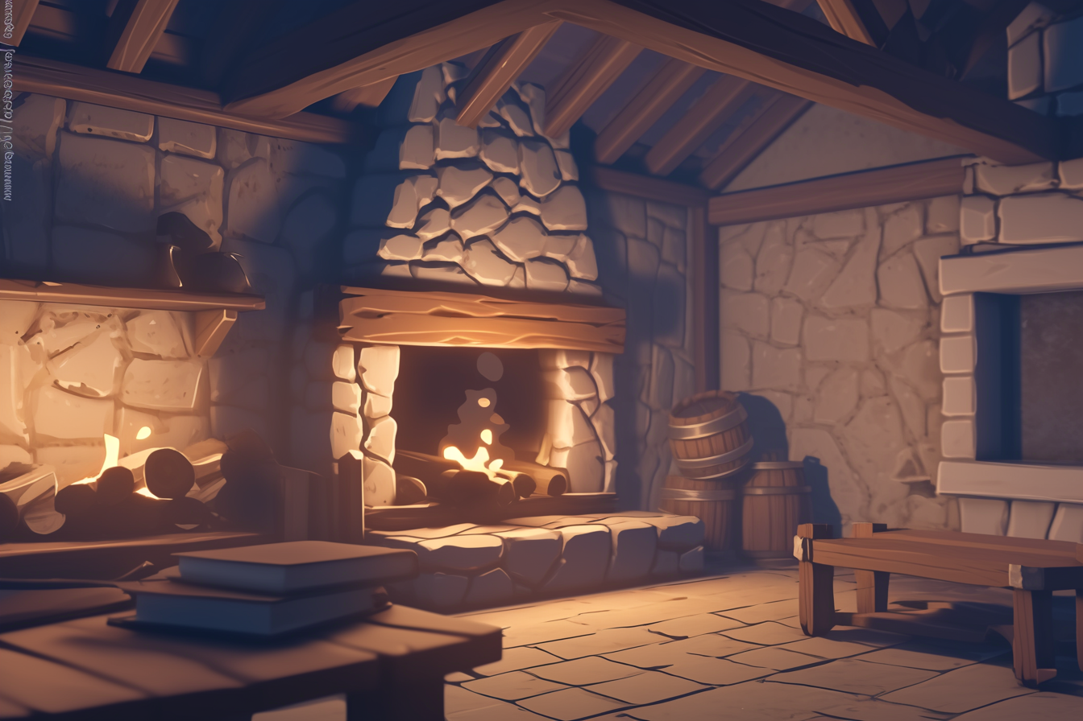
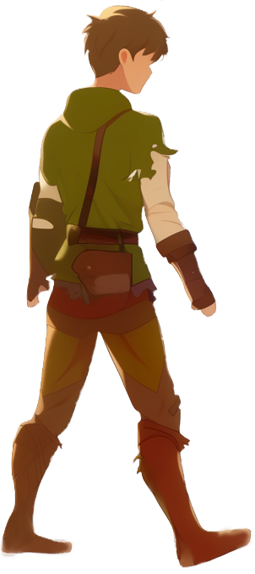
Panic is not in the house

Slide 4

I guess I will read this book while waiting

Slide 5
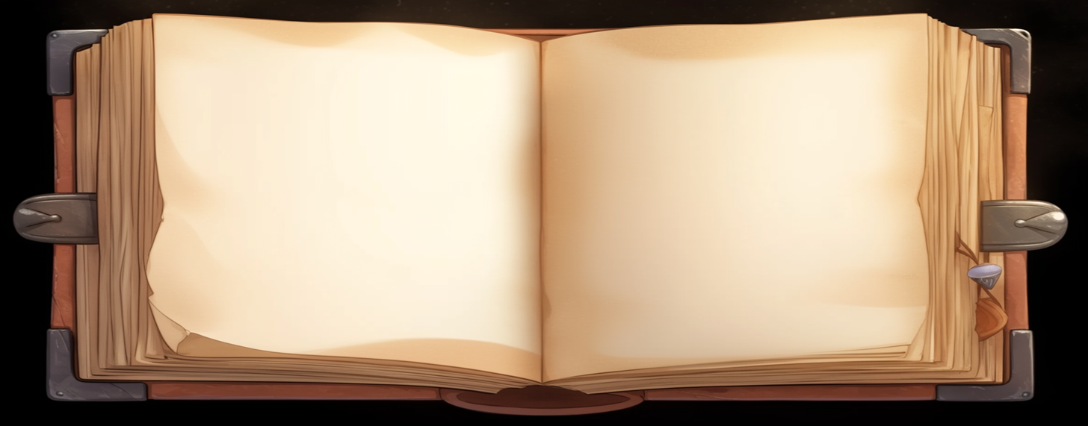
Next is the book minigame
The book is ruined and some
words are damaged.
Your task is to click
on the damaged words
and guess them

Slide 6


