Slide 1


It is surprising that we managed to find wild tomatoes and wild eggplants!
You are now back to safety
in Panic house
The land around the village was
all cultivated fields before the monsters invaded

Slide 2


Do you like ratatouille?
It has eggplant, tomato, mushroom, and potatoes.

Slide 3

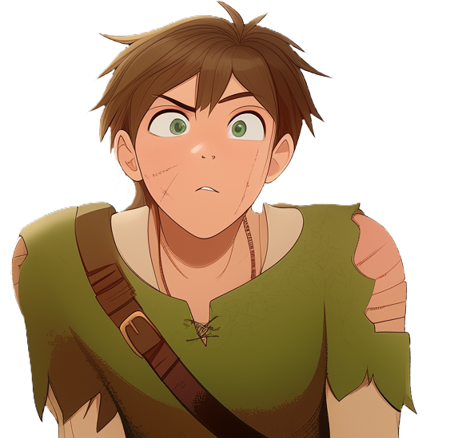
Potatoes?
We did not collect any potatoes!
This village farms potatoes on top of buildings and walls

Slide 4


Out of reach of the monsters
Potato sacks line our walls
to grow the carbs we need to survive

Slide 5

Wow, that is pretty smart!

Slide 6
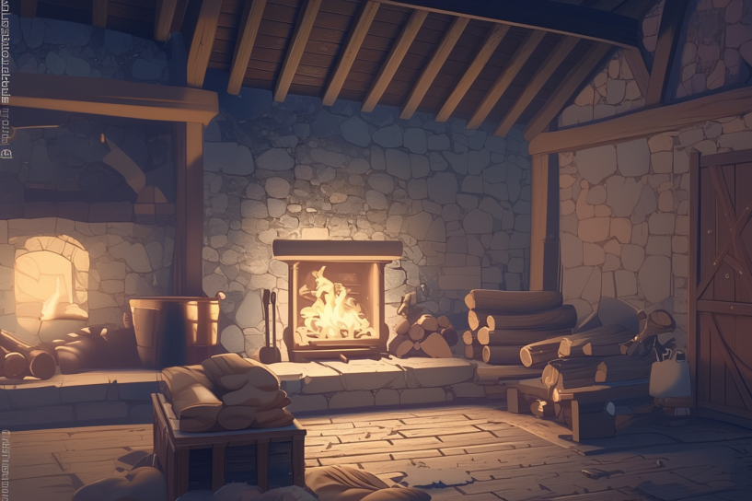
With the sweet, savory taste of the ratatouille
still lingering, they drifted off to sleep
The night passed peacefully, with no sign of danger.
By morning, they woke up refreshed, ready to face a new day

Slide 7
This game is divided in 'Days'
You just completed Day 1
Days work as save points

