Slide 1
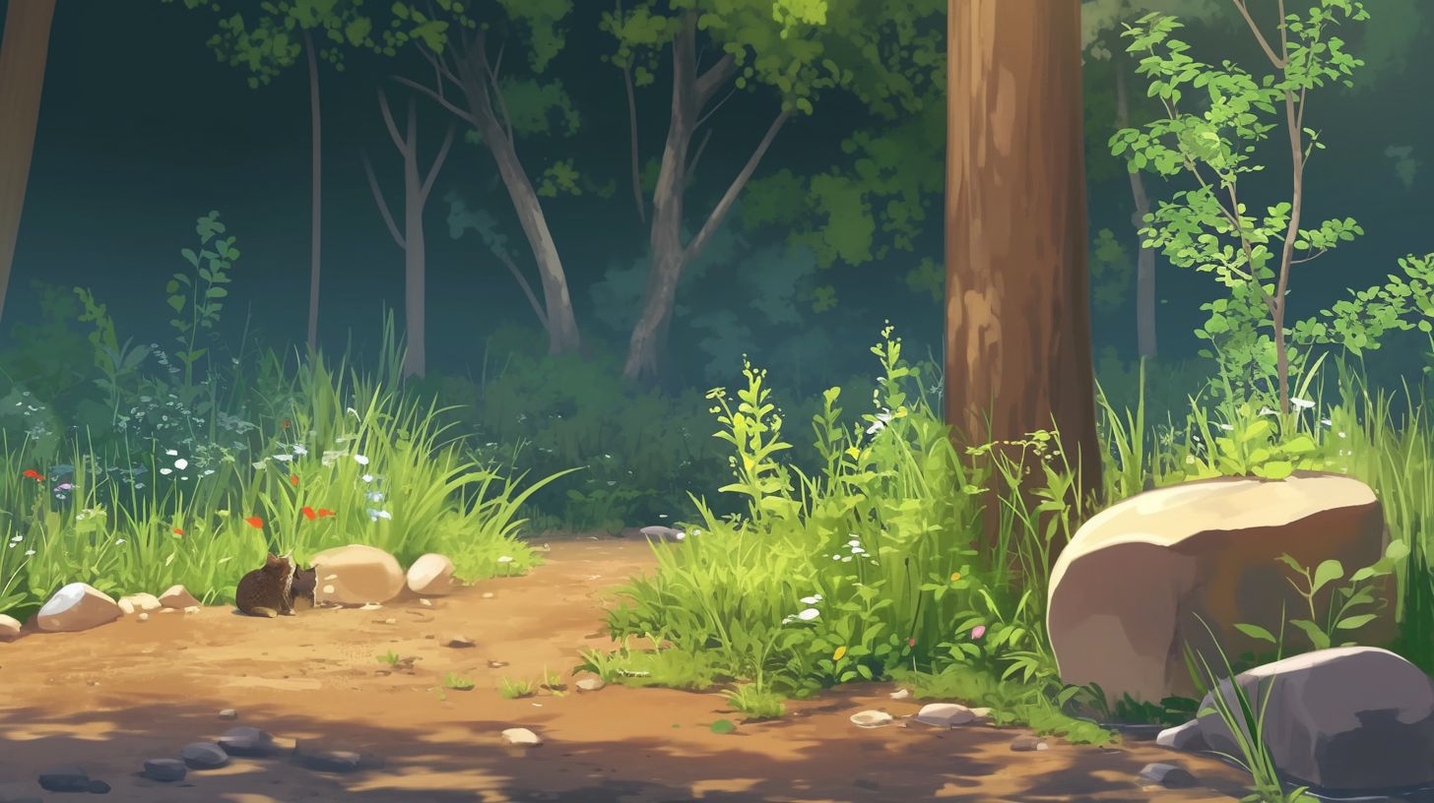


Ok, enough food for dinner!

Slide 2
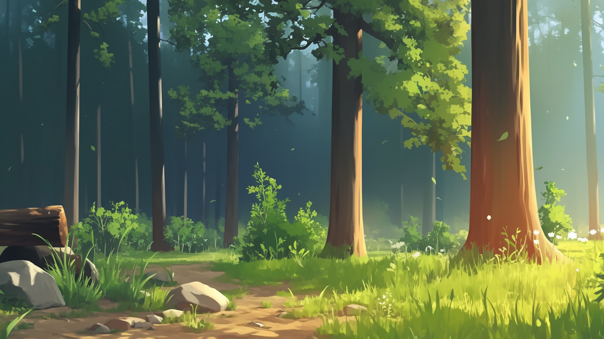

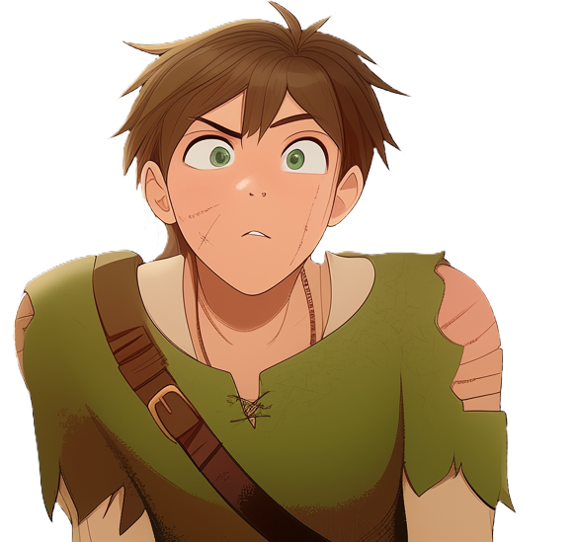
Let's walk back before the monsters come out of hiding
when the air gets cooler in the evening
oh, do they like mushrooms too?

Slide 3

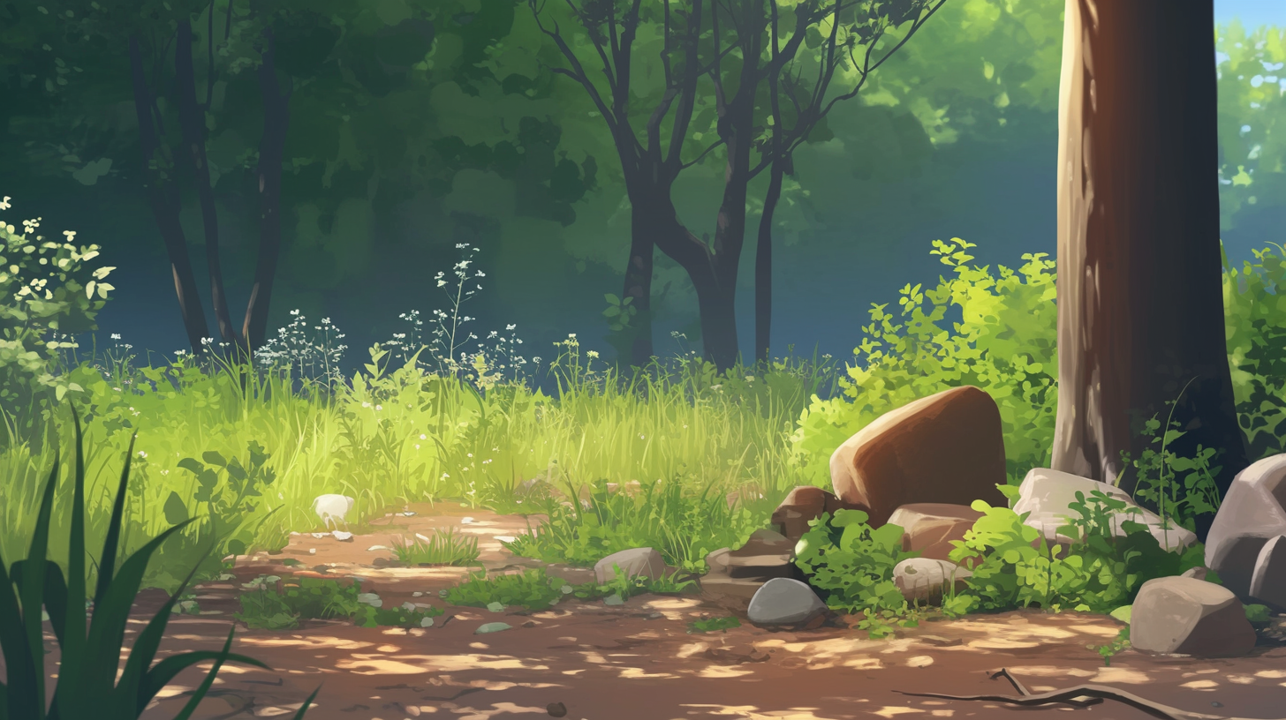
Yes, they eat all and everything they can get
their hands on

Slide 4
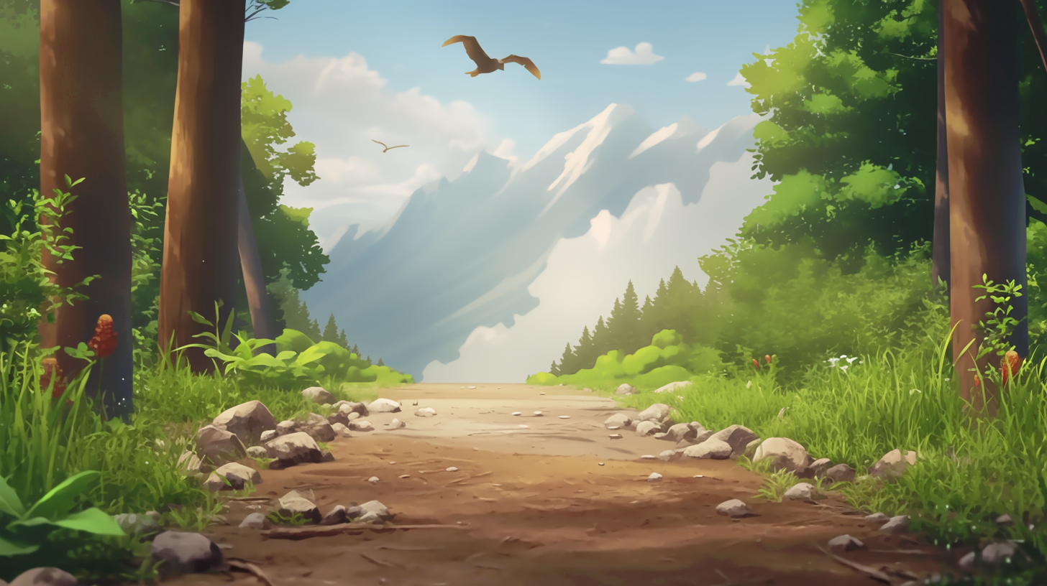
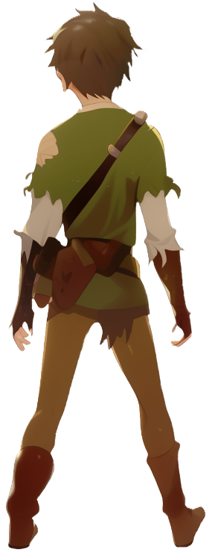
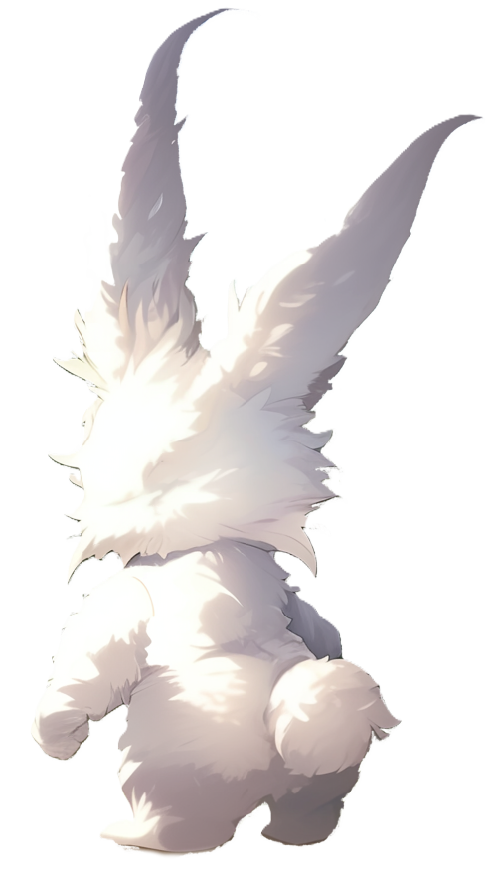
ok, let’s walk home then
Hey! Stop! You are going the wrong way!
The mountains are full of monsters!

Slide 5
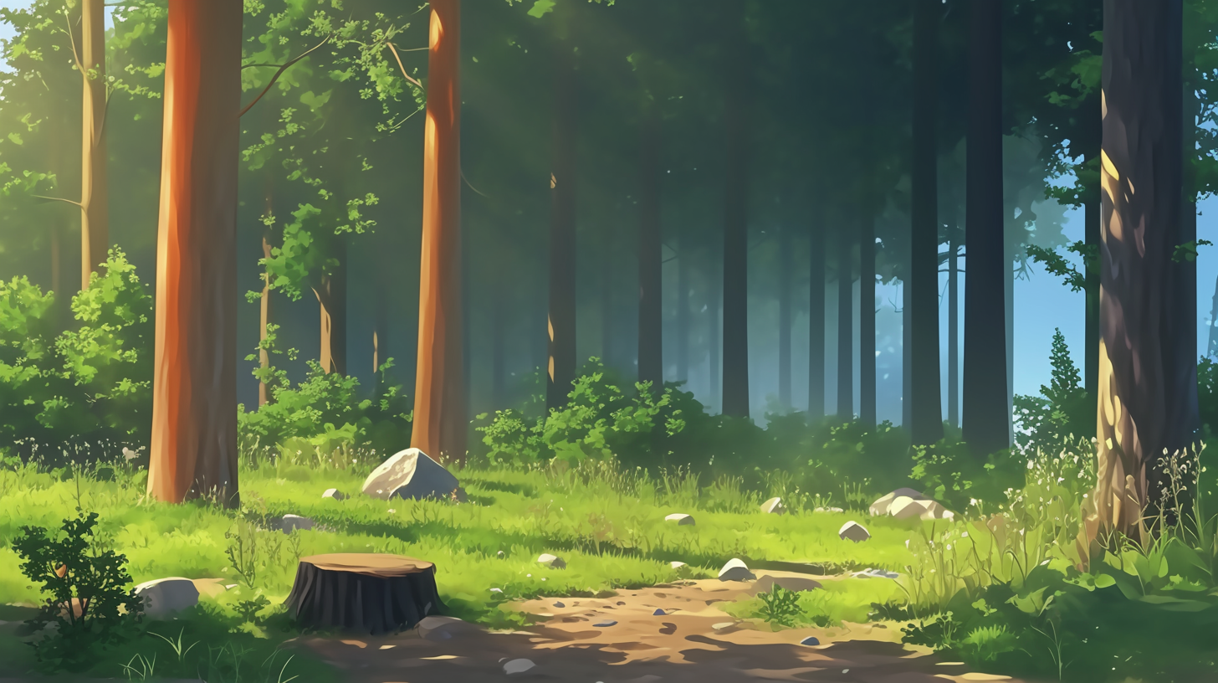


I need to learn to turn around!
I can teach
you the .reverse method!

Slide 6
Complete method .reverse
inside Direction. This method
should return a Direction
by calling `this.turn.turn`

Slide 8
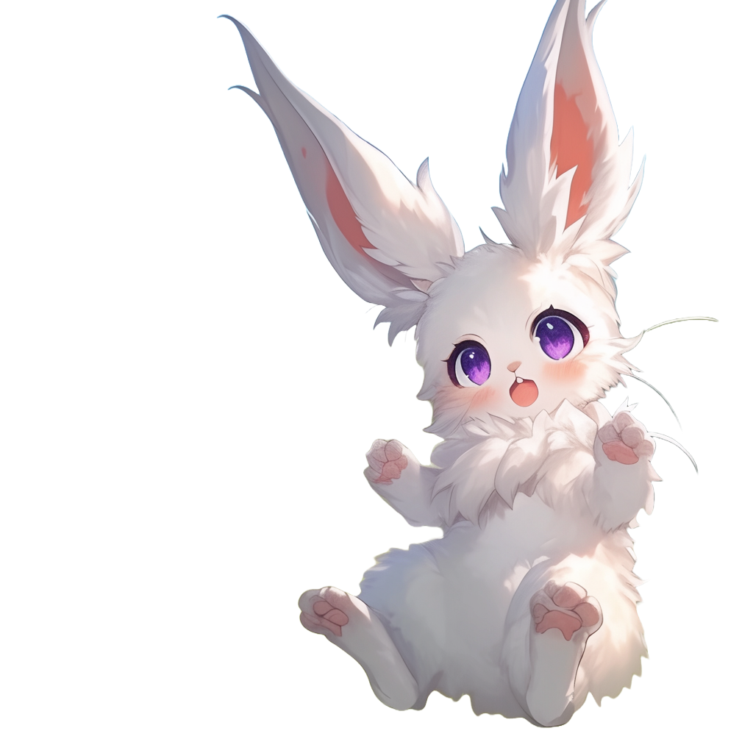

Slide 9
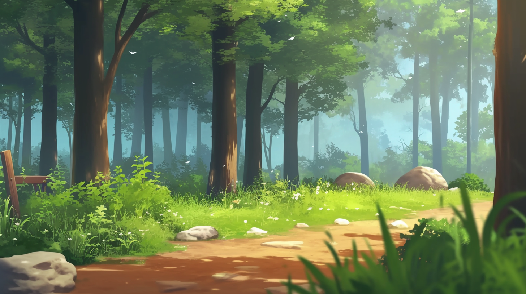
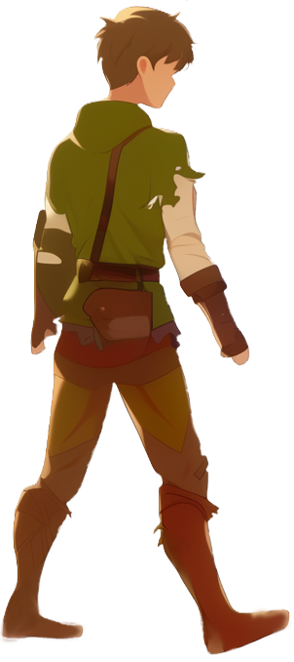
Thanks for helping me, I felt so stuck!
I have to ask,
what is this 'this'?
'this' is a kind of parameter
By using parameters we can generalize behavior

Slide 10

The 'this'
parameter becomes 'North' when we call
'North.reverse'
and 'South'
when we call 'South.reverse'

Slide 11

We can practice with 'this' on the way home!

