Slide 1
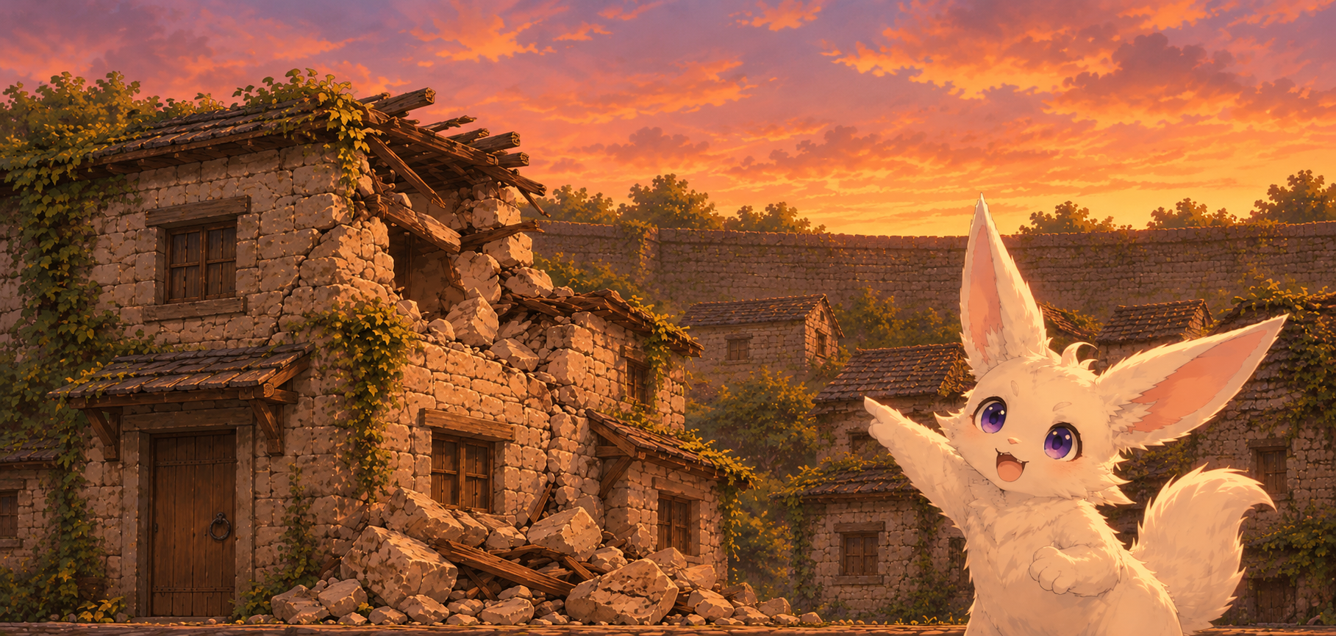
This house suffered clear damage
Drag and drop code from the right pile
to the left pile
We need more bricks and stones to fix the tower
We can take them from the damaged houses
Do not remove what is needed for the house code to work

Slide 2
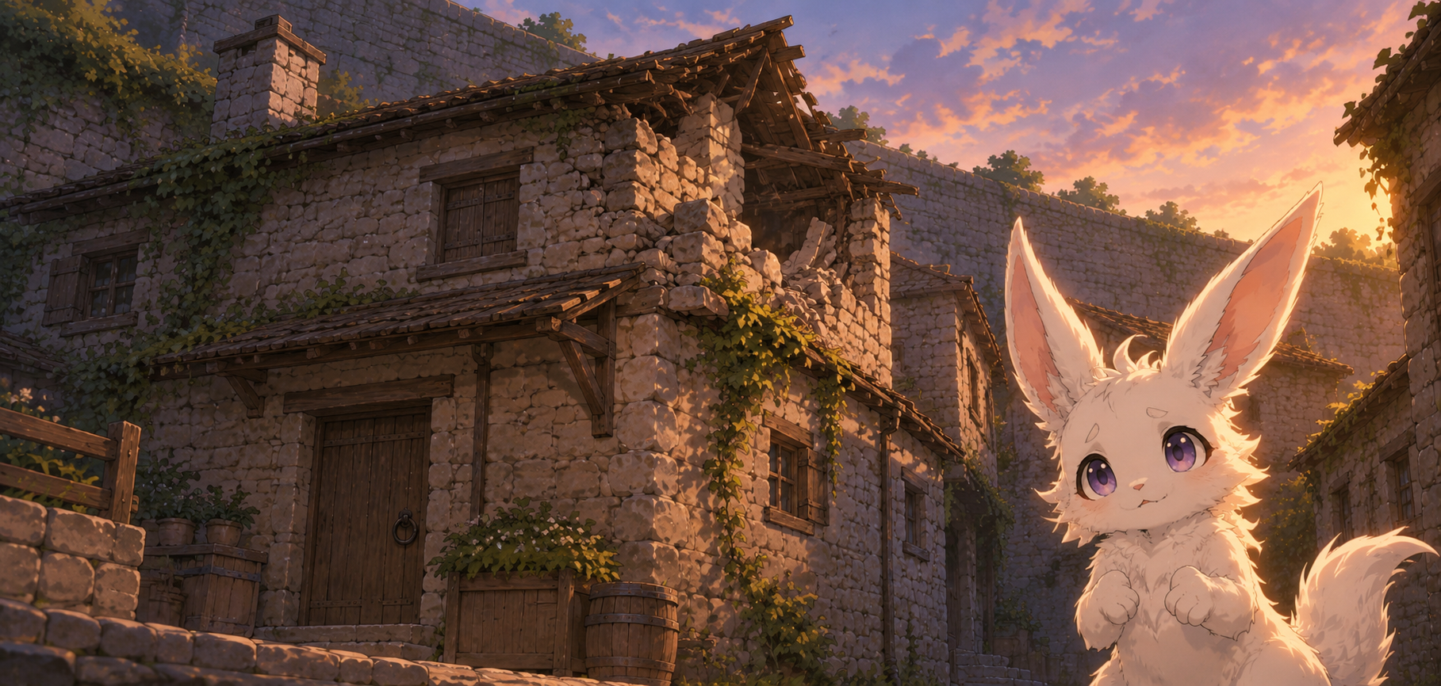
Here just removing bricks is not enough
To extract the code without making the house collapse we will need to switch some bricks too

Slide 3
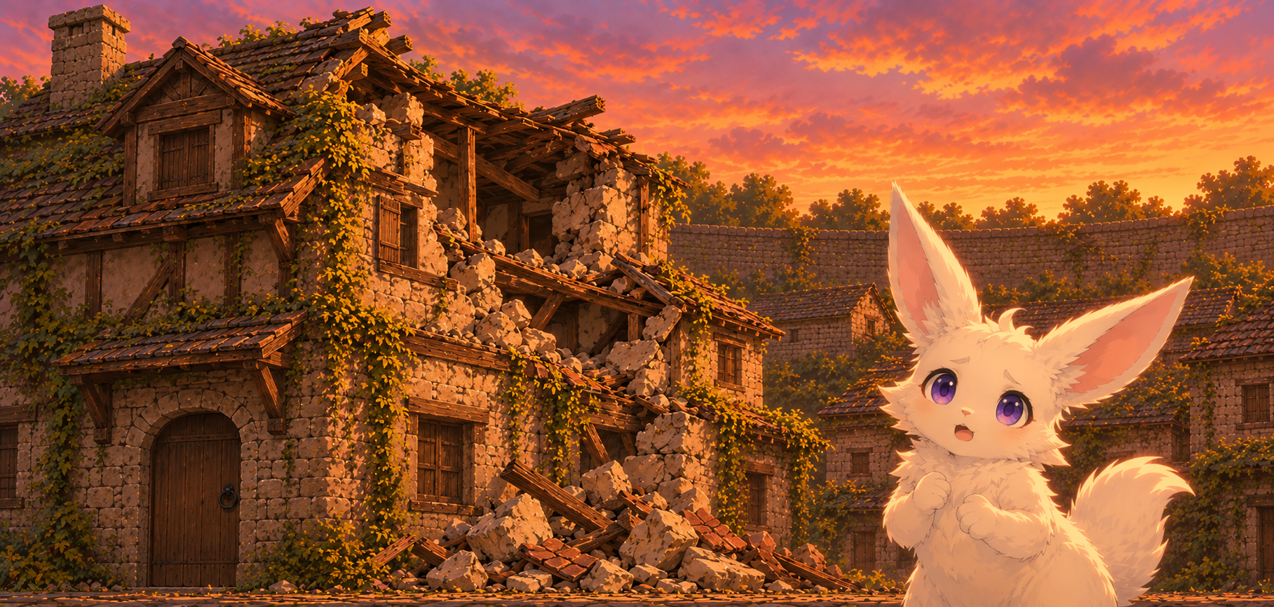
Oh,wow this one
It looks like a real challenge

Slide 4
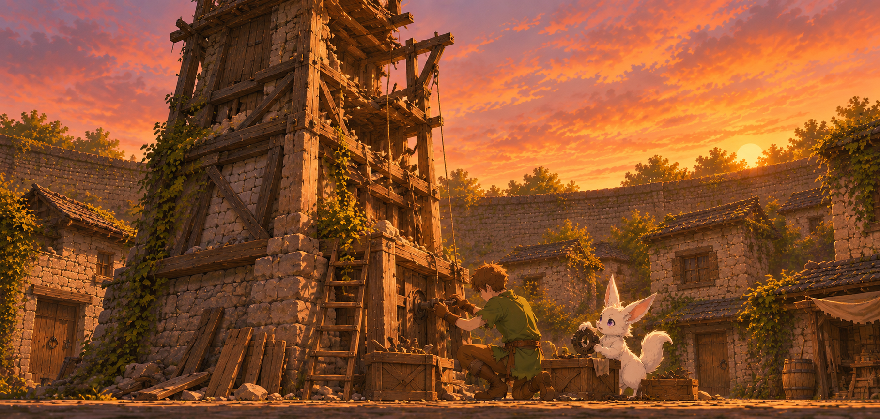
This is the weight dial
I gathered all the pieces we could get
Let’s fix the tower,
floor by floor
oh, do they like mushrooms too?

Slide 5
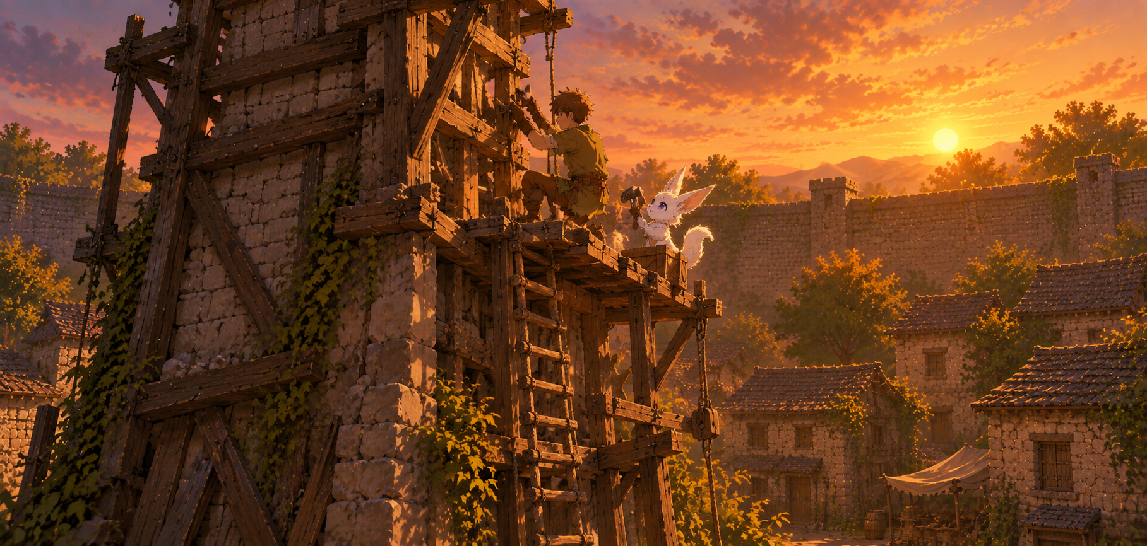
Some piece broke in two
Then we glue them back together
oh, do they like mushrooms too?

Slide 6
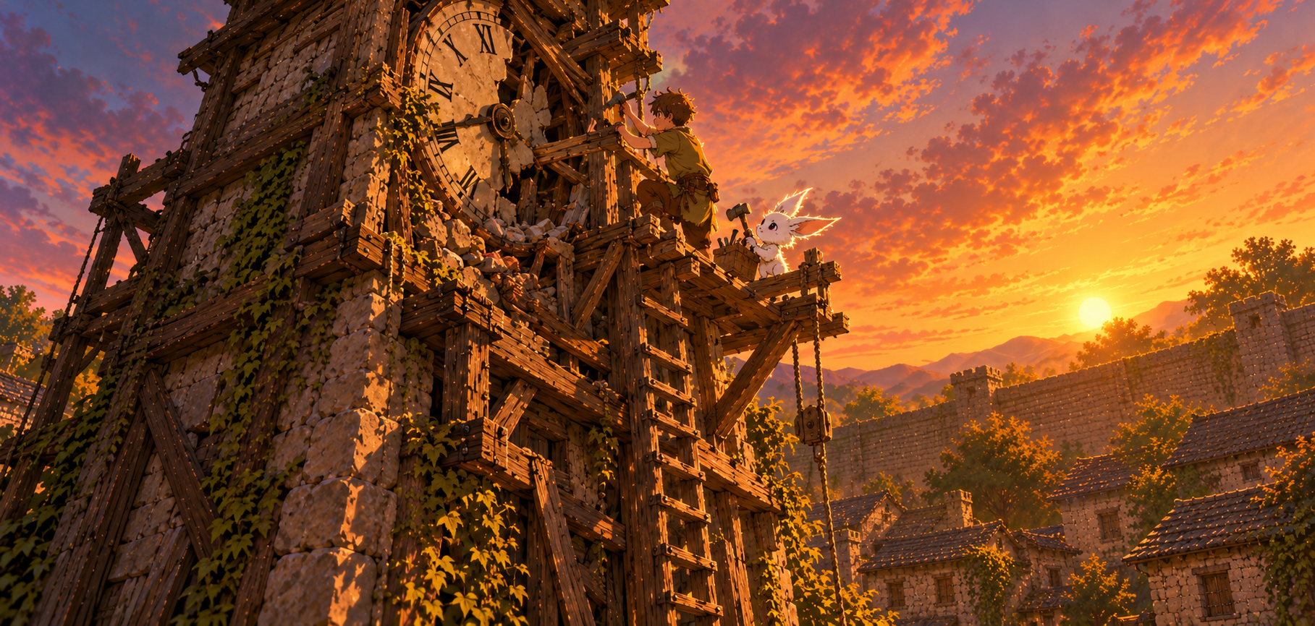
Quite a lot
of work here
oh, do they like mushrooms too?

Slide 7
oh, do they like mushrooms too?

Slide 8
Complete method .reverse
inside Direction.
The method body should be
'this.turn.turn'

