Slide 1
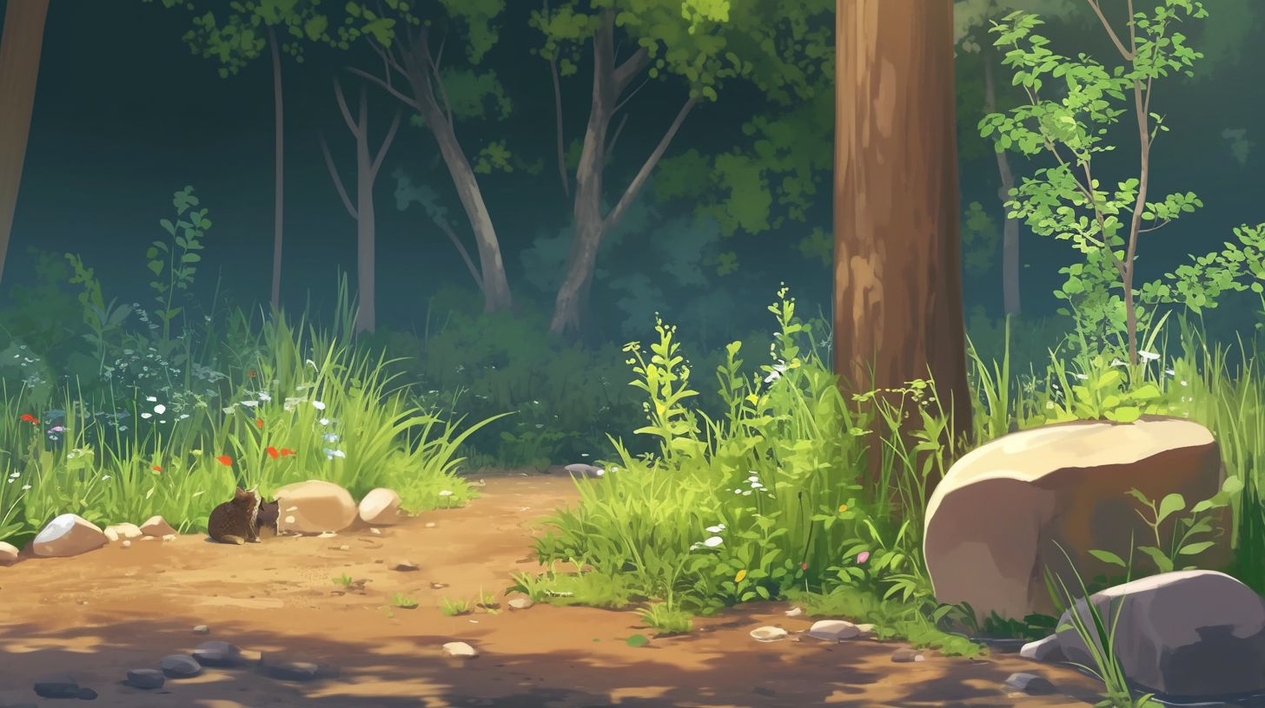


Ok, ok, this is a good area for some tasty
mushrooms and wild eggplants
Are they edible?

Slide 2
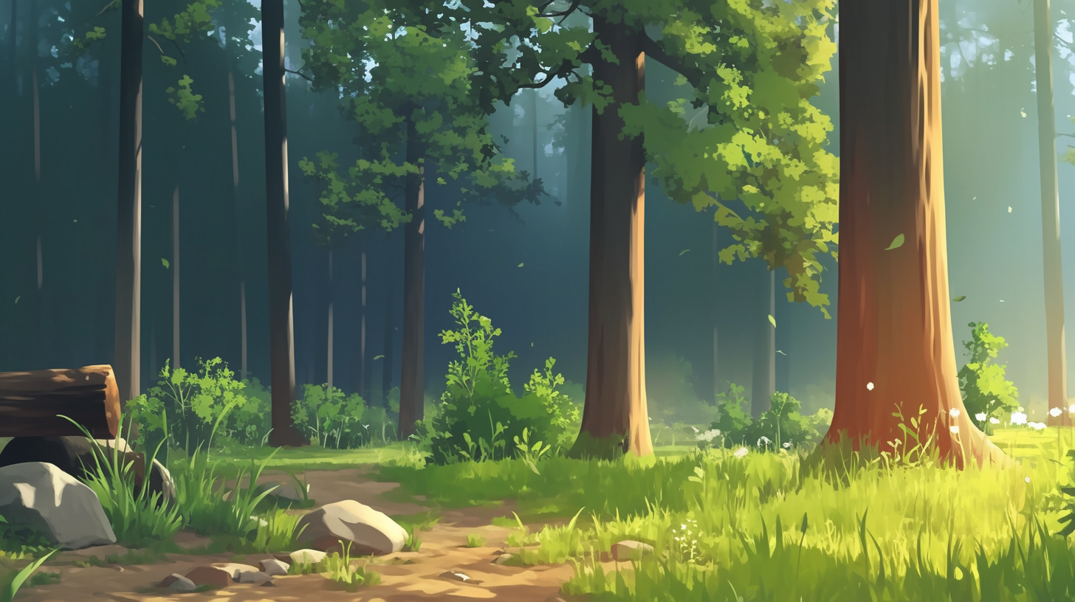


Some of them are toxic, as if there
was an error in their magic code
That's why we have many baskets:
we need to divide them following what their magic does

Slide 3
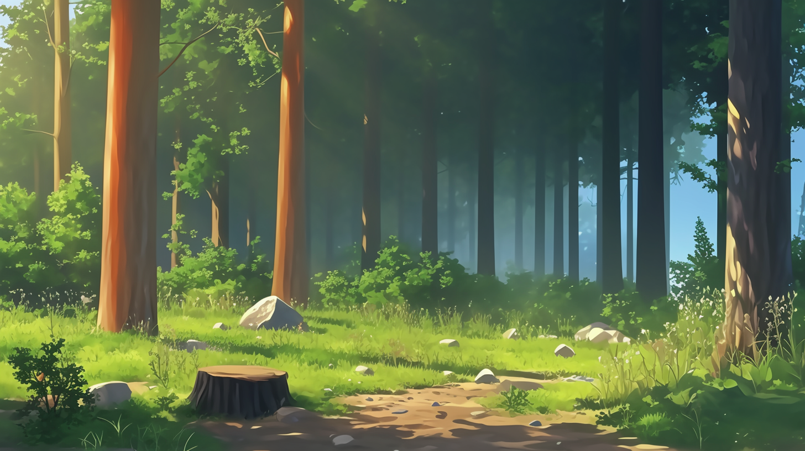
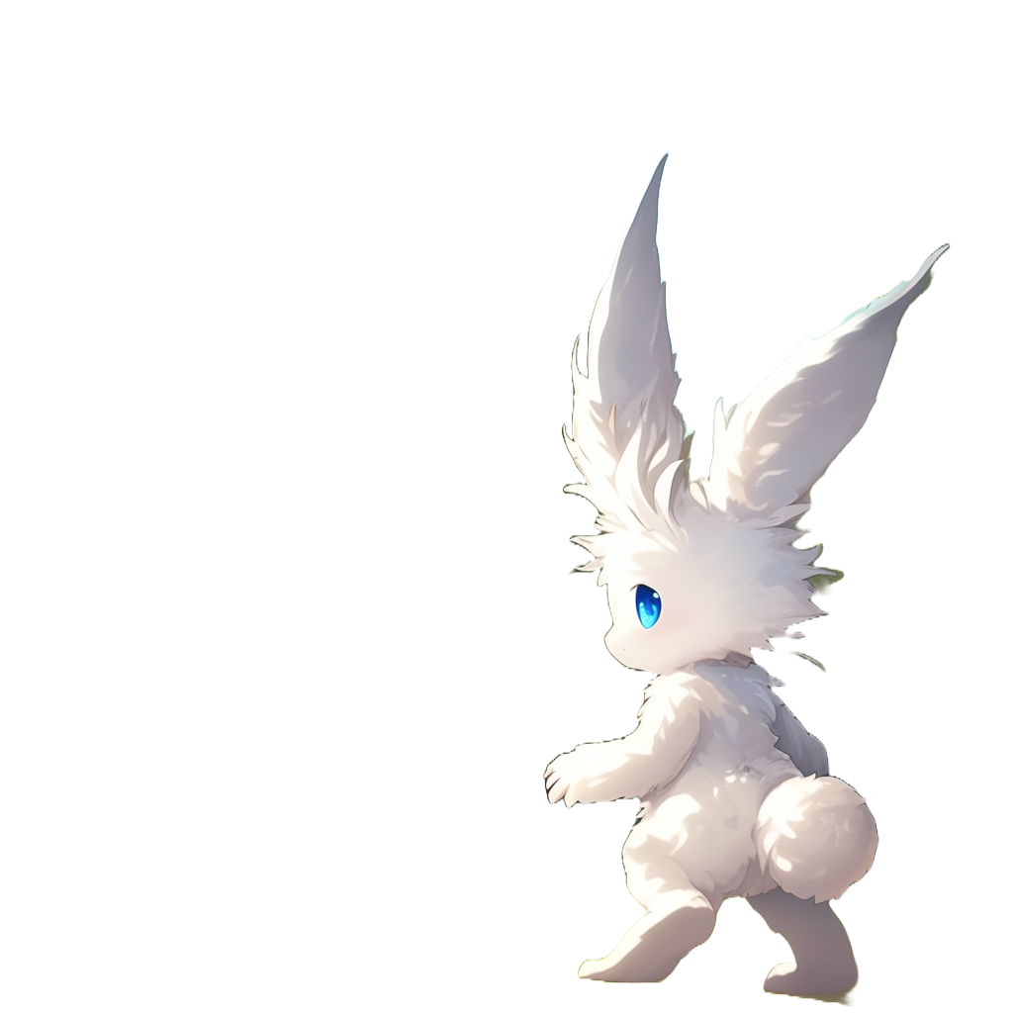

What happens if we mix them up?
Not-toxic plus not-toxic still equals
yummy, right?
They would
rot before we get home, the different
codes would fight each other in the basket!

Slide 4
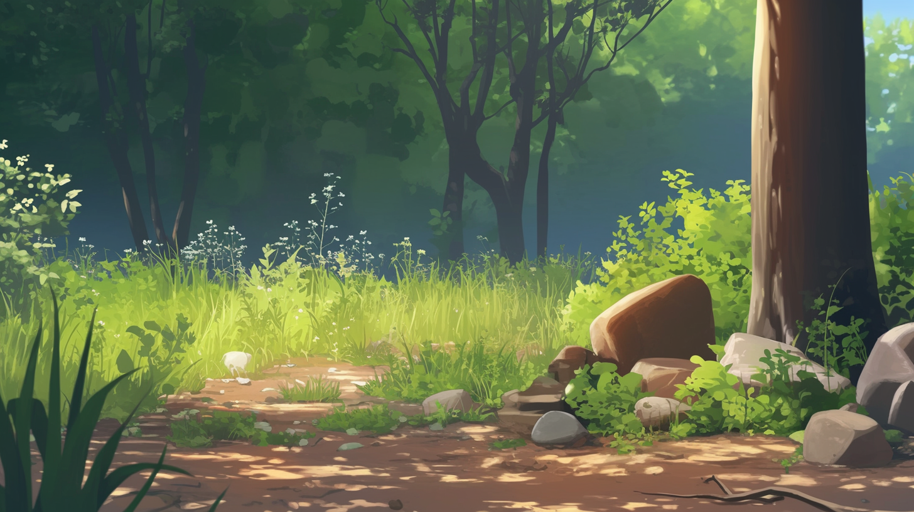

Superficial differences are ok,
it is the meaning of the code that matters
For example,
empty parenthesis `()` `[]`
can be omitted.
In many case `{}` can be omitted too
You will discover those cases with experience

Slide 5
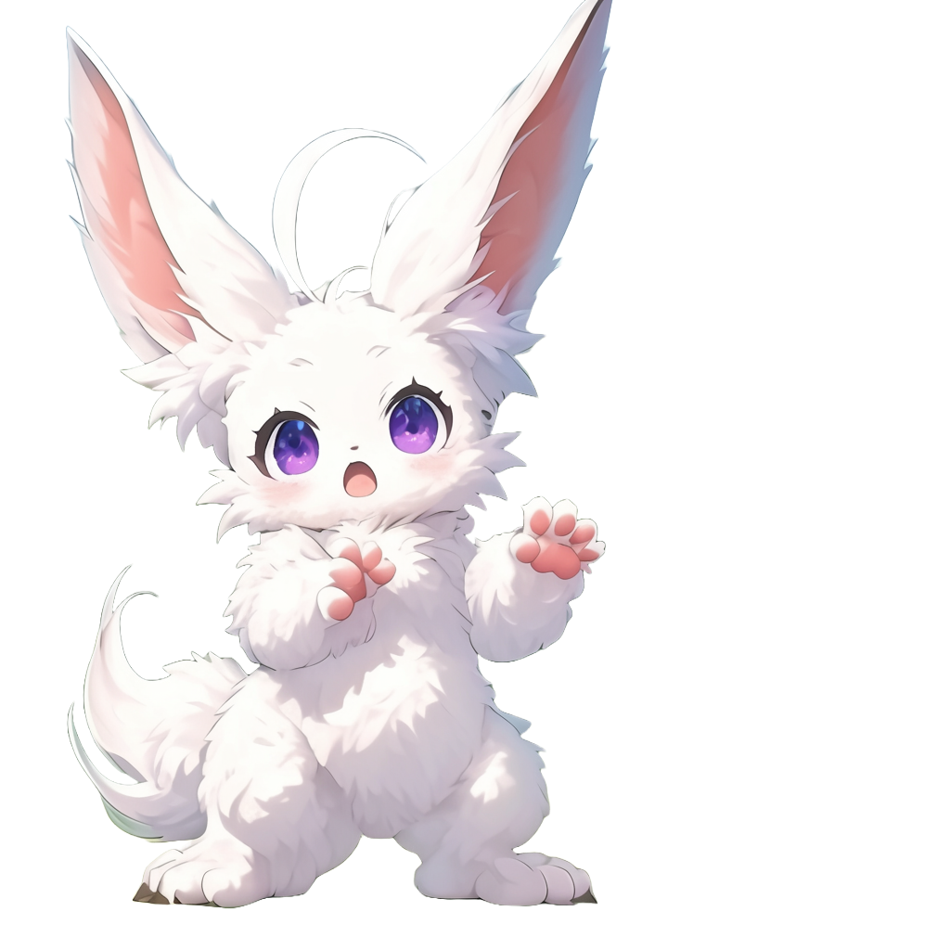
In many cases also '.turn->'
can be omitted!
We learn through trial and error
We deliberately make mistakes to test the limits of what works and what doesn’t!

Slide 6
Let's go!
Just drag the
plants in the baskets

