Slide 1
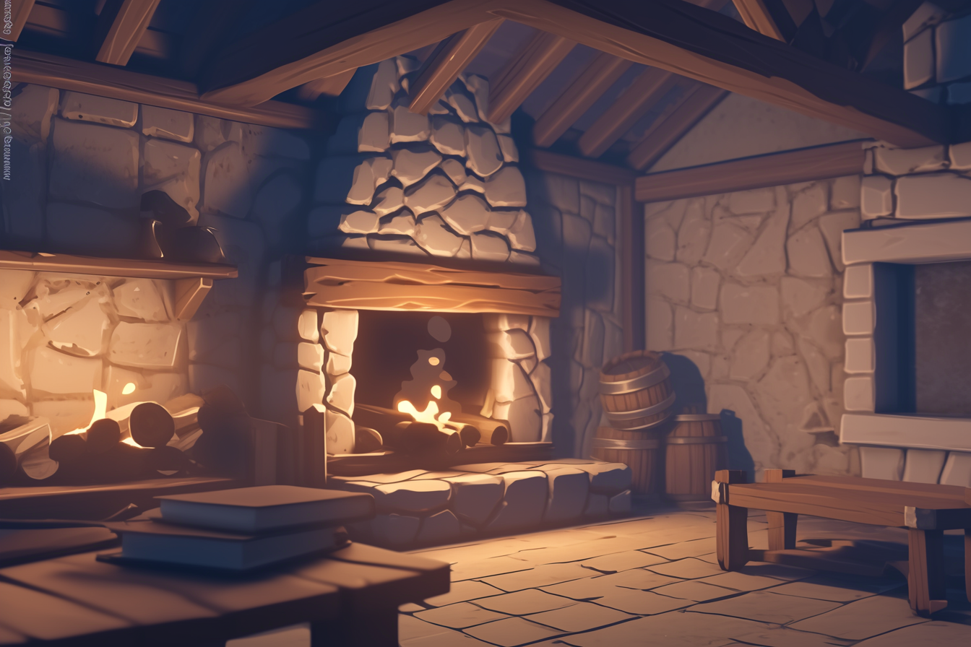
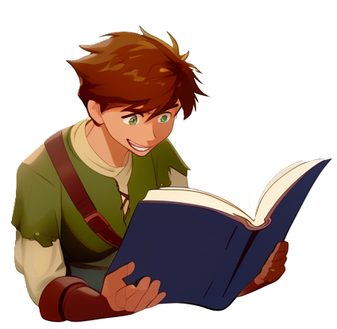

Slide 2
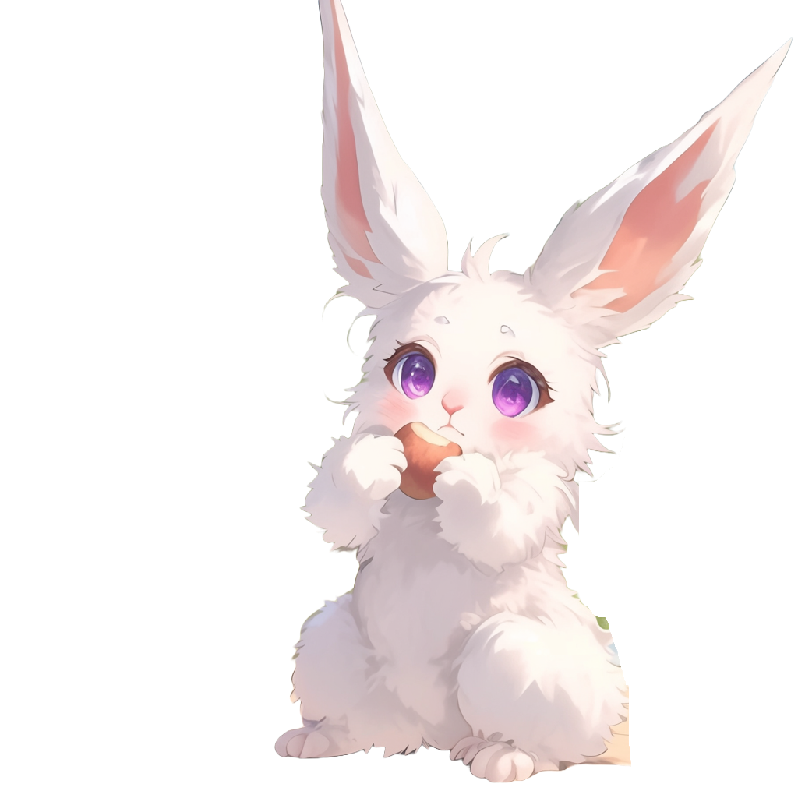
Panic enters the room
with a basket of food
I've got more potatoes for breakfast!

Slide 3


They are so convenient!
This time
I steamed them with the magic hot stones!
After enchanting them, they stay piping hot forever

Slide 4

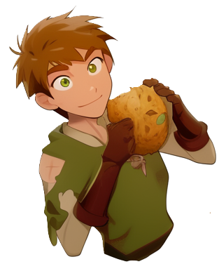
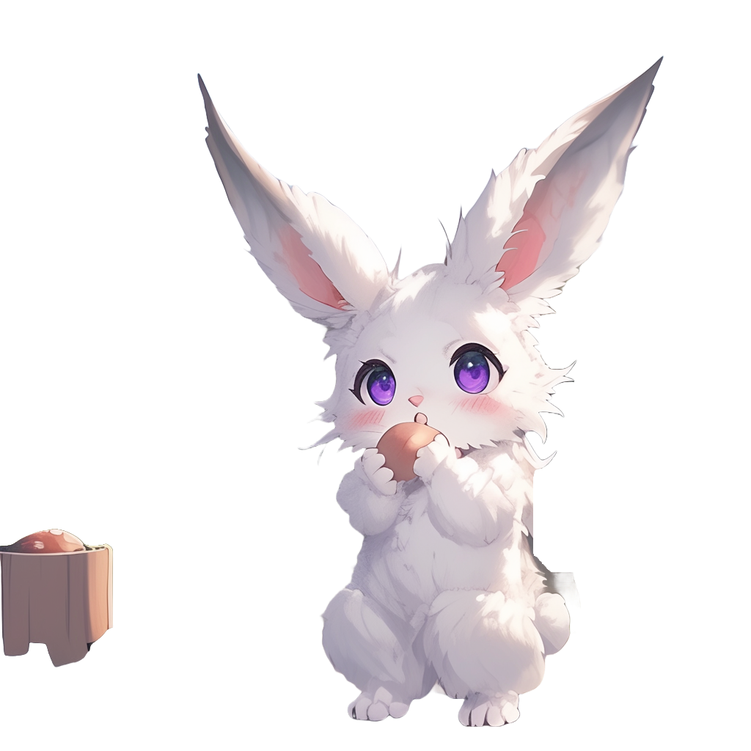
I see you have
been reading my Archery book
Yea, sorry
for that, I was bored

Slide 5

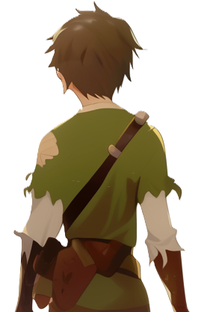

Not to worry! Please read any books you like!
If you want some archery practice, there is a training ground outside
Shall we go?

Slide 6


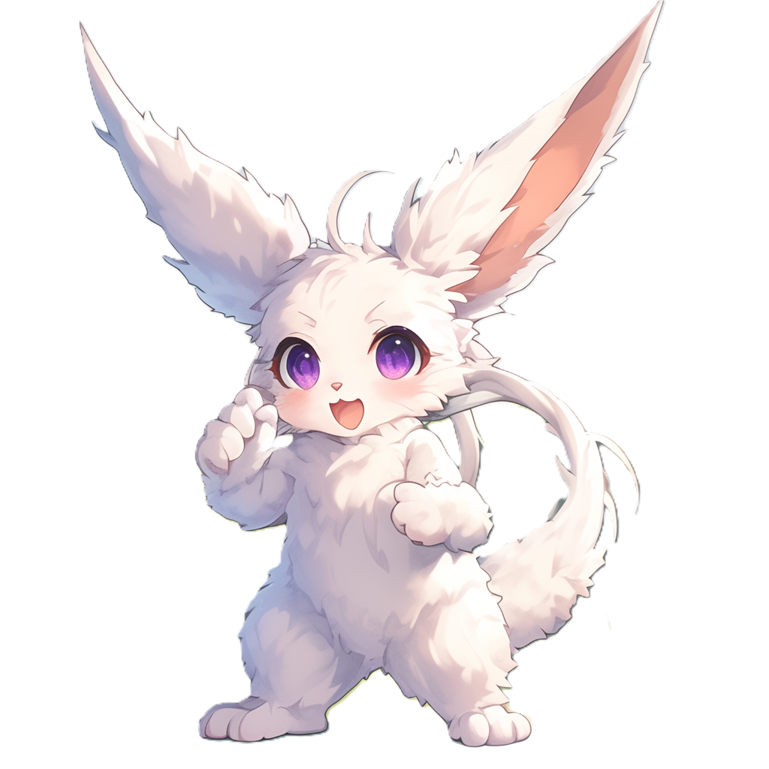
They start walking toward
the training ground
You look way
too excited about it

Slide 7
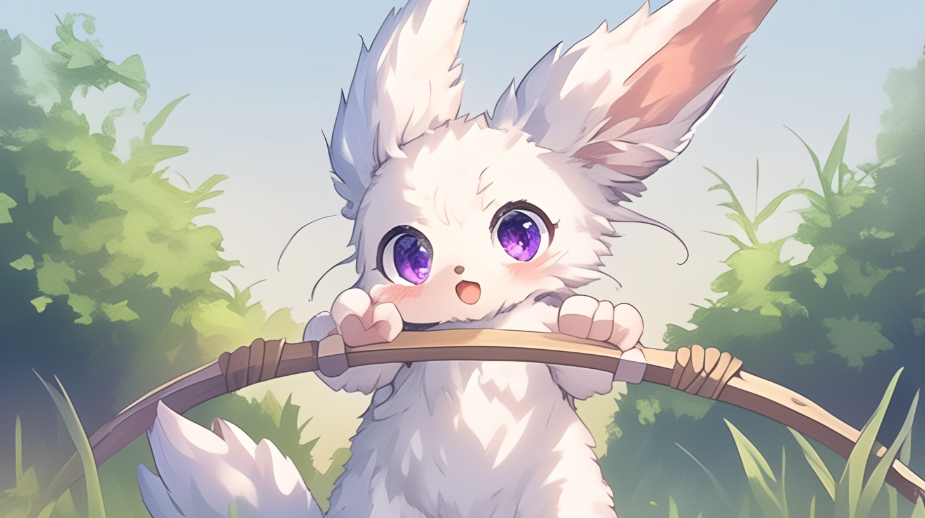
Take this bow and go!

Slide 8
1

Slide 9
2

Slide 10
3

Slide 11
4

Slide 12
5

Slide 13
6

Slide 14
7

Slide 15
8

Slide 16
9

Slide 17
10

Slide 18
11

Slide 19
12

Slide 20
13

Slide 21
14

Slide 22
15

Slide 23
16

Slide 24
17

Slide 25
Very good!
At home I will give you the second volume, with more advanced archery
Those books are
ruined and some words are hard to read
Use the context to understand them

