Slide 1
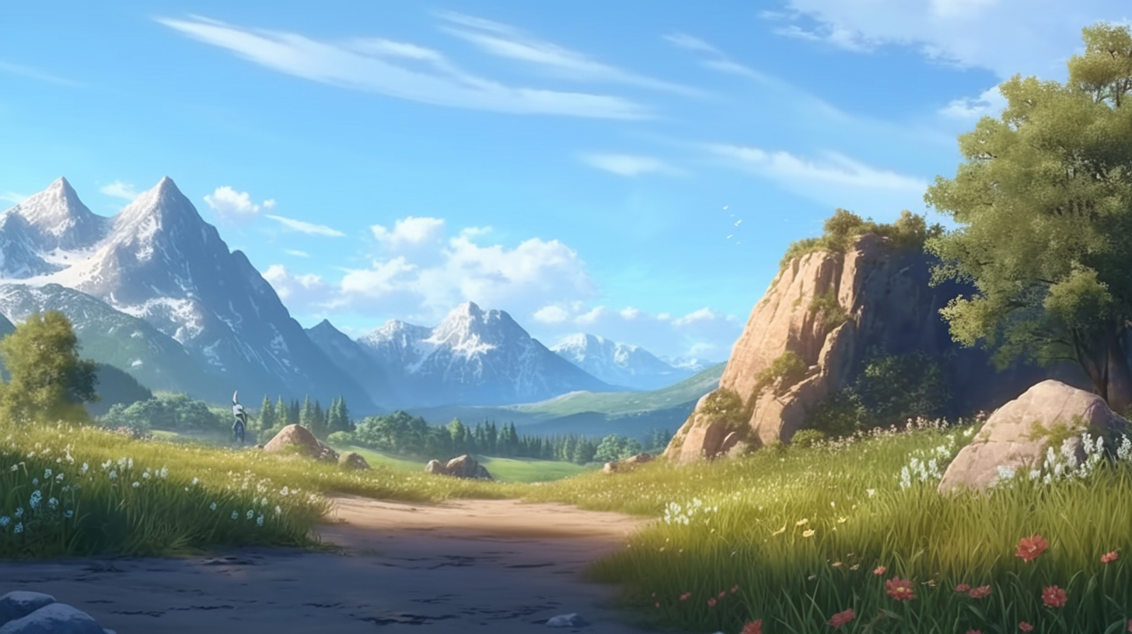
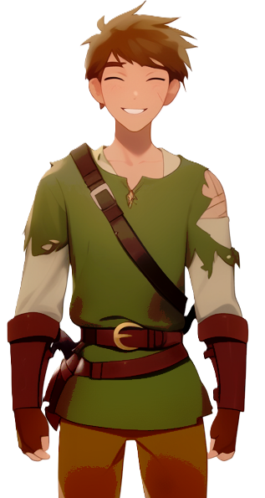

That plateau was quite amazing
Back home, after
gathering food
There are mushrooms, flowers, and no monsters

Slide 2



I understand that the situation here is pretty critical
How are the nearby villages
hanging on?

Slide 3

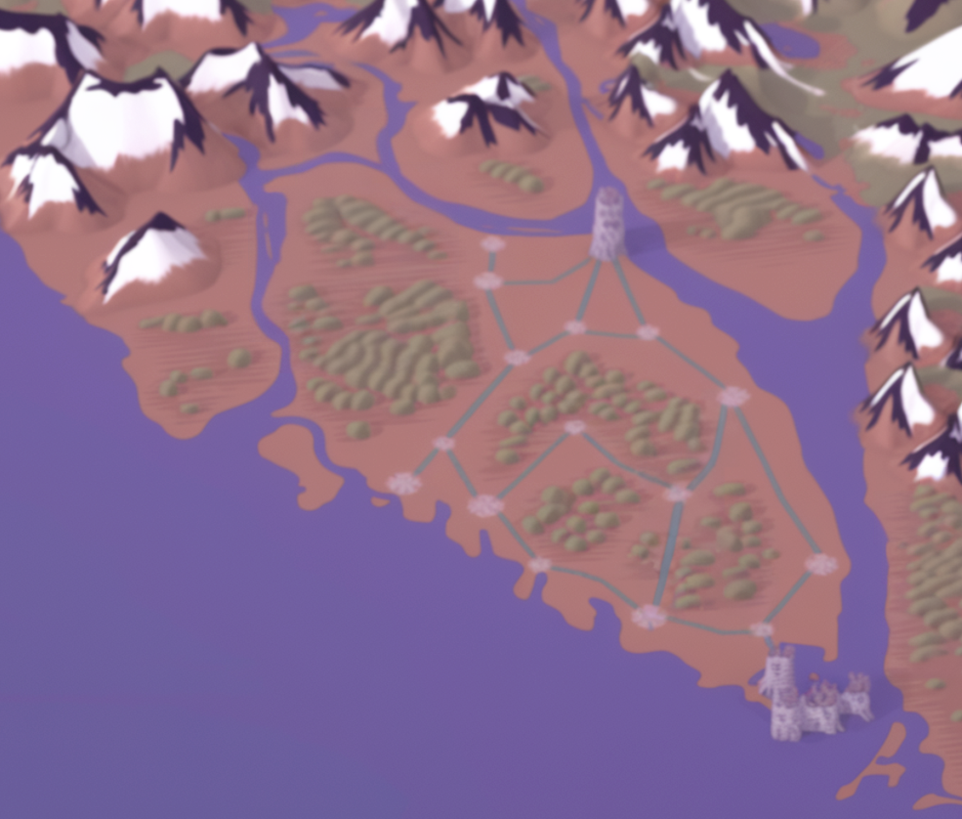

We are here in Aligard, on the coastline
We are in
a decent situation because we can
also fish
A

Slide 4
one
hour walking
Here, about
there is the village of Baligard
B

Slide 5


They are quite far from the coastline
To get
them fishing,
we built a stone wall with a walkway on top
B

Slide 6
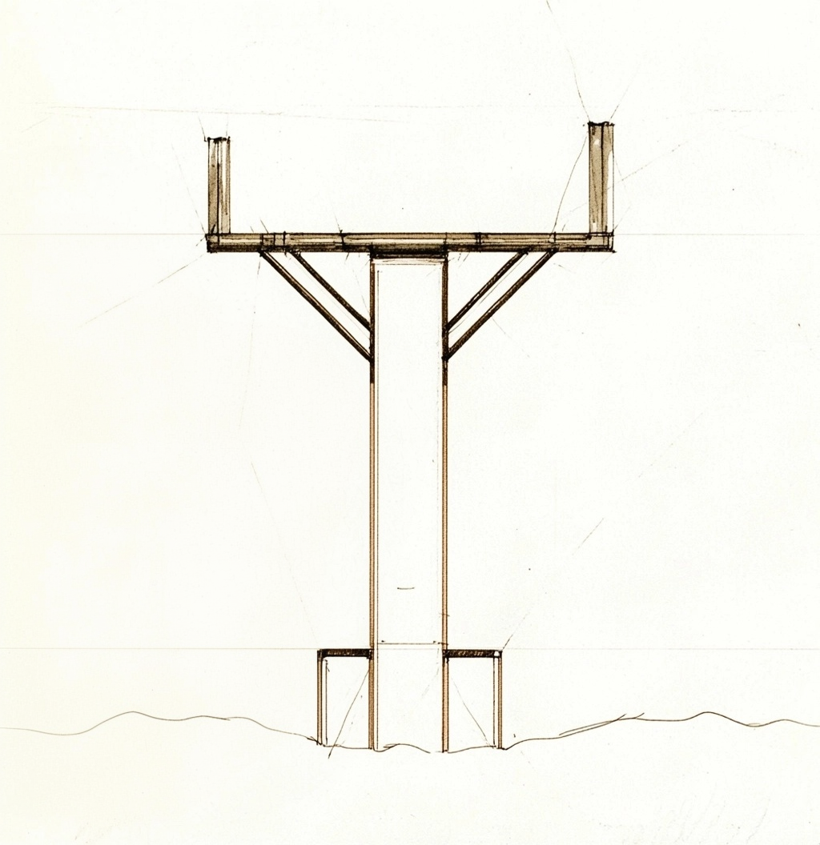
The extended walkway prevents
monsters from climbing over it
and gives us enough
space to walk

Slide 7
Near us to the East
also
about one
hour walking
There is the town of Caligard
C
Also on the coastline, so they can fish as well

Slide 8


What if we build a wall here?
That would keep the monsters out!

Slide 9

Not a bad idea,
but we do not really have enough stone
to build such
a large wall
We had just enough stones to build the wall from Aligard to Baligard

Slide 10

an easier option
that we are attempting, is to build another wall here
in this way we would get a triangle of land to reclaim
from the monsters

Slide 11
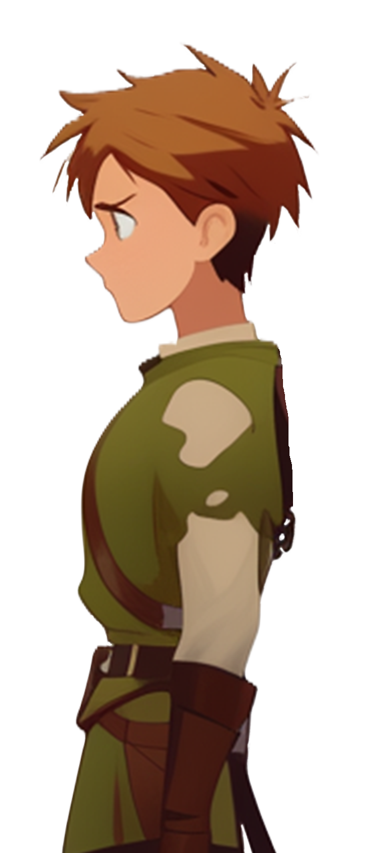

Unfortunately, we do not have enough stones for it
is that going to be strong enough
so we are building a
wooden palisade instead
to keep the monsters out?

Slide 12

But of course!
They are just dumb beasts
Somehow not reassured, we
conclude day three

Slide 13


