Slide 1
WCS 101
A short and painless introduction to Web Coverage Service

Slide 2
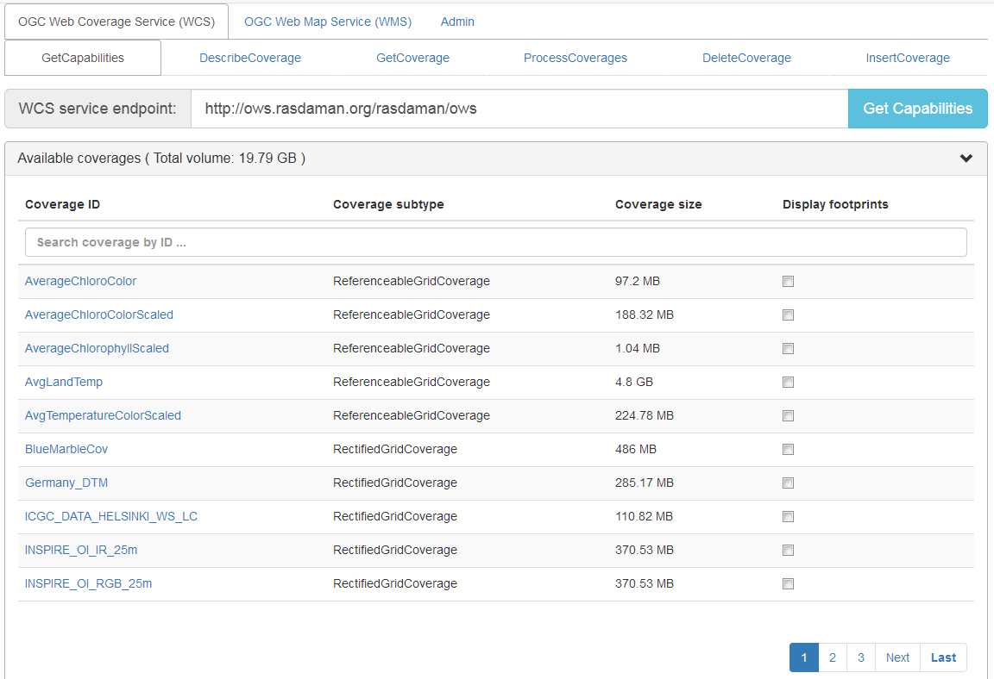

Navigating rasdaman and WCS

Slide 3
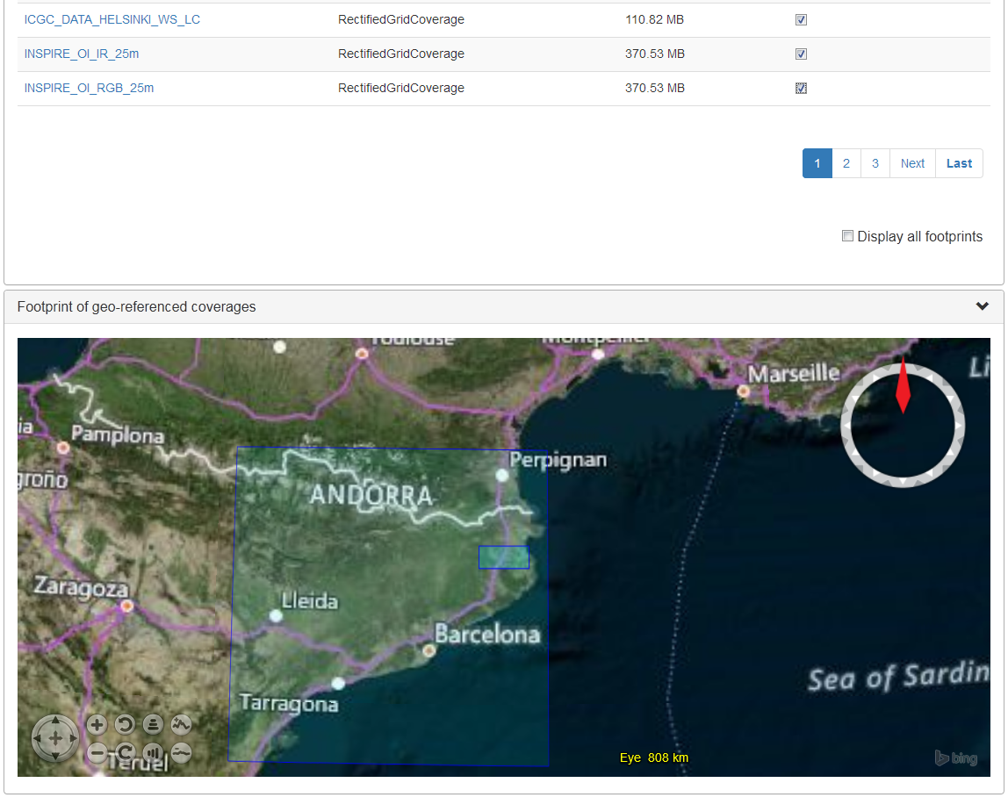
Navigating rasdaman and WCS

Slide 4
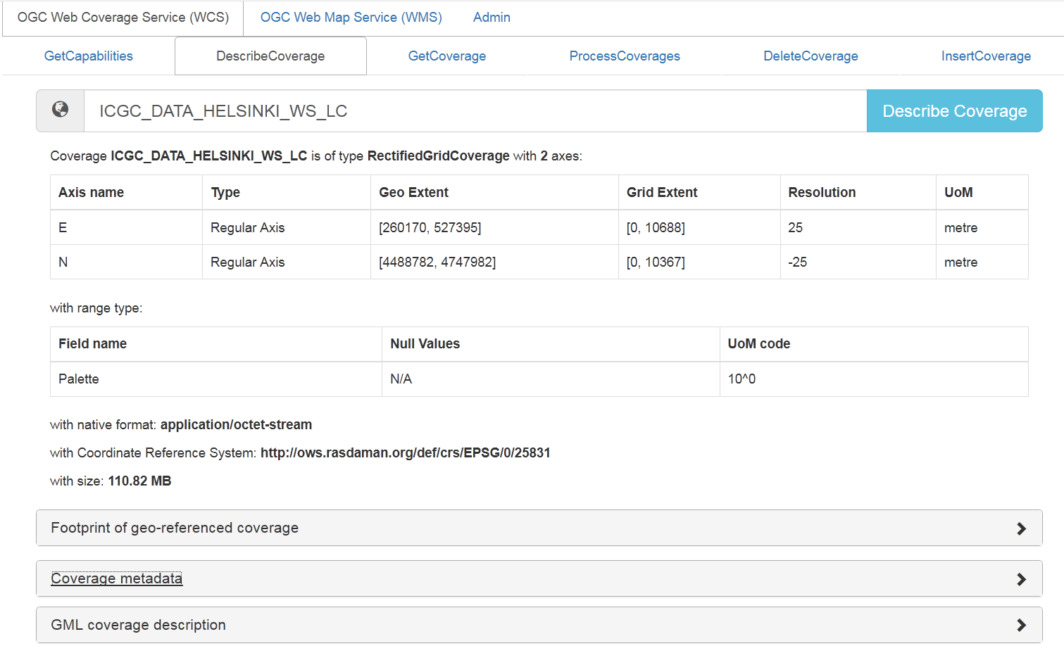
Navigating rasdaman and WCS
http://ows.rasdaman.org/rasdaman/ows?& SERVICE=WCS& VERSION=2.0.1& REQUEST=DescribeCoverage& COVERAGEID=ICGC_DATA_HELSINKI_WS_LC

Slide 5
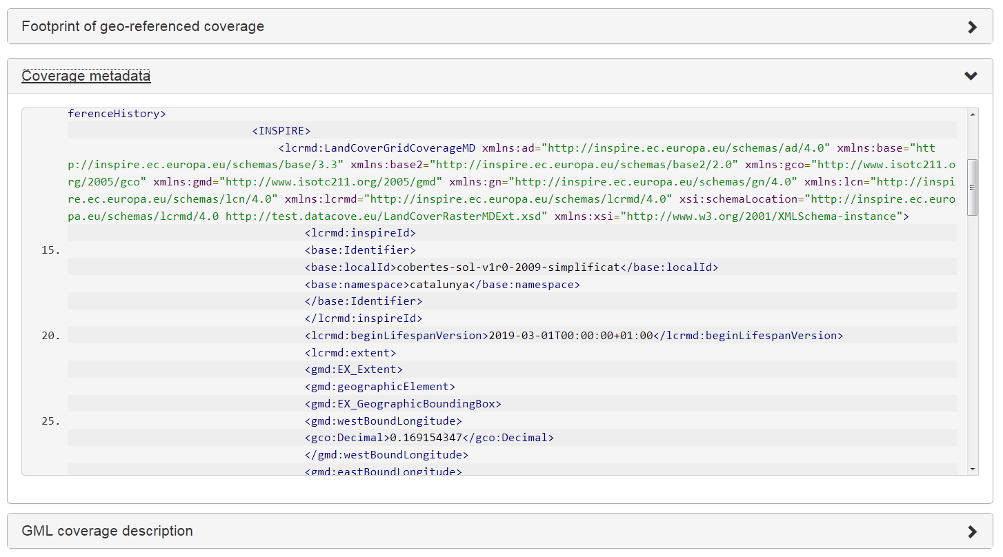
Navigating rasdaman and WCS

Slide 6
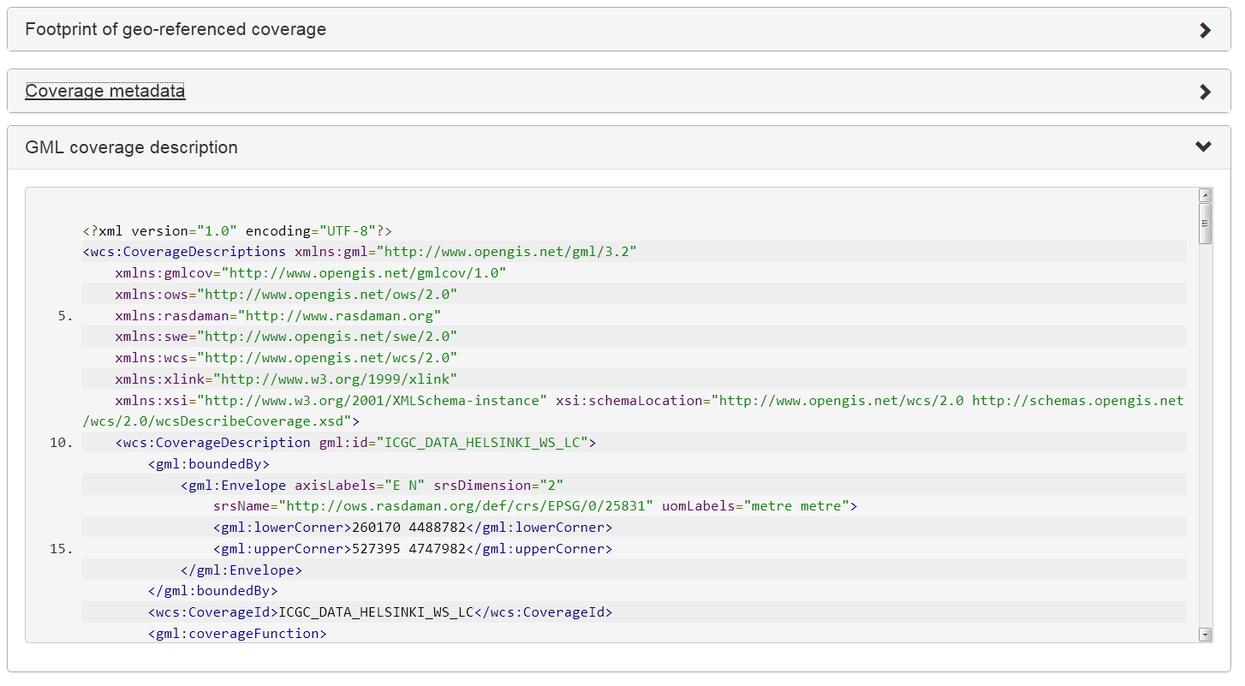
Navigating rasdaman and WCS

Slide 7
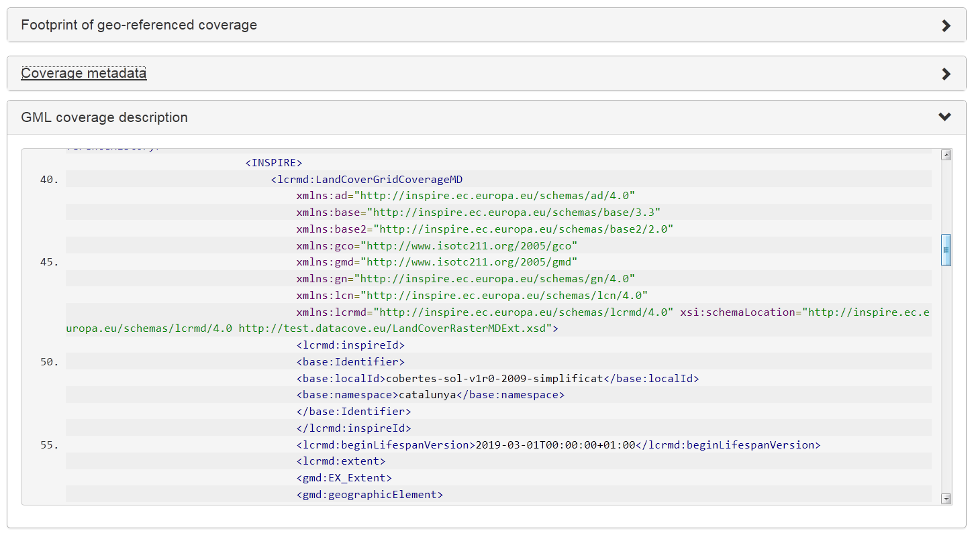
Navigating rasdaman and WCS

Slide 8
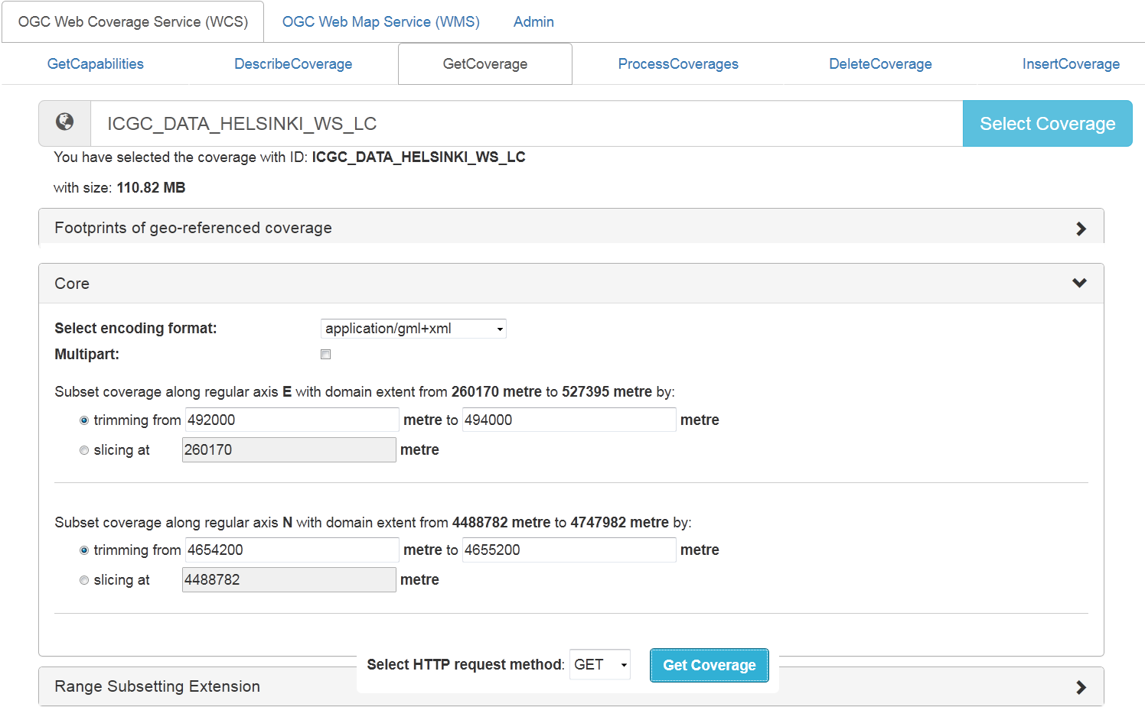
Navigating rasdaman and WCS

Slide 9
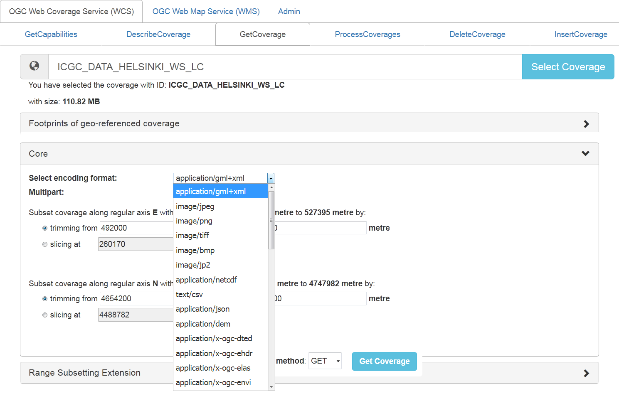
Navigating rasdaman and WCS

Slide 10
Navigating rasdaman and WCS
http://ows.rasdaman.org/rasdaman/ows?& SERVICE=WCS& VERSION=2.0.1& REQUEST=GetCoverage& COVERAGEID=ICGC_DATA_HELSINKI_WS_LC& SUBSET=E(492000,494000)& SUBSET=N(4654200,4655200)& FORMAT=application/gml+xml

Slide 11
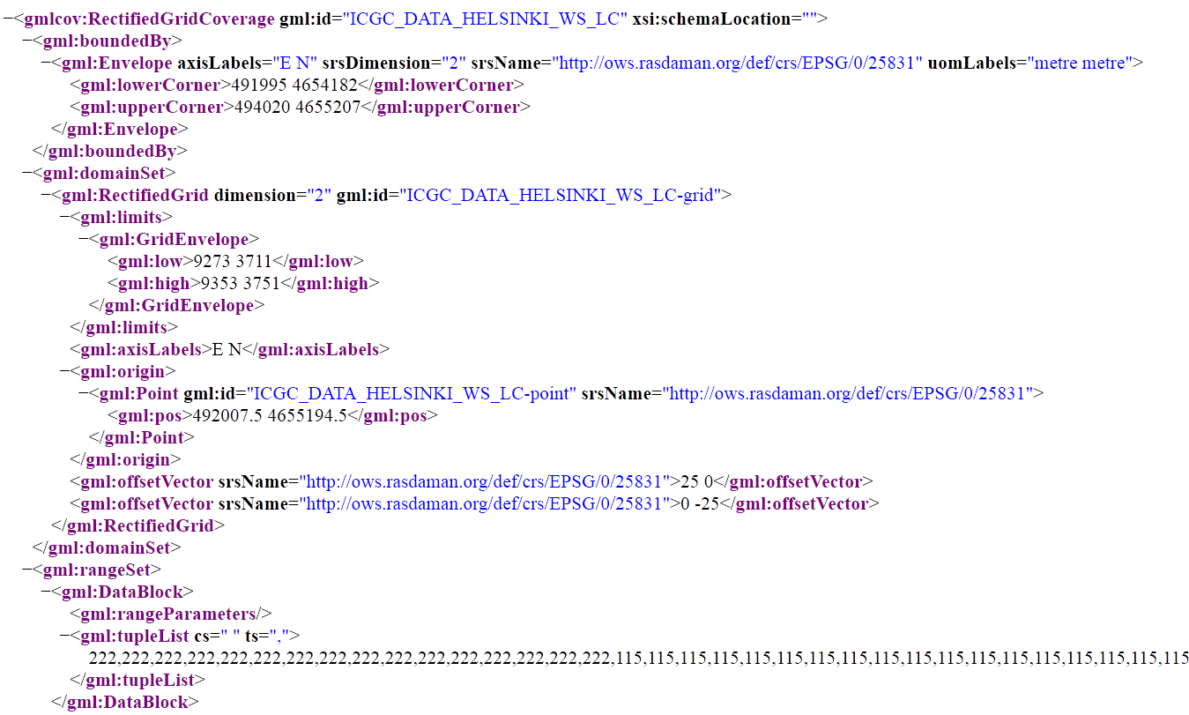
Navigating rasdaman and WCS

Slide 12
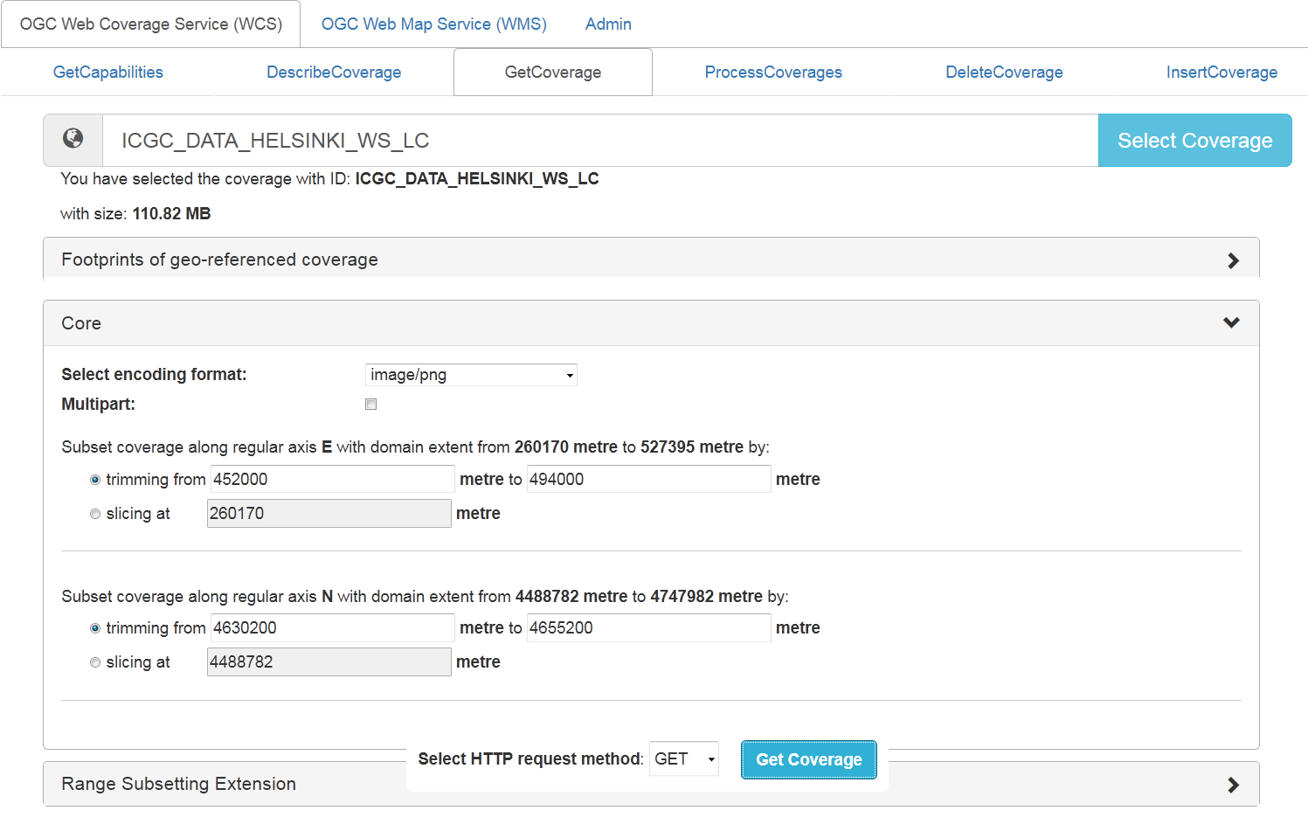
Navigating rasdaman and WCS
http://ows.rasdaman.org/rasdaman/ows?& SERVICE=WCS& VERSION=2.0.1& REQUEST=GetCoverage& COVERAGEID=ICGC_DATA_HELSINKI_WS_LC& SUBSET=E(452000,494000)& SUBSET=N(4630200,4655200)& FORMAT=image/png

Slide 13

Navigating rasdaman and WCS

