Slide 1


Django vs. Ruby on Rails
A Pet Shelter Website
Zhen (Marco) Xu
zxu3@ualberta.ca

Slide 2

Table of Contents
Similarities
Differences
The Pet Shelter Website
References

Slide 3
Similarities
Model-View-Controller (MVC)
Representational-State-Transfer (REST)
Database integration (back end)
Template utilization (front end)
Test driven designing
... ...

Slide 4
Differences – installation and creation
sudo pip install django
sudo apt-get install python-mysqldb
django-admin.py startproject Django
cd Django; python manage.py runserver 8080
sudo gem install rails
# \curl -sSL https://get.rvm.io | bash -s stable --rails
sudo apt-get install libmysqlclient-dev
sudo gem install mysql2
rails new Rails -d mysql
cd Rails; rails server -p 3030
Javascript runtime on Linux

Slide 5
Differences – architecture
App oriented MVC
Easy to extend
No apps
Website
Website
Models
Views
Controllers
App1
App2
...
Model1
View1
Model2
View2
Controller1
Model
Model
View3
View
View
Controller
Controller
Model3
View4
Controller2
...
...
...

Slide 6
Differences – model
Models: objects in database (tables)
Each model -> table of database
Variable -> column of table
Source codes:
class People(models.Model):
name = models.CharField()
# ... ...
Synchronize to database:
python manage.py syncdb
Terminal commands:
rails g model people \
name:string \
[--force]
Migrate to database:
rake db:migrate

Slide 7
Differences – controller
Controllers are methods
Located in “views.py”
Controller methods may:
  Render a template page
  Respond message
  Redirect to another method
Pass variables by dictionary
Terminal commands:
rails g controller welcome \
[--force]
By default, controllers will render
template pages in the same name
Pass global variables to
template pages

Slide 8

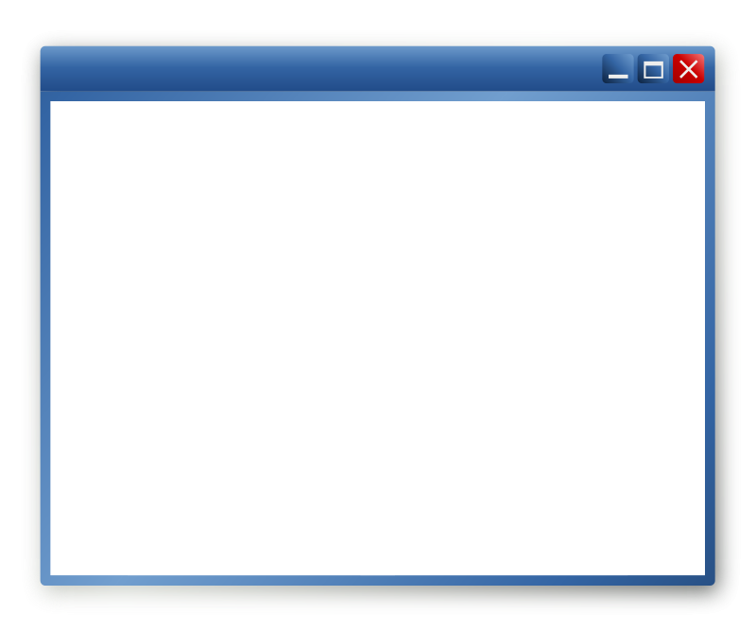
Differences – view
Template HTML pages
  Pieces of HTML codes
  Extend from base pages
Codes extended from pages
Template extend outer “partials”
Base HTML file
Template HTML file
Template page
(blocks)
Partials
(blocks)

Slide 9
Differences – view (continue)
Load static files (CSS, js, etc.)
  Separated from templates
  Specify as “static”
Serve multimedia
  Same as serving static files
CSS, JS in Ruby on Rails
  Static files are “assets”
  Any file in “assets” directory
  will be applied automatically
Multimedia
  Mostly in “public” area
  Specify and managed as
  “images”, “audios” and “videos”

Slide 10
The Pet Shelter Website - requirement
Information:
  shelters, staffs, animals
Activities:
  receipts, adoptions, surrenders, donations, volunteers
Applications:
  adopting, surrendering, donating, volunteering
Management:
  shelters, staffs, animals; requests from above applications

Slide 11
The Pet Shelter Website - configuration
Database
# ./Django/settings.py
DATABASES = {
'ENGINE': \
'django.db.backends.mysql',
'NAME': 'Django',
'USER': 'MarcoXZh',
'PASSWORD': 'project',
}
# ./config/database.yml
development:
adapter: mysql2
database: Rails_development
username: MarcoXZh
password: project
test:
database: Rails_test
production:
database: Rails_production

Slide 12
The Pet Shelter Website - configuration
Other configurations
# ./Django/settings.py
INSTALLED_APPS = (
# ... ...
'PetShelter',
)
TIME_ZONE = 'America/Edmonton'
USE_TZ = False
# Nothing more to do!
# MySQL terminal:
GRANT ALL ON Django.* TO 'MarcoXZh'@'localhost' IDENTIFIED BY 'project';

Slide 13
The Pet Shelter Website - REST
Routes (URIs)
# ./Django/urls.py
urlpatterns = patterns('',
# .. ..
url(r'', include('PetShelter.urls')),
)
# ./Django/PetShelter/urls.py
urlpatterns = patterns('',
url(r'^$', views.index, name='index'),
# ... ...
)
# ./config/routes.rb
Rails::Application.routes.draw do
root 'petshelter#index'
get 'animals/' => 'petshelter#animals'
# ... ...
end

Slide 14
The Pet Shelter Website - controller
# ./PetShelter/views.py
def index(request):
Return HttpResponse('Welcome to PetShelter!')
def animals(request):
animals = Animals.objects.all()
Return render(request, 'PetShelter/animals.html', animals)
# ... ...
class PetshelterController < ApplicationController
layout 'base' # 'layouts/base.html.erb'
def index
# Rails renders "index.html.erb" by default
end
def animals
@animals = Animal.all
render 'petshelter/animals'
end
# .. ...

Slide 15
The Pet Shelter Website - view
Layout (base file)
<html>
<head>
<title>
{% block title %}
{% endblock %}
</title>
</head>
<body>
{% block body %}
{% endblock %}
</body>
</html>
<html>
<head>
<title>
<%= yield :title %>
</title>
</head>
<body>
<%= yield :body %>
</body>
</html>

Slide 16
The Pet Shelter Website - view
Template
{% extends "PetShelter/base.html" %}
{% block title %}
Welcome to the "PetShelter"
{% endblock %}
{% block body %}
<p> Welcome to PetShelter! </p>
{% endblock %}
<% content_for :title do %>
Welcome to "PetShelter"
<% end %>
<% content_for :content_block do %>
<p> Welcome to PetShelter! </p>
<% end -%>

Slide 17
The Pet Shelter Website - view
Ruby on Rails: template rendering partials
<!-- index.html -->
<html>
<body>
<%= render 'body' %>
</body>
</html>
<!-- _body.html.erb -->
<p> Welcome to PetShelter! </p>

Slide 18
The Pet Shelter Website - view
Static files in templates
{% load staticfiles %}
<!-- ./PetShelter/static/PetShelter/css/style.css -->
<link rel="stylesheet" type="text/css"
href="{% static 'PetShelter/css/style.css' %}" />
<!-- ./PetShelter/static/PetShelter/javascript/script.js -->
<script src="{% static 'PetShelter/javascript/script.js' %}">
</script>
<!-- app/assets/stylesheets/style.css -->
<%= stylesheet_link_tag "style" %>
<!-- app/assets/javascripts/script.js -->
<%= javascript_include_tag "script" %>

Slide 19
The Pet Shelter Website - view
Multimedia files in templates
{% load staticfiles %}
<!-- ./PetShelter/static/PetShelter/mm/image.jpg -->
<img src="{% static 'PetShelter/mm/image.jpg' %}" />
<!-- ./PetShelter/static/PetShelter/mm/audio.wav -->
<audio src="{% static 'PetShelter/mm/audio.wav' %}" />
<!-- ./PetShelter/static/PetShelter/video.mp4 -->
<video src="{% static 'PetShelter/mm/video.mp4' %}" />
<!-- ./public/images/image.jpg -->
<%= image_tag 'image.jpg' %>
<!-- ./public/audios/audio.wav -->
<%= audio_tag 'audio.wav' %>
<!-- ./public/videos/video.mp4 -->
<%= video_tag 'video.mp4' %>

Slide 20
The Pet Shelter Website - view
Forms
<form method='POST' action="/">
{% csrf_token %}
<!-- input tags -->
<input name="name" />
<input type="submit" />
</form>
<form method='POST' action="/">
<input name="authenticity_token" type="hidden"
value="<%= form_authenticity_token %>" />
<!-- input tags -->
<input type="submit" />
</form>

Slide 21
The Pet Shelter Website - view
Form
def index(request):
if request.method == 'POST':
v = request.POST['name']
# do POST things
pass
# do GET things
# route for POST
post '/' => 'petshelter#index'
def index
if nil != \
params['authenticity_token']
# do POST things
else
# do GET things
end
end

Slide 22
The Pet Shelter Website - view
Ruby on Rails: form_for method
<%= form_for :post do |f| %>
<!-- input tags -->
<%= f.text_field :name %>
<%= f.submit %>
<% end %>
# route for POST
post '/' => 'petshelter#index'
def index
if params[:post] != nil
# do POST things
else
# do GET things
end
end

Slide 23
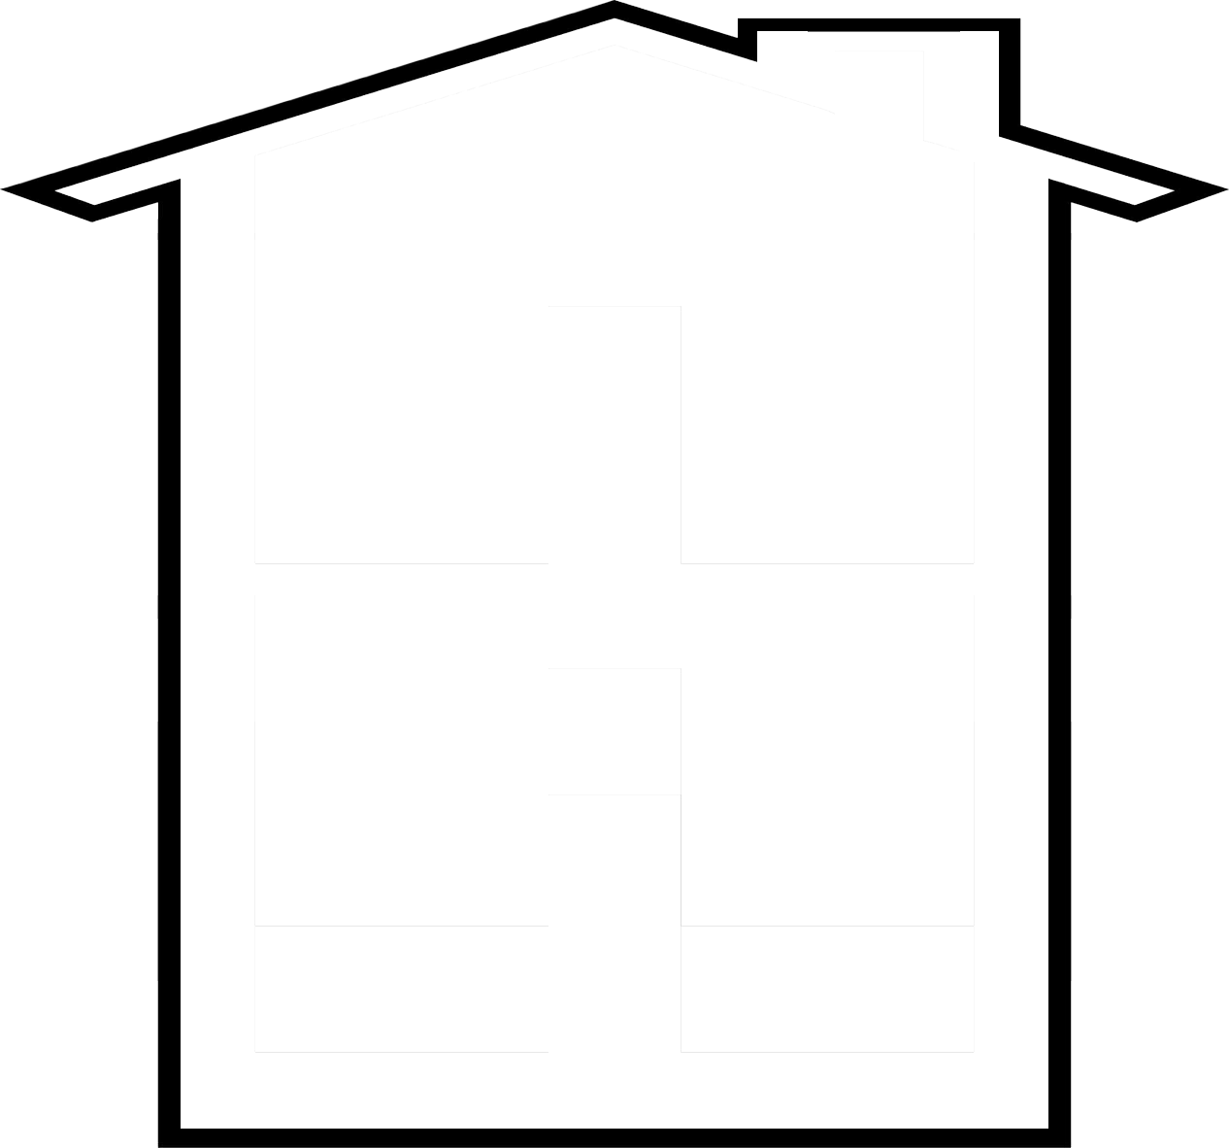






The Pet Shelter Website - scenario
Shelter1
Shelter2
Vet1
js-11
js-12
js-21
js-22
js-31
js-32
AS01
AD01
AB01
AC03
AD02
AC01
AB02
AC02
AB03
AD03
AS02
js-s01
js-s02
js-s03

Slide 24
The Pet Shelter Website - scenario
Shelter1
Shelter2
Vet1
js-11
js-12
js-21
js-22
js-31
js-32
AS01
AD01
AB01
AC03
AD02
AC01
AB02
AC02
AB03
AD03
AS02
?
js-a01
js-a02
js-a03

Slide 25
The Pet Shelter Website - scenario
Shelter1
Shelter2
Vet1
js-11
js-12
js-21
js-22
js-31
js-32
AS01
AD01
AB01
AC03
?
AD02
AC01
AB02
AC02
AB03
AD03
AS02
js-d01
js-d02
js-d03

Slide 26
References
https://www.djangoproject.com/
https://docs.djangoproject.com/en/1.6/intro/tutorial01/
http://rubyonrails.org/
http://guides.rubyonrails.org/getting_started.html
http://guides.rubyonrails.org/active_record_querying.html
http://guides.rubyonrails.org/layouts_and_rendering.html

