Slide 1





Marco La Barbera
Giulio Lotto
AXI4 High-Speed Communication for Microprocessors and RegEx Architectures
18 July 2024
marco.labarbera@mail.polimi.it
giulio.lotto@mail.polimi.it

Slide 2

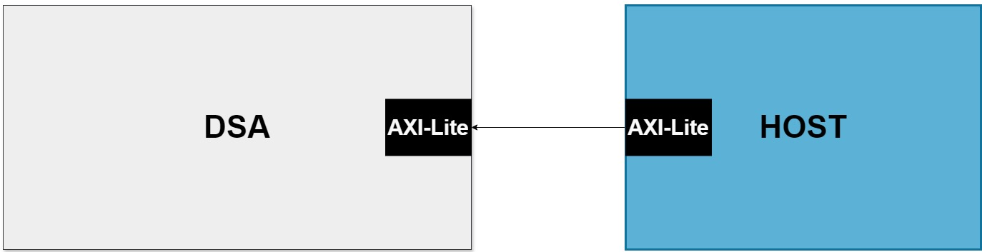
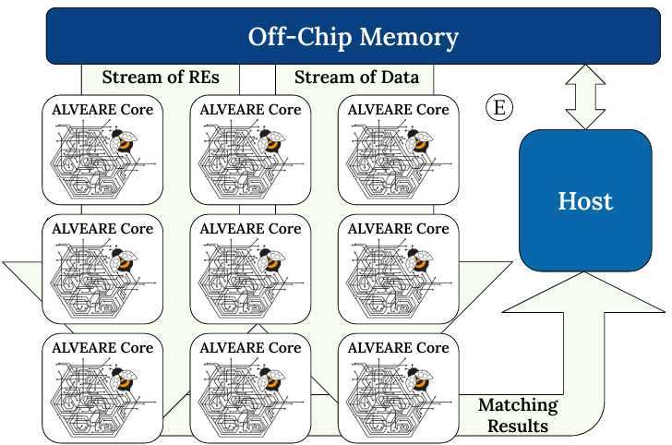
A PROBLEM
Fast architectures may be impaired by a slow communication system with the host.
A case study:
ALVEARE is a comprehensive framework that presents a solution that achieves a 34x speedup execution factors and enhances RE performance BUT it is limited by the protocol used to send data to the architecture.
Filippo Carloni, Davide Conficconi, and Marco D Santambrogio. ALVEARE: a Domain-Specific Framework for Regular Expressions. 2024.

Slide 3
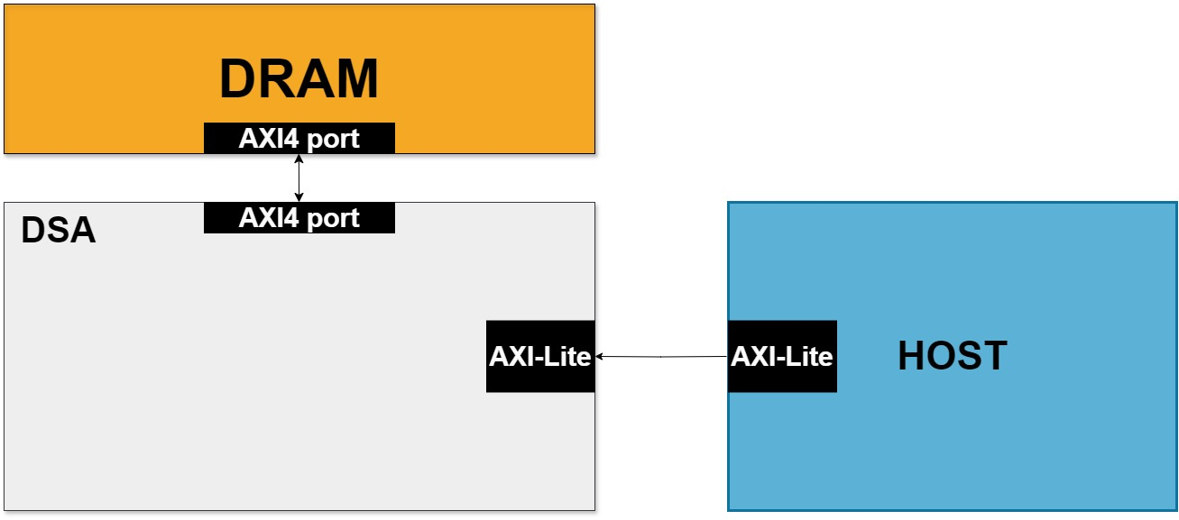
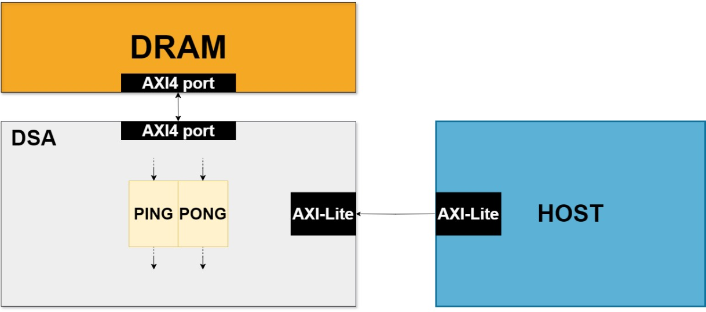
PROJECT GOALS
GOAL 1: FAST DRAM CONNECTION
GOAL 2: CACHING SYSTEM
DSA will receive data packets and instructions from the DRAM through the AXI4 and will write back the results.
The current state-of-the-art buffering system will be replaced by a more streamlined and engaging double-cache system to allow a faster access to the data.
3
Notes:
Perché la cache? LOCALITA’

Slide 4


AXI4 IMPLEMENTATION
VHDL
HLS
- FSM implementation
- FSM implementation
- Very tough to test
- Easier to test
- Backpressure to handle
variable latency

Slide 5
ALVEARE
ASH
INPUT
OUTPUT
INPUT
OUTPUT
DATA
DATA
RESULT
FOUND/
NOT FOUND
PATTERN
POSITION
OPERATION
Notes:
Impiegare meno tempo a spiegarla e meglio
Giustificativa per dire che abbiamo creato ASH

Slide 6

SELEC=0
SYSTEM BEHAVIOR
DRAM
A | B | OP
RES
SELEC=0
SELEC=1
ASH
SELEC=2
Master1
Master2
Master3
Master0
SELEC,
ADDRESSES
HOST
NEW A
NEW B
OP
RES
Slave Port

Slide 7
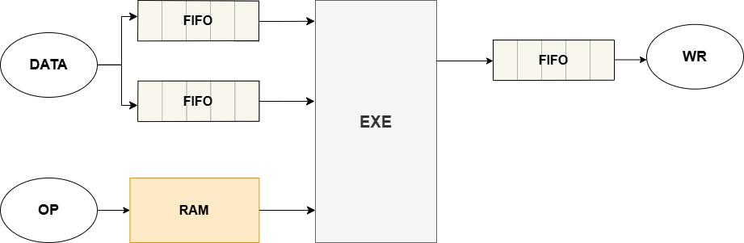
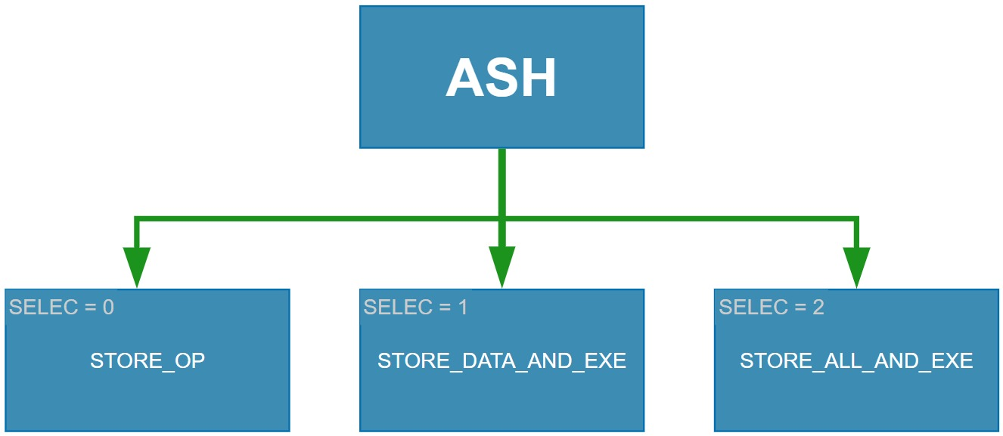
ASH HLS DESIGN
A very simple ALU architecture was first created using HLS to establish a diverse set of functions, in a data-flow approach
Load and Store functions are responsible for transmitting data through the AXI4s
Execution uses data and operations to perform different calculations (sum, subtraction, multiplication, and division)
Write function will write the results back to the DRAM using the AXI4
Notes:
- Implementato con approccio DATA FLOW

Slide 8
ALVEARE IS A VHDL-GENERATED ARHITECTURE
We must be able to insert a custom DSA inside the VHDL code generated by HLS.
What is the function module that executes the operation?
The EXECUTE
Notes:
- INTEGRARE CUSTOM DSA PARTENDO DA QUELLO FATTO IN HLS

Slide 9
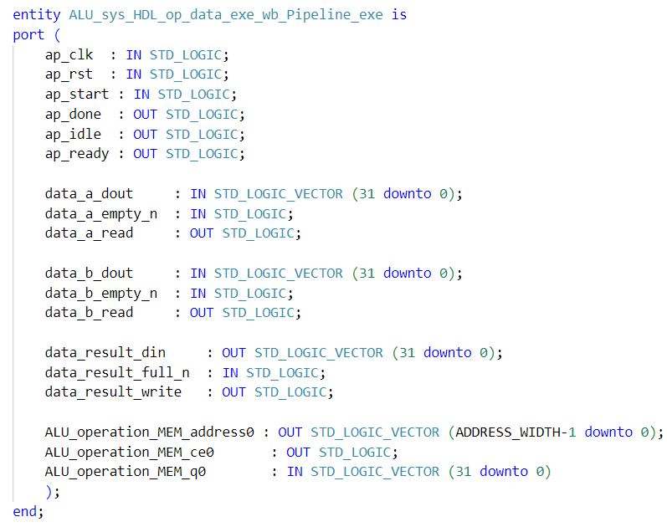
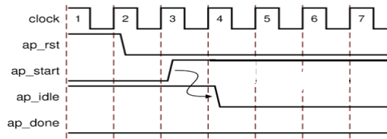
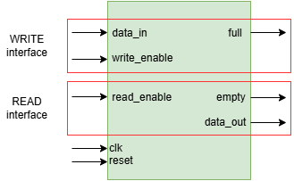
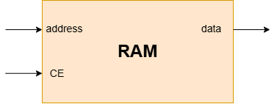
A
B
A
B
The Xilinx All Programmable PowerPoint Template (bme.hu)

Slide 10
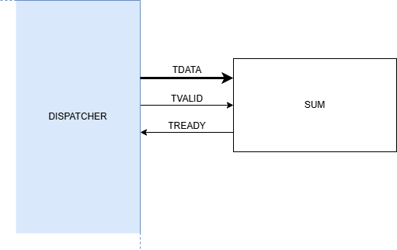
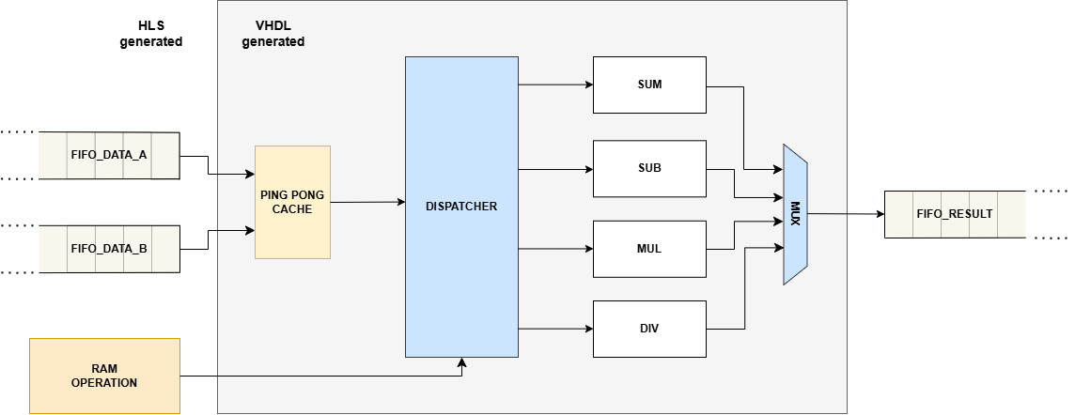
EXECUTE MODULE
RES
After 30 CC
After 10 CC
NEW A
NEW A
NEW A
NEW A
NEW B
NEW B
NEW B
NEW B
RES
RES
RES
DIV
DIV
MUL
SUM
Notes:
Il funzionamento è analogo a quello di una COMPLEX PIPELINE
ILP (Instruction Level Parallelism)
- Volendo le FU possono essere replicate (es. 2 blocchi per la moltiplicazione)

Slide 11


EVALUATION ENVIRONMENT
PYNQ-Z2 board
HLS 2023.2
Vivado 2023.2
PYNQ-Z2 environment for Host-DSA
communications (Jupyter, Python)
100 MHz clock
Scaled out from a burst of 50 data to a burst of 400 data, as it is the maximum number fitting our FPGA resources.
https://www.amd.com/en/corporate/university-program/aup-boards/pynq-z2.html

Slide 12
RESULTS
 | TIME |  | SPEED UP
DIM BURST | SISD | ASH | ASH/SISD
50 | 4.878 ms | 0.0445 ms | 109.65
100 | 10.2 ms | 0.0672 ms | 151.76
200 | 20.1 ms | 0.0841 ms | 239.26
400 | 38.9 ms | 0.15 ms | 256.57

Slide 13
RESULTS
 | ASH RESOURCES
DIM BURST | LUT | FF
50 | 10.564 | 17.625
100 | 12.166 | 24.056
200 | 15.737 | 36.903
400 | 22.762 | 62.680
Notes:
Pp cache

Slide 14
CONCLUSIONS
The use of the AXI4 and a double-cache system implies a maximum 256x speed-up compared to a basic AXI-Lite ALU version.
The system created is suitable not just for ALVEARE but also for other architectures since we use a general architecture to simulate ALVEARE’s behavior.
Notes:
Dare numeri e riasumere meglio

Slide 15

QUESTIONS?
THANK YOU FOR YOUR ATTENTION
marco.labarbera@mail.polimi.it
giulio.lotto@mail.polimi.it

