Slide 1





30/06/2024
High-Speed System Communication and Caching Enhancement for RegEx Matching
filippo.carloni@polimi.it
marco.labarbera@mail.polimi.it
giulio.lotto@mail.polimi.it

Slide 2
A PROBLEM
Communication between hardware has always been one of the challenges of systems design, particularly today when the limitation is no longer the architecture’s kernel but the vast amounts of data that need to be managed

Slide 3
A CASE STUDY
ALVEARE is a comprehensive framework that presents a solution that achieves a 34x speedup execution factors and enhances RE performance
BUT
ALVEARE's speed is limited by the protocol used to send data to the architecture. ALVEARE receives data and instructions through an AXI-Lite interface designed for non-complex transmission. So…

Slide 4
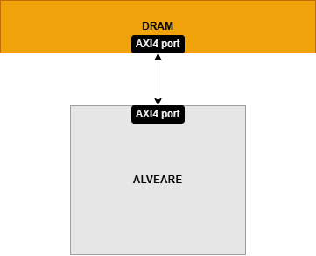
DRAM CONNECTION
Goal 01
To speed up data transfer the DMA has to be replaced with a direct connection from ALVEARE system to the DRAM.
ALVEARE has to receive information about data location from the Zynq through an AXI-Lite interface
ALVEARE will then receive data packets and instructions from the DRAM through the AXI4 and will write back the result in the memory

Slide 5
CACHING
SYSTEM
Goal 02
To further improve communication performances another goal is to implement a caching system
The current state-of-the-art buffering system will be replaced by a more streamlined and engaging double-cache system.

Slide 6
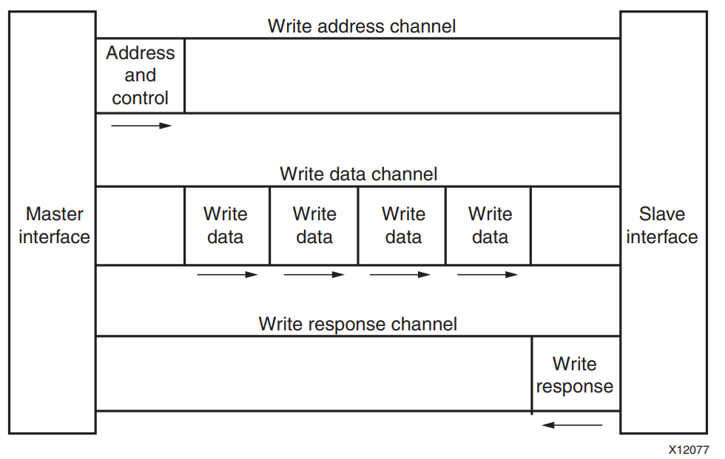
AXI4
AXI4 is a memory-mapped protocols, this means that all transactions involve the concept of transferring a target address within a system memory space and data.
What do we need?
ALVEARE needs to know where data are mapped
Manage data mapping
Addresses
Data (for sure...)
https://docs.xilinx.com/v/u/en-US/ug1037-vivado-axi-reference-guide

Slide 7
ALVEARE
ASH
INPUT
OUTPUT
INPUT
OUTPUT
PATTERN
OPERATION
DATA
DATA
RESULT
FOUND/
NOT FOUND
POSITION

Slide 8

A
B
A
B
SIMD
DRAM
A | B
RES
ASH IP
Master1
Master2
Master0
ZYNQ
OPERATION,
ADDRESSES
Slave Port

Slide 9
A
B
A
B
MIMD
DRAM
A | B | OP
RES
ASH IP
Master1
Master2
Master3
Master0
ZYNQ
ADDRESSES
Slave Port

Slide 10
SELEC=0
DECOUPLED MIMD
DRAM
A | B | OP
RES
SELEC=0
SELEC=1
Master1
Master2
Master3
Master0
SELEC=2
SELEC,
ADDRESSES
ZYNQ
NEW A
NEW B
OLD A
OLD B
OLD OP
NEW OP
Slave Port

Slide 11
SELEC=0
ALV_MIMD
DRAM
A | B | OP
RES
SELEC=0
SELEC=1
Master1
Master2
Master3
Master0
SELEC=2
SELEC,
ADDRESSES
ZYNQ
NEW A
NEW B
OP
RES
Slave Port

Slide 12
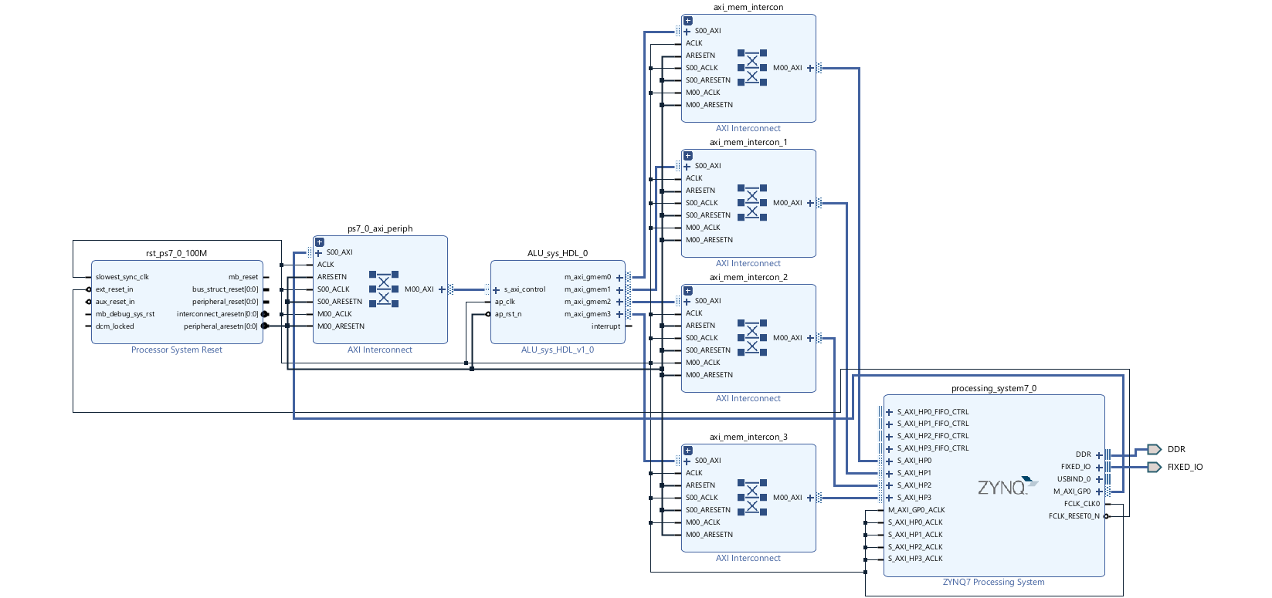
BLOCK DIAGRAM

Slide 13
HLS IMPLEMENTATION
A very simple ALU architecture has been first created using HLS to establish a diverse set of functions, in a data-flow approach
Load and Store functions are responsible for transmitting data through the AXI4s
Execution uses data and operations to perform different calculations (sum, subtraction, multiplication, and division)
Write-Back function will write the results back to the DRAM using the AXI4
Using these functions together in different ways the architecture implements the functions that correspond to the different value of the selec

Slide 14
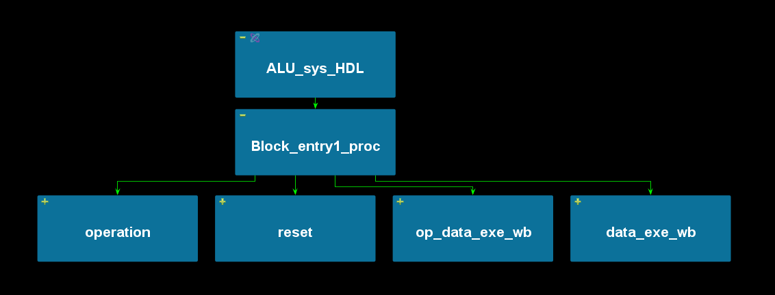
HLS IMPLEMENTATION
Data flow
Load and Store operation
Execute
Write Back

Slide 15
ALVEARE IS A VHDL-GENERATED ARHITECTURE
WE MUST BE ABLE TO INSERT IT INSIDE THE VHDL CODE GENERATED BY HLS
WHAT IS THE FUNCTION-MODULE THAT EXECUTES THE OPERATION?
THE EXECUTE

Slide 16
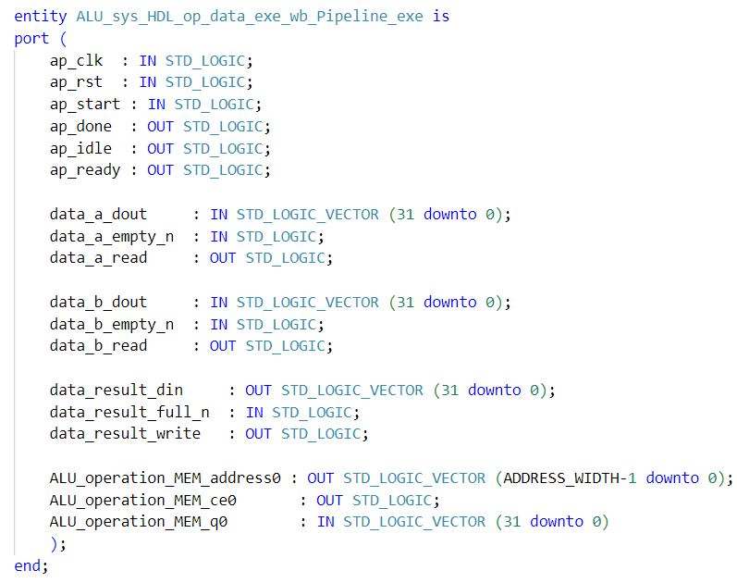
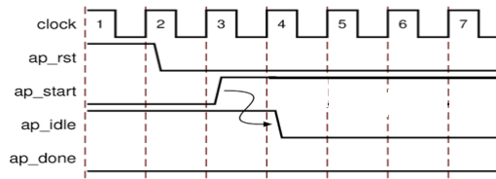
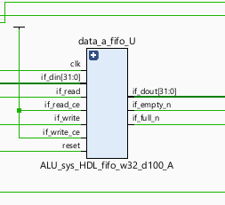
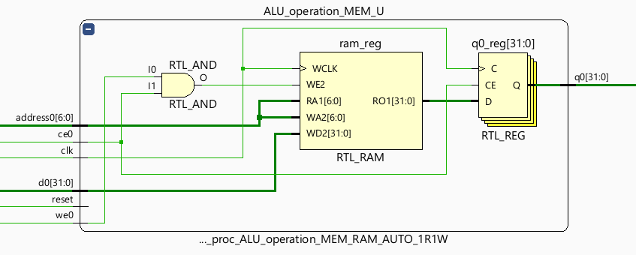
A
B
A
B
The Xilinx All Programmable PowerPoint Template (bme.hu)

Slide 17
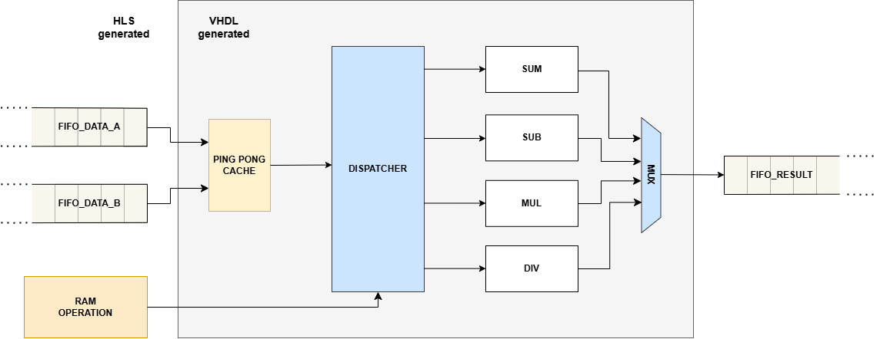
EXECUTE MODULE
RES
NEW A
NEW A
NEW A
NEW A
NEW B
NEW B
NEW B
NEW B
RES

Slide 18
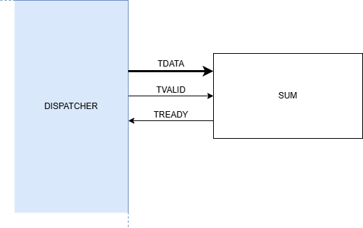
EXECUTE MODULE

Slide 19
EXECUTE MODULE
PING-PONG CACHE: Read data from the FIFOs and in the meantime send stored data to the DISPATCHER
DISPATCHER: Send the data to the right FU checking which operation is associated with a certain couple of data
FUNCTIONAL UNITS: Execute the operations and write back in order the result
AXI-STREAM COMMUNICATION

Slide 20
EXECUTE MODULE
FUs execute different operations…and some operations have a computational time bigger than others.
A MUL takes more computational time than a SUM to complete its operation, so it is possible that a MUL starts before a SUM but the SUM ends before the MUL.
How does the write-back work in this case?
An index is sent to the FUs with the data, this index is compared with an external counter that allows an in-order write-back.
All the ready results in the FUs that are scheduled after the FU that write-back the results stall.

Slide 21
EXECUTE MODULE
1
9
CC=
2
3
8
10
RES
NEW B
NEW A
NEW A
NEW B
RES

Slide 22




EVALUATION ENVIRONMENT
PYNQ-Z2 board
HLS 2023.2
Vivado 2023.2
PYNQ-Z2 environment for Host-DSA
communications (Jupyter, Python)
100 MHz clock
Scaled out from a burst of 50 data to a burst of 400 data, as it is the maximum number fitting our FPGA resources.
https://www.amd.com/en/corporate/university-program/aup-boards/pynq-z2.html

Slide 23
RESULTS
 | TIME |  |  | SPEEDUP
DIM BURST | PYTHON | SISD | ASH | SISD/PYTHON | ASH/PYTHON | ASH/SISD
50 | 0.3 ms | 4,878 ms | 0.0445 ms | 0.05 | 6.75 | 109.65
100 | 0.538 ms | 10.2 ms | 0.0672 ms | 0.05 | 8.01 | 151.76
200 | 0.954 ms | 20.1 ms | 0.0841 ms | 0.05 | 11.34 | 239.26
400 | 2.00 ms | 38.9 ms | 0.15 ms | 0.05 | 13.25 | 256.57

Slide 24
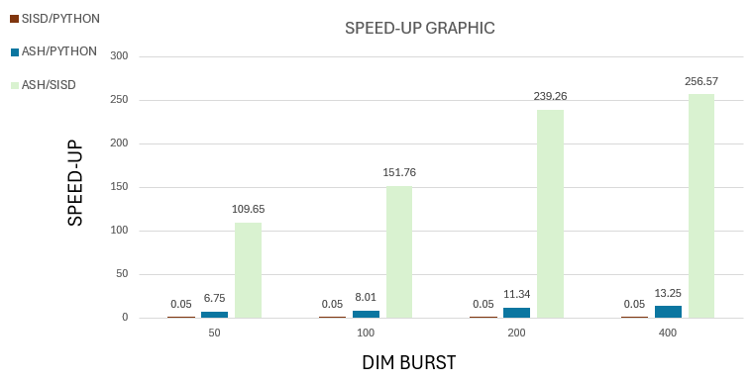
RESULTS

Slide 25
RESULTS
 | ASH
DIM BURST | LUT | FF | BRAM | DSP | WORST NEG. SLACK | HOLD
50 | 10564 | 17625 | 4.5 | 2 | +0.620 ns | +0.007 ns
100 | 12166 | 24056 | 4.5 | 2 | +0.636 ns | +0.015 ns
200 | 15737 | 36903 | 4.5 | 2 | +0.767 ns | +0.022 ns
400 | 22762 | 62680 | 4.5 | 2 | +0.632 ns | +0.020 ns

Slide 26
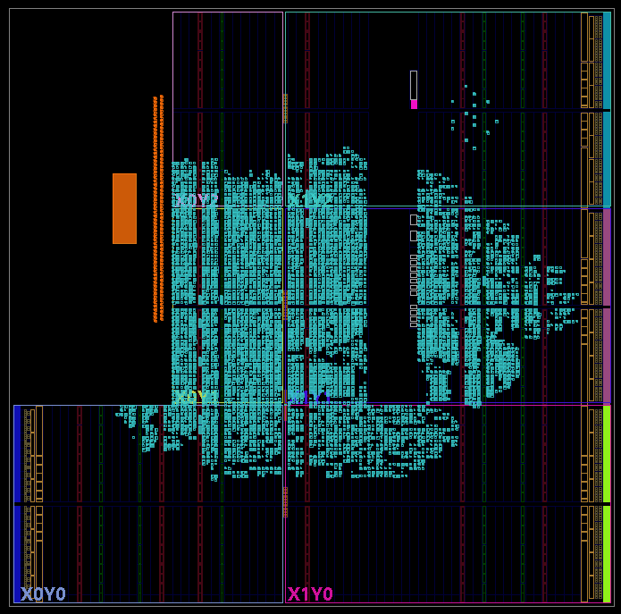
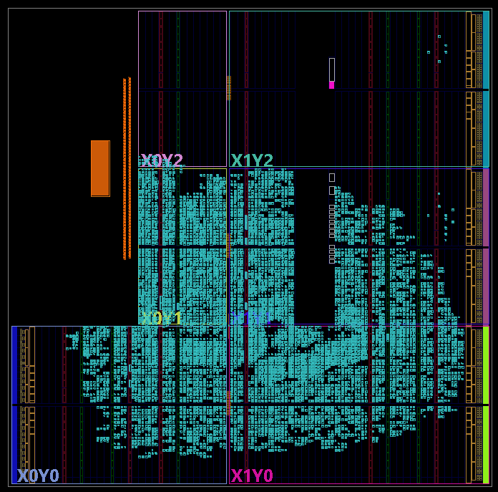
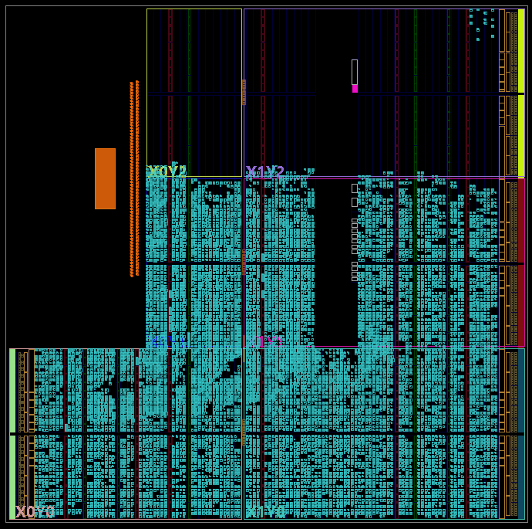
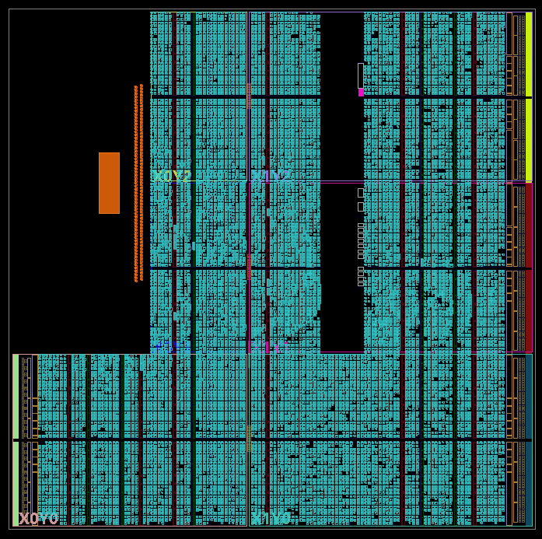
RESULTS
Burst dimension
50
Burst dimension
100
Burst dimension
200
Burst dimension
400

Slide 27
CONCLUSIONS
THE USE OF THE AXI4 IMPLY A GREAT SPEED-UP COMPARED TO THE PREVIOUS COMMUNICATION PROTOCOL
THE SYSTEM CREATED IS SUITABLE NOT JUST FOR ALVEARE BUT ALSO FOR OTHER ARCHITECTURES SINCE WE USED AN ALU TO SIMULATE ALVEARE’S BEHAVIOUR

Slide 28
QUESTIONS?

Slide 29

THANK YOU FOR YOUR ATTENTION
filippo.carloni@polimi.it
marco.labarbera@mail.polimi.it
giulio.lotto@mail.polimi.it

