Slide 1
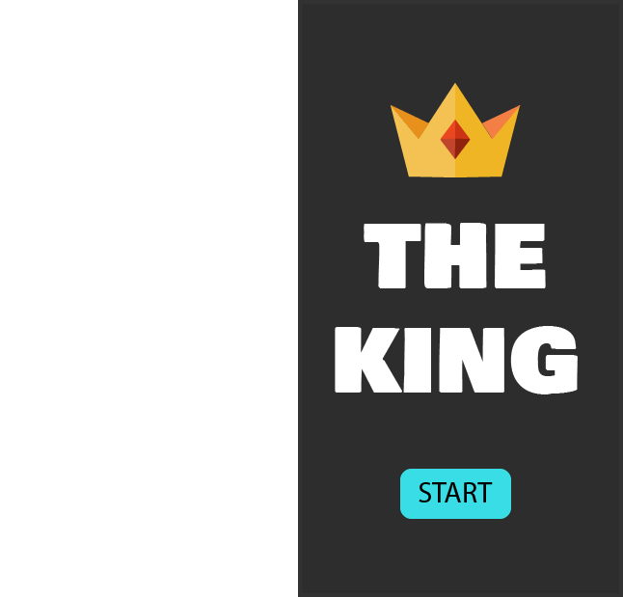

The King Game
Members
Tools
Jacob - Programmer
Slack
Android Studio
WhatsApp
Giada - Designer
Juan - PM
Version
1.0
Status
In Progress

Slide 2
Requirement Definition Document
Project Description
This Game will allow the user to:
Select the number of players
Put the name of the players
Player will be able to draw 1 card and do the ruling
Requirement
Display
Board
Facing down Cards
Card draw display
Text with the ruling
Actions
Draw card Button
Reset Button
Exit Button
Game
Get the ruling
Get Drunk
Have Fun!
Target
Anyone who wants to see their friend drunk in a easy and fun way

Slide 3
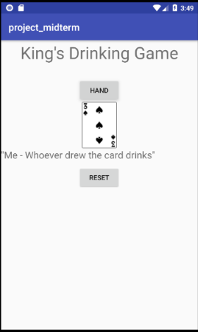
Programs Specification
“As Is”
1
2
Specification | Function
1. Name of the Game | Provide the total amount of money that the player has to continue playing
2. Draw Card Button | Provides the total amount of money selected by the player for betting
3. Display of the Card | Shows the Dealer’s hand (cards) so that the player can make a decision for stand or hit
4. Rule that needs to be followed | Shows the Dealer’s current points
5. Reset Button | Shows the Player’s hand (cards) so that the player can make a decision for stand or hit
3
4
2

Slide 4
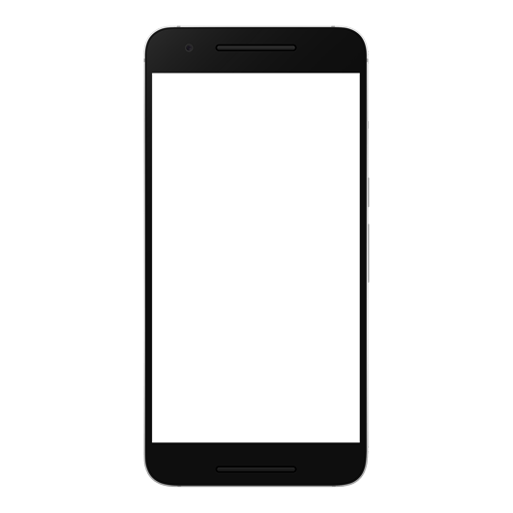
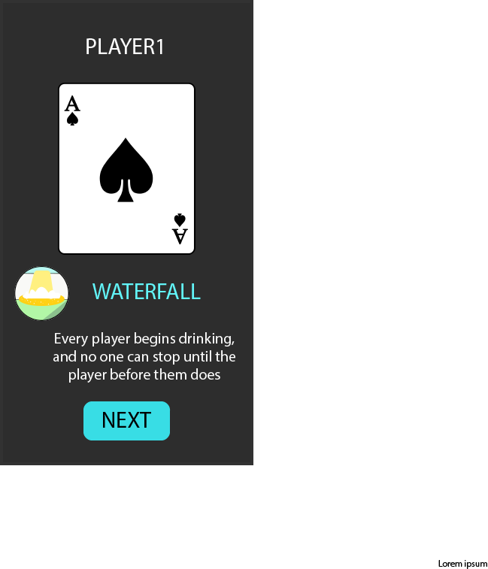
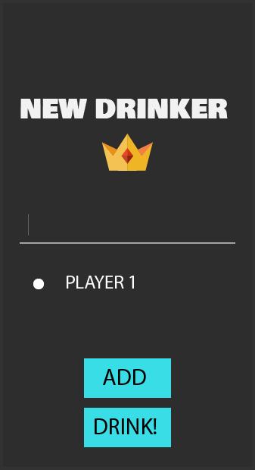
Mock Up

