Slide 1
COORDINATE REFERENCE SYSTEMS & MAP PROJECTIONS

Slide 2
THE EARTH IS NOT A SPHERE
6356 Km
6378 Km

Slide 3
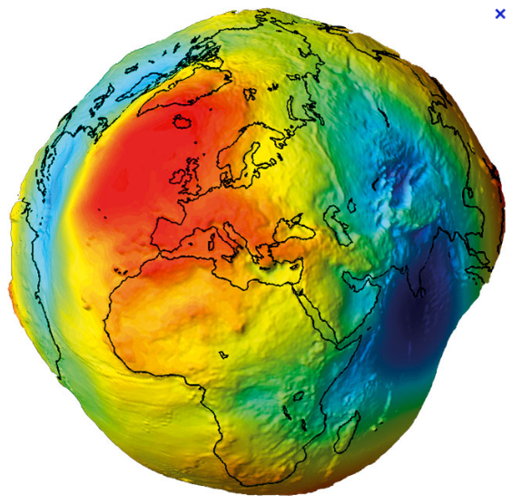
THE EARTH IS NOT AN ELLIPSOID EITHER

Slide 4
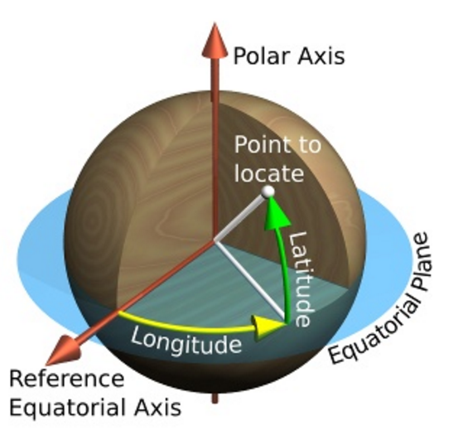
SPHERICAL COORDINATES
http://www.progonos.com/furuti

Slide 5
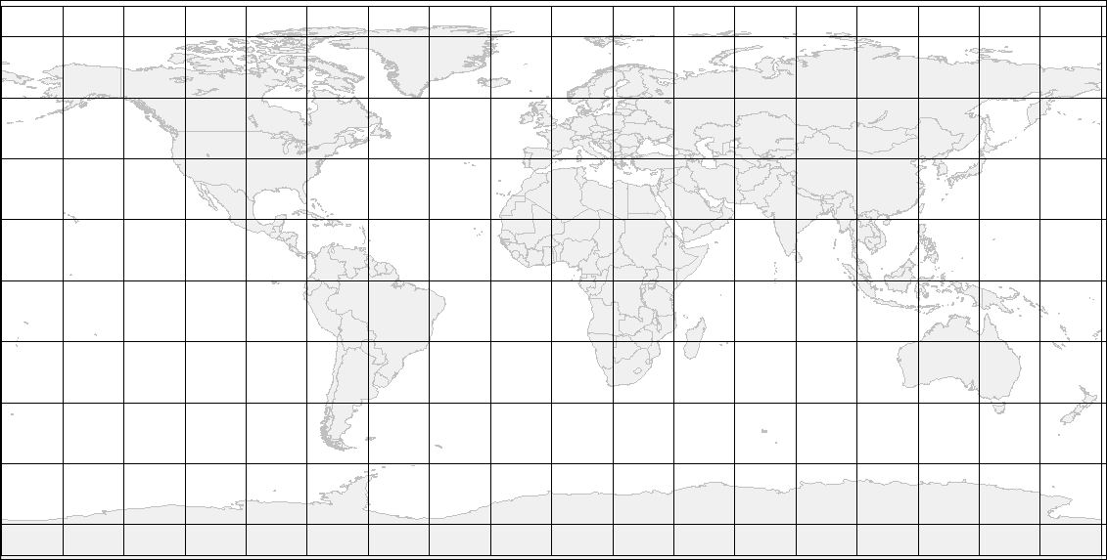
CRS & MAP PROJECTIONS
50º N
40º E
20º N
120º W
10º S
130º E
20º S
60º W

Slide 6
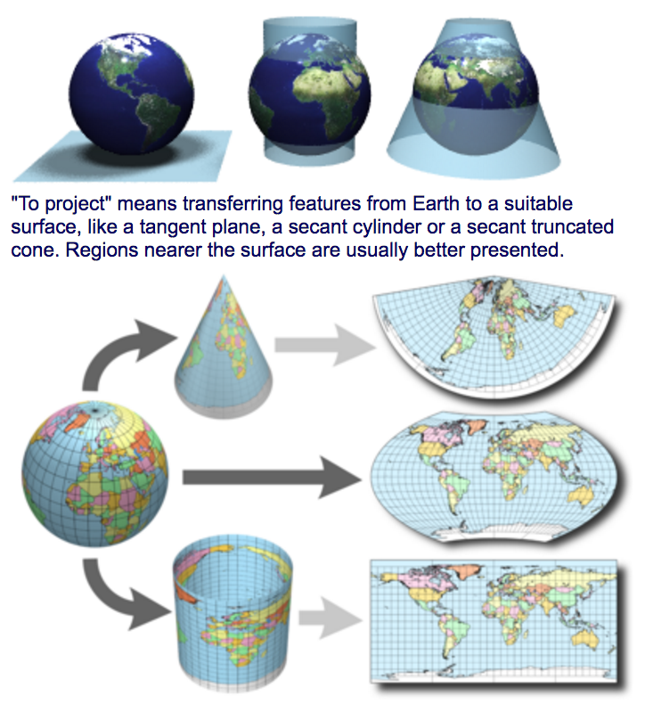
FLATTEN THE WORLD
http://www.progonos.com/furuti

Slide 7
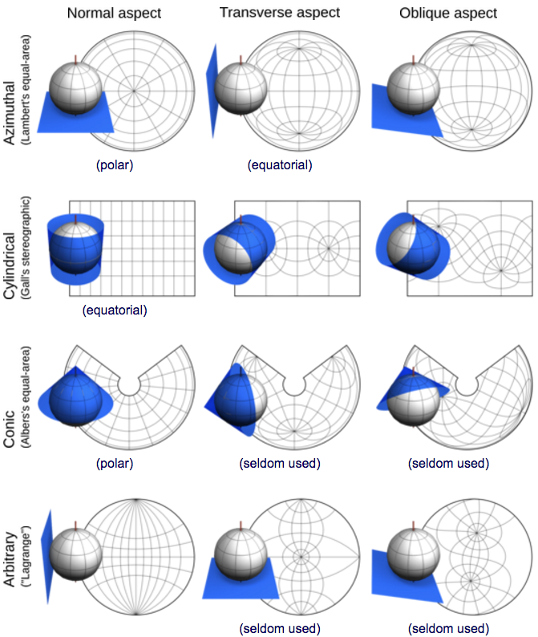
TYPES & ASPECTS OF MAP PROJECTIONS
http://www.progonos.com/furuti

Slide 8
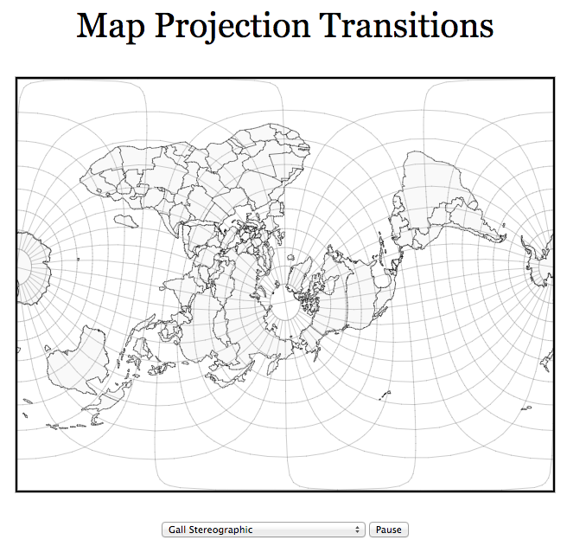
TYPES & ASPECTS OF MAP PROJECTIONS
https://www.jasondavies.com/maps/transition/

Slide 9
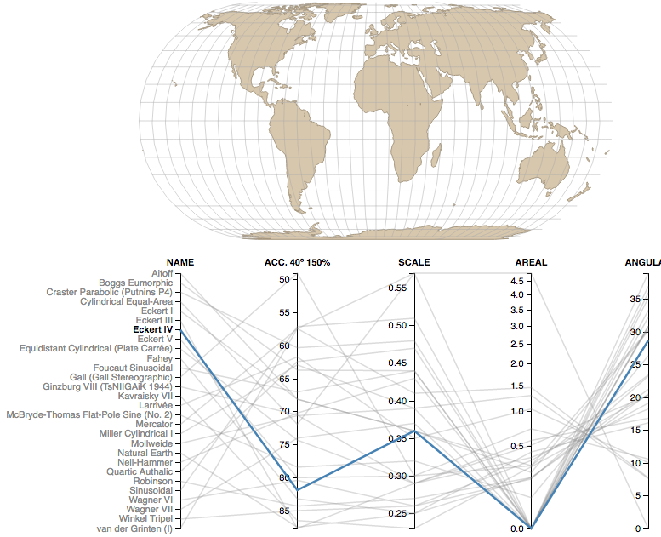
COMPARING MAP PROJECTIONS
https://bl.ocks.org/syntagmatic/ba569633d51ebec6ec6e

Slide 10
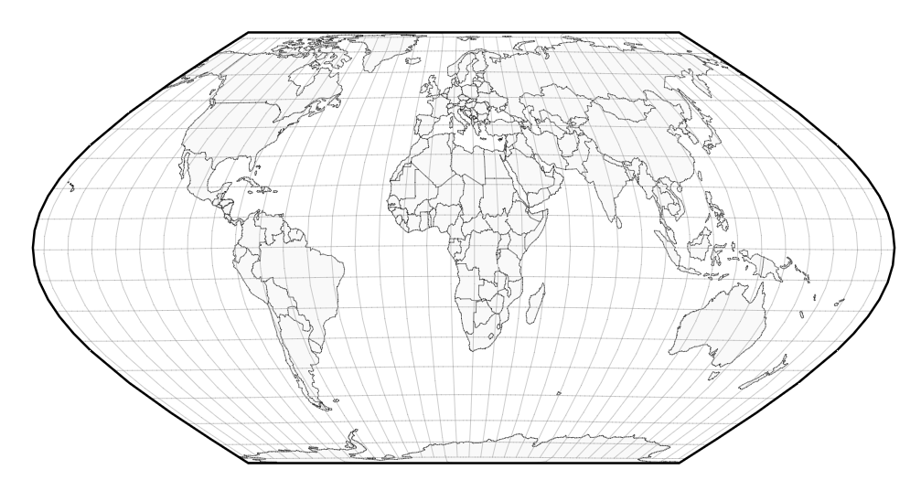
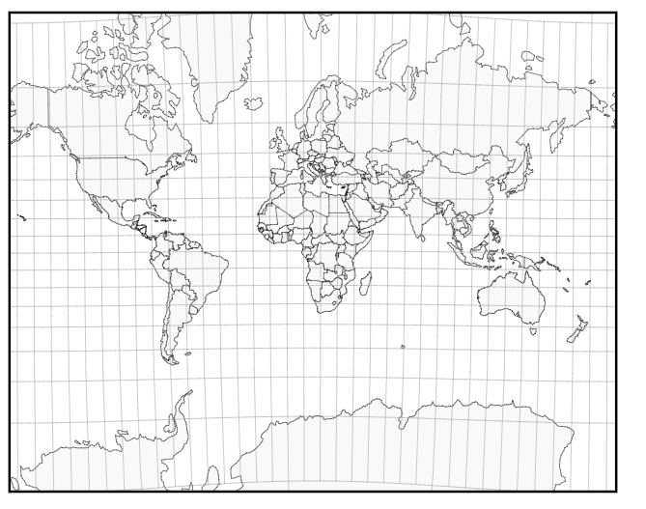
COMPARING MAP PROJECTIONS
https://www.jasondavies.com/maps/transition/
Eckert VI
Mercator

