Slide 1
COMPARE AREA OF CIRCLES

Slide 2
COMPARE LENGTH OF BARS

Slide 3
COMPARE LENGTH OF BARS

Slide 4
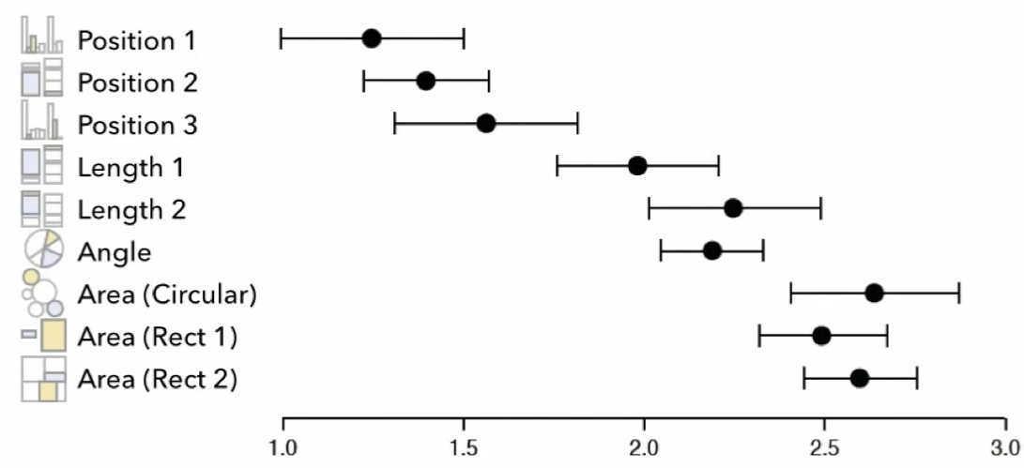
ACCURACY OF VISUAL ENCODING
Log estimation error

Slide 5
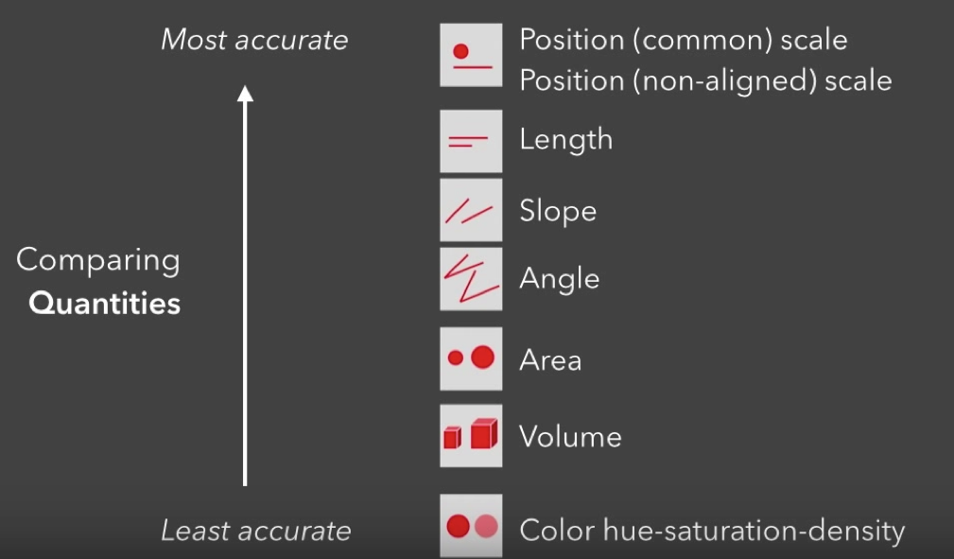
RANKING VISUAL ENCODINGS

